Slide 1
Seeing Through the Conversation: Audio-Visual Speech Separation based on Diffusion Model
Suyeon Lee*, Chaeyoung Jung*, Youngjoon Jang, Jaehun Kim, Joon Son Chung
*: equal contribution
Korea Advanced Institute of Science and Technology
Notes:
Good afternoon everyone, this is Suyeon Lee from KAIST Multimodal AI lab.
I’m excited to present our work, Seeing Through the Conversation: Audio-Visual Speech Separation based on Diffusion Model.
This work was done in equal contribution with Chaeyoung Jung.

Slide 2
AVDiffuSS Overview
speech
speaker’s face
lip movements
Audio-Visual Speech Separation
Notes:
Let me briefly overview our work, AVDiffuSS.
This is an audio-visual speech separation model. It means that the model uses visual information along with the speech, such as speaker’s face or lip movements.

Slide 3
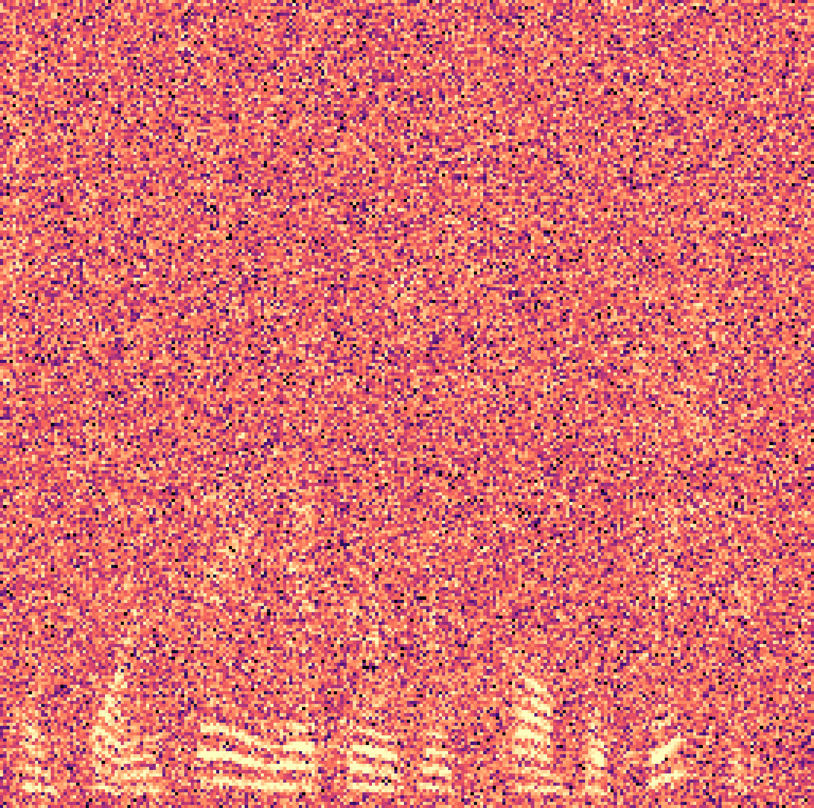
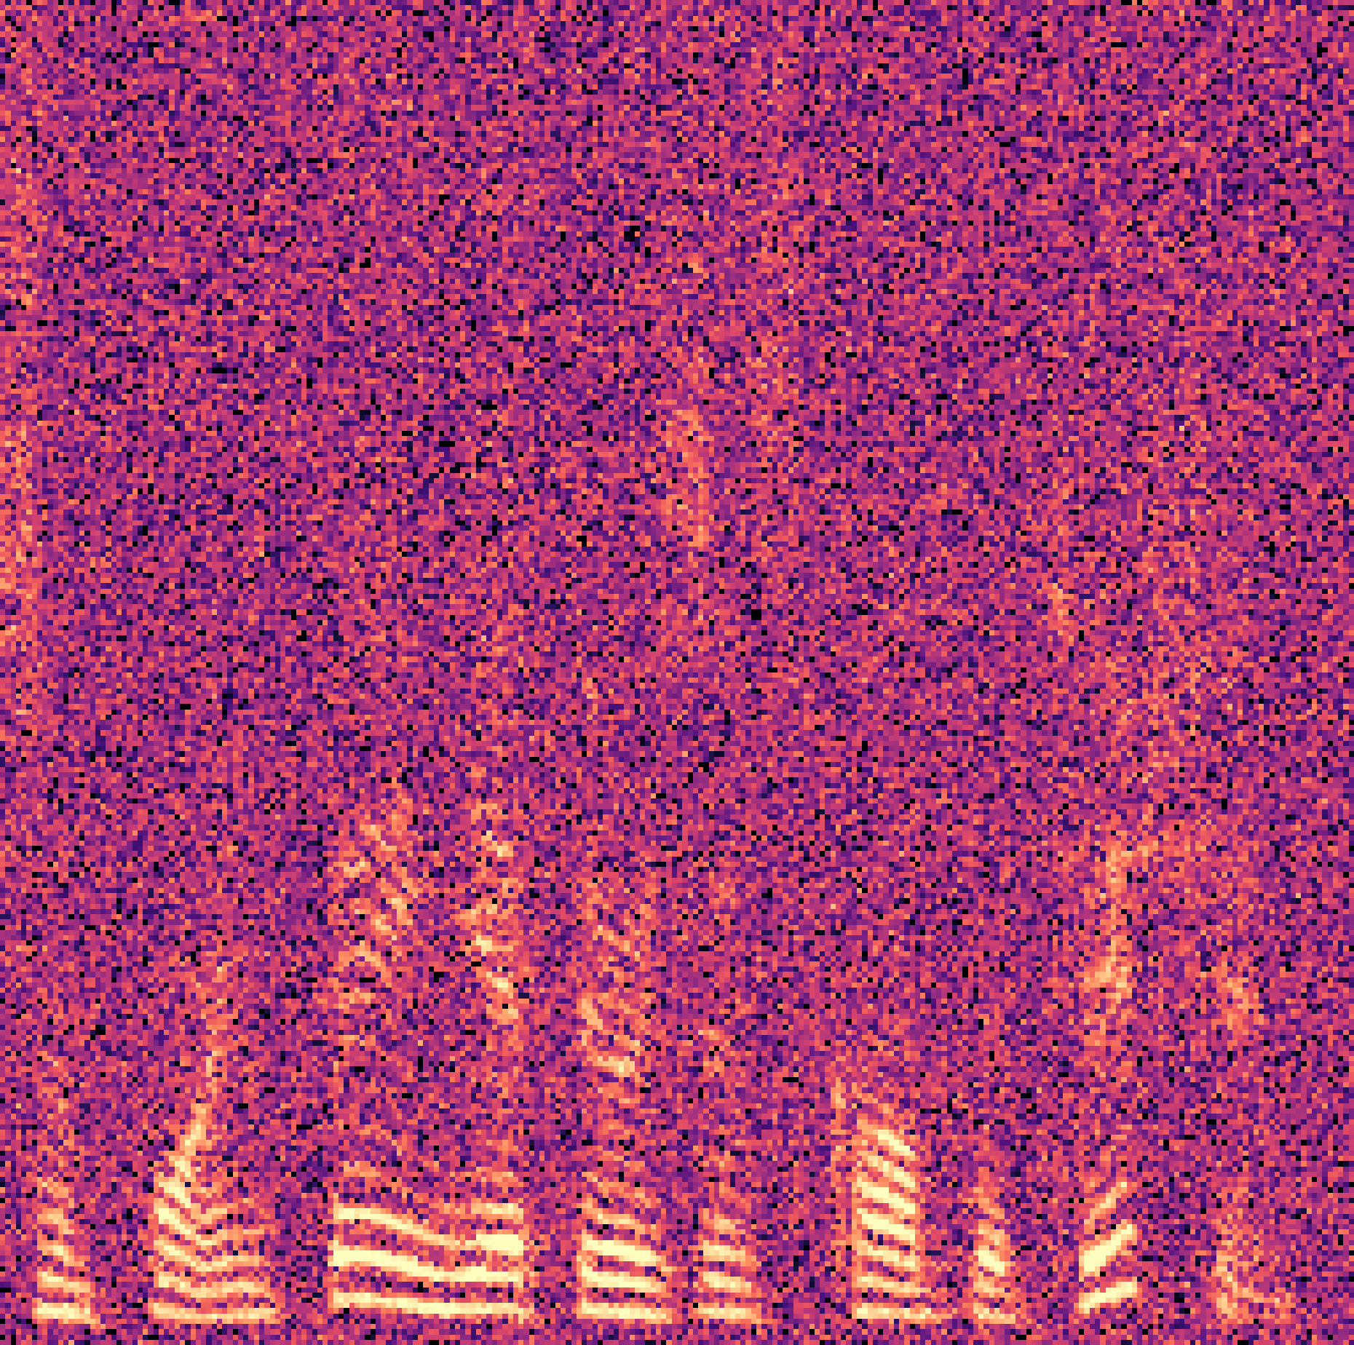
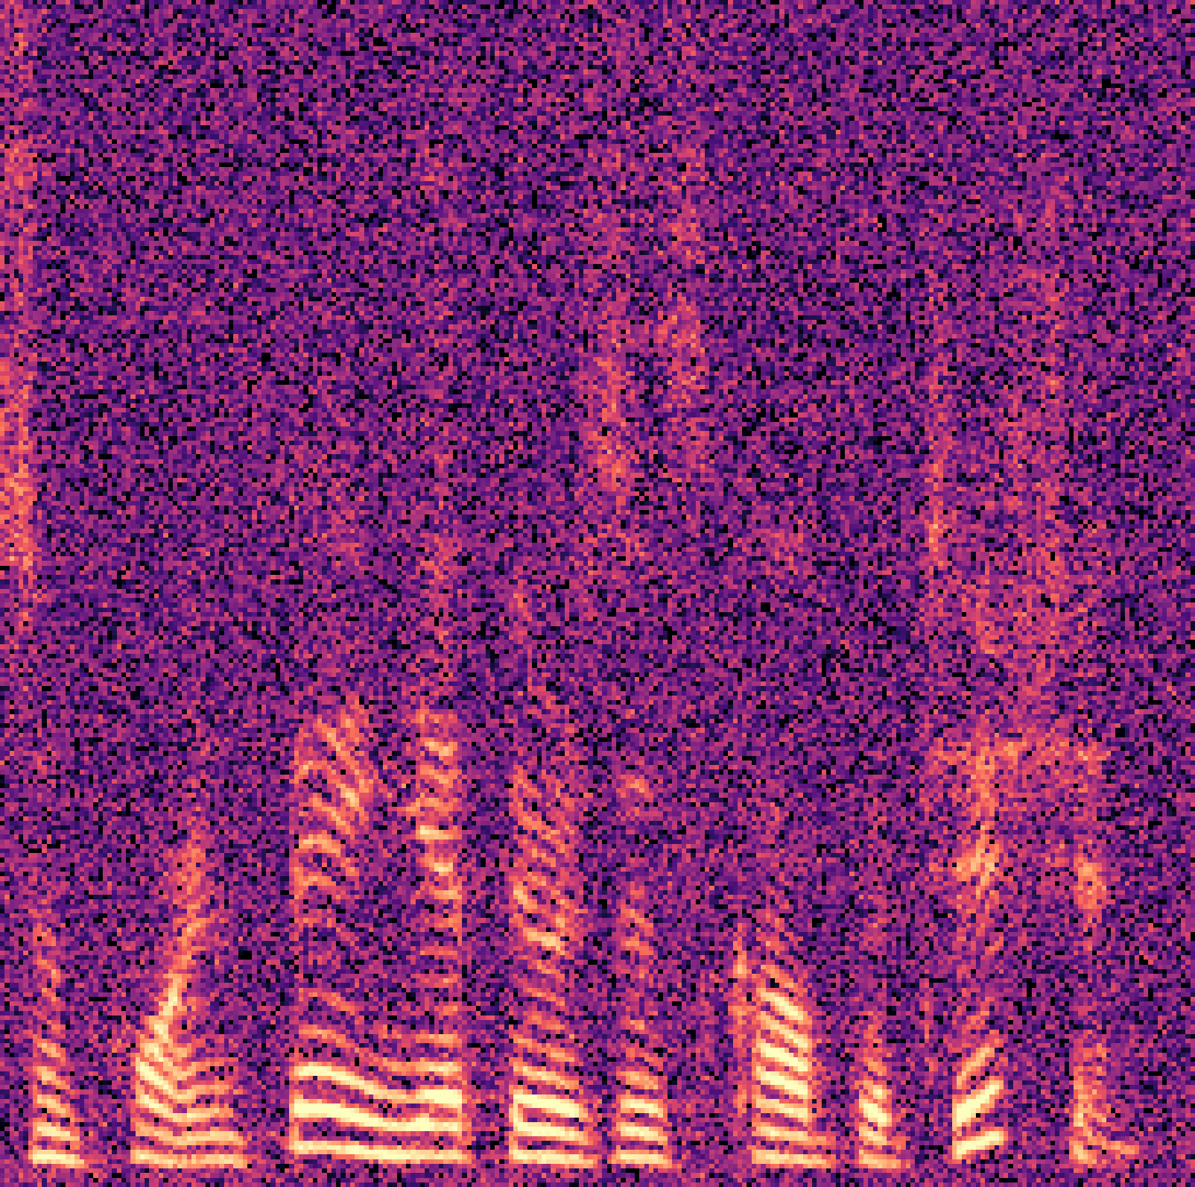
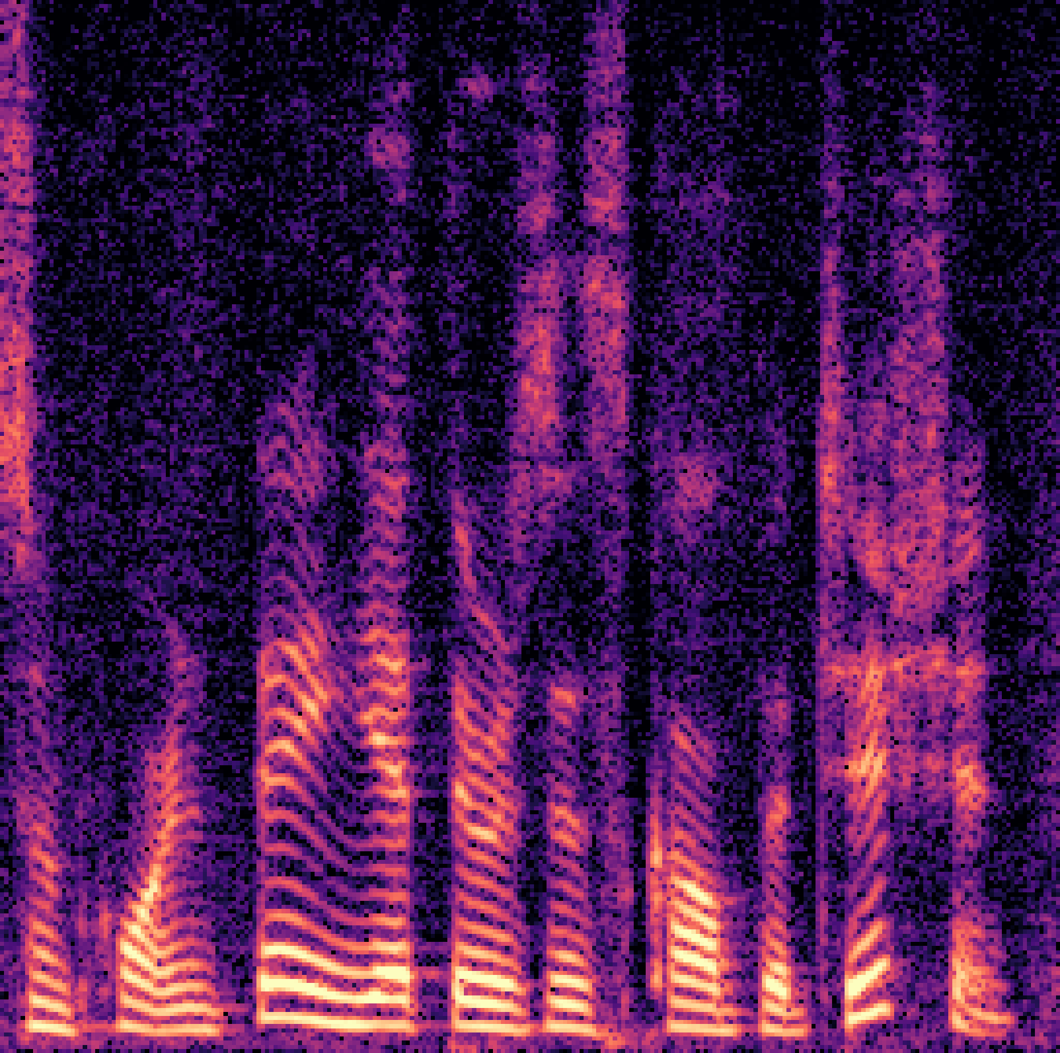
AVDiffuSS Overview
speech
speaker’s face
lip movements
Audio-Visual Speech Separation
based on Diffusion model
Notes:
And our work was the first to apply diffusion model in the audio visual speech separation framework.

Slide 4
AVDiffuSS Overview
speech
speaker’s face
lip movements
Audio-Visual Speech Separation
based on Diffusion model
Audio-visual fusion through iterative cross-attention modules
Notes:
This was made possible by audio-visual fusion through iterative cross-attention modules.

Slide 5
Audio-Visual Speech Separation (AVSS)
Advantage of using visual information in speech separation
1. Naturally designates the target speaker
2. Lip movements → contents of utterance
robust in noisy environment
3. Facial characteristics → voice characteristics
Notes:
Let’s listen to the overlapped speech sample. (오디오 플레이)
Speech separation model aims to separate the speech of each speaker from this overlapped speech.
However, only given the audio, it is hard to designate the target speaker that we want to hear.
But, if the visual information of the speaker is given like this,
the speech separation model is able to find the target speaker naturally.
So this is the first benefit of using visual information.
Also, the model can get extra information from lip movements of the speaker,
which are related to the contents of the utterance. Therefore it is more robust to speeches even in noisy environment.
By looking at the face, the model also acquires some hints of the characteristics of speaker’s voice.
- 온라인 미팅 등이 많아지면서, 비디오가 제공되는 상황에서의 speech separation이 필요해짐.
- 비주얼 정보를 함께 이용했을 때의 장점:
naturally designates the target speaker through face -> especially useful for the separation scenario
입술 움직임으로부터 말의 내용 추측 (kind of lip reading)
acquire some hints of the characteristics of speaker’s voice (gender, nationality -> pitch, intonation, …)
오디오만을 이용한 speech separation 성능도 뛰어나지만, 시끄러운 상황에서의 발화를 온전히 추출해 내는 데에는 여전히 한계가 있습니다.
반면, 비주얼 정보를 함께 이용하는 Audio-visual speech separation의 경우, 사람들끼리 실제로 대화할 때에 얼굴을 바라보며 대화하듯
입술의 움직임으로부터 말의 내용을 추측할 수 있고, 화자의 성별, 인종 등의 정보를 토대로 화자의 목소리와 억양에 대한 힌트를 얻을 수 있습니다.
같은 이유로 인해, 여러 목소리 중에서 듣고 싶은 화자를 직접 지정할 수 있다는 장점도 있습니다. 이는 줌과 같은 온라인 미팅 상황에서도 장점으로 작용할 것입니다.

Slide 6
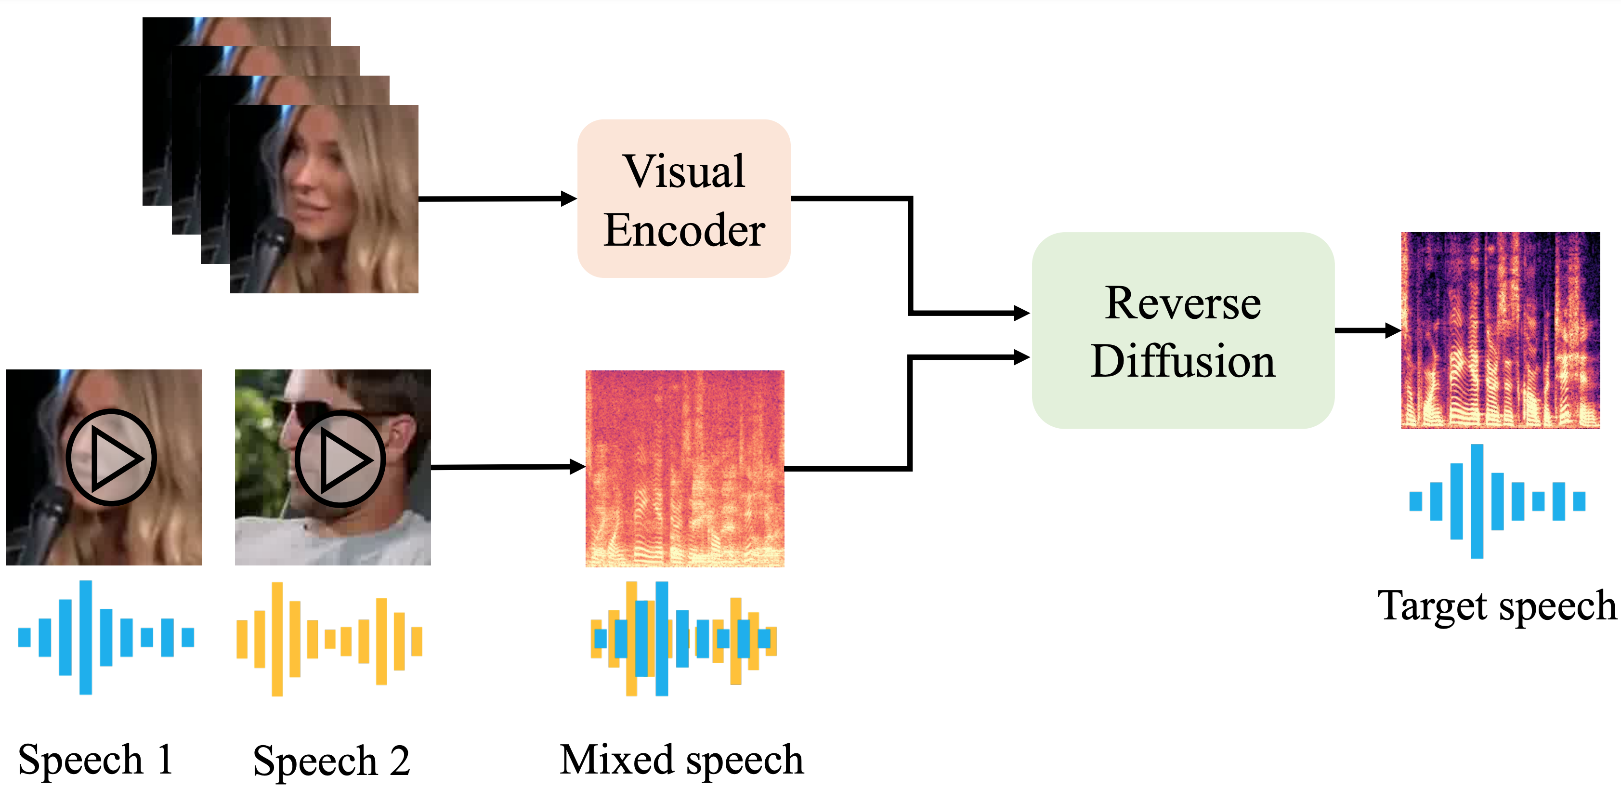
AVSS using Diffusion Model
Audio-visual speech separation pipeline
AVSS model
Notes:
This is the pipeline of our Audio-visual speech separation model.
Given the face-cropped video of the target speaker and the mixed speech,
we first encode the visual information using the visual encoder,
and the mixed speech is transformed into a spectrogram.
Then, the two representations go into the AVSS model to output the target speech.

Slide 7
AVSS using Diffusion Model
Audio-visual speech separation pipeline
Notes:
In our approach, we applied diffusion model in the separation process.
By this, we could enhance the quality of the separated speech.

Slide 8
AVDiffuSS = AVSS + Diffusion
Diffusion model
Multi-modal Fusion
2-stage architecture
Notes:
These are the key components of our model architecture.
Let’s go through these main points.

Slide 9
Model Architecture – Diffusion Models
Diffusion models for speech input
model
train a model to “denoise” a noisy speech
Reverse Diffusion = Generation
Notes:
As same as the image diffusion models, we train a model to “Denoise” a noisy speech spectrogram.
We used complex-valued spectrogram to reconstruct not only the magnitude but also the phase information.

Slide 10
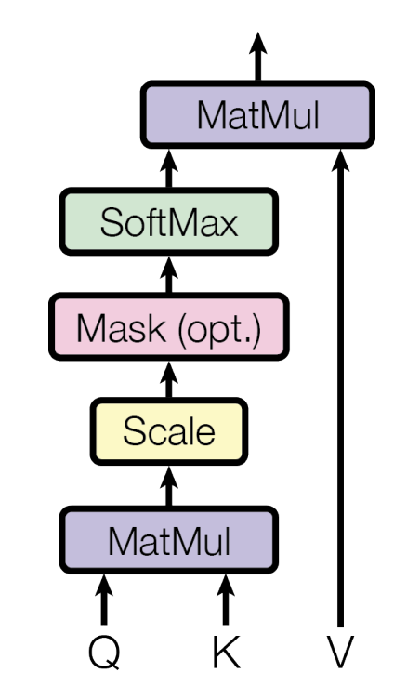
Model Architecture – Multi-modal fusion
Cross-attention
: effective for learning relations between two sequential information
T
0
T
0
Vaswani et al., Attention Is All You Need (NeurIPS 2017)
Notes:
For the multi-modal fusion, we utilized cross-attention module.
It is effective for learning relations between two sequential information.

Slide 11
Model Architecture – Multi-modal fusion
Cross-attention
: effective for learning relations between two sequential information
visual embedding $v$
0
T
…
Q
KV
Q
KV
model
Notes:
So we can plug in visual information in the model by using additional cross-attention modules.
This is extremely simplified version of our model.

Slide 12
Model Architecture – Cross Attention
…
Q
KV
Q
KV
model
Multi-modal fusion in U-net layers
Iterative cross-attention on intermediate layers of both stages
Query: speech feature, Key & Value: visual embedding
Notes:
Our model includes U-net-based networks with additional cross-attention modules for multi-modal fusion.
We applied cross-attention between the visual embedding, and the U-net features.
The modules are iteratively appended in the downsampling and upsampling paths.
The cross-attention layers are inspired by Latent-Diffusion.
Query is speech feature from U-net layers, and the Key and Value are the visual embedding.

Slide 13
$$x_{t}$$ | Current diffusion process estimate at time t
$$y$$ | Spectrogram of mixed speech
$$v$$ | Visual embedding
$$D_{θ}$$ | Stage 1: Predictive stage
$$G_{∅}$$ | Stage 2: Generative stage using diffusion model
$$s_{∅}$$ | Score network in stage 2
Model Architecture – 2 stage
Reverse-diffusion process
Notes:
Let’s look into the details of 2-stage architecture.
Actually, the noisy spectrogram input does not go directly into the reverse-diffusion stage.

Slide 14
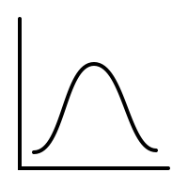
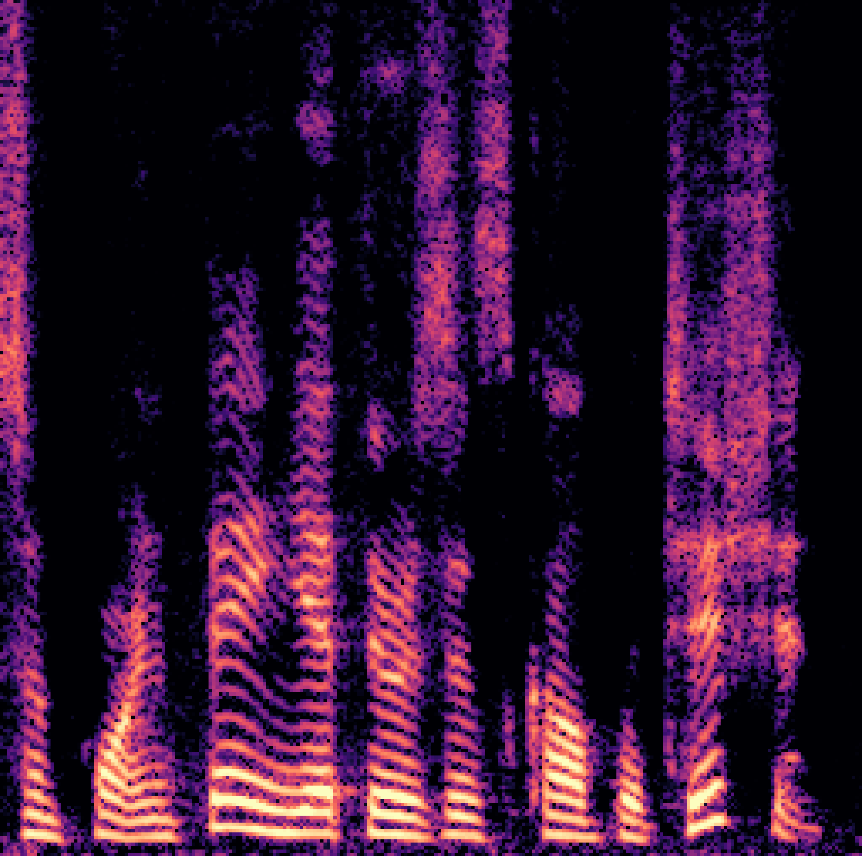
Model Architecture – 2 stage
Baseline model: StoRM (Lemercier et al., 2023)
Reverse-diffusion process
$$D_{θ}(y,v)$$
$$x_{T}$$
J.M. Lemercier et al., StoRM: A Diffusion-based Stochastic Regeneration Model for Speech Enhancement and Dereverberation (TASLP 2023)
Notes:
Before the diffusion model in the second stage,
we first de-noise the speech using additional model $D_{θ}$, by training the model to directly predict the clean spectrogram.
The output of the first stage is utilized as a mean of the prior distribution for the reverse-diffusion.
So the first sample for the reverse-diffusion, which is $x_{T}$, is sampled from the Gaussian distribution centered at $D_{θ}(y,v)$.
This 2-stage method is from the baseline model, StoRM, which is an audio-only speech enhancement model.
Using this method, the diffusion model in the stage 2 could generate natural and precise speech with less diffusion steps.

Slide 15
Model Architecture – 2 stage
Mixed Speech
$$y$$
Stage 1 output
$$D_{θ}(y, v)$$
Stage 2 output
$$\hat{x}$$
Ground-truth
$$x$$
Notes:
The spectrograms below are the input to the model, output of the two stages, and the ground truth.
The initial prediction is a kind of ‘over-denoised’ version of the target speech. Please compare the region in the green box.
Then, by the stage 2, our model re-generates the speech into a more natural and precise version.
The region in the stage 1 output has lost frequency components, but the stage 2 recovered those components nicely.

Slide 16
Training – Loss functions
Two objectives are combined for end-to-end training
Weight values $λ_{1}$ and $λ_{2}$ are both set to 0.5
Stage 1
Stage 2
Total loss
Notes:
These are the loss functions for the training.
Stage 1 is trained with L_pred to directly predict the target speech x,
and the stage 2 is trained to estimate the score of each timestep.
Two objectives are combined as a weighted sum of two loss functions for end-to-end training in the total loss.
The weight values 람다1 and 람다2 are empirically set to 0.5.

Slide 17
Inference procedure
1) Obtain the initial prediction $D_{θ}(y, v)$ from the Stage 1
2) Sample $x_{T}$ from $𝒩(μ_{T}, σ_{T}^{2} I)$ and concatenate with the condition $D_{θ}(y, v)$
3) Starting from $x_{T}||D_{θ}(y, v)$, repeat the reverse process for the number of diffusion steps N → obtain target speech $\hat{x}$
N was set to 30 in our evaluation
Notes:
In the inference,
we first obtain the initial prediction $D_{θ}(y, v)$ from the stage 1.
Then, we sample $x_{T}$ from the Gaussian distribution centered at the initial prediction,
and concatenate it with the condition $D_{θ}(y, v)$.
Starting from $x_{T}$, we repeat the reverse-diffusion process for N times, which is the number of diffusion steps.
Then we can obtain the final output, x hat.
N was set to 30 in our evaluation.

Slide 18
Experimental Setup
Models for comparison
DiffSep: Audio-only diffusion-based SS model
VisualVoice: Audio-visual non-diffusion SS model
Dataset
train: VoxCeleb2 (30 epochs)
test: VoxCeleb2 & LRS3
Objective evaluation
PESQ, ESTOI, SI-SDR
Subjective evaluation
MOS
 | Audio | Visual | Diffusion
DiffSep | O | X | O
VisualVoice | O | O | X
AVDiffuSS (Ours) | O | O | O
Notes:
The detail of the experimental setup is as follows.
We trained our model on VoxCeleb2 for 30 epochs.
For the evaluation, we tested on LRS3 test set along with the VoxCeleb2, to demonstrate robustness of our model on cross-dataset evaluation.
We’ve conducted objective evaluation using three metrics, and subjective M.O.S. evaluation
We compared it with other baseline models.
First, DiffSep is an Audio-only diffusion-based SS model, and the VisualVoice is audio-visual NON-diffusion model.
By comparing with these models, we could see the benefit of using visual modality and diffusion models.

Slide 19
DiffSep
Results – Objective evaluation on VoxCeleb2
VisualVoice
AVDiffuSS (Ours)
AVDiffuSS benefits both from diffusion model and visual information
Higher PESQ for diffusion-based approaches
Higher ESTOI and SI-SDR for audio-visual models
(dB)
Notes:
First I will show you the results of the objective evaluation on VoxCeleb2. The result of our model is in yellow.
By comparing the PESQ metrics of the three models, two diffusion-based models got higher scores than the non-diffusion-based approach.
And by comparing the ESTOI and SI-SDR metrics, two audio-visual models have acquired higher scores than the audio-only approach.
This result tells us that our model, AVDiffuSS benefits both from using visual information and the diffusion-based approach.

Slide 20
DiffSep
Results – Objective evaluation on LRS3
VisualVoice
AVDiffuSS (Ours)
Robustness of AVDiffuSS on a cross-dataset evaluation
Every model was trained on VoxCeleb2 and evaluated on LRS3
AVDiffuSS shows favorable performance for one-shot speech separation scenario
(dB)
Notes:
For the second objective evaluation, every model was trained on VoxCeleb2 and evaluated on LRS3.
The yellow bar in the graphs, which are the result of AVDiffuSS, shows the highest performance for all metrics.
So our model has the capability to be applied for one-shot speech separation scenario.

Slide 21
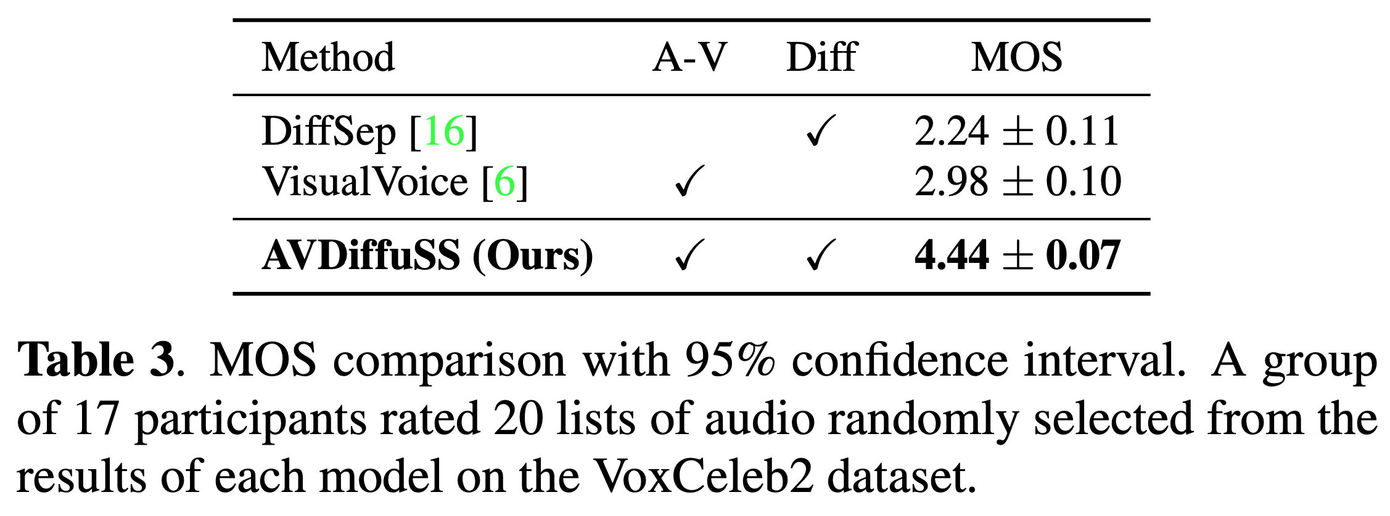
Results – Subjective evaluation (MOS)
Evaluation criteria:
(1 ) Audio quality relative to the corresponding GT
(2) Degree of separation
AVDiffuSS shows the highest score among the three models
Notes:
For the subjective evaluation, we conducted MOS.
The criteria were audio quality relative to the corresponding ground truth speech, and the degree of separation.
Our model could achieve the highest score among the three models.

Slide 22
Ablation study
Ablation on U-net feature resolution choices for cross-attention
Adding more cross-attention layers improved performance
Each model were trained for 15 epochs for a fair comparison
256
256
128
64
128
64
32
32
Notes:
Now, you might wonder whether the cross-attention modules were actually effective or not.
So we conducted ablation on U-net feature resolution choices for cross-attention.
We selectively applied them according to the feature resolutions of the U-net layers shown in the left figure..
The results suggest that the more the cross-attention modules are applied in the model, the better the performance gets.
So it has shown that our cross-attention module was helping speech separation.

Slide 23
Other speech samples & comparison with other models available at https://mmai.io/projects/avdiffuss/
Results on Real-world Video
Notes:
This is the demo video of our model, using the real-world video with overlapping speech.
So you can see that our model also works well in real-world scenarios.

Slide 24
Conclusion
Audio-Visual Speech Separation based on Diffusion model
Multi-modal fusion through iterative cross-attention modules
Highest performance in both objective & subjective evaluation
Robust to real-world videos with overlapped speech
Notes:
So this is the conclusion of today’s presentation.
Our model was audio-visual speech separation based on diffusion model.
And the multi-modal fusion was implemented through iterative cross-attention modules in the U-net.
Our model achieved the highest performance in both objective and subjective evaluations,
and it is robust to real-world videos with overlapped speech.

Slide 25
Conclusion
Audio-Visual Speech Separation based on Diffusion model
Multi-modal fusion through iterative cross-attention modules
Highest performance in both objective & subjective evaluation
Robust to real-world videos with overlapped speech
Thank you !

Slide 26
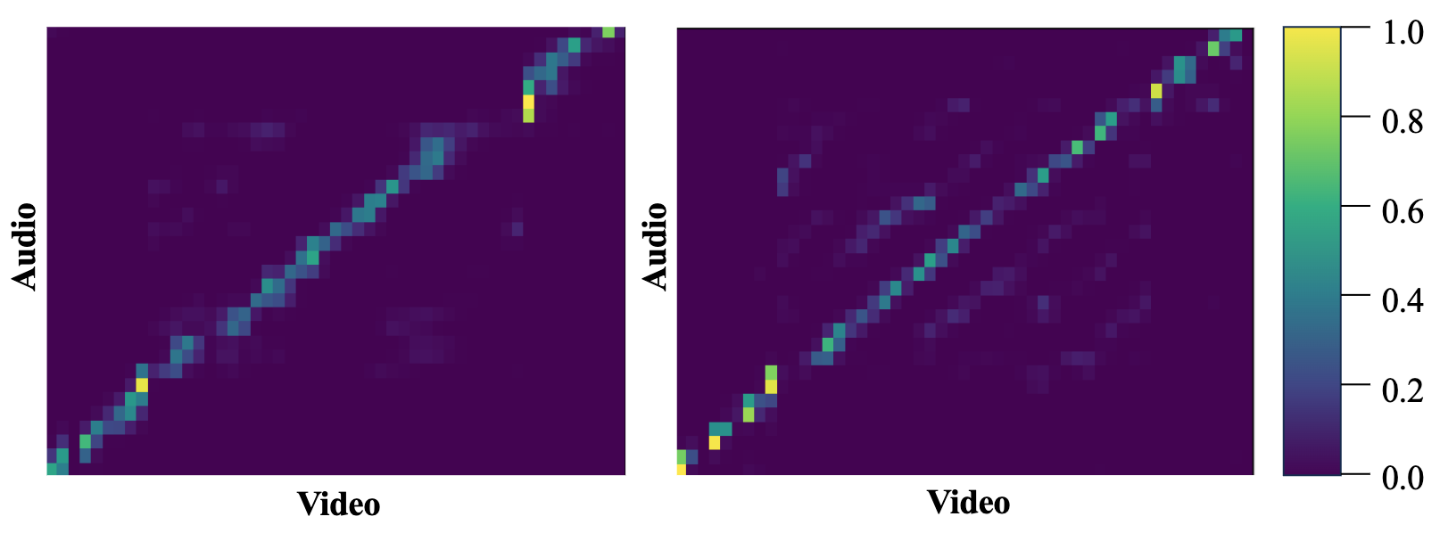
Appendix 1 – Cross-attention map
Attention map visualizations of the innermost cross-attention layer in the first stage. Brighter colors indicate higher correspondences between audio-video modalities.

Slide 27
Appendix 2 – Speech Enhancement
Speech enhancement results on VoxCeleb2 test set. StoRM is an audio-only diffusion-based speech enhancement model.

Slide 28
Appendix 3 – Visual Encoder
(B, T, H, W)
Conv3D
(B, T, H’, W’)
…
ResNet18
T
(B, T, C=512)
0
T
0
Temporal Convolutional Network
visual embedding $v$
Grayscale face-crop images
Conv1D
(B, T, C=256)
Ruijie et al., Is Someone Speaking? Exploring Long-term Temporal Features for Active Speaker Detection (ACM MM 2021)

Slide 29
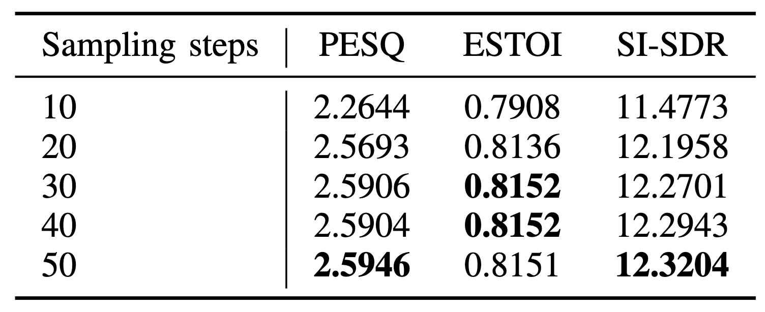
Appendix 4 – Diffusion steps
Results for varying number of diffusion sampling steps (N)

Slide 30
Appendix 5 – SDE
Forward SDE:
Reverse SDE:
Notes:
Drift coefficient f(x,t): defined by the output of the stage 1.

Slide 31
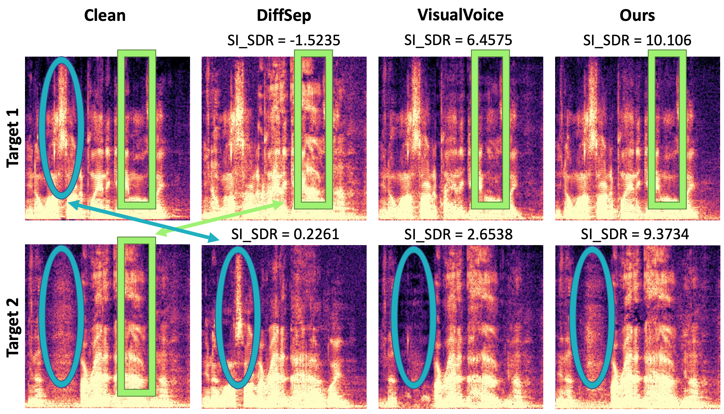
Appendix 7 – Results in Difficult cases
Spectrogram examples from the difficult cases
Audio-visual models are better at accurately identifying the target speech
AVDiffuSS avoids over-denoising effect observed in predictive approach (VisualVoice)
Notes:
For visualization, we’ve analyzed the audio spectrogram from the difficult cases.
The figure below shows the ground truth and the output of the three models, from the left.
Audio-visual models, which are our model and the VisualVoice, are better at accurately identifying the target speech, and able to exclude the other speakers. Please compare the regions in blue ellipses and green boxes of the clean GT samples and the output of the models.
Our model also avoids over-denoising effect from the predictive approach. It was possible by introducing generative diffusion model.

