Slide 1
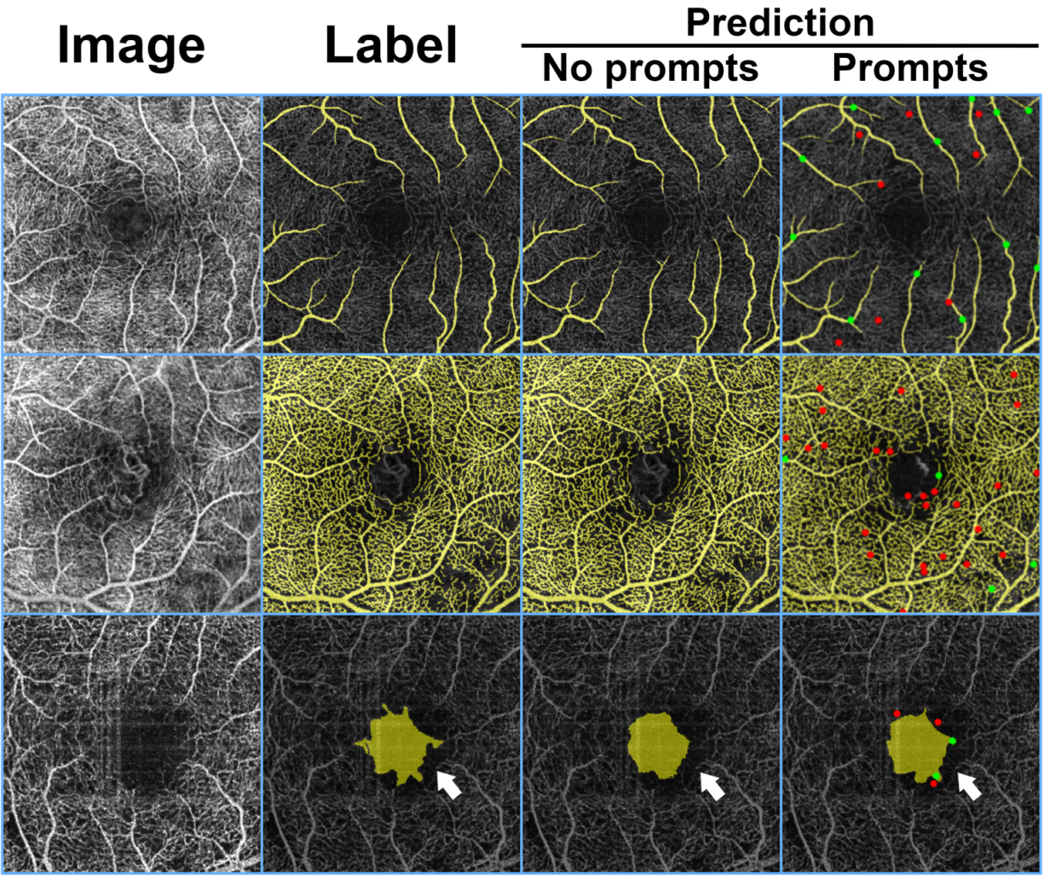
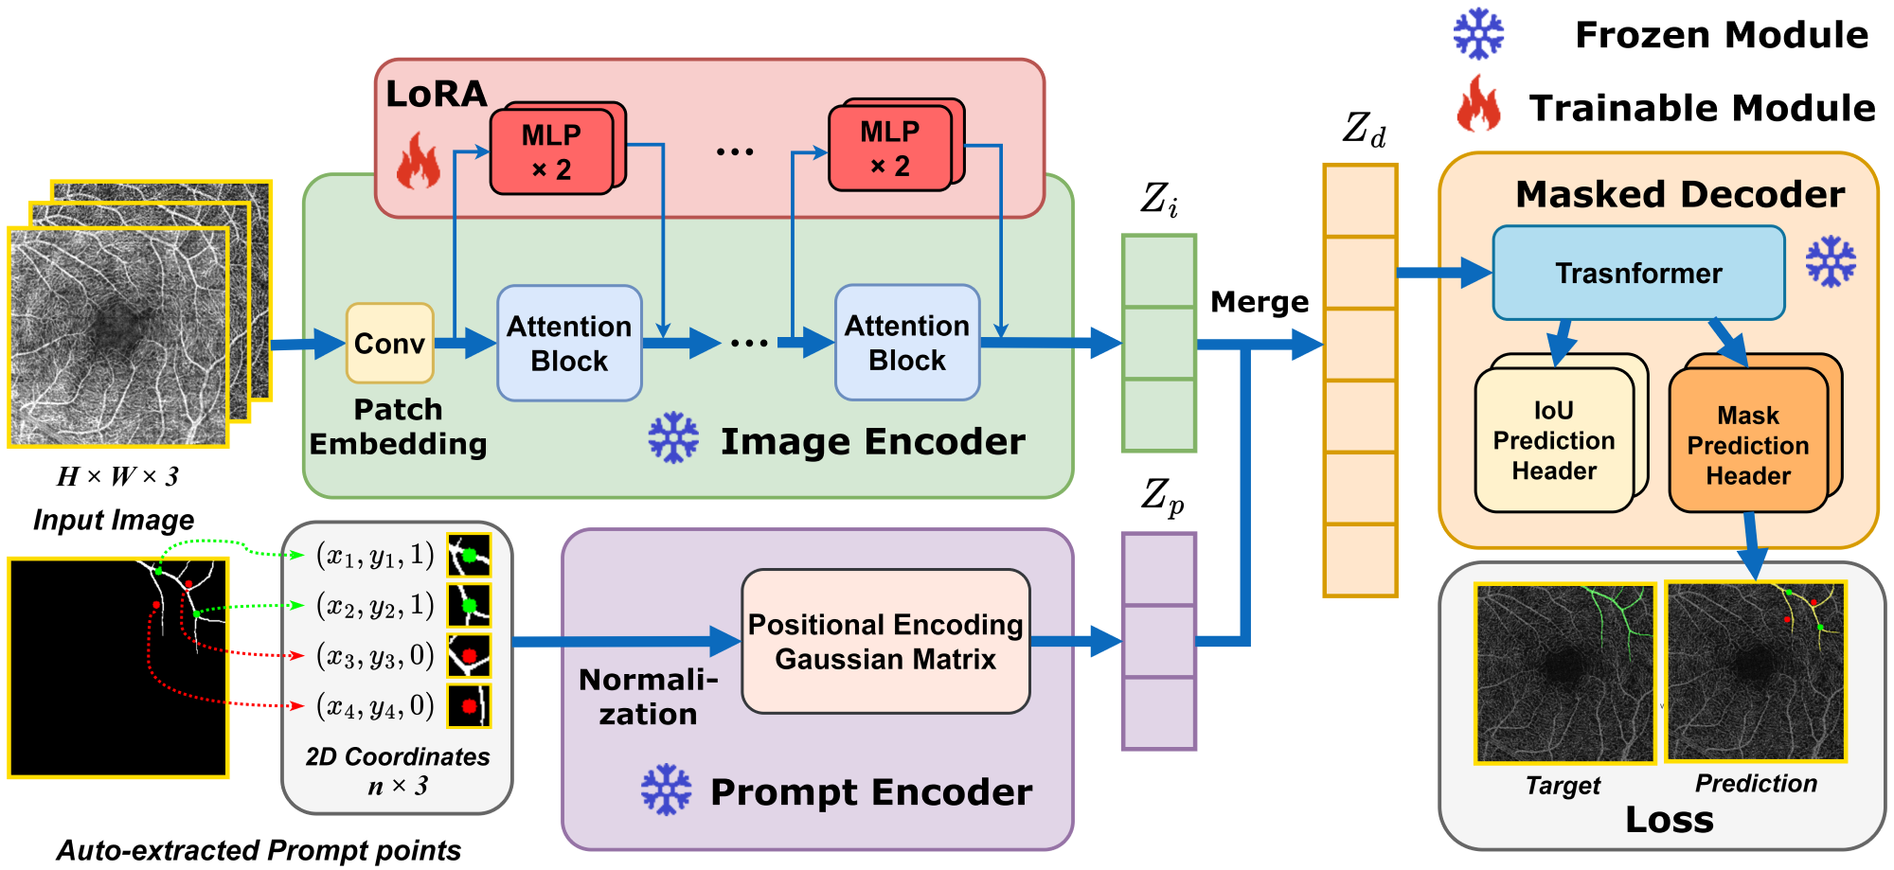
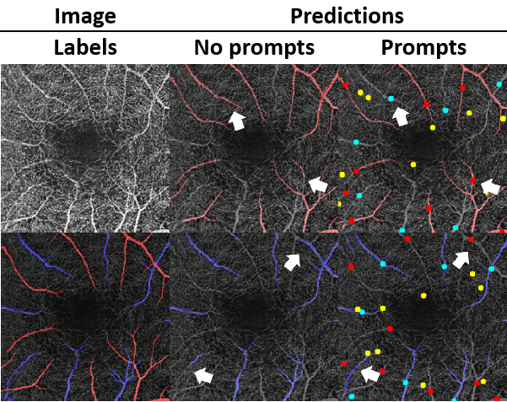
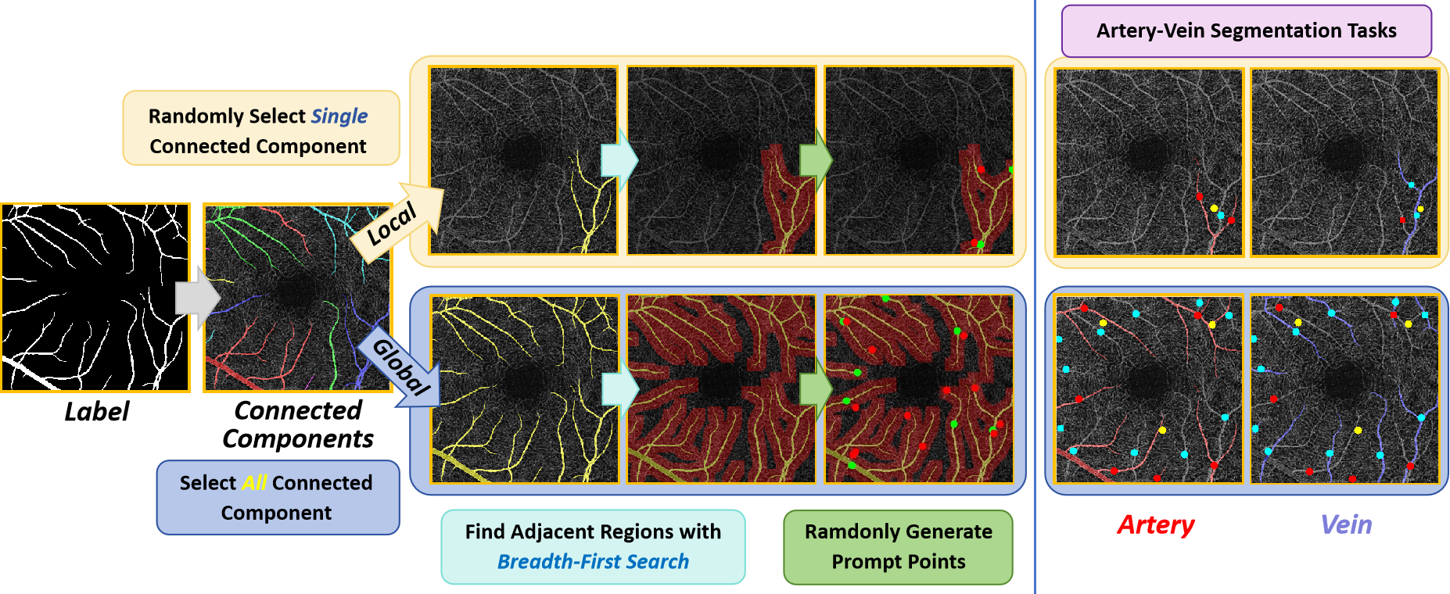
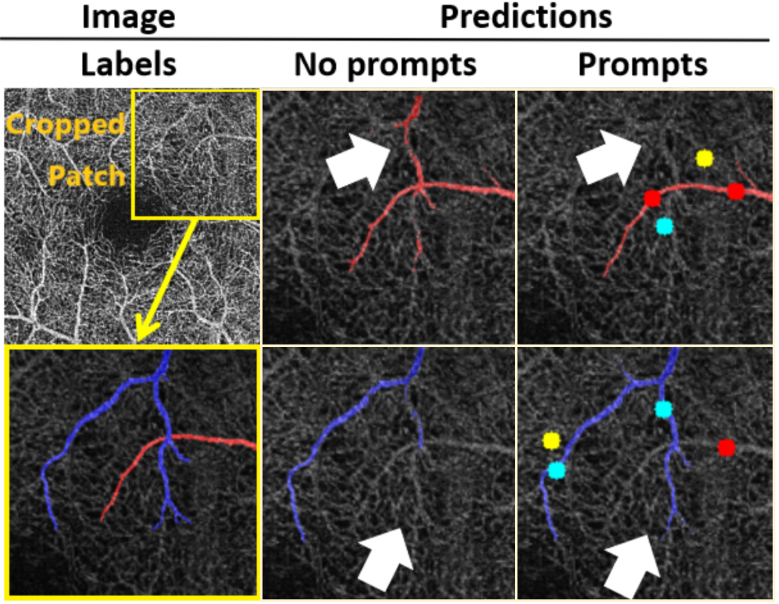
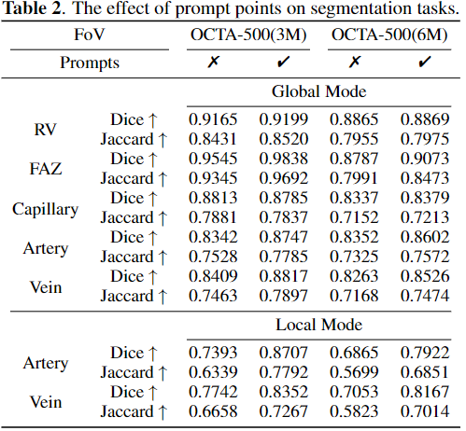
Introduction
Segmentation
The low-rank adaptation technique is adopted for foundation model fine-tuning and proposed corresponding prompt point generation strategies for segmentation tasks on OCTA datasets, which has been experimented on the publicly available OCTA-500 dataset.
Model Architecture
Prompt Points Generation
The prompt points generation strategy has two types: global and local modes. The segmenting individual vessels as a local segmentation task has not been attempted in previous works.
Global Mode
Local Mode
Experimental Results

