Slide 1
PLIP BASED UNSHARP MASKING FOR MEDICAL IMAGE ENHANCEMENT
IEEE International Conference on Acoustic, Speech and Signal Processing (ICASSP 2016) March 2016, Shanghai, China
Zhou Zhao, Yicong Zhou
University of Macau, Macao SAR of China

Slide 2
Outline
Introduction
PLIP Multiplication
Proposed Algorithm
Experimental Results
Conclusion

Slide 3
Introduction
Enhancement of digital medical images is necessary.
Existing methods:
Histogram based.
Unsharp masking.
Parameterized logarithmic image processing (PLIP) – a nonlinear arithmetic framework.

Slide 4
Outline
Introduction
PLIP Multiplication
Proposed Algorithm
Experimental Results
Conclusion

Slide 5
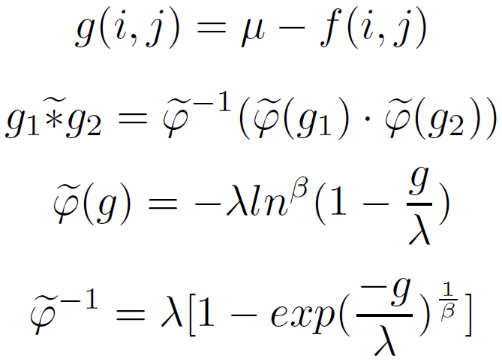
PLIP Multiplication
PLIP Multiplication can be expressed as:

Slide 6
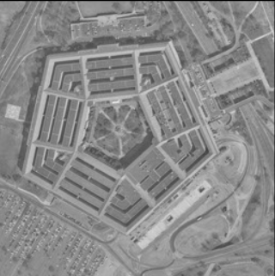
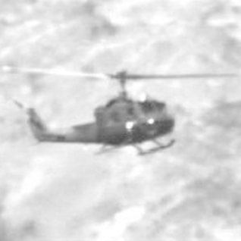
PLIP Multiplication (cont.)

Slide 7
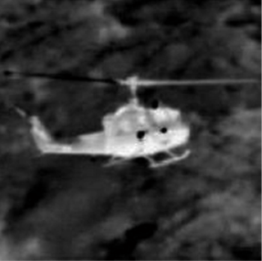
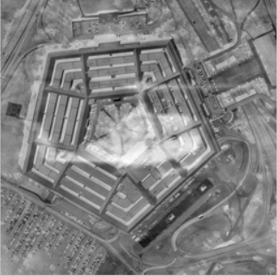
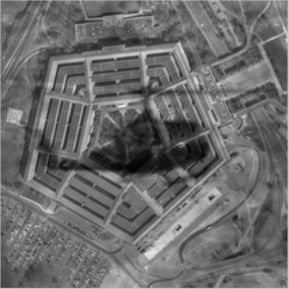
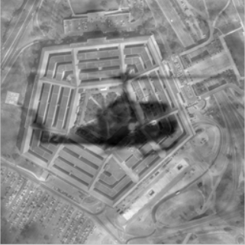
PLIP Multiplication (cont.)

Slide 8
Outline
Introduction
PLIP Multiplication
Proposed Method
Experimental Results
Conclusion

Slide 9
Proposed Method
Original Image
PLIP Fusion
Enhanced Image
Decomposed Image

Slide 10
Proposed Method (cont.)
Decompose image using a threshold:
Extract regions of our interest.
Remove back ground noise.

Slide 11
Proposed Method (cont.)
Transform images into gray-tone images:
Apply PLIP multiplication:
where:

Slide 12
Proposed Method (cont.)
The enhanced image is obtained by applying the same gray-tone function on the result of the PLIP multiplication:

Slide 13
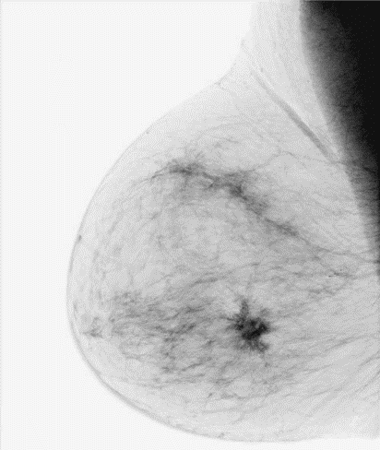
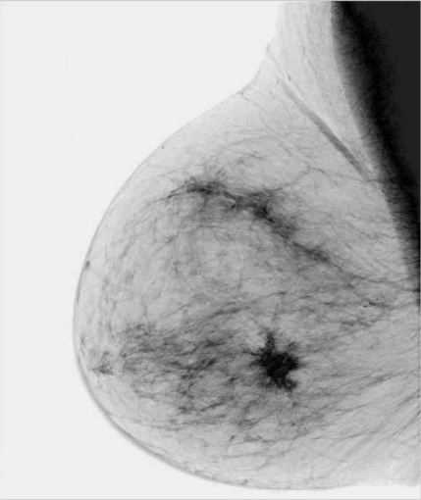
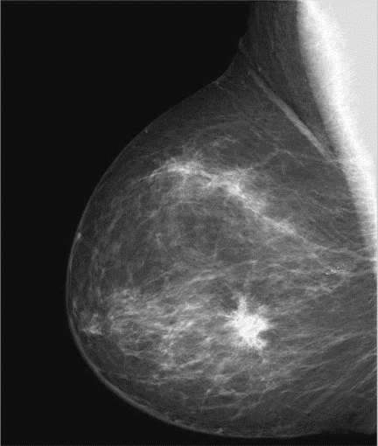
Proposed Method (cont.)

Slide 14
Outline
Introduction
PLIP Multiplication
Proposed Method
Experimental Results
Conclusion

Slide 15
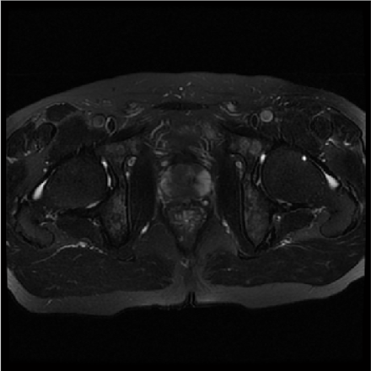
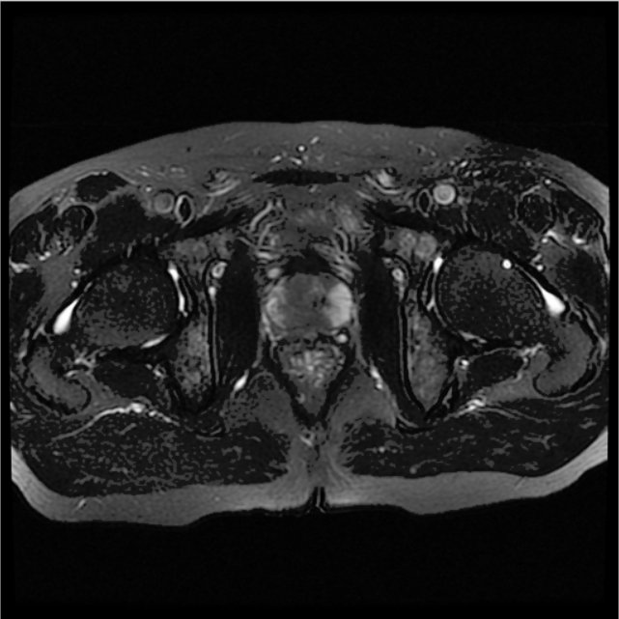
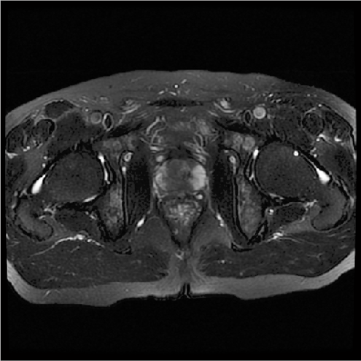
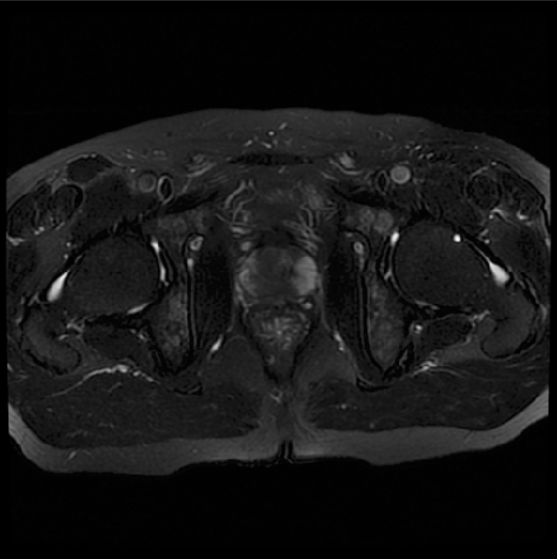
Experimental Results
Parameter Selection:
1. The original image; 2. enhanced image with t = 25, μ = 200, λ = 400, β = 2; 3. enhanced image with t = 15, μ = 200, λ = 400, β = 2; 4. enhanced image with t = 15, μ = 500, λ = 1000, β = 2

Slide 16
Histogram equalization (HE)
Contrast Limited adaptive histogram equalization (CLAHE)
Unsharp Masking (UM)
Improved UM (IUM)
Proposed Method

Slide 17
Experimental Results (cont.)
EMEE:

Slide 18
Experimental Results (cont.)
EMEE Measurement:

Slide 19
Outline
Introduction
PLIP Multiplication
Proposed Method
Experimental Results
Conclusion

Slide 20
Conclusion
PLIP operations can solve problems of linear operations.
Proposed a new enhancement method for medical images combining the unsharp masking scheme with the PLIP multiplication.
The experimental results have demonstrated that the proposed method is able to enhance details and edges in medical images while suppressing background noise.

Slide 21
Thank You!

Slide 22
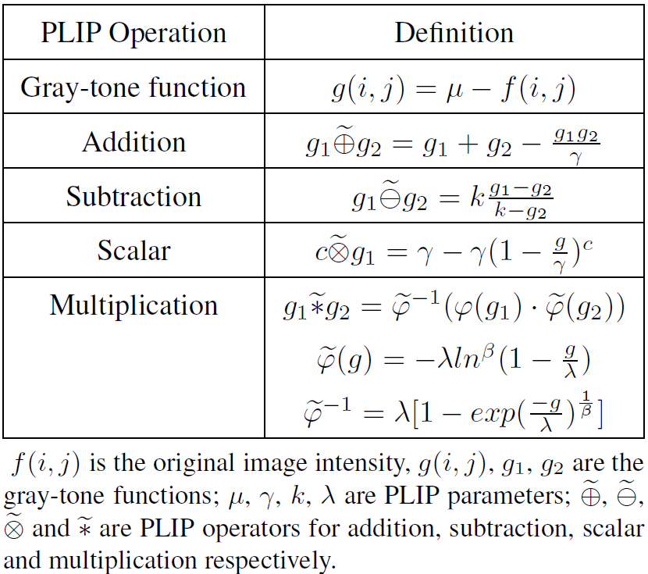
Additional Slides
A list of common PLIP operations:

