Slide 1
2022 IEEE International Conference on Acoustics, Speech and Signal Processing
MODELING INTENTION, EMOTION AND EXTERNAL WORLD IN DIALOGUE SYSTEMS
Wei Peng^{1,2}, Yue Hu^{1,2} , Luxi Xing^{1,2}, Yuqiang Xie ^{1,2} , Xingsheng Zhang^{1,2} , Yajing Sun^{1,2}
¹ Institute of Information Engineering, Chinese Academy of Sciences, Beijing, China
² School of Cyber Security, University of Chinese Academy of Sciences, Beijing, China
{pengwei, huyue, xingluxi}@iie.ac.cn

Slide 2
2022 IEEE International Conference on Acoustics, Speech and Signal Processing
/ Index
Introduction
Approach
Experiments
Summary
目录
CONTENTS
MODELING INTENTION, EMOTION AND EXTERNAL WORLD IN DIALOGUE SYSTEMS

Slide 3
2022 IEEE International Conference on Acoustics, Speech and Signal Processing
/ Index
Introduction
Approach
Experiments
Summary
目录
CONTENTS
MODELING INTENTION, EMOTION AND EXTERNAL WORLD IN DIALOGUE SYSTEMS

Slide 4
Introduction
2022 IEEE International Conference on Acoustics, Speech and Signal Processing
Definition of the task
In a dialog system, dialog act recognition and sentiment classification are two correlative tasks.
(2) Dialog intention recognition: it aims to attach semantic labels to each utterance in a dialog which represent the underlying intentions. In this paper, intention can be categorized into request, suggest, command, accept, reject, question and inform.
(3) Dialog sentiment classification: it focuses on the emotion of speakers to recognize the emotional labels to each utterance. The emotion classification includes happy, neutral, sadness, anger, content and disgust.
MODELING INTENTION, EMOTION AND EXTERNAL WORLD IN DIALOGUE SYSTEMS

Slide 5
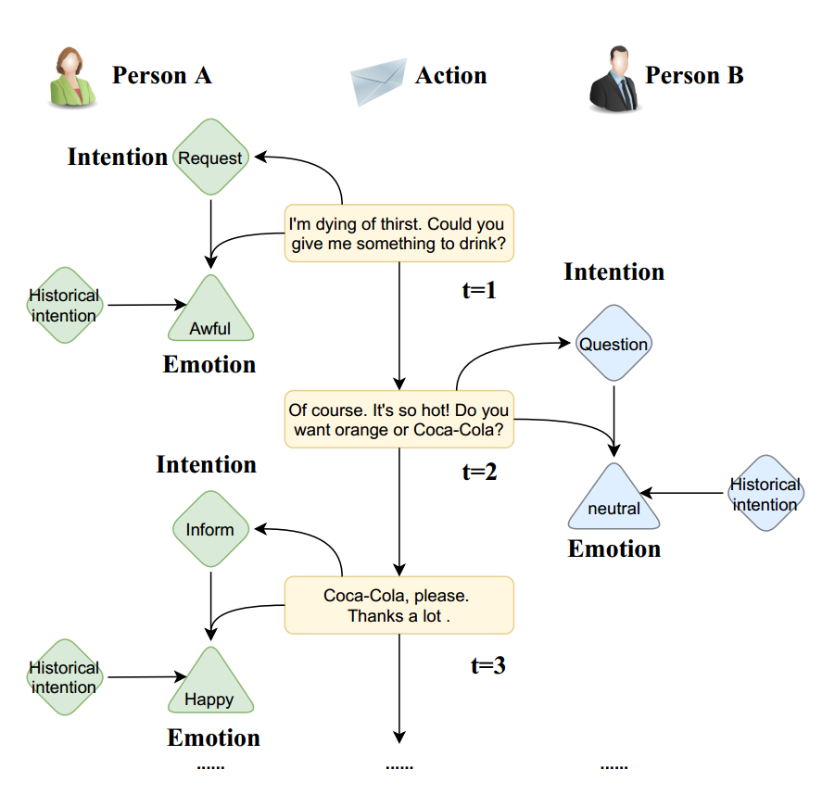
Introduction
2022 IEEE International Conference on Acoustics, Speech and Signal Processing
◆ Motivation
(1) Intention, emotion and action (defined as the utterance in this scene) are important elements in human activities. Modeling the interaction process between individuals by analyzing the relationships between these elements is a challenging task.
(2) Previous work mainly focused on modeling intention and emotion independently, and neglected of exploring the mutual relationships between intention and emotion.
MODELING INTENTION, EMOTION AND EXTERNAL WORLD IN DIALOGUE SYSTEMS
Notes:
As shown in , implicitly expressed in the utterance, how to analyze the relationships between the …. And recognize them are challenge.

Slide 6
Introduction
2022 IEEE International Conference on Acoustics, Speech and Signal Processing
◆ Contributions
(1) We propose a RelAtion Interaction Network (RAIN), consisting of Intention Relation Module and Emotion Relation Module, to jointly model mutual relationships and explicitly integrate historical intention information.
(2) We introduce an intention dictionary (in Intention Relation Module) and integrate historical intention (in Emotion Relation Module) to make analysis and explanation of intention recognition and emotion prediction.
(3) The important observation is the significant performance obtained from RAIN and explanation to the two tasks.
MODELING INTENTION, EMOTION AND EXTERNAL WORLD IN DIALOGUE SYSTEMS

Slide 7
2022 IEEE International Conference on Acoustics, Speech and Signal Processing
/ Index
Introduction
Approach
Experiments
Summary
目录
CONTENTS
MODELING INTENTION, EMOTION AND EXTERNAL WORLD IN DIALOGUE SYSTEMS

Slide 8
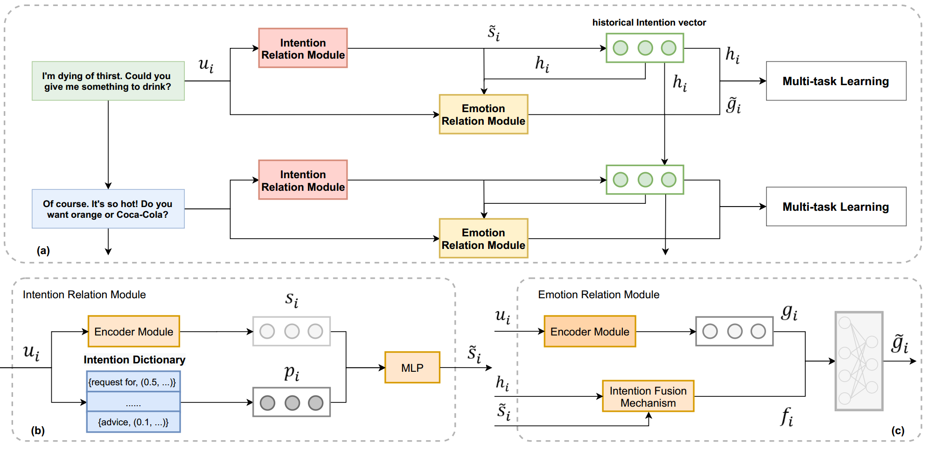
Approach
2022 IEEE International Conference on Acoustics, Speech and Signal Processing
◆ Overview
(a) is the overview of our RAIN which consists of the Intention Relation Module (b) and Emotion Relation Module (c)
MODELING INTENTION, EMOTION AND EXTERNAL WORLD IN DIALOGUE SYSTEMS
Notes:
After interaction between the … and …, the classifier layer outputs the probability distribution with multi-task learning.

Slide 9
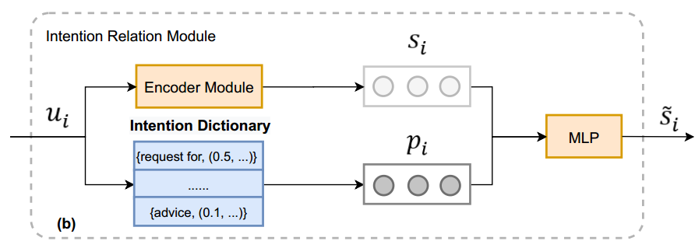
Approach
2022 IEEE International Conference on Acoustics, Speech and Signal Processing
Intention Relation Module
The module obtains the contextual representations of dialogues with the encoder module and
introduces an intention dictionary to make an interpretable intention recognition.
Encoder Module
i : i-th sentence
T: the number of words
[0]: the representation of the [CLS]
MODELING INTENTION, EMOTION AND EXTERNAL WORLD IN DIALOGUE SYSTEMS

Slide 10
Approach
2022 IEEE International Conference on Acoustics, Speech and Signal Processing
Intention Relation Module
Intention Dictionary
Observing that certain specific words such as ask for, proposal can reflect intention, we extract the feature words for integrating symbolic representation. We count the number of labeled feature words, count the word frequency of each feature word over different intentions, and normalize it to get the probability distribution .
Finally, the intention vectors, integrating symbolic representation and neural representation, can be obtained as the equation.
MODELING INTENTION, EMOTION AND EXTERNAL WORLD IN DIALOGUE SYSTEMS
Notes:
Finally, the intention vectors s~i, integrating symbolic representation and neural representation, can be obtained as the equation.

Slide 11
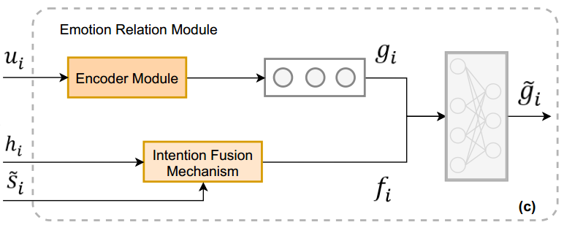
Approach
2022 IEEE International Conference on Acoustics, Speech and Signal Processing
Emotion Relation Module
The module designs an intention fusion mechanism to explicitly integrate historical intention information for obtaining the emotion vectors .
Encoder Module
The Emotion Relation Module utilizes another RoBERTa as the Encoder Module for obtaining the sentence-level representation .
MODELING INTENTION, EMOTION AND EXTERNAL WORLD IN DIALOGUE SYSTEMS

Slide 12
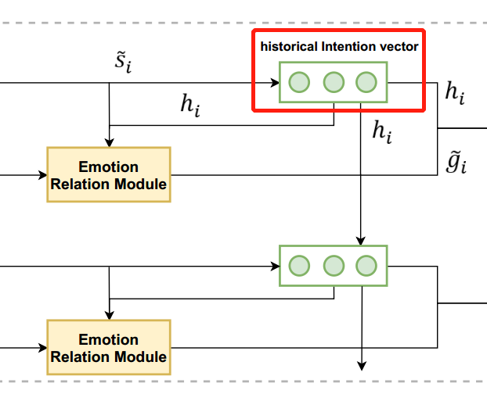
Approach
2022 IEEE International Conference on Acoustics, Speech and Signal Processing
Emotion Relation Module
Historical Intention Modeling
To capture the temporal features within the historical intentions, a LSTM is considered as:
Intention Fusion Mechanism
To effectively integrate historical intention information
and current intention, a fusion layer is defined in the
following.
MODELING INTENTION, EMOTION AND EXTERNAL WORLD IN DIALOGUE SYSTEMS

Slide 13
Approach
2022 IEEE International Conference on Acoustics, Speech and Signal Processing
Emotion Relation Module
The emotion vectors, modeling the mutual relationships between the intention and emotion, obtained as:
Finally, two MLPs are considered for performing intention recognition and emotion prediction.
MODELING INTENTION, EMOTION AND EXTERNAL WORLD IN DIALOGUE SYSTEMS

Slide 14
2022 IEEE International Conference on Acoustics, Speech and Signal Processing
/ Index
Introduction
Approach
Experiments
Summary
目录
CONTENTS
MODELING INTENTION, EMOTION AND EXTERNAL WORLD IN DIALOGUE SYSTEMS

Slide 15
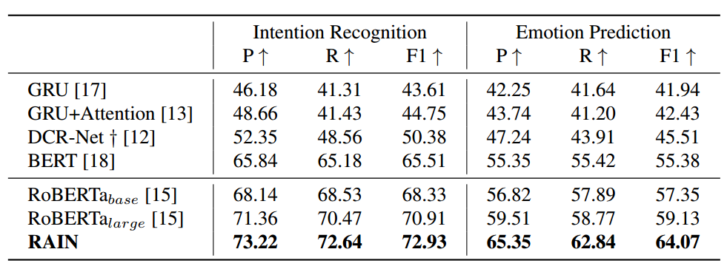
Experiments
2022 IEEE International Conference on Acoustics, Speech and Signal Processing
◆ Dataset & Evaluation Metric
The DailyDialog datasets contain 13,118 multi-turn dialogues. In order to obtain the intention dictionary, we extract 2,046 conversations for the annotation. As for the evaluation metric, macro-average Precision (P), Recall (R) and F1 are considered for the DailyDialog dataset.
Main Results
MODELING INTENTION, EMOTION AND EXTERNAL WORLD IN DIALOGUE SYSTEMS

Slide 16
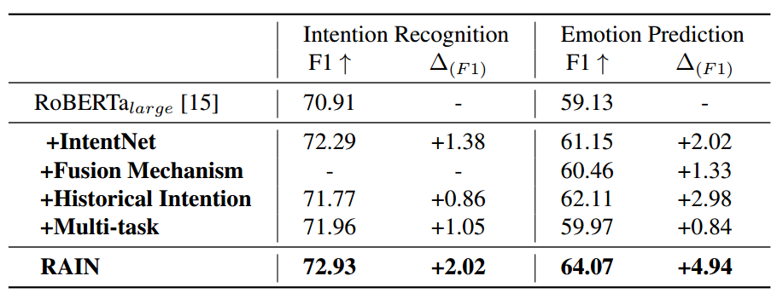
Experiments
2022 IEEE International Conference on Acoustics, Speech and Signal Processing
The performance with respect to the number of epochs on the dataset
Ablation study on model components
MODELING INTENTION, EMOTION AND EXTERNAL WORLD IN DIALOGUE SYSTEMS

Slide 17
Experiments
2022 IEEE International Conference on Acoustics, Speech and Signal Processing
Case Study
As for the explanation of the emotion, we give the generative template based on the outputs, like Emotion of speaker is happy because his intention is satisfied.
MODELING INTENTION, EMOTION AND EXTERNAL WORLD IN DIALOGUE SYSTEMS

Slide 18
2022 IEEE International Conference on Acoustics, Speech and Signal Processing
/ Index
Introduction
Approach
Experiments
Summary
目录
CONTENTS
MODELING INTENTION, EMOTION AND EXTERNAL WORLD IN DIALOGUE SYSTEMS

Slide 19
2022 IEEE International Conference on Acoustics, Speech and Signal Processing
/ Summary
We present a RelAtion Interaction Network (RAIN) to jointly model mutual relationships between the intention and emotion, and explicitly integrate historical intention information.
We show that the proposed RAIN is effective and interpretable, which outperforms the previous methods with a single model.
For the future work, some other psychological factors (Intention and emotion in this paper) will be considered, such as personal character, educational background and so on.
MODELING INTENTION, EMOTION AND EXTERNAL WORLD IN DIALOGUE SYSTEMS
Notes:
NLU

Slide 20
Thanks!
More related works can be viewed as follows
CSDN Blogs：https://blog.csdn.net/ganxiwu9686
Zhihu column ：NLU ongoing
Machine reading comprehension : https://zhuanlan.zhihu.com/indexfziq
Knowledge-based machine reading comprehension：
https://github.com/XingLuxi/KMRC-Research-Archive
Wei Peng
Institute of Information Engineering, Chinese Academy of Sciences
2022.04

