Slide 1
Quality Assessment of Mobile Videos with In-Capture Distortions
Deepti Ghadiyaram, Janice Pan, Alan Bovik,
Anush Moorthy, Prasanjit Panda, and Kai-Chieh Yang

Slide 2
Presentation Overview
Introduce the problem of perceptual video quality assessment.
Describe the characteristics of a new video quality assessment database that we created.
Describe our subjective quality assessment study on this database to gather ground truth human opinion scores.
Analyze several aspects of emergent mobile devices in capturing videos.
Analyze different aspects of subjects’ sensitivity to distortions.
Notes:
In this talk, I will very briefly introduce the problem of perceptual video quality assessment, describe a new video quality assessment database and our subjective study framework to conduct a video quality assessment study.
Then, I will discuss our findings from the subjective data about the performance of different emergent mobile phones and also about aspects of subjects’ perception of distortions.

Slide 3
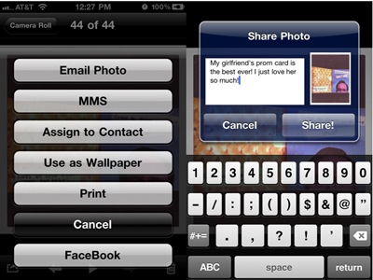
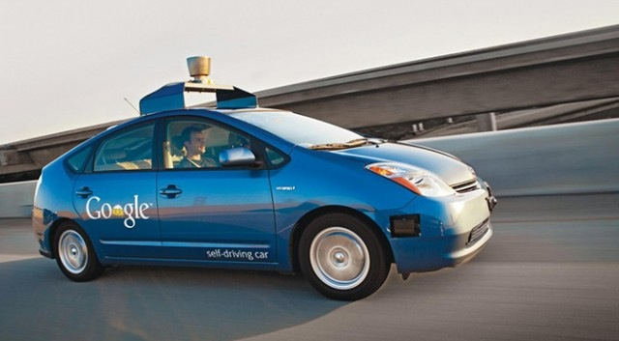
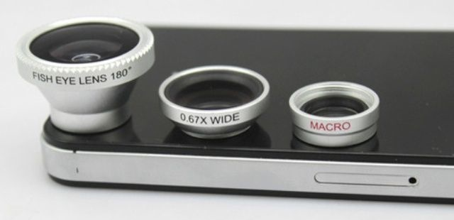
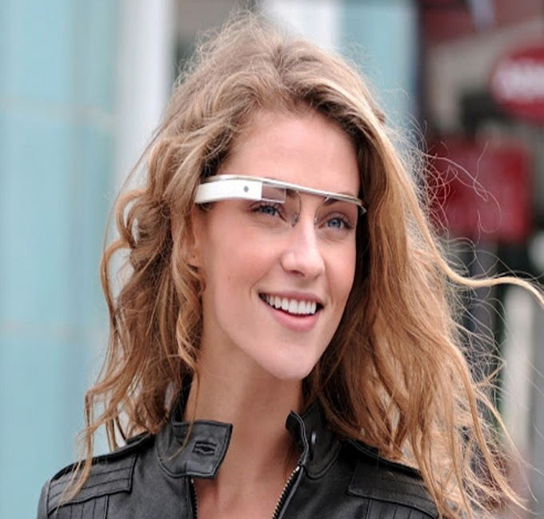
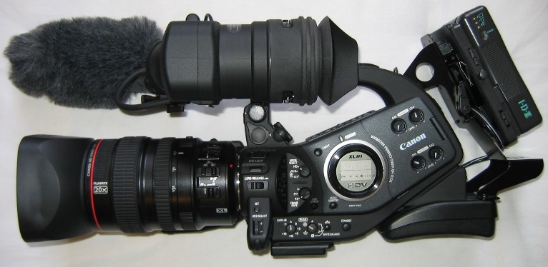
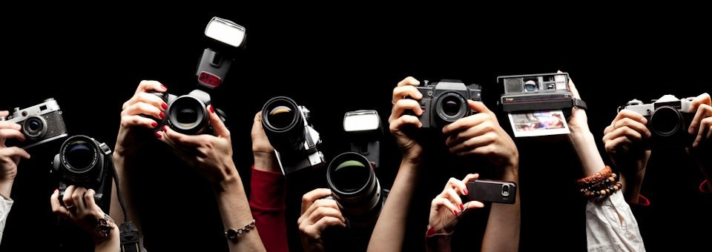
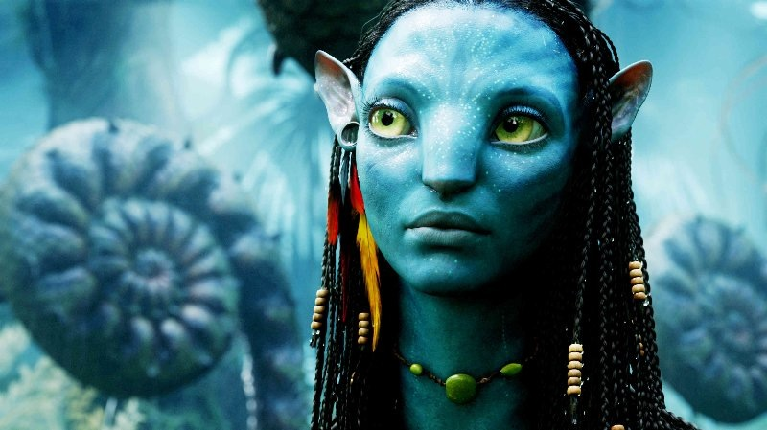
Pervasiveness of visual media
E-commerce
High-definition Cameras
Google glass
3D movies
Notes:
We are all aware of the explosive growth in the field of visual media driven by significant advances in the technology made by camera and mobile devices manufacturers, the development of several photo-centric social networking and e-commerce websites. All of these are allowing us to efficiently capture, store, and share large volumes of pictures and videos with our friends and communities.

Slide 4
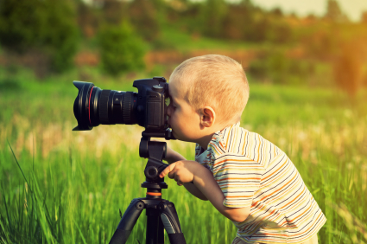
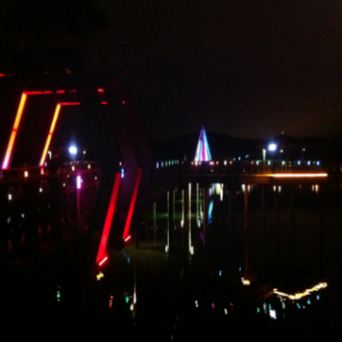
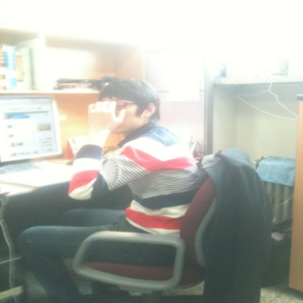
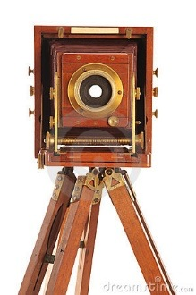
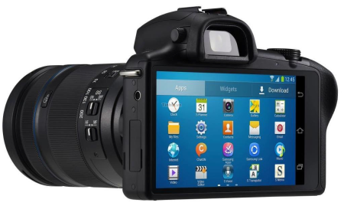
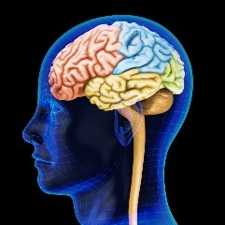
Sources of distortions in images and videos
Amateur camera users
Varied camera devices
Ambient illumination conditions
Network congestion
All front-end
digital
processing
classical
channel
All back-end
digital
processing
Natural image
signal
Mapping
&
display
Perceptual
image/video
signal
Sensing &
digitizing
Transmitter
The Image/Video Channel
Receiver
Notes:
However, a vast majority of these videos are taken by casual, inexpert users and delicate variables such as lighting conditions, exposure, and lens limitations can adversely affect the quality of the captured videos.
Additionally, insufficient network capacity especially while transmitting videos could introduce frequent playback interruptions which are probably the worst kind of distortions that can effect our quality of experience.
Moreover, every image and video passes through numerous processing stages each of which could potentially introduce visual distortions thereby effecting their overall quality.

Slide 5
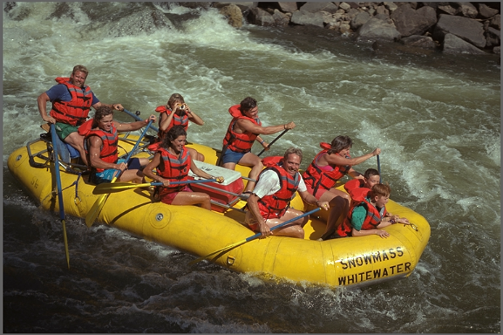
What is Perceptual Visual Quality?
Save, transmit, render
Save, transmit, render
Perceptual quality: Quality as perceived by human observers.
Notes:
This aspect of quality of visual media “as perceived by human observers” is termed as perceptual visual quality.
And as has been illustrated earlier, perceptual visual quality different from the standard signal fidelity.

Slide 6
Objective Video Quality Assessment
Goal: Given a video (possibly distorted), automatically and accurately predict its perceptual quality.
Test video
Large database of
pristine and distorted
videos
Video Quality predictor
Associated human
opinion scores (MOS)
Predicted human opinion score.
Notes:
Designing “objective” automatic predictors typically follows the following pipeline. Given a large collection of distorted videos along with subjective human opinion scores. This data is analyzed to derive a quality predictor such that, given an unseen test video, its quality can be accurately predicted.

Slide 7
Current work in Video Quality Assessment (VQA)
Video Quality Assessment Databases
LIVE VQA Database [1]
LIVE Mobile Video Database [2]
EPFL-Polimi Video Quality Database [3]
VQEG HD3 Database [4]
LIVE Mobile Stall Video Database-II [5]
LIVE-NFLX Database [6]
.
.
.
Video Quality Predictors
MOVIE index [7]
ST-RED index [8]
V-BLIINDS [9]
VIIDEO [10]
VMAF [11]
ST-MAD [12]
.
.
[1] K. Seshadrinathan et.al, 2008 [2] A. K. Moorthy et.al, 2012
[3] F. D. Simone et.al., 2009 [4] VQEG, 2010
[5] D. Ghadiyaram et.al., 2017 [6] C. Bampis et. al., 2017
[7] K. Seshadrinathan et.al, 2008 [8] R. Soundararajan et.al 2012
[9] M. Saad et al., 2014 [10] A. Mittal et.al., 2016
[11] Netflix, 2016 [12] V. Phong et. al., 2012
Notes:
And there are a number of standard benchmark databases designed to support this framework. Each of these databases model different forms of single distortions such as frame freezes, bitrate variations, temporal jitter, and so on.
And these databases have proven to be very valuable towards designing a number of video quality predictors.
In this work, we focus on the construction of a video quality database.

Slide 8
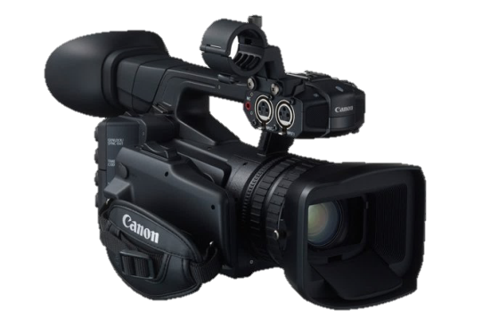
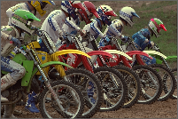
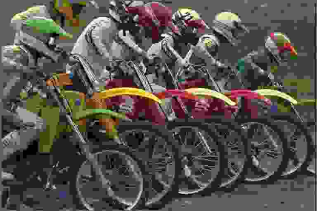
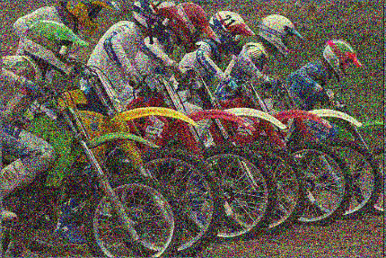
Standard process followed by database originators
High-end cameras
High-quality (pristine) video
Highly controlled conditions
A single distortion type of a specific severity
Systematically simulated
synthetically distorted videos.
Post-capture distortions
Notes:
All of the benchmark video quality databases have been designed in the following manner. A small collection of high quality photos and videos are taken and under controlled conditions, a single distortion of known severity is added to those videos. .
This generates a pool of distorted videos, afflicted with a single distortion..
Also note that, since the distortions are introduced after a video is captured, we refer to these distortions as post capture distortions.

Slide 9
Limitations of the existing databases
1. Type of synthetic distortions modeled in all existing databases
MPEG-2 and H.264 compression artifacts
Frame-freezes
Wireless channel packet loss
Bitrate-switches.
Scaling artifacts
and so on..
Real-world video distortions do not occur in isolation!
Notes:
Some examples of the type of distortions modeled in these database are compression artifacts, frame freezes, upscaling or downscaling artifacts, and so on. Note that since these distortions are being synthetically introduced into these videos, we refer to them as “inauthentic distortions.

Slide 10
More limitations with the existing databases
2. Limited variety of source content (restricted to that of pristine videos)
10 unique video contents in LIVE VQA Database [1]
10 unique video contents in LIVE Mobile Video Database [2],
8 contents in EPFL-Polimi Video Quality Database [3]
3. Lack of diversity in the video capturing devices.
None of the databases have video content captured using mobile devices
Do not model in-capture, authentic distortions.
[1] K. Seshadrinathan et.al, 2008 [2] A. K. Moorthy et.al, 2012 [3] F. D. Simone et.al., 2009
Notes:
There are several other limitations with the existing databases.
1) Since the distorted videos are generated from a small pool of 8-10 high-quality pristine videos, the video content modeled in these databases is to limited to these 8-10 videos.
2) Also, these 8-10 pristine videos are almost always captured using the same camera, and thus the databases do not model the different types of distortions inherently introduced by the sensors of different camera manufacturers during the capture process.
3) More importantly, the single synthetic distortions do not reflect the mixtures of authentic distortions that we encounter while capturing videos in our day-to-day lives.

Slide 11
Authentic, In-capture Video Distortions
Sources causing in-capture distortions:
Scene lighting
Exposure
Camera shake
In-camera processing
Focal length
Noise sensitivity
and so on..
Video distortions occurring during the capture process.
Notes:
Just to reiterate, we refer to the distortions that occur naturally during a video capture as incapture distortions.
There are many sources that could cause these distortions. Some of them are the ambient lighting conditions, exposure, or camera shake, focal length of the camera’s lens, and so on.

Slide 12
Our goals: LIVE-Qualcomm Mobile In-capture Video Quality Database
To design a database containing a large number of authentically distorted videos and subjective scores.
To better understand the quality of videos created using cameras in the emergent mobile devices.
To understand the impact of different in-capture distortions on subjective distortion type and severity perception.
Notes:
With that background, I now proceed to introduce our goals:
a) First design a database that has a large number of videos with incapture distortions and also with associated with subjective opinion scores.
b) To understand the difference in the performance of different phones in terms of the quality of the videos being captured.
c) To analyze the subjective behavioral responses of humans when viewing these videos to understand how different distortions types and severities are perceived.
d) Another crucial use of this data collection is that it allows us to benchmark the performance of existing VQA models on real world distortions.

Slide 13
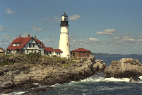
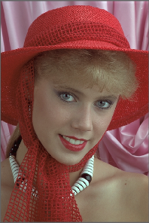
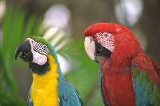
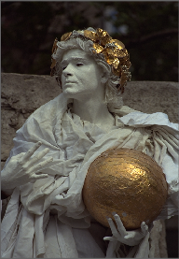
Construction of an VQA database
Step 1) Gather video content
Step 2) Gather Opinion Scores
Notes:
Designing a video quality database comprises of two main steps : 1) Gathering video content and 2) Conducting a human study to gather the perceived quality opinion scores on this content . Lets first look at the details of our video collection.

Slide 14
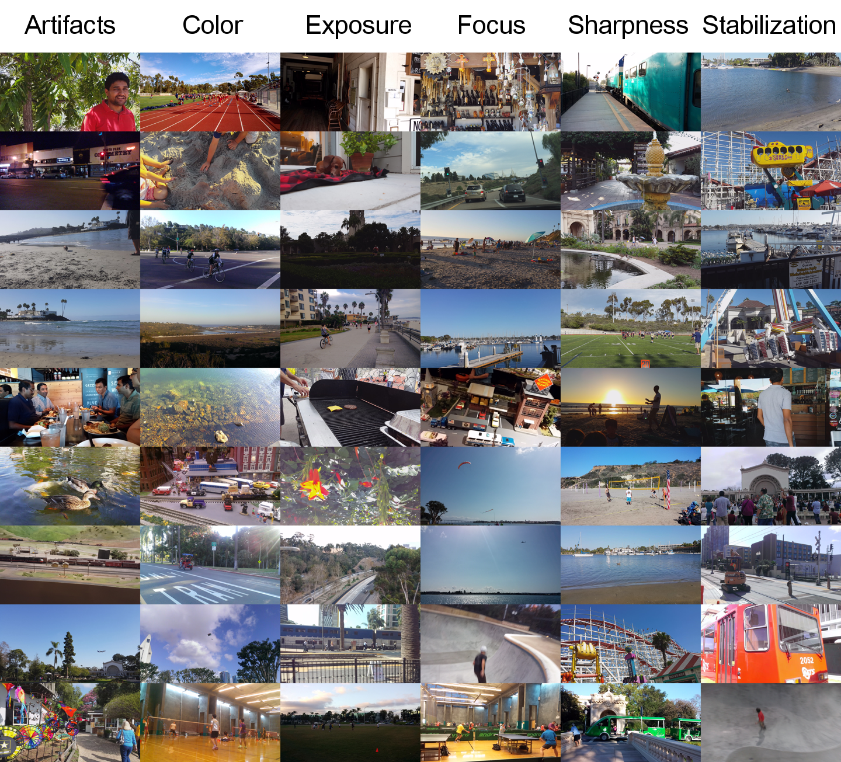
LIVE-Qualcomm Mobile In-capture Video Quality Database
208 total videos
8 different mobile video capturing devices
54 unique contents
6 dominant distortions
15 second long
All videos of resolution 1920x1080
Do not contain any
post-capture distortions
Notes:
Our video collection is called the LIVE-Qualcomm Mobile Incapture Video Quality Database. This data collection consists of 208 total video contents and 54 unique contents. Each unique content is captured by 3-4 different phones, thus allowing to compare the performance of these phones given the same content.
All videos are 15 second long and are of resolution 1920x1080.
We modeled 6 dominant distortion types in these videos using 8 different mobile camera devices.
Note that this database does not capture any post-capture disotrtions.

Slide 15
Distribution of different mobile devices used
Motivation behind our choice of devices:
The above were among the most widely-used mobile devices during the time of video content acquisition.
2. The resulting video content reasonably spans the entire quality spectrum.
Notes:
Here are the different phones that were used to capture the video content in our database. Also is the Here is the distribution of the number of videos captured using each device.
Our choice of mobile devices was driven by two key factors:
Some of these were among the widely-used mobile devices during the time of video content acquisition.
We aimed to have videos span the entire quality spectrum reasonably.

Slide 16
Six dominant distortion categories

Slide 17
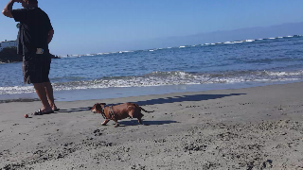
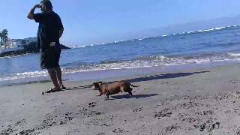
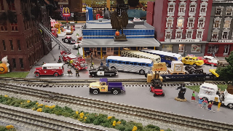
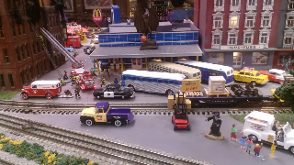
Samsung’s Galaxy GS6 vs. HTC One VX
Artifacts
Noise and blockiness distortions
Color
Incorrect or insufficient color representation
vs.
Exposure
Over/under exposure
Notes:
Our goal was to capture videos afflicted with any of the following distortion catgories.
Artifacts - Noise and blockiness distortions not part of the video content.
Color - Videos with incorrect or insufficient color representation.
Exposure - Over/under-exposure, making it difficult to see parts or the entirety of the scene.

Slide 18
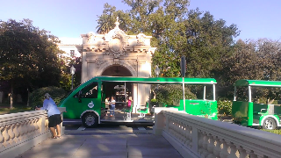
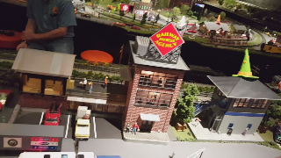
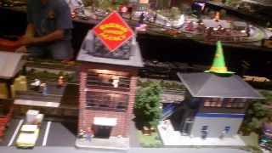
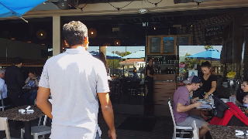
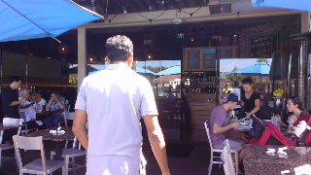
Samsung’s Galaxy GS6 vs. HTC One VX
Sharpness
General lack of detail or crispness
Focus
Autofocus related distortions
vs.
Stabilization
Camera shake
Notes:
Focus - Autofocus related distortions, i.e., videos that are intermittently sharp or blurry over time.
Sharpness - General unsharpness, i.e., lack of detail, texture in the content. This distortion differs from out-of focus distortion in that with sharpness distortion, objects
are in focus but do not appear ‘crisp’ or detailed.
Stabilization - Camera shake that overwhelms content

Slide 19
Categorization of videos into distortion categories
These are the six most significant in-capture distortions that frequently occur in mobile videos.
Some of these distortions are very subtle to perceive and distinguish, thus challenging the existing objective VQA metrics.
Notes:
Here is the distribution of all the videos into the 6 distortion categories.

Slide 20
Video capturing process
Divided eight phones into groups of four for every video content capture.
Both groups had phones that reasonably span the entire quality spectrum.
Used a rig capable of holding four phones simultaneously while capturing a video content.
Content was spatially and temporally aligned across phones.
Allowed us to analyze the performance of different phones given common content.
Used each phone’s default settings.
Each video content was captured with an intended distortion in mind.
Eg: To test the quality of stabilization, videos were captured while walking.
Other in-capture distortions could also jointly occur in a video.
Notes:
During every content capture, we divided the eight phones into two groups of four phones such that each group had sufficient perception separability.
We used a rig which can hold four phones to simultaneously capture a video content. Thus, the four video contents captured at a given time are spatially and temporally aligned – thus allowing us to compare the performance of different phones.
We used the default settings of each phone.
And the video contents were captured with an intended distortion in mind, for instance, to test the quality of stabilization, we captured videos while walking.

Slide 21
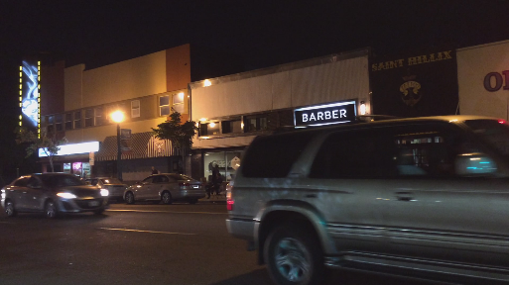
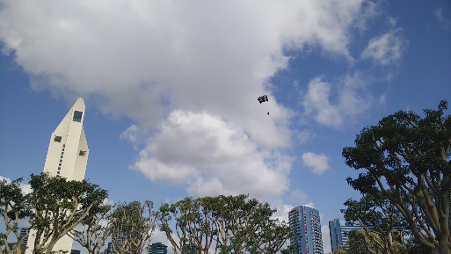
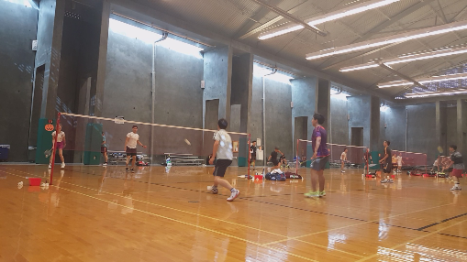
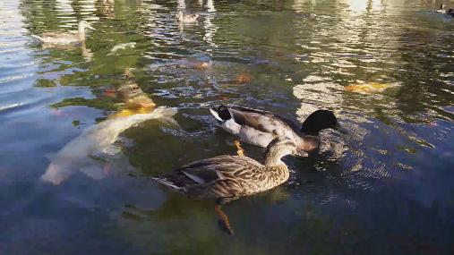
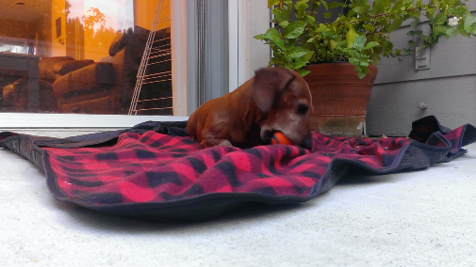
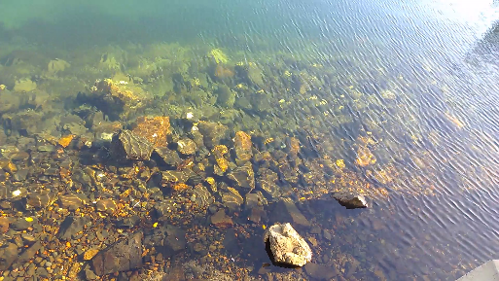
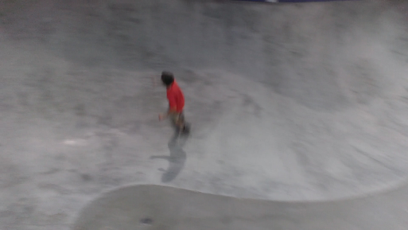
Wide variety of video content: videos of people, objects, indoor, and outdoor scenes
None of these features are modeled in any of the existing
video quality databases!
In-capture distortions of varied severities
Notes:
With this setup, we captured a wide-variety of video content - of people, objects, indoor and outdoor scenes.
It has incapture distortions of varied severities.
These videos have been captured under a high variety of lighting conditions during both night and day, thus introducing different degrees of over and under exposure distortions.

Slide 22
Construction of an VQA database
Step 1) Gather video content
Step 2) Gather Opinion Scores
Notes:
Upon collecting the video content, our next task was to gather subjective scores on these videos.

Slide 23
Goals of our Subjective Study
Goal 1
To understand the distortion that
most dominated a viewer’s perception
Goal 2
To understand how each of the six
dominant distortions influence human
judgments
Distortion-unbiased study setup
Free viewing setup
No information about the underlying distortion is provided
Have viewers pay attention to overall quality during playback
Distortion-biased study setup
A guided study setup
Prior information about the underlying distortion is provided
Have viewers pay attention to a particular distortion during playback
Notes:
We wanted to understand two different aspects of human perception.
First, we wanted to understand given a video, which distortion most dominates a viewer’s perception.
And second, how each of the six dominant distortion categories influence human judgments.
For the first goal, the subjects viewed videos in a free-viewing setup, where no information was provided about the underlying dominant distortion type.
Thus, viewers paid attention to the overall quality in general and later reported whichever distortion dominated their perception.
The second setup was a guided setup, where subjects were informed a priori about the type of distortion dominating the video that will be viewed next.
This bias led to viewers paying attention to a particular distortion and rating a video based on that distortion.

Slide 24
Unbiased Study Setup
Biased Study Setup
Notes:
Thus in the unbiased setup, after a subject reads instructions and participates in a training phase which helped a subject to understand the task and learn to navigate through the interface.
The training phase was followed by a test phase were a video is presented one after the other. Upon watching the video, a subject is asked to provide an overall quality score. Next, a subject is also asked to pick which of the 6 distortions they perceived in the presented video.
By contrast, a biased study session, is divided into two sub-sessions, one per distortion category. Thus, after reading through the instructions, a subject participates in a training phase where videos afflicted with only one dominant distortion are presented. This process repeats in the test phase as well. Upon watching each test video, the viewer is simply asked to rate their overall quality score.

Slide 25
Subjective Study details
39 subjects
Undergraduate and graduate students studying electrical engineering at UT-Austin.
The study was conducted in a controlled laboratory environment.
3 sessions of 45 minutes each, 70 videos per session.
We computed biased and unbiased Mean Opinion Score (MOS) per video from individual subject scores.
Biased group | Unbiased group

Slide 26
Subjective Data Analysis and Findings
Notes:
Next I present some of the findings from the subjective data on behavioral responses and performance of phones

Slide 27
Unbiased vs. Expert Distortion Labeling
Recall: Unbiased subjects selected the most dominant distortion for each presented video.
Selected distortion labels do not agree well with the expert distortion labels (accuracy: 26.44%) for certain distortions.
Exposure and Color related distortions are confusing!
TRUE DISTORTION
Easy to identify stabilization distortion!
Humans have different degrees of sensitivity to different distortions occurring
jointly in a video.
SELECTED DISTORTION
Notes:
Recall that the unbiased subjects also selected the most dominant distortion category, in addition to providing an overall quality score.
We used a majority ruling strategy to derive the preferred distortion category and computed a confusion matrix between the chosen distortion labels and the true distortion labels.
We found that subjects in general did not agree well with the expert labels with about 26% accuracy.
Another key takeaway is that stabilization was a distortion that was quite easy to identify but there was a lot of confusion between exposure and color distortions. The latter is not surprising because the color and exposure distortions cannot always occur in isolation as they are interrelated.
This analysis also highlights that humans have different degrees of sensitivity to the distortions that occur in videos.

Slide 28
Unbiased vs. Biased Distortion Perception
Biased and unbiased subjects generally agree with respect to perceptual video quality: Pearson correlation = 0.80
Though the unbiased subjects could not accurately identify the type of distortion,
they generally agree with the biased subjects on distortion perception.
Notes:
We next compared the MOS values obtained from the bias and the unbiased subjects. We found that these two groups agree reasonably well wrt their perceptual quality rating, with a pearson correlation of 0.8.
This shows that though the two groups do not agree well on the type of distortion, they generally agree with each other in estimating and rating the severity of distortion.

Slide 29
Phone Rankings based on Subjective Scores (overall)
Samsung’s Galaxy S6 and Apple’s iPhone 5S were the best performing phones.
HTC One VX performed very poorly.
Notes:
We next aggregated the MOS values obtained from each phone over all the contents. We found that samsung’s galaxy gs6 and apple 5S were considered as the top-performing phones. On the other hand, HTC One X performed consistently poorly.

Slide 30
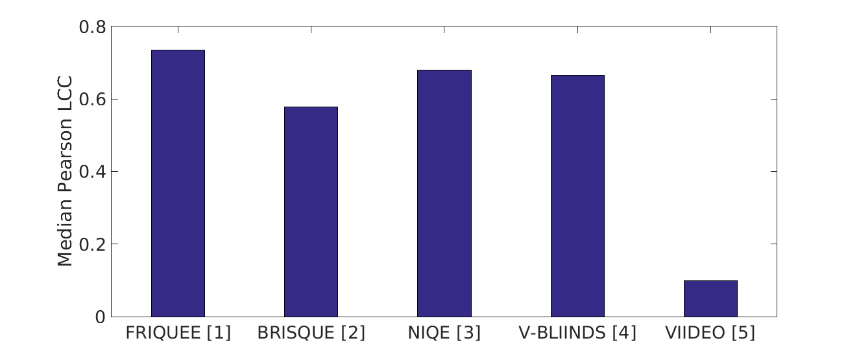
Performance of Objective Quality Metrics
Performance metric: Pearson correlation between the subject human opinion scores and predicted scores by the model.
Existing blind IQA/VQA algorithms have room for improvement in their ability to predict quality of videos with naturally-occurring, in-capture distortions
[1] D. Ghadiyaram et.al, 2017 [2] A. Mittal et. al., 2012 [3] A. Mittal et. al., 2013 [4] M. Saad et. al., 2014
[5] A. Mittal et. al., 2016
Notes:
We evaluate the performance of several IQA and VQA models and compute a pearson correlation values between the predicted and the human opinion scores. From these correlations scores, it can be noted that existing VQA models have room for improvement in their ability to predict the quality of videos suffering from incapture distortions.

Slide 31
Summary and Conclusions
 | All the benchmark databases | LIVE-Qualcomm Mobile In-capture Video Quality Database
Authentic, in-capture distortions
Wide-variety of source content
Diverse source capturing mobile devices
Reference videos
✗
✓
✗
✓
✗
✓
✓
✗
Conducted an unbiased and biased subjective study to gather human opinion scores.
The database will be made publicly available very soon!
This database is a valuable resource for developing robust video quality predictors for real-world distortions.
Thank you!
(Contact Information: deepti@cs.utexas.edu)

