Slide 1
Deep Learning: Propelling Recent Rapid Advances in AI
Li Deng
Deep Learning Technology Center (DLTC)
Microsoft Research
Redmond, WA. USA
Plenary at IEEE-GlobalSIP, December 16, 2015
Thanks go to many colleagues at DLTC/MSR, collaborating universities,
and at Microsoft’s engineering groups

Slide 2
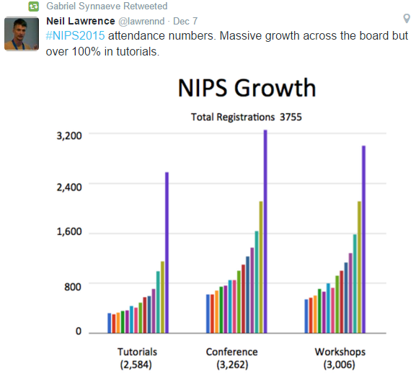
Newest Update on AI, ML, & DL
Dec 7-12, 2015
2013
2009

Slide 3
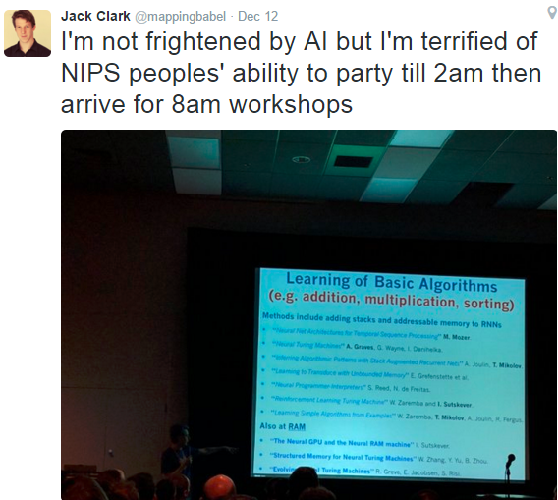
“… (NIPS) 2015 conference this week in Montreal. It was an incredible experience, like drinking from a firehose of information. …” (single track; posters 7pm-midnight)

Slide 4
What Is It?
Deep learning (deep machine learning, or deep structured learning, or hierarchical learning, or sometimes DL) is a branch of machine learning based on a set of algorithms that attempt to model high-level abstractions in data by using model architectures, with complex structures or otherwise, composed of multiple non-linear transformations.^{[1](p198)[2][3][4]}

Slide 5
(Slide from Bengio, 2015)

Slide 6
More Recent Media Reports (2015)

Slide 7
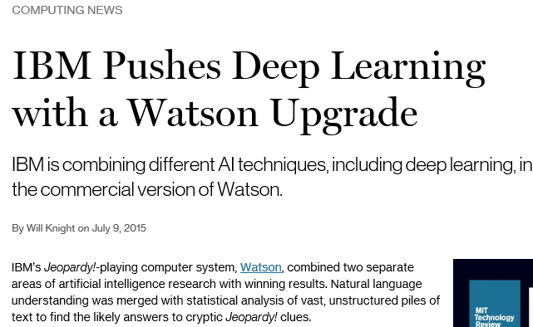
More Recent Media Hype

Slide 9
OpenAI (http://abcnews.go.com/Technology/profit-prevent-robot-apocalypse/story?id=35757070
Announced Dec 11/12, 2015
Final days of NIPS
Research Director Ilya
Gave final talk at NIPS WS
10 employees at NIPS
All in deep learning
~$1B; open IP, open pub.

Slide 10
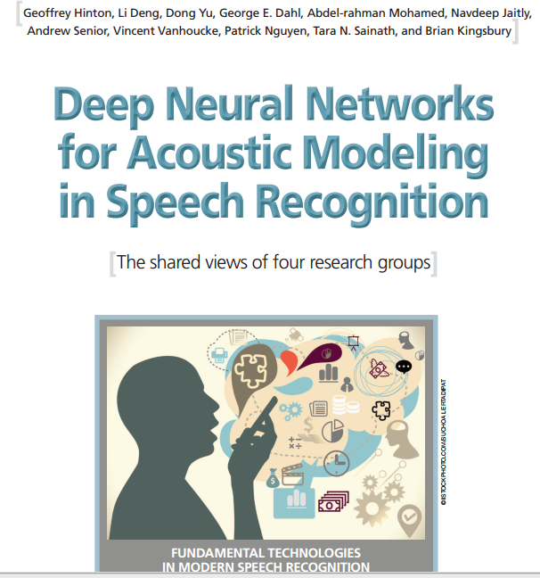
In Academic World
“This joint paper from the major speech recognition laboratories was the first major industrial application of deep learning.”

Slide 11
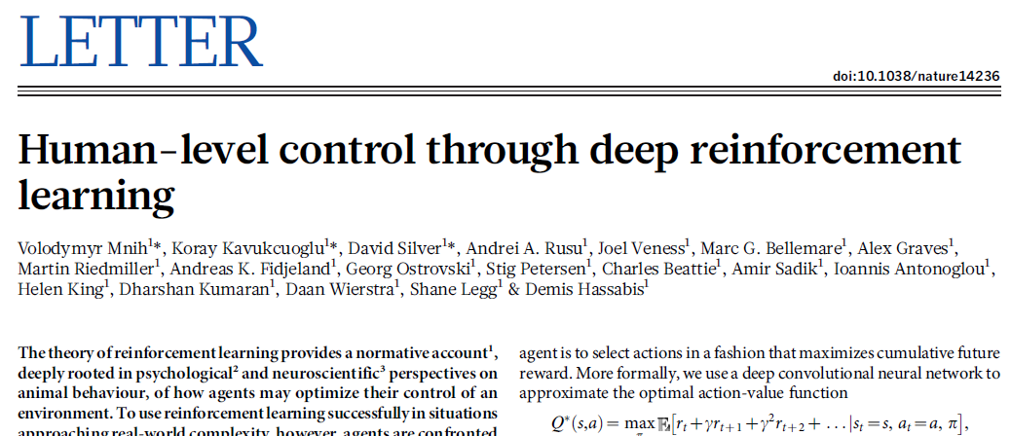

Slide 12
Outline
Deep learning rising in industry:
Speech recognition & translation (2010+)
Deep image recognition & computer vision (2012+)
Deep language processing; example applications (2014+)
Key Issues and Future of Deep Learning

Slide 13
The Rise of Deep Learning in Industry
--- Started with Deep Speech Recognition (since 2010)
& a successful application example: Microsoft Skype Translator

Slide 14
Notes:
Long story how we three got into organizing this WS; Waterloo; NIPS 2008

Slide 15
2015
2009

Slide 16
Invitee 1: give me one week to decide …,…
Not worth my time to fly to Vancouver for this…
Notes:
Several in the audience attended and gave invited talks at workshop (“deep speech recognition” is born; inroad of Deep learning into ASR)
In planning this workshop, GH and I were looking at who to invite.
Remember a very well-known person (nameless now) in all NN, deep generative model, and ASR, declined (something like “give me one week to think whether it is worth my time to travel to Whistler”); one week later, answer is “no”. Other invitees who declined --- “crazy idea of using waveform for ASR, like using photons for image recognition” (now we have a good paper at Interspeech-2014, Hermann Ney’s group, on this “crazy idea”)

Slide 17
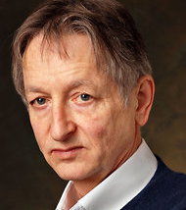
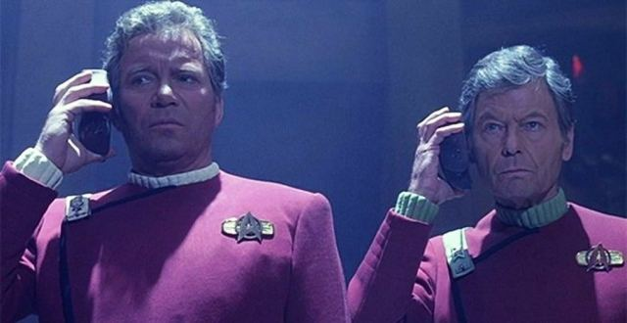
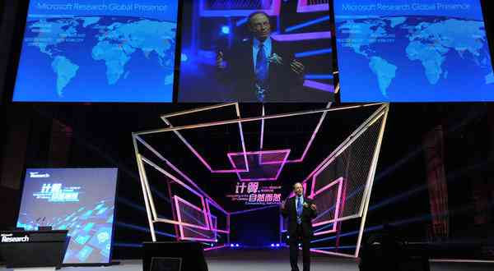
The Universal
Translator …
comes true!
Scientists See Promise in Deep-Learning Programs
John Markoff
November 23, 2012
Tianjin, China, October, 25, 2012
Deep learning
technology enabled
speech-to-speech
translation
A voice recognition program translated a speech given by
Richard F. Rashid, Microsoft’s top scientist, into Mandarin Chinese.

Slide 18
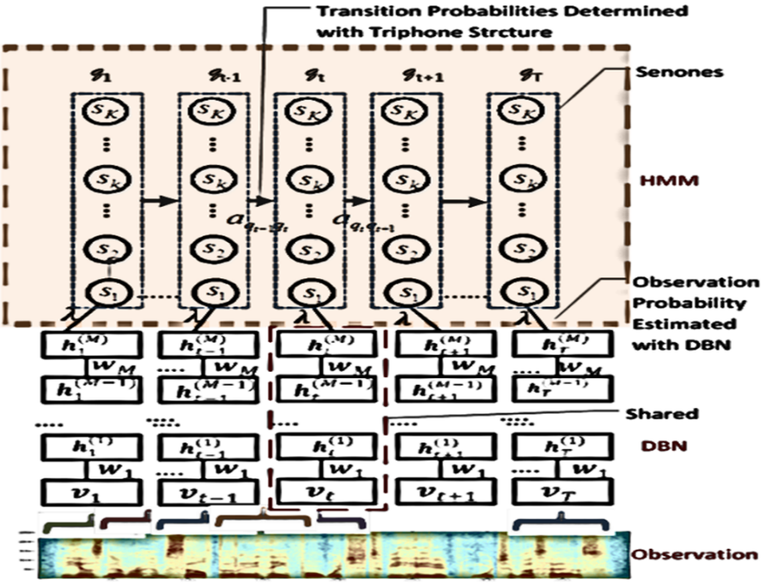
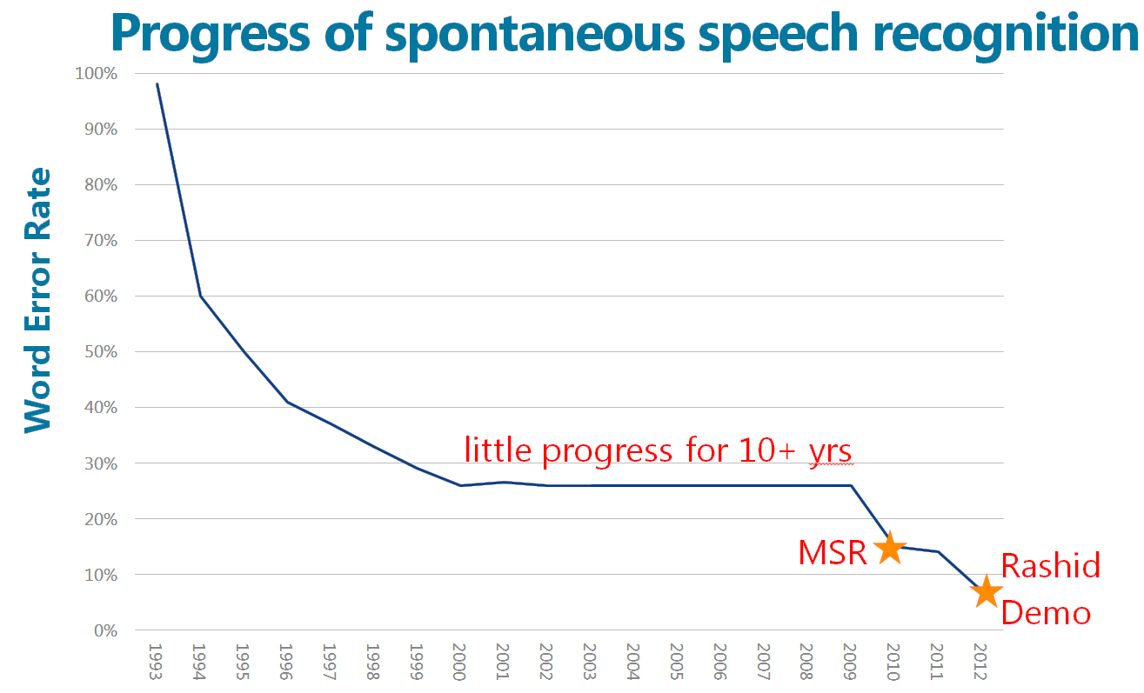
IEEE Trans. Audio. Speech, and Language Processing. 2012
CD-DNN-HMM invented at MSR, 2010

Slide 19
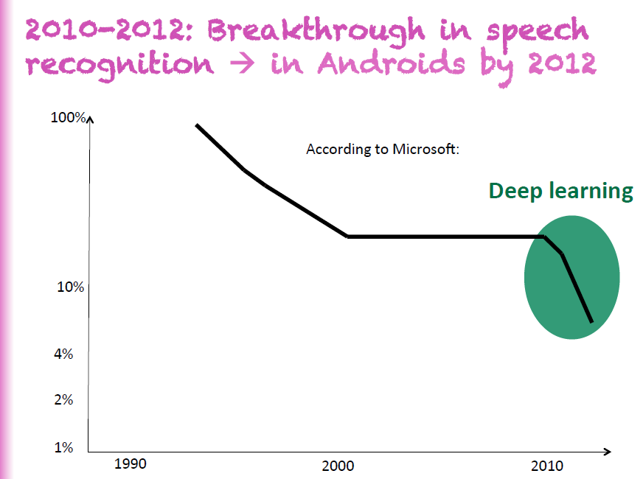
Slide from Yoshua Bengio, 2015

Slide 20
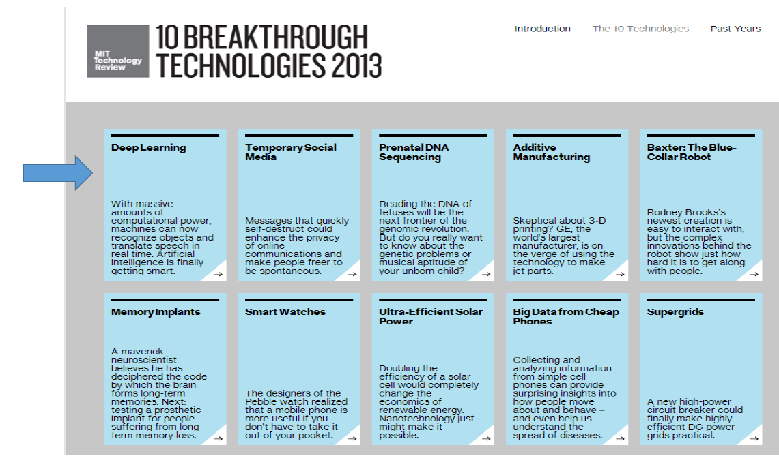

Slide 21
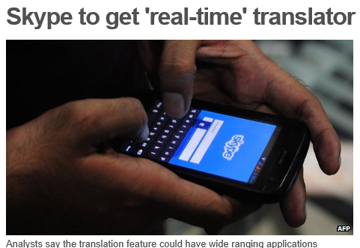
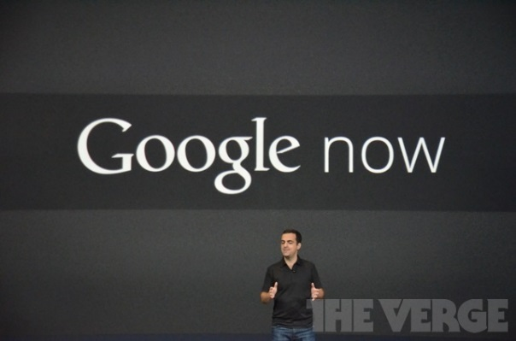
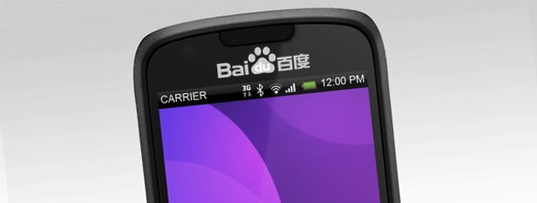
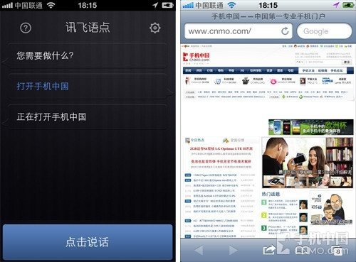
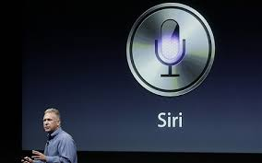
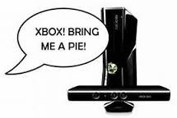
Across-the-Board Deployment of DNN in Speech Industry
(+ university labs & DARPA programs)

Slide 22
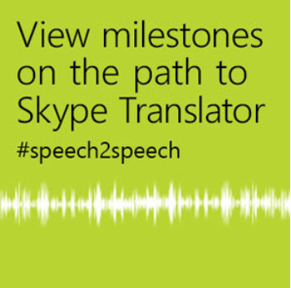
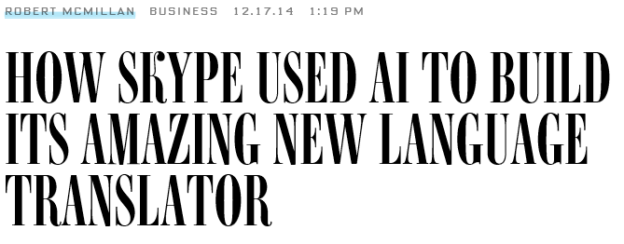
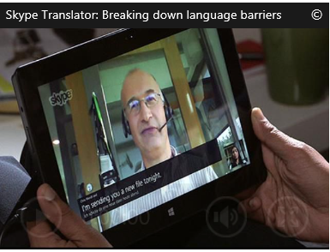
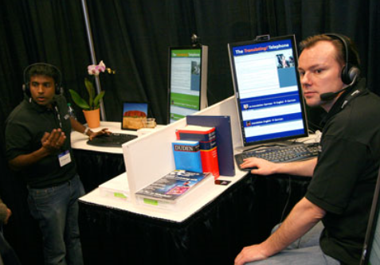
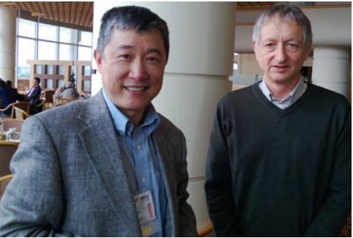

Slide 23
Deep Learning also Shattered the Entire Field of
Image Recognition and Computer Vision
(since 2012)

Slide 24
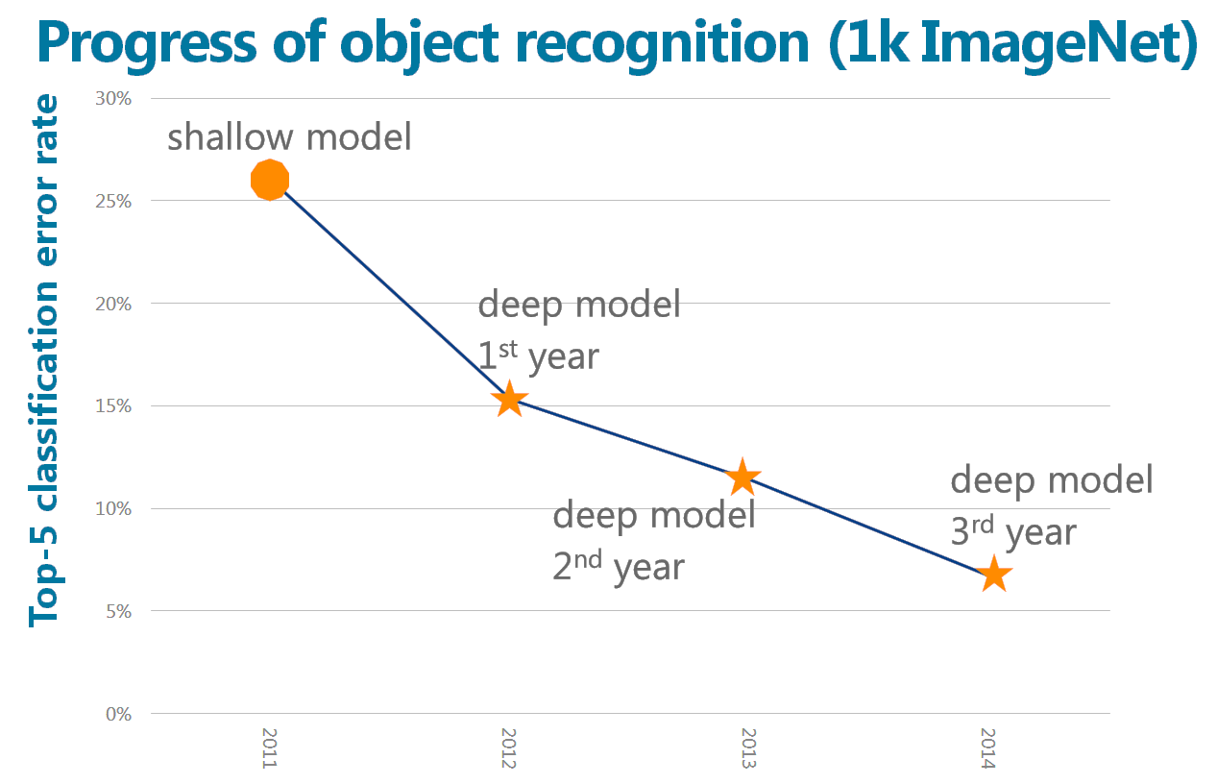
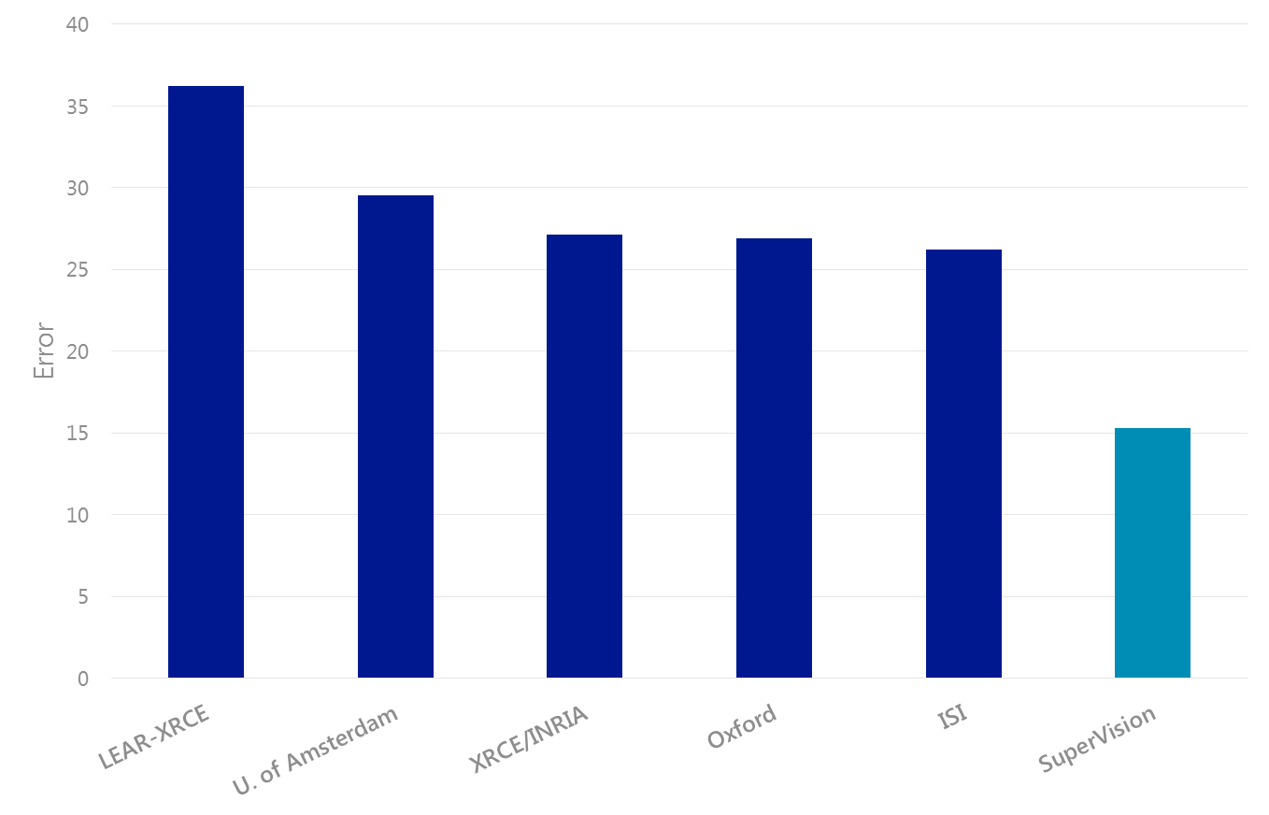
ImageNet Competition
Krizhevsky et al., “ImageNet Classification with Deep Convolutional Neural Networks.” NIPS, Dec. 2012
GoogLeNet 6.67%
Presented @ NIPS 2012
4.94%
3.57%
2012 - 2015
Deep CNN
Univ. Toronto team
Top-5 classification error rate
?

Slide 25
ImageNet Competition
4th year
Announced
Dec.2015
3.567%
3.581%
2012 - 2015
very deep: 152 layers

Slide 26
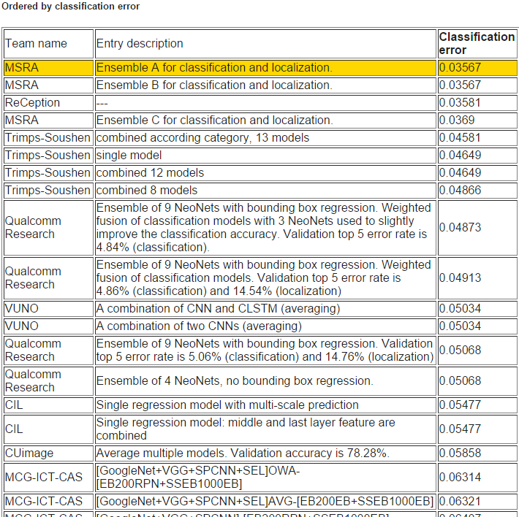
http://image-net.org/challenges/LSVRC/2015/results

Slide 27
Deep Language Processing with Semantic Modeling
--- A revolution undergoing (Google, Microsoft, FB, Baidu…OpenAI?)
--- Rapid progress over past 2 years
--- Some selected Applications next

Slide 28
Deep Structured Semantic Model (DSSM)
Build word/phrase, or sentence-level semantic vector representation
Trained by a similarity-driven objective
projecting semantically similar phrases to vectors close to each other
projecting semantically different phrases to vectors far apart

Slide 29
DSSM for learning semantic embedding
Initialization:
Neural networks are initialized with random weights
Semantic vector
$$v_{s}$$
$$v_{t^{+}}$$
$$v_{t^{−}}$$
d=300
d=300
d=300
W₄
d=500
d=500
d=500
W₃
Letter-trigram embedding matrix
d=500
d=500
d=500
W₂
Letter-trigram encoding
matrix (fixed)
dim = 50K
dim = 50K
dim = 50K
W₁
Bag-of-words vector
dim = 100M
dim = 100M
dim = 100M
Input word/phrase
s: “racing car”
t⁺: “formula one”
t ⁻: “racing to me”

Slide 30
DSSM for learning semantic embedding
Training:
Compute Cosine similarity between semantic vectors
Compute
gradients
$${∂\frac{exp⁡(cos\left(v_{s },v_{t^{+}}\right))}{\sum_{t^{′}=\{t^{+},t^{−}\}}{exp⁡(cos\left(v_{s },v_{t^{′}}\right))}}}/{∂W}$$
$$cos⁡(v_{s},v_{t^{+}})$$
$$cos⁡(v_{s},v_{t^{−}})$$
Semantic vector
$$v_{s}$$
$$v_{t^{+}}$$
$$v_{t^{−}}$$
d=300
d=300
d=300
W₄
d=500
d=500
d=500
W₃
Letter-trigram embedding matrix
d=500
d=500
d=500
W₂
Letter-trigram encoding
matrix (fixed)
dim = 50K
dim = 50K
dim = 50K
W₁
Bag-of-words vector
dim = 100M
dim = 100M
dim = 100M
Input word/phrase
s: “racing car”
t⁺: “formula one”
t ⁻: “racing to me”

Slide 31
DSSM for learning semantic embedding
Runtime:
similar
apart
Semantic vector
$$v_{s}$$
$$v_{t1}$$
$$v_{t2}$$
d=300
d=300
d=300
W_{s,4}
W_{t,4}
W_{t,4}
d=500
d=500
d=500
W_{s,3}
W_{t,3}
W_{t,3}
Letter-trigram embedding matrix
d=500
d=500
d=500
W_{s,2}
W_{t,2}
W_{t,2}
Letter-trigram encoding
matrix (fixed)
dim = 50K
dim = 50K
dim = 50K
W_{s,1}
W_{t,1}
W_{t,1}
Bag-of-words vector
dim = 100M
dim = 100M
dim = 100M
Input word/phrase
s: “racing car”
t1: “formula one”
t2: “racing to me”

Slide 32
Many applications of DSSM (many low-hanging fruits): Learning semantic similarity between X and Y
Tasks | Source X | Target Y
Word semantic embedding | context | word
Web search | search query | web documents
Query intent detection | Search query | Use intent
Question answering | pattern / mention (in NL) | relation / entity (in KB)
Machine translation | sentence in language a | translated sentences in language b
Query auto-suggestion | Search query | Suggested query
Query auto-completion | Partial search query | Completed query
Apps recommendation | User profile | recommended Apps
Distillation of survey feedbacks | Feedbacks in text | Relevant feedbacks
Automatic image captioning | image | text caption
Image retrieval | text query | images
Natural user interface | command (text / speech / gesture) | actions
Ads selection | search query | ad keywords
Ads click prediction | search query | ad documents
Email analysis: people prediction | Email content | Recipients, senders
Email search | Search query | Email content
Email declutering | Email contents | Email contents in similar threads
Knowledge-base construction | entity from source | entity fitting desired relationship
Contextual entity search | key phrase / context | entity / its corresponding page
Automatic highlighting | documents in reading | key phrases to be highlighted
Text summarization | long text | summarized short text

Slide 33
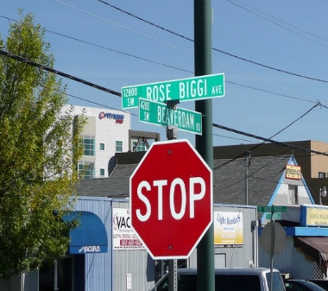
Automatic image captioning (MSR system)
Detector Models,
Deep Neural Net Features, …
street
signs
Computer Vision
System
light
under
on
pole
stop
red
building
sign
bus
city
traffic
Language Model
Caption Generation System
a red stop sign sitting under a traffic light on a city street
a stop sign at an intersection on a street
a stop sign with two street signs on a pole on a sidewalk
a stop sign at an intersection on a city street
…
a stop sign
a red traffic light
a stop sign at an intersection on a city street
DSSM Model
Semantic Ranking System
Fang, Gupta, Iandola, Srivastava, Deng, Dollar, Gao, He, Mitchell, Platt, Zitnick, Zweig, “From captions to visual concepts and back,” accepted to appear in CVPR, 2015; in arXiv 2014

Slide 34
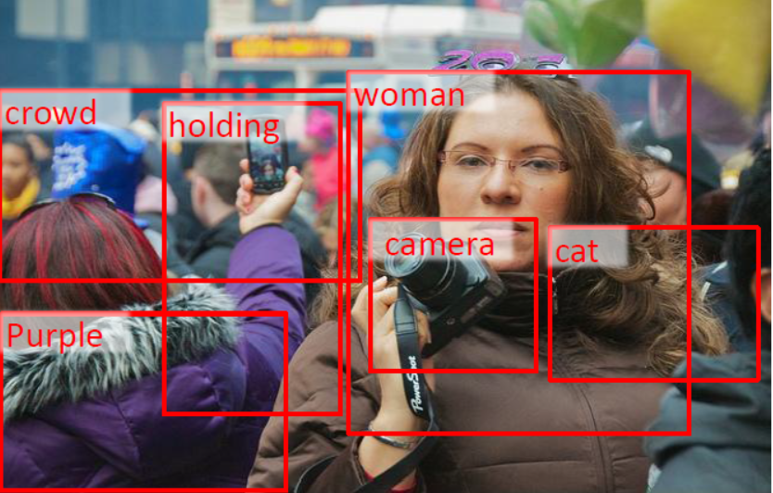
Microsoft System (MSR):
Use of DSSM for Global Semantic Matching

Slide 35
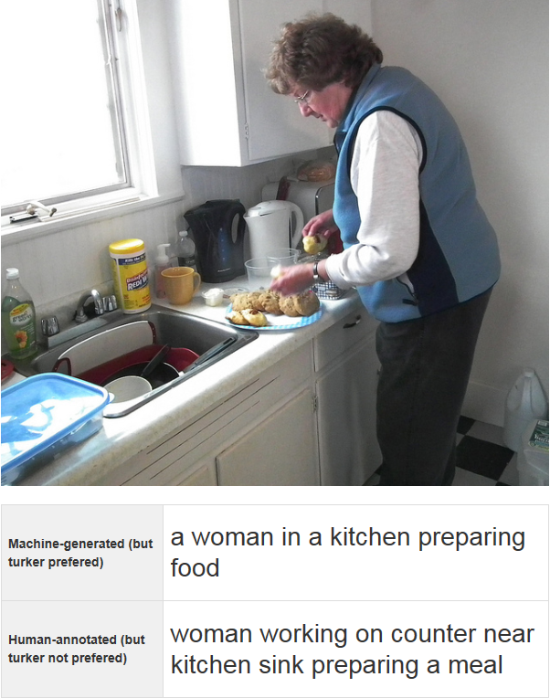
A
B

Slide 36
Machine:
Human:

Slide 37
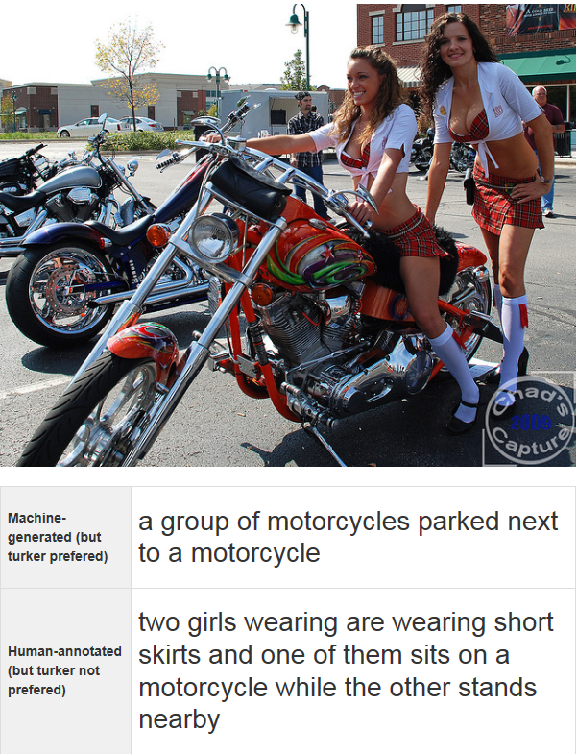
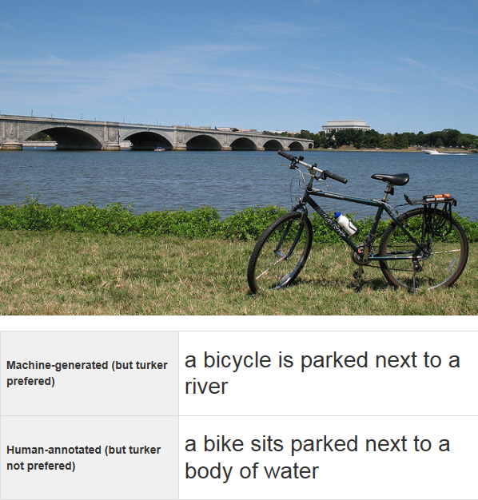
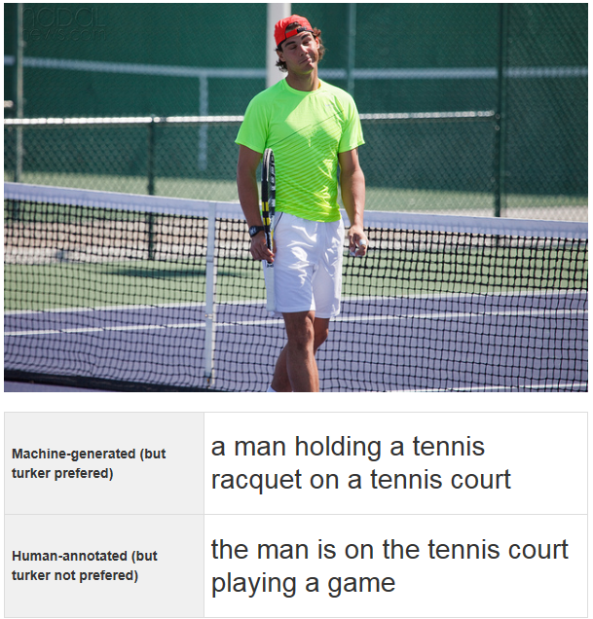
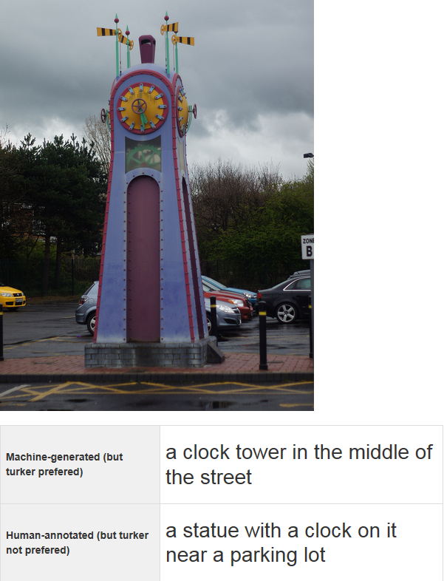

Slide 38
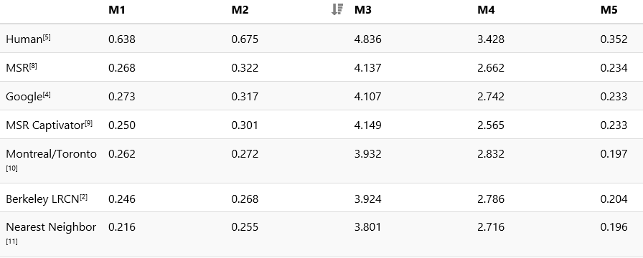
Competition results (CVPR-2015, June, Boston)

Slide 39
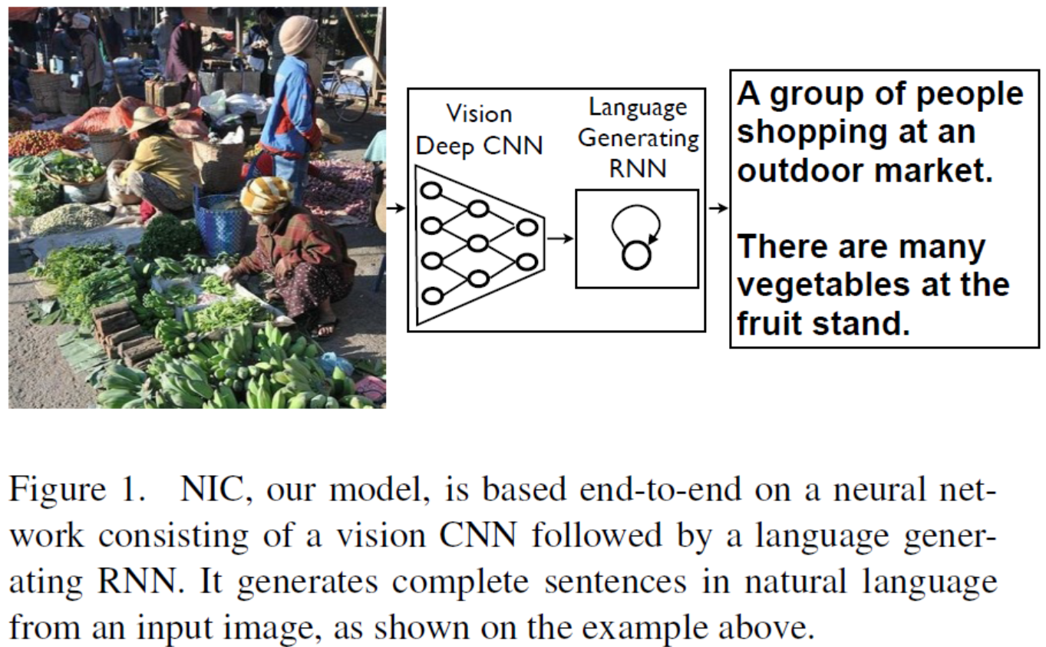
Google System: two-stage approach

Slide 40
Many applications of DSSM (many low-hanging fruits): Learning semantic similarity between X and Y
Tasks | Source X | Target Y
Word semantic embedding | context | word
Web search | search query | web documents
Query intent detection | Search query | Use intent
Question answering | pattern / mention (in NL) | relation / entity (in KB)
Machine translation | sentence in language a | translated sentences in language b
Query auto-suggestion | Search query | Suggested query
Query auto-completion | Partial search query | Completed query
Apps recommendation | User profile | recommended Apps
Distillation of survey feedbacks | Feedbacks in text | Relevant feedbacks
Automatic image captioning | image | text caption
Image retrieval | text query | images
Natural user interface | command (text / speech / gesture) | actions
Ads selection | search query | ad keywords
Ads click prediction | search query | ad documents
Email analysis: people prediction | Email content | Recipients, senders
Email search | Search query | Email content
Email declutering | Email contents | Email contents in similar threads
Knowledge-base construction | entity from source | entity fitting desired relationship
Contextual entity search | key phrase / context | entity / its corresponding page
Automatic highlighting | documents in reading | key phrases to be highlighted
Text summarization | long text | summarized short text

Slide 41
http://blogs.bing.com/search/2014/12/10/bing-brings-the-worlds-knowledge-straight-to-you-with-insights-for-office/

Slide 42
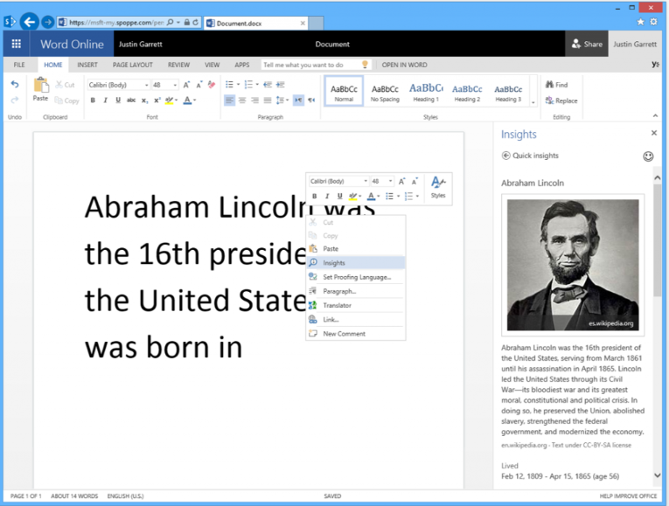
Scenario: Contextual search in Microsoft Office/Word
When “Lincoln” is selected, pages of a car company, movie, or the town in Nebraska will not appear

Slide 43
Summary
Speech recognition is the first success example of deep learning at industry scale
Deep learning is very effective in speech recognition, speech translation (Skype Translator), image recognition (Onedrive Image tagging), image captioning, language understanding (Cortana), semantic intelligence, multimodal and multitask learning, web search, advertising, entity search (Insights for MS Office), user and business activity prediction, etc.
Enabling factors:
Big datasets for training deep models
Powerful GPGPU computing
Innovations in deep learning architectures and algorithms
How to discover distant supervision signals free from human labeling
How to build deep learning systems grounded on exploiting such “smart” signals (example: DSSM)

Slide 44
Issues for “Near” Future of Deep Learning
For perceptual tasks (e.g. speech, image, video, gesture, etc.)
With supervised data: what will be the limit for growing accuracy wrt increasing amounts of labeled data?
Beyond this limit or when labeled data are exhausted or non-economical to collect, will novel and effective unsupervised deep learning emerge and what will they be (e.g. deep generative models)?
For cognitive tasks (e.g. natural language, reasoning, knowledge, etc.)
Will supervised deep learning (e.g. MT) beat the non-deep-learning state of the arts like speech/image recognition?
How to distill/exploit “distant” supervision signals for supervised deep learning (e.g. DSSM: already got many low-hanging fruits)?
Will dense vector embedding with distributed representations be sufficient for language? Do we need to directly encode and recover syntactic/semantic structure of language?
For big-data analytics tasks
Is vector-embedding of business activities, people, and events the right approach?
Should the embedding methods be different from those for language?
What are the most effective “distant” supervision signals to exploit for data-analytics tasks?
Data privacy issue; the needs for encryption before deep learning and for decryption after deep learning?

Slide 45
The Future of Deep Learning
Continue rapid progress in language processing methods and applications by both industry and academia
From image to video processing
From supervised learning (huge success) to unsupervised learning (not much success; ideas abound)
From perception to cognition
More exploration of attention modeling
Combine representation learning with complex reasoning
Modeling human memory functionality
Learning to act and control (deep reinforcement learning)

