Slide 1
* equal contribution
Notes:
SS-L11.1 16:30 - 16:50 https://cmsworkshops.com/ICASSP2024/view_paper.php?PaperNum=10374#top

Slide 2
General motivation of Speech-LLM
Contributions in this paper
A unified framework for various existing speech tasks
Transfer textual knowledge, emergent and in-context learning ability from LLM
SALM which performs multi-task speech-text language modeling in a unified LLM framework
Equip speech-to-text models with zero-shot in-context learning (ICL) ability for the first time, demonstrated by keyword boosting
Propose speech supervised in-context training to further boost ICL ability of speech models.

Slide 3
Related works
Deep integration between speech models and LLMs
Previous works include SpeechGPT, AudioPaLM, LTU, Speech-LLaMA, etc.
This work shares similar architectures as Speech-LLaMA, concatenating speech and text embeddings as GPT inputs
In-context learning (ICL) for speech
Most previous works focus on the text-to-speech models, e.g. VALL-E and Voicebox
This work extends ICL to speech-to-text models
Keyword boosting / contextualization for speech
Previous works require external context biasing graphs or learning explicit model weights for boosted words, e.g. WFSTs based biasing or CLAS and variants

Slide 4
Architecture and multitask instruction tuning

Slide 5
Architecture Details
Audio encoder (trainable):
Pretrained fast conformers (stt_en_fastconformer_transducer_large )
Modality adapter (trainable):
2-layer fast conformer
LLM (frozen+LoRA):
2B internal Supervised Fine-Tuning LLM
*
*
* Publically accessible through https://catalog.ngc.nvidia.com/orgs/nvidia/teams/nemo/models/stt_en_fastconformer_transducer_large
* We released a pretrained SALM checkpoint using llama2-chat separately

Slide 6
In-context learning (ICL) for speech
In-context learning is one of the biggest breakthrough from LLMs: Predict labels for unseen inputs without additional parameter updates
Most previous speech ICL works focus on the text-to-speech models: Synthesize high-quality speech for unseen speakers without fine-tuning
We define ICL for speech-to-text models: Take keyword boosting as the proxy, learn the boosted words from the prompting text context, without back-propagation
Distinction to previous keyword boosting: No explicit keyword weights during training (CLAS) or external biasing graphs (WFST)

Slide 7
In-context learning for speech-to-text models
Supervised in-context training for speech

Slide 8
Experimental setup
Data
ASR training data: 1K hours LibriSpeech
AST training data: 5K hours English audio from Offline Track of IWSLT 2023 paired with pseudo-generated translations to German and Japanese
2B internal LLM was pretrained on 1.1T tokens and supervised fine-tuned with public dataset.
Recipe
Global batch size of 64
3 epochs using the Adam optimizer
Learning rate of 1e-4 and weight decay of 1e-3
Used 8 A100 GPUs
Inference with greedy decoding by default
128-dimensional LoRA
See later slides for pretrained checkpoint release
Notes:
Make a speaker switch here

Slide 9
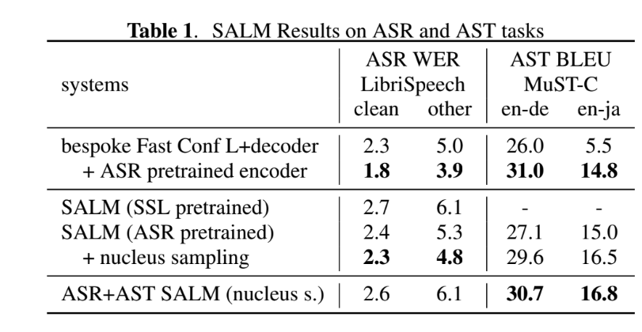
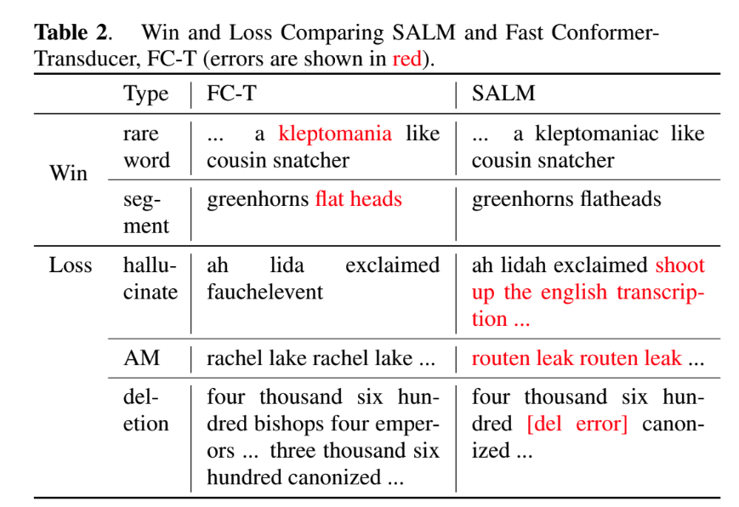
Result: general ASR and AST tasks
*
Comparable performance as separate ASR and AST strong baselines
* We found nucleus sampling (t = 0.2, p = 0.95, k = 50) can deliver better results than the default greedy decoding

Slide 10
In-context Learning (ICL) for keyword boosting
Evaluate LibriSpeech trained models on NVIDIA GTC talks data
Keywords: words and phrases with high occurrences in GTC test set and low recognition accuracy, e.g. NVIDIA, GPU, Omniverse, Geforce, NeMo, etc.
Evaluation: precision, recall, and F-score on keywords
Baseline boosting: WFST shallow-fusion with MAES algorithm
*
* Kim J, Lee Y, Kim E. Accelerating RNN transducer inference via adaptive expansion search. IEEE Signal Processing Letters. 2020 Nov 6;27:2019-23.

Slide 11
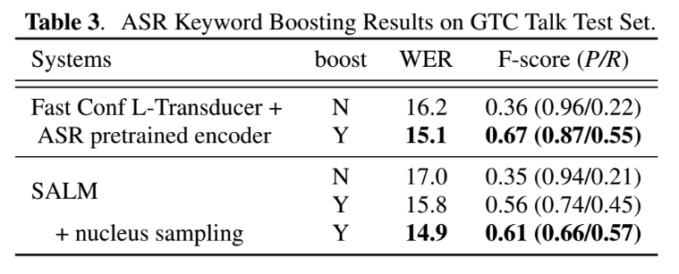
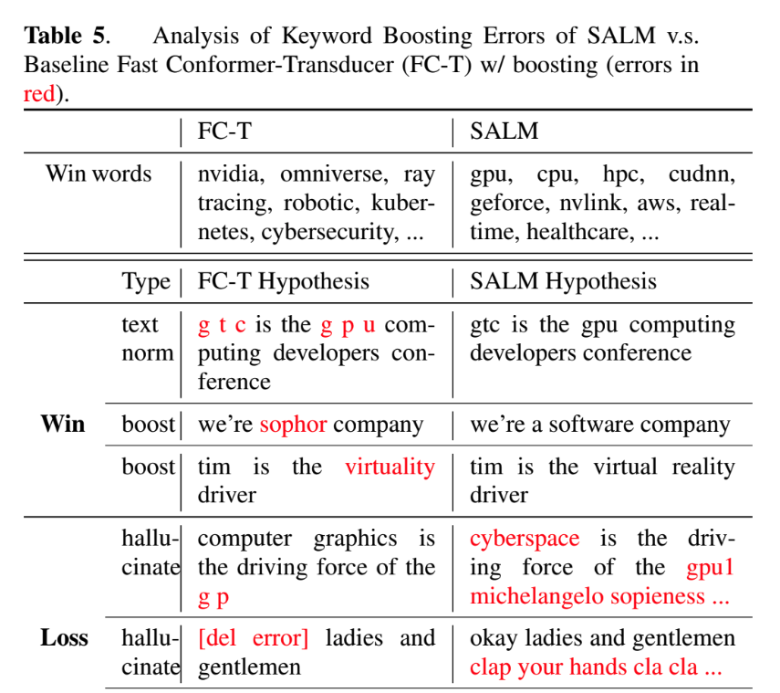
Result: keyword boosting by In-context learning
*
Similar relative gains from contextualization as the WFST method
* We found nucleus sampling (t = 0.2, p = 0.95, k = 50) can deliver better results than the default greedy decoding

Slide 12
Result: Initial keyword boosting study in AST
Unified In-context learning based solution for ASR and AST

Slide 13
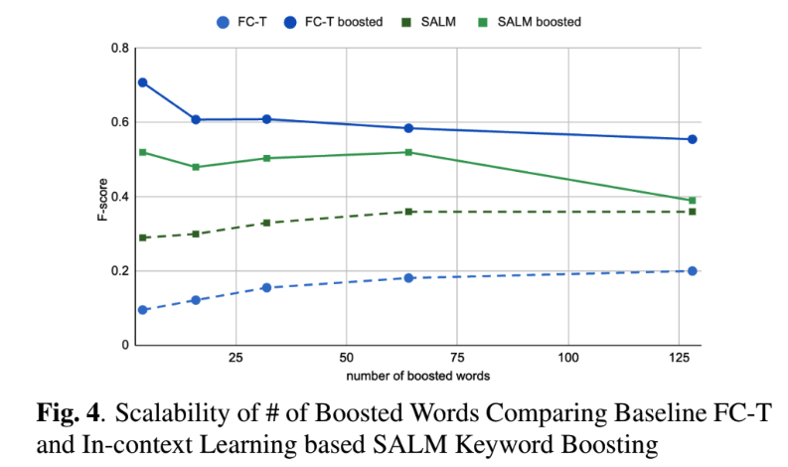
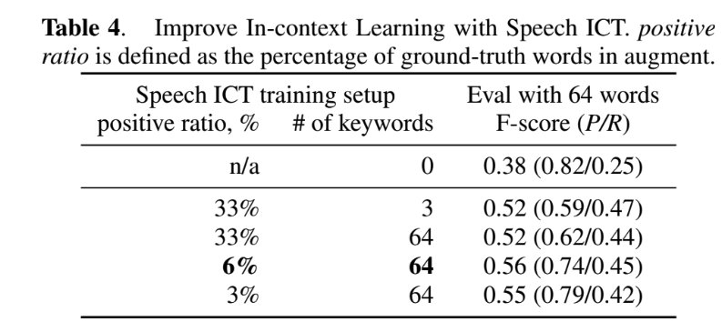
Ablation: necessity of speech supervised in-context training
Supervised in-context training is necessary
Scalability is still a problem needs to be solved

Slide 14
Conclusion
We introduce the open-source Speech-LLM work, called SALM
Multitask speech processing for ASR and AST
Demonstrate In-context Learning ability on speech-to-text model and further improve on it
Result
SALM performs on par with bespoke Conformer baselines in ASR and AST
In-context learning obtains similar relative gains from contextualization as the WFST method
Open-source
The training and inference code is released in NeMo (with model parallelism, 7B SALM can train on 32GB V100)
Pretrained SALM checkpoint is released in NGC
Keyword boosting testset about GTC talks (coming soon)

Slide 15
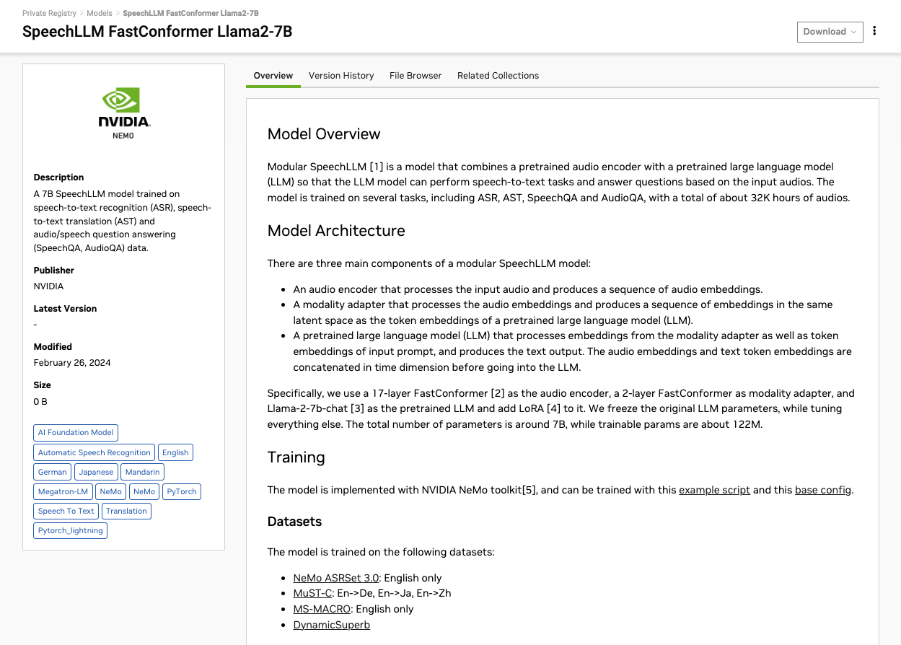
Notes:
Code and checkpoint release
https://registry.ngc.nvidia.com/orgs/nvstaging/teams/nemo/models/speechllm_fc_llama2_7b

Slide 16
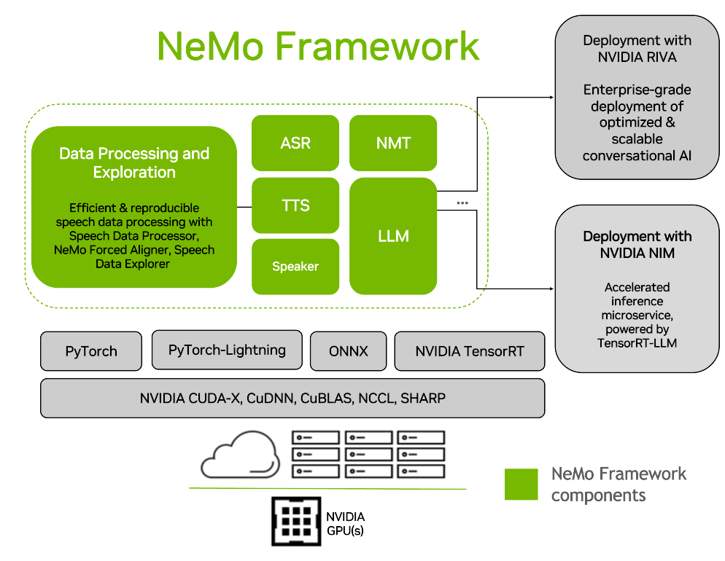
NeMo Open-source Toolkit and Framework
Conversational AI & LLMs​ toolkit
Code (Apache 2.0): github.com/NVIDIA/NeMo ​
Consistent interface for ASR, TTS, LLM, …
Release pretrained models
NVIDIA NGC and HuggingFace ​
Training is with PyTorch Lightning​
Scale to 1000+ GPUs​
LLM domain leverages NVIDIA Megatron ​
Scale up to 1 trillion parameter models​
Notes:
Speech AI Demystified GTC Spring 2024.pptx

Slide 17
Coming works

