Slide 1
Cross-component Sample Adaptive Offset
Kwai Inc.
Che-Wei Kuo, Xiaoyu Xiu, Yi-Wen Chen, Hong-Jheng Jhu, Wei Chen,
Ning Yan, and Xianglin Wang

Slide 2
Outline
Introduction
Cross-component Sample Adaptive Offset
Decoding Process
Encoding Algorithm
Complexity Analysis
Experimental Results
Conclusion
Related Work and References

Slide 3
Introduction
Finalized in July 2020, VVC provides 40% BD-rate savings over HEVC
Recently, JVET started to explore new coding technologies for future video coding standard development
Published in January 2021, ECM demonstrated 12% BD-rate savings over VTM [4]
In VVC/ECM, in-loop filters are applied to reduce artifacts caused by block partitioning and quantization process
LMCS/DBF/SAO/ALF/CCALF
Block discontinuities, ringing artifacts, texture/edge smoothing
Efficiently improve video quality, but correlations among different color components are not fully exploited

Slide 4
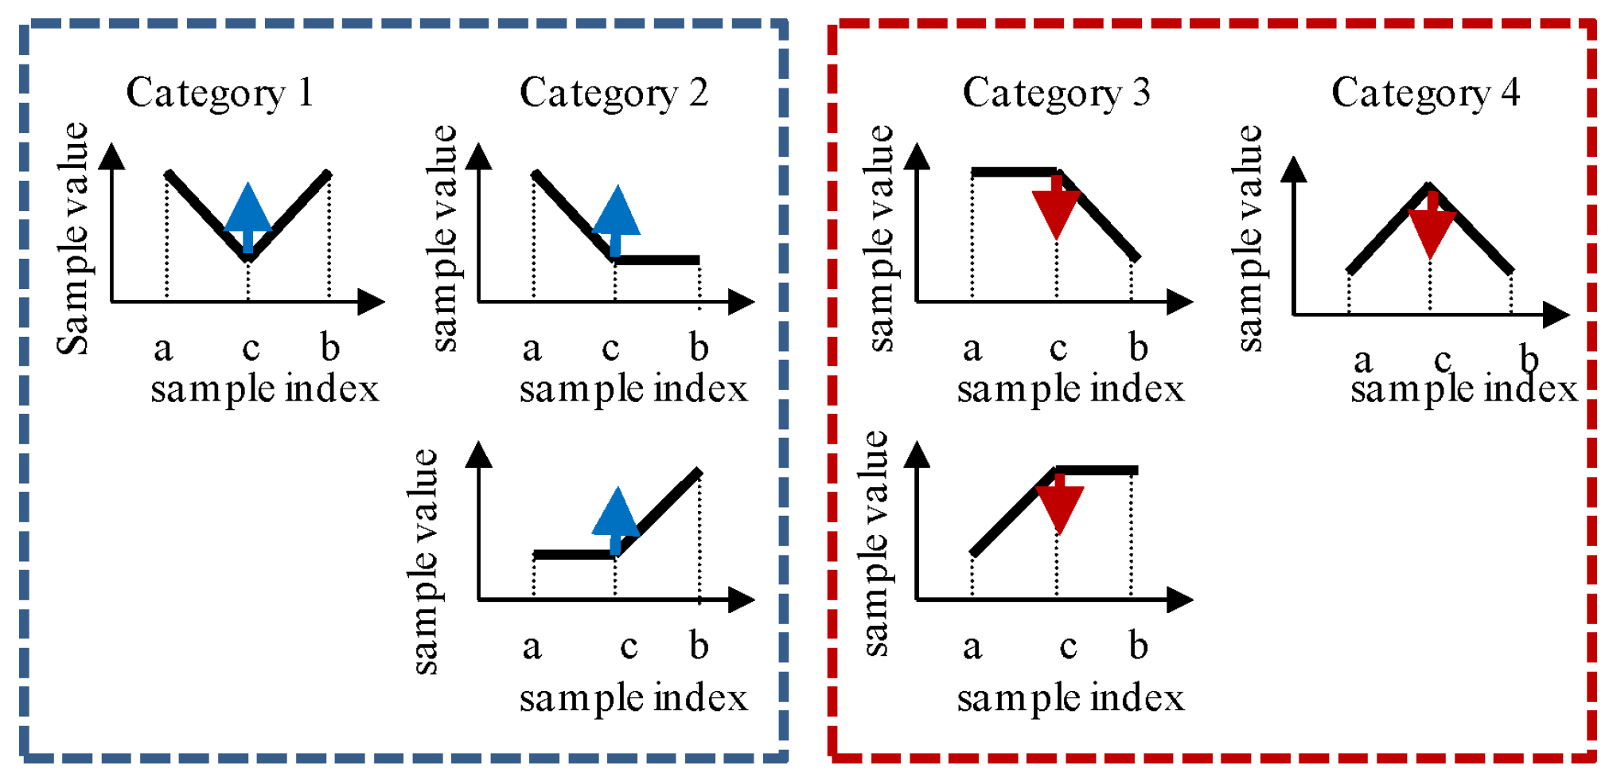
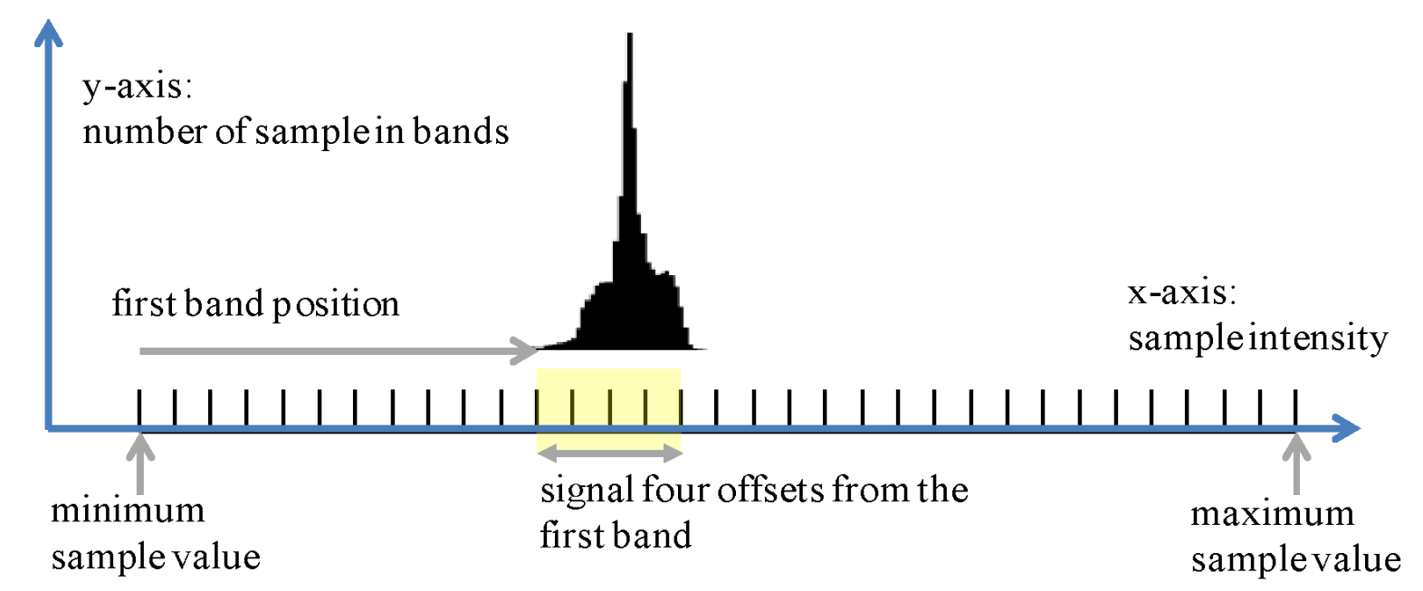
Introduction
SAO in HEVC/VVC/ECM [7]
Classifies reconstructed samples into multiple categories
For each category, one offset is derived at encoder and explicitly signaled
EO removes ringing artifacts near sharp transitions
BO alleviates the mean deviation occurs during the coding process
Only uses samples in one component for classification, without considering the strong correlation between different channels

Slide 5
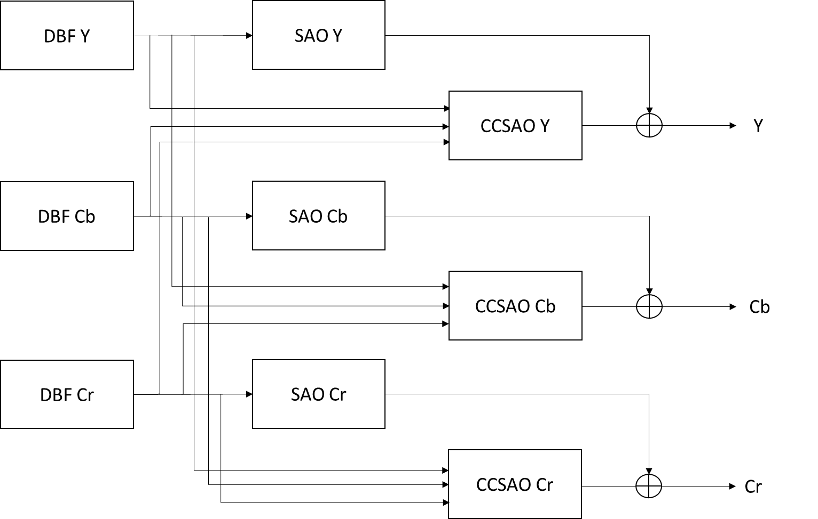
Cross-component Sample Adaptive Offset
Utilizes all three components to classify the sample in one component
At encoder, one offset is derived and explicitly signaled for each category
Compensate the distortion between reconstructed and original samples
Uses output samples from the de-blocking filter for classification
Parallel processing between SAO and CCSAO

Slide 6
Classification
E.g., current sample is a choma U sample located at , three component samples are used to classify it
4
4
4
4
$$\begin{aligned}{band}_{Y}=\left(Y_{col}∙N_{Y}\right)≫BD \\ {band}_{U}=\left(U_{col}∙N_{U}\right)≫BD \\ {band}_{V}=\left(V_{col}∙N_{V}\right)≫BD \\ i={band}_{Y}{∙\left(N_{U}∙N_{V}\right)+band}_{U}{{∙N}_{V}+band}_{V} \\ {C′}_{rec}=Clip1\left(C_{rec}+σ_{CCSAO}\left[i\right]\right)\end{aligned}$$
$Y_{col}$, $U_{col}$, $V_{col}$
$N_{Y}$, $N_{U}$, $N_{V}$
BD
$C_{rec}$, $C_{rec}^{′}$
$σ_{CCSAO}\left[i\right]$
collocated three component samples used to classify the current sample
numbers of equally divided bands applied to {$Y_{col}$, $U_{col}$, $V_{col}$} full range
internal coding bit-depth
reconstruction samples before/after CCSAO
i-th BO category CCSAO offset

Slide 7
CTB-level Classifier Switch
Pic Height
Pic Width
Different classifiers for different local regions
Parameters for each classifier are signaled in frame level
Position of $Y_{col}$ which can be chosen from 9 candidates
Maximum of {$N_{Y}$, $N_{U}$, $N_{V}$} is set to {16, 4, 4}
Offsets are constrained to be within the range [-15, 15]
Which classifier to be used is explicitly signaled and switched in CTB level
Maximum classifiers per frame is constrained to be 4

Slide 8
Encoding Algorithm
$$N_{Y}∙N_{U}∙N_{V}$$
8
16
32
64
Fast Classifier Selection with Early Termination
Early terminate R-D processes of the classifiers with more sample categories
Skip if $N_{Y}$ < $N_{U}$, $N_{V}$, or $N_{Y}∙N_{U}∙N_{V}$ > 64
Iterative Offset Derivation
Derive one initial offset for each category by fast distortion estimation [7]
Iteratively test smaller offsets, select the offset with minimum R-D cost
Select CTB samples where R-D cost is improved by CCSAO to refine the offsets
Repeat CTB-based offset derivation process until no further R-D improvement
$$∆D=D_{post}−D_{pre}=Nh^{2}−2hE$$
$∆J=∆D+λ∆$R

Slide 9
Robust Classifier Derivation
Adaptively determine the number of classifiers for each frame
Determine one classifier, sort the distortion of CCSAO CTBs
Exclude ½ CTBs with small distortion, derive a new classifier for ½ CTBs
Re-allocate classifier for each CTB, iteratively derive offsets for all classifiers
Increase the number of classifiers until no further R-D improvement
Pic Height
Pic Width

Slide 10
Complexity Analysis
Computational Operations
Per sample 3 multiplications, 3 shifts, 1 addition, 1 clip (single clip after SAO/CCSAO)
Calculation of the joint index $i$ may be implemented in different ways:
one example only involves simple wiring to access the $i$-th offset
Memory Usage
CCSAO offsets per frame: 16*4*4*4*5 bits=640 Bytes
$$\begin{aligned}{band}_{Y}=\left(Y_{col}∙N_{Y}\right)≫BD \\ {band}_{U}=\left(U_{col}∙N_{U}\right)≫BD \\ {band}_{V}=\left(V_{col}∙N_{V}\right)≫BD \\ i={band}_{Y}{∙\left(N_{U}∙N_{V}\right)+band}_{U}{{∙N}_{V}+band}_{V} \\ {C′}_{rec}=Clip1\left(C_{rec}+σ_{CCSAO}\left[i\right]\right)\end{aligned}$$
$$\left.i={\left(band\right.}_{Y}{≪6) | (band}_{U}{≪4) | (band}_{V}≪2\right)$$

Slide 11
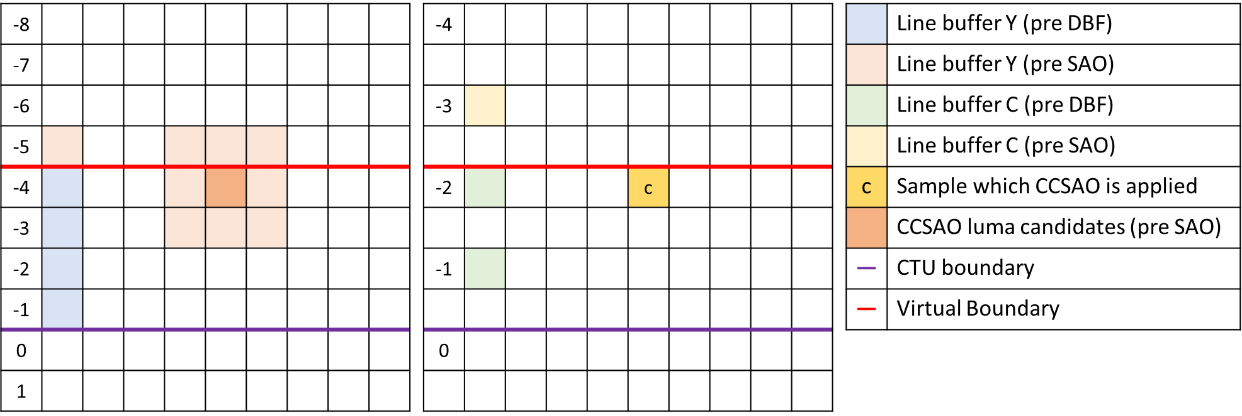
Line Buffer Requirement
Line buffer storage for in-loop filters in VVC (luma example)
DBF across CTU boundary: process at the below CTU row, buffer 4 row samples of the above CTU row
SAO needs one extra row of samples before SAO, to process row -4 SAO (since -3 may be modified by DBF)
ALF does not increase line buffers by applying padding for samples above VBs [14]
CCSAO does not need any extra line buffer storage
E.g., for chroma sample “c”, all 9 collocated luma samples and 2 collocated/current chroma samples are available either in the line buffer or in the current CTU row

Slide 12
Experimental Results
Implemented on top of ECM-1.0 [4] with simulations conducted on test sequences defined in the JVET common test conditions (CTC)
Encoding/decoding time can be further optimized by SIMD
 |  | All Intra |  |  | Random Access |  |  | Low Delay B
 |  | Y | U | V | Y | U | V | Y | U | V
Class Summary | Class A1 | 0.03% | -0.89% | -1.43% | -0.37% | -2.15% | -4.25%
 | Class A2 | 0.05% | -1.69% | -0.28% | 0.09% | -2.52% | -1.36%
 | Class B | 0.14% | -2.30% | -3.16% | 0.11% | -4.51% | -5.01% | -0.24% | -11.74% | -11.40%
 | Class C | 0.12% | -1.27% | -1.24% | 0.05% | -2.22% | -2.00% | 0.06% | -5.96% | -5.11%
 | Class D | 0.06% | -0.93% | -0.59% | 0.05% | -1.87% | -1.45% | 0.16% | -6.25% | -5.04%
 | Class E | 0.11% | -1.12% | -1.82% |  |  |  | -0.18% | -2.94% | -6.82%
 | Class F | -0.11% | -1.97% | -2.37% | -0.23% | -2.87% | -2.95% | 0.00% | -7.46% | -7.04%
 | Calss TGM | -0.76% | -1.45% | -1.44% | -1.15% | -3.03% | -3.24% | -2.23% | -7.59% | -7.60%
Overall Summary | Average | -0.05% | -1.50% | -1.63% | -0.20% | -2.83% | -2.98% | -0.41% | -7.36% | -7.36%
 | EncT | 103% |  |  | 106% |  |  | 108%
 | DecT | 102% |  |  | 101% |  |  | 101%

Slide 13
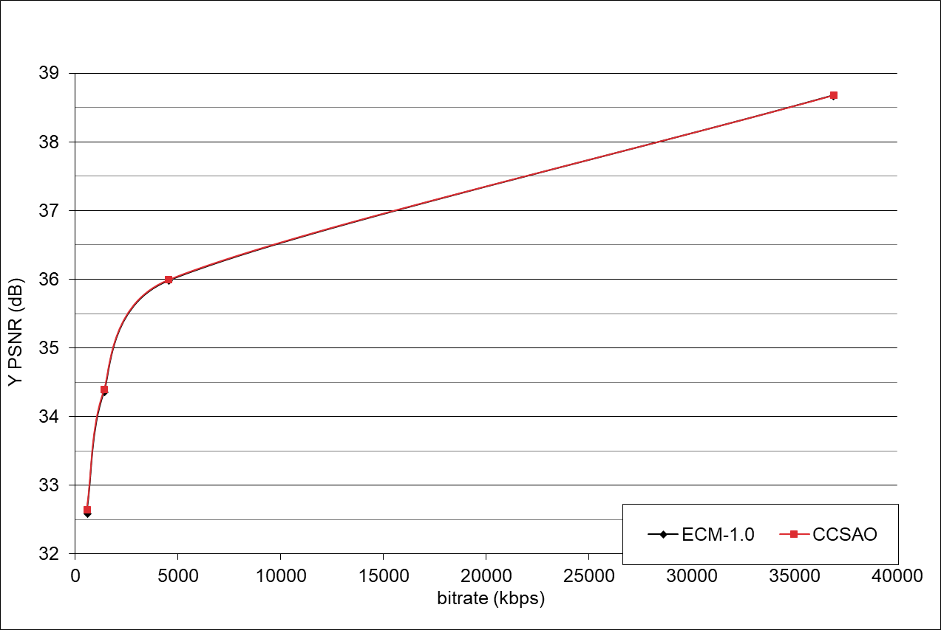
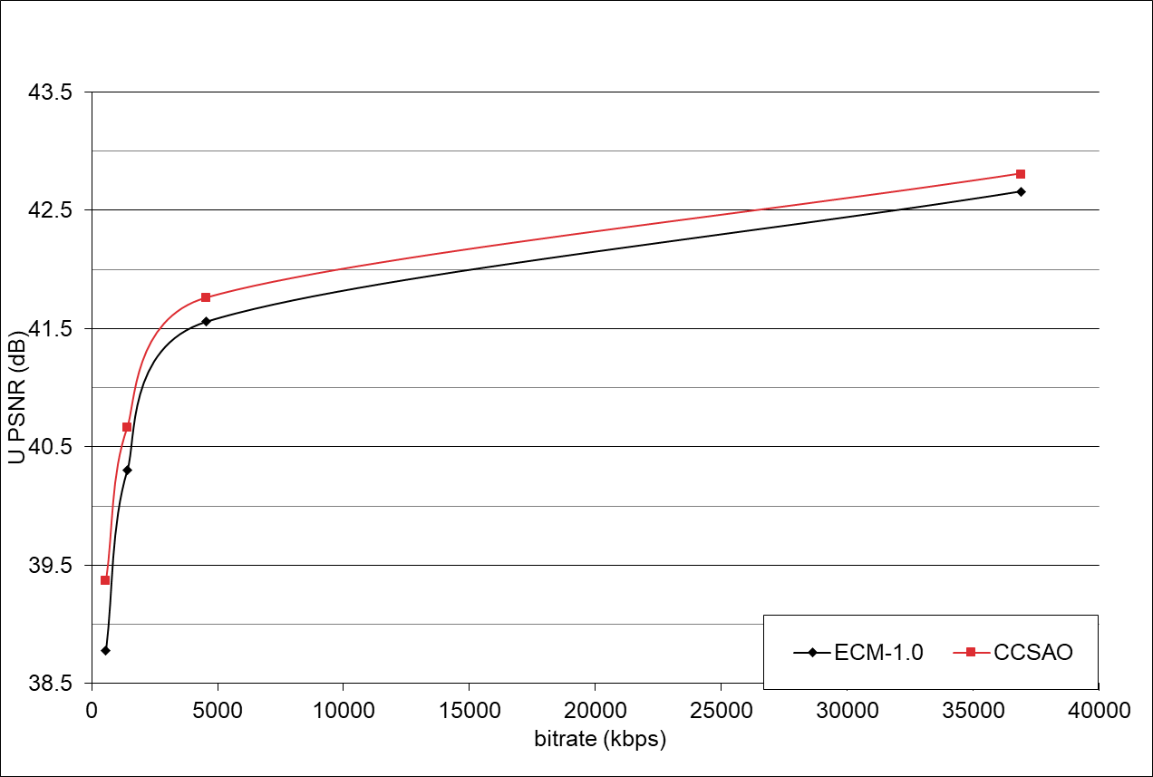
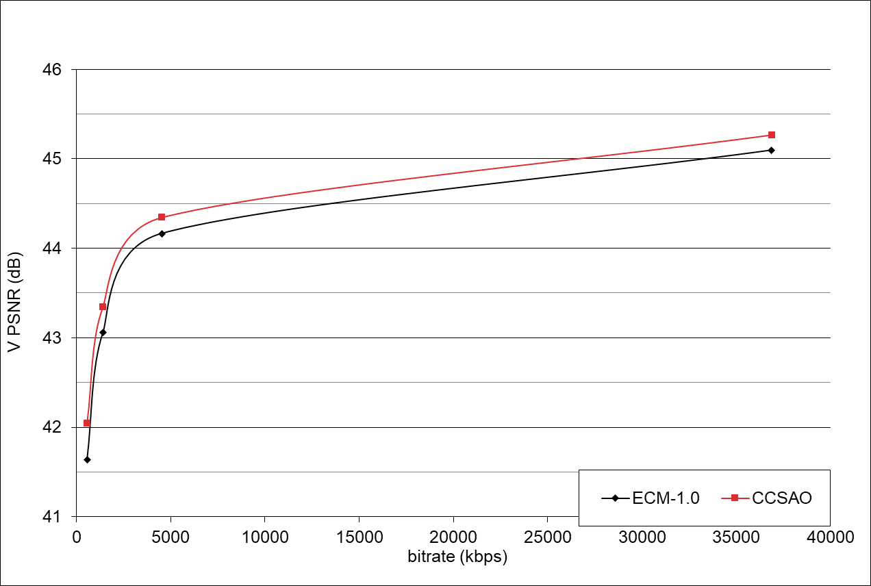
R-D Curves
BQTerrace, LB configuration
High coding improvements on chroma components
Luma component usually retains more useful information than chroma
Impact of CCSAO is more effective to the luma-to-chroma path

Slide 14
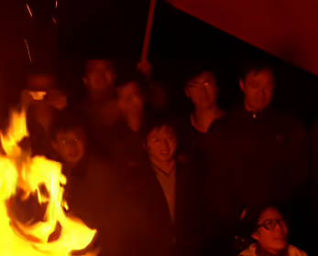
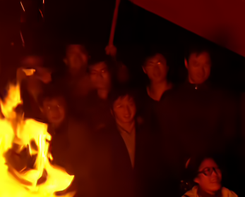
Subjective Benefits
Compared to anchor, details of people’s faces become much clear
Campfire, POC 207, Random Access, QP 37

Slide 15
Conclusion
Cross-component sample adaptive offset (CCSAO) is proposed
Adopted to ECM-2.0 for compression efficiency exploration beyond VVC
Exploits the strong correlation among luma and chroma components
Divide the reconstructed samples into different categories
Apply one offset to the reconstructed samples for each category
One hierarchical encoding algorithm is proposed
Derive the CCSAO parameters/offsets signaled at frame level
Friendly to hardware codec implementations
Low computational complexity
No additional line buffer required
Significant coding performance improvement on ECM
{Y, U, V} BD-rate savings for AI, RA, and LB:
{0.05%, 1.50%, 1.63%}, {0.20%, 2.83%, 2.98%}, and {0.41%, 7.36%, 7.36%}

Slide 16
References
[1] B. Bross, J. Chen, S. Liu, Y.-K. Wang, “Versatile Video Coding (Draft 10),” JVET-S2001, Teleconference, Jul. 2020.
[2] G. J. Sullivan, J. Ohm, W. Han and T. Wiegand, “Overview of the High Efficiency Video Coding (HEVC) Standard,” in IEEE Transactions on Circuits and Systems for Video Technology, vol. 22, no. 12, pp. 1649-1668, Dec. 2012.
[3] Y.-J. Chang et al, “Compression efficiency methods beyond VVC,” JVET-U0100, Teleconference, Jan. 2021.
[4] ECM-1.0, https://vcgit.hhi.fraunhofer.de/ecm/jvet-v-ee2/VVCSoftware_VTM
[5] M. Karczewicz et al., “VVC In-Loop Filters,” in IEEE Transactions on Circuits and Systems for Video Technology, vol. 31, no. 10, pp. 3907-3925, Oct. 2021.
[6] T. Lu et al., “Luma Mapping with Chroma Scaling in Versatile Video Coding,” 2020 Data Compression Conference (DCC), 2020, pp. 193-202.
[7] C.-M. Fu et al., “Sample Adaptive Offset in the HEVC Standard,” in IEEE Transactions on Circuits and Systems for Video Technology, vol. 22, no. 12, pp. 1755-1764, Dec. 2012.
[8] C.-Y. Tsai et al., “Adaptive Loop Filtering for Video Coding,” in IEEE Journal of Selected Topics in Signal Processing, vol. 7, no. 6, pp. 934-945, Dec. 2013.
[9] K. Misra, F. Bossen and A. Segall, “On Cross Component Adaptive Loop Filter for Video Compression,” 2019 Picture Coding Symposium (PCS), 2019.
[10] C.-W. Kuo, X. Xiu, W. Chen, Y.-W. Chen, and X. Wang, “Cross-component Sample Adaptive Offset,” AVS-M5595, Aug. 2020.
[11] X. Li, R.-L. Liao, J. Chen, Y. Ye, “CE2-1 related: Modification on CCSAO classification method,” AVS-M5897, Dec. 2020.
[12] Y. Jian et al., “CE 3-1 related: Improvement on CCSAO,” AVS-M6110, Feb. 2021.
[13] X. Zhao et al., “Study On Coding Tools Beyond AV1,” 2021 IEEE International Conference on Multimedia and Expo (ICME), 2021, pp. 1-6.
[14] A. M. Kotra, S. Esenlik, B. Wang, H. Gao and J. Chen, “Non-CE: Loop filter line buffer reduction,” JVET-M0301, Marrakech, Morocco, Jan. 2019.
[15] C.-W. Kuo, X. Xiu, Y.-W. Chen, H.-J. Jhu, W. Chen, X. Wang, “EE2-5.1: Cross-component Sample Adaptive offset,” JVET-W0066, Teleconference, Jul. 2021.
[16] M. Karczewicz, Y. Ye, “Common Test Conditions and evaluation procedures for enhanced compression tool testing,” JVET-V2017, Teleconference, May 2021.
[17] G. Bjøntegaard, “Calculation of average PSNR differences between RD-Curves,” ITU-T SG16 Q.6 Document, VCEG-M33, Austin, US, Apr. 2001.

Slide 17
Related Work
DBF Y
SAO Y
[10]
[11]
[12]
[13]
[15]
CCSAO Y
Y
DBF Cb
SAO Cb
CCSAO Cb
a | c | b
 | a
 | c
 | b
a
 | c
 |  | b
 |  | a
 | c
b
Cb
…
DBF Cr
SAO Cr
CCSAO Cr
Cr

Slide 18
Thanks

