Slide 1
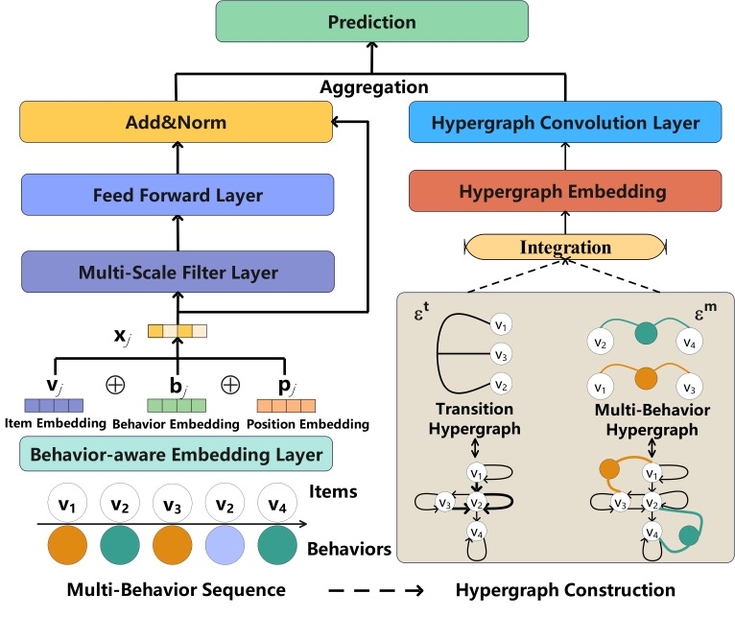
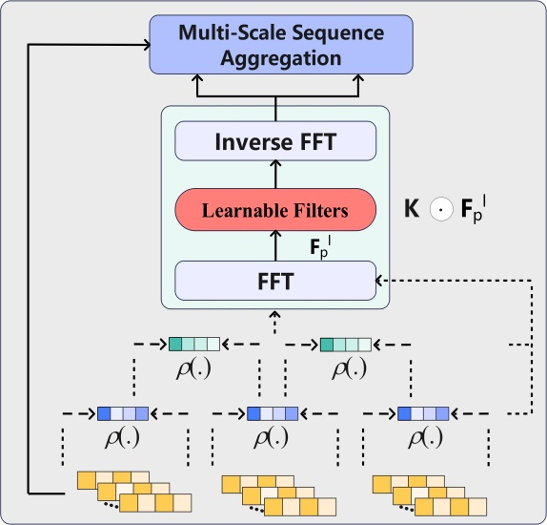
Filter-enhanced Hypergraph Transformer framework for Multi-Behavior Sequential Recommendation
Zhufeng Shao^{1,3} , Shoujin Wang², Wenpeng Lu^{1,3} , Weiyu Zhang^{1,3} , Hongjiao Guan^{1,3} , Long Zhao^{1,3}
¹Key Laboratory of Computing Power Network and Information Security,
¹Ministry of Education, Shandong Computer Science Center (National Supercomputer Center in Jinan),
¹Qilu University of Technology (Shandong Academy of Sciences), Jinan, China
²The Data Science Institute, University of Technology Sydney
³Shandong Provincial Key Laboratory of Computer Networks,
³Shandong Fundamental Research Center for Computer Science, Jinan, China
Background
Challenge
Exploring the sequential patterns underlying user-item interactions becomes difficult (as depicted in Fig. 1) when multiple behavioral dependencies are taken into account .
In real-world recommendation scenarios, users’ behaviors tend to exhibit different periodic trends (e.g., daily or weekly routines). Hence, it is essential to model behavior-aware sequential patterns under the item transitions with different periodic trends explicitly;
The dependencies across different behavior types of a user become heterogeneous when sequential information is incorporated. Therefore, it is necessary to model such heterogeneous dependencies across multi-behaviors embedded in the multi-behavior sequence of users.
Fig. 1. Example of multi-behavior sequence. A user interacts with items under various behaviors.
Our contribution
We propose a filter-enhanced hypergraph transformer framework (Fig. 2), which uncovers the behavior-aware sequential patterns and heterogeneous multi-behavior dependencies.
The main innovation is depicted in Fig. 3, we design a filter-enhanced multi-scale transformer equipped with the learnable filters to mine the scale-specific interests of user.
The framework contains three modules: filter-enhanced multi-scale modeling module (left panel), hypergraph learning module (right panel), and prediction module (top panel).
Experiments

