Slide 1
FrAUG: A Frame Rate Based Data Augmentation Method for Depression Detection from Speech Signals
Vijay Ravi¹, Jinhan Wang¹, Jonathan Flint², Abeer Alwan¹
¹ Dept. of Electrical and Computer Engineering, UCLA
² Dept. of Psychiatry and Biobehavioral Sciences, UCLA
Notes:
Hello everyone and welcome to this talk. My name is Vijay, and I am a Ph.D. Student in the Speech-Production and Auditory Perception Lab at UCLA. Today I will be presenting our ICASSP 2022 paper titled “FrAUG: A Frame Rate Based Data Augmentation Method for Depression Detection from Speech Signals”. This work is in collaboration with Jinhan Wang, Prof. Jonathan Flint and Prof. Abeer Alwan.

Slide 2
Outline
Background
Proposed Approach
Experimental Details
Database
Models
Results & Discussion
Notes:
This presentation is organized as follows – I will first introduce the problem statement with some background work and then explain the approach that is proposed in this paper. This will be followed by experimental details which will include data and model descriptions. I will then discuss the results and conclude the talk with a brief summary of future work.

Slide 3
Background

Slide 4
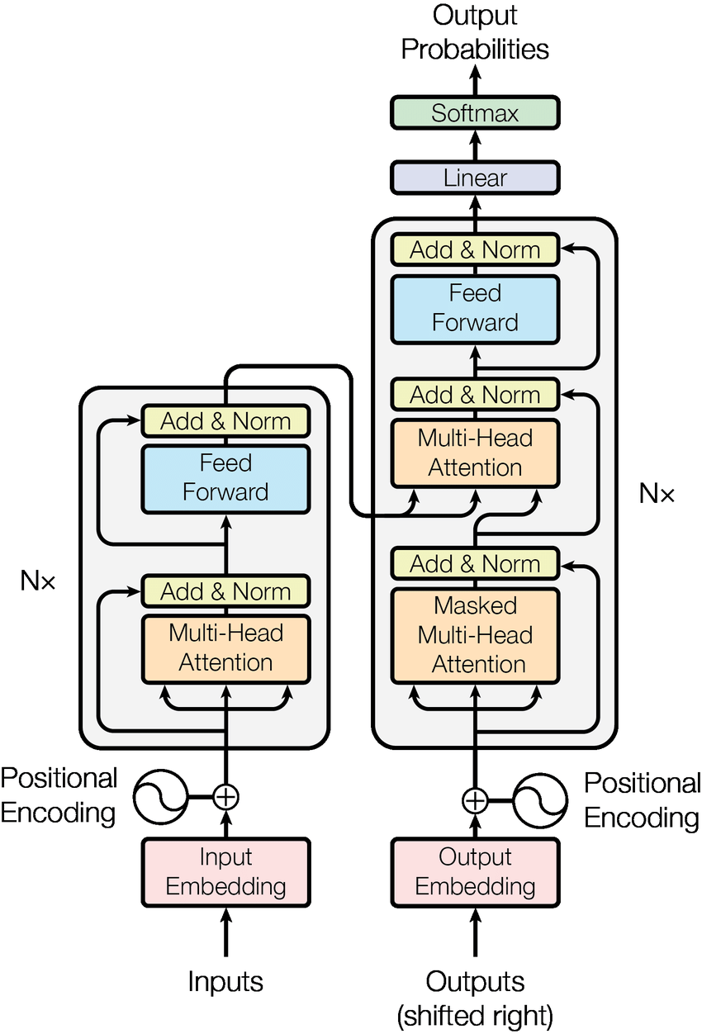
Background
Transformer models – an example of a
data-hungry deep learning model
Speech-based depression detection has gained significant momentum in the recent years.
Advancements in deep learning have made speech-modeling very robust (e.g.: ASR, speaker recognition, etc.)
But deep-learning models are data hungry.
Collection of large-scale datasets for mental health applications can be challenging.
Image Source: Attention Is All You Need Vaswani et al., 2017.
Notes:
Recently, speech-based automatic diagnosis of depression has gained significant momentum and advancements in deep learning have pushed their performance to newer heights. However, data scarcity still remains one of the major challenges in building reliable systems for depression modeling purposes. Given the sensitivity of mental healthcare data, collection of data can be expensive and challenging due to a variety of reasons such as governmental regulations, privacy issues and so on.

Slide 5
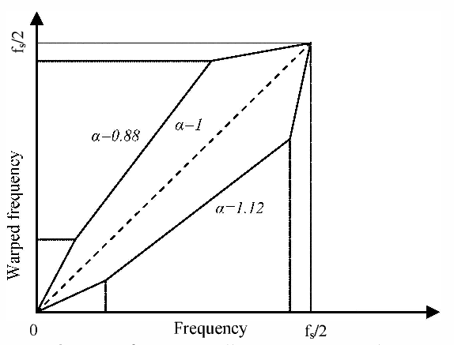
Background
To circumvent scarcity of data –
Artificially create new training samples (data augmentation).
Conventional augmentation methods in the speech literature:
Noise Augmentation [29]
Vocal Tract Length Perturbation (VTLP) [30]
Speed Perturbation [31]
Pitch Perturbation [31]
Conventional methods alter acoustic parameters that may carry information related to underlying mental health.
E.g.: pitch, formant frequencies, speaking-rate [8]
VTLP
Image Sourcce: https://www.semanticscholar.org/paper/Development-of-vocal-tract-length-normalized-engine-Sharma-Madhavi/
Notes:
Alternatively, data augmentation can be performed to artificially upsample the training data. In the past, this has been achieved with methods such as Noise augmentation, Vocal Tract Length Perturbation or VTLP, Speed perturbation, etc. In noise augmentation, speech samples are modified with addition of background noise or reverberation. In VTLP, the frequency axis of the spectrogram of each speaker is linearly warped using a warp factor α. In Speed perturbation, the speaking rate of the utterance is increased or decreased via time stretching. Most of the existing methods, however, alter acoustic parameters which may carry information related to the underlying disorder like the pitch or formants, or speaking rate.

Slide 6
Proposed Approach

Slide 7
Proposed Approach
Equation that represents the Short Time Fourier Transform (STFT):
L = frame-width, R= frame-shift
L and R control the time-frequency resolution.
L is specified in milliseconds and R as a % of L.
Notes:
Before we look at frame rate-based augmentation, let’s look at the windowing or framing process that is applied to speech signals prior to feature extraction and this is represented as shown in the equation on this slide. The frame width and shift are denoted by L and R. These values controls the time-frequency resolution of the extracted feature.

Slide 8
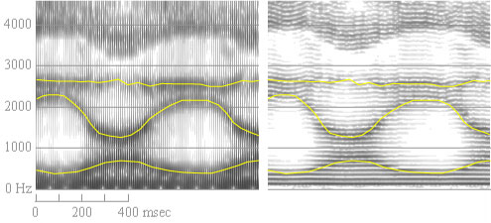
Proposed Approach – Changing L & R
Small window length –
Wide-band spectrogram
Better time resolution.
Larger window length –
Narrow-band spectrogram
Sharper frequency resolution
For most applications, L and R are fixed at 25ms and 40%, respectively [33].
wide band (left) and narrow band (right) spectrograms
of the same word
Image Source: https://home.cc.umanitoba.ca/~robh/howto.html
Notes:
There is a trade-off between time and frequency resolutions in the generated features in that a smaller window leads to a wide band spectrogram giving better time resolution whereas a larger window results in a narrow band spectrogram and a better frequency resolution. Usually, a fixed value of L and R are used to balance the two resolutions.

Slide 9
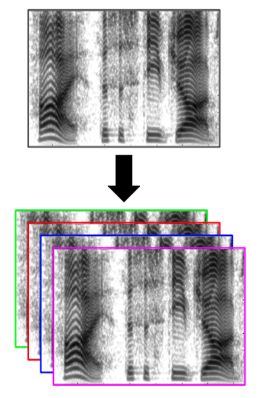
Proposed Approach
Augment training data with features extracted using multiple L and R.
By changing L and R, we change the frame rate and time-frequency resolution of the extracted features.
Since we are augmenting training data based on frame-rate, we refer to this method as FrAUG – Frame-rate-based data augmentation.
Independent of the model, features, and dataset.
Notes:
In this paper, we propose a data augmentation method where features for training samples are extracted using multiple values of L and R. The new samples created this way only have different time-frequency resolutions ensuring that vocal parameters related to the underlying disease are not altered. Since most speech features employ this windowing mechanism, this method can extend beyond the spectral features.

Slide 10
Experimental Details

Slide 11
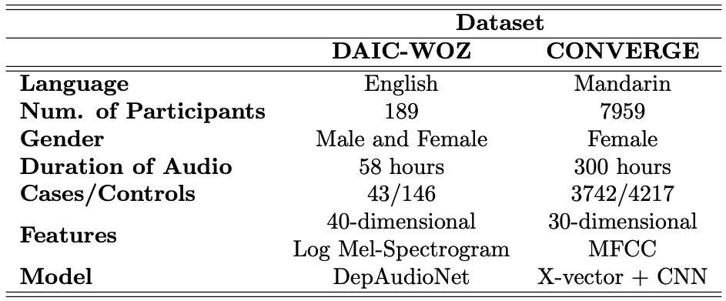
Databases and Models
Notes:
Two datasets were used in this paper namely DAIC WOZ which is in English and CONVERGE which is in Mandarin. The corresponding data-distribution, acoustic features, and models used with these datasets is as shown in the table. There are 189 participants, both male and female in the DAIC-WOZ dataset and 7959 female participants in the CONVERGE dataset. In total, there is approximately 58 hours of audio data in the daic-woz dataset and about 300 hours in the converge dataset. As can be seen, there is an imbalance in cases/controls distribution in both datasets. Two different features and models were used with each dataset. For DAIC-WOZ 40-dimensional mel spectrogram were used with the DepAudioNet model. In comparison, for CONVERGE, 30-dimensional MFCCs were used to first extract x-vectors which were then used with a downstream Convolutional neural network classifier.

Slide 12
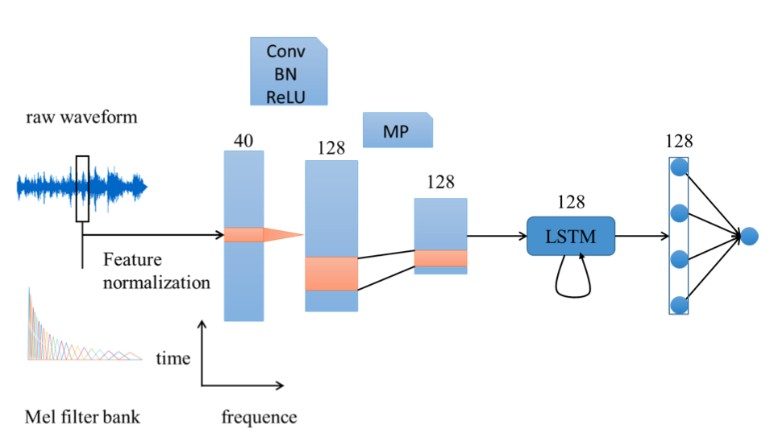
Models - DepAudioNet
DepAudioNet –
Deep Neural Network for Depression Detection using audio.
Widely accepted as a baseline in speech literature.
1 Convolution Layer (CNN) + 2 unidirectional LSTM layers.
Convolutional layer captures low-level features
LSTM captures high-level temporal features.
Pre-processing of all features
To balance cases/controls data random cropping and sampling of features are applied.
Image Source: DepAudioNet, X. Ma et al., 2017
Notes:
For the DAIC-WOZ dataset, DepAudioNet model was used. This model consisted of a convolution layer followed by two recurrent LSTM layers. A Sigmoid output activation was used to directly predict depression class labels. To minimize the effects of class-imbalance, random cropping and sampling of audio frames was applied.

Slide 13
Models – x-vector + CNN
Speaker representations have been shown to be useful for mental health diagnoses.
Extract x-vector for all data- training, validation, test and augmented training. The x-vector model is trained using the CN-Celeb dataset.
Use x-vectors to train a downstream network.
Downstream network consists of 2 CNN layers and predicts binary labels - depressed/non-depressed.
We use pretrained x-vector models for speaker embedding extraction.
Frame-rate data augmentation not applied to the training of the x-vector model.
Notes:
In contrast, for CONVERGE dataset, x-vector embeddings were first extracted from a pretrained TDNN model which were then used to train a downstream DNN classifier. The motivation to use x-vector embedding was that in the past, speaker-discriminative representations have been shown to be useful for detection of mental health disorders. Since this setup was used with CONVERGE which is in Mandarin, CN-CELEB, a Chinese speaker recognition dataset was used to train the x-vector model using the Kaldi toolkit. After extracting the x-vectors, the CNN model was trained to classify utterances into depressed or healthy classes.

Slide 14
Augmentation
Baseline for DepAudioNet [ ] : Single-Frame rate (L = 64ms, and R = 50%).
Augmentation : L = 32ms, 64ms, 128ms and R = 10%, 25%, 50%.
Frame-rates chosen empirically.
Augmentation of features (Mel-spectrogram and MFCCs) only for the training data.
Test and validation were maintained at baseline frame-rates throughout the experiment.
Notes:
Baseline features were extracted with a frame width of 64ms and shift of 50%. When FrAUG was applied, in addition to baseline frame-rates, training features were also extracted with L=32ms and 128ms and R=10% and 25%. Data-augmentation frame rates were chosen empirically and upto 9-fold augmentation was evaluated.

Slide 15
Experiments
Effectiveness of the proposed method is demonstrated in 3 ways –
Exp1 – FrAUG vs No FrAUG
Compare performance with and without proposed data augmentation.
Exp 2 – FrAUG vs conventional data augmentation
Exp 3 – Generalizability of FrAUG
Extend FrAUG to other datasets, models and acoustic features.
Notes:
Effectiveness of FrAUG is demonstrated in three stages. First, we evaluate performance of FrAUG vs a baseline without any augmentation. Then, we compare the performance of FrAUG against other commonly used augmentation methods. Lastly, we extend FrAUG to another dataset to show that the proposed approach generalizes well. Since this is binary classification task with class-imbalance, we use the F1-Score as an evaluation metric and higher F1-score implies a better.

Slide 16
Results

Slide 17
Results - I
Results, in-terms of the F1-Score comparing baseline (single frame rate) versus FrAUG (multi frame rate)
using DepAudioNet and the DAIC-WOZ Validation set
Baseline
Best performance
The best performance result is statistically significant.
Notes:
Results for the first experiment as shown on this slide. System performance with FrAUG is better than baseline and better than width-only or shift-only augmentation. The combination of frame-rates that perform the best is considered as a hyper-parameter that can be tuned for any given dataset.

Slide 18
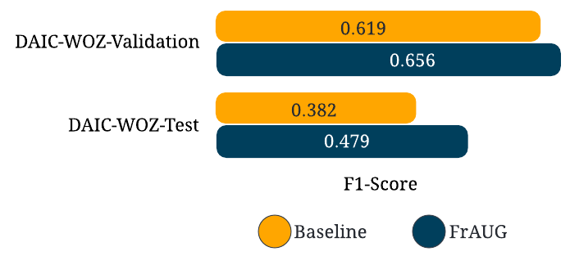
Results - I
Results, in-terms of F1-Score comparing baseline versus best performing multi frame rate training
using DepAudioNet and the DAIC-WOZ
Notes:
FrAUG improves system performance over baseline on validation set by 5.97% from 0.619 to 0.656 and on the test-set by 25.13% from 0.382 to 0.479. Higher baseline scores have been reported on the test set in some previous works, but a comparison could not be made because of difference in evaluation protocols and data partitioning. These results demonstrate that the proposed method can be used to artificially increase training data samples in a way that improves the classification accuracy.

Slide 19
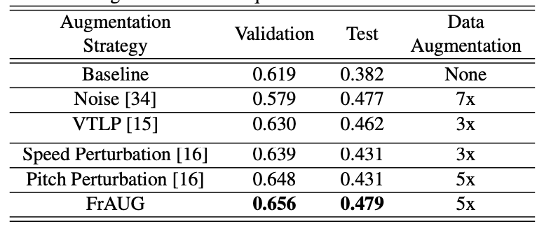
Results - II
Results, in-terms of F1-Score comparing conventional data augmentation methods and proposed method
using DepAudioNet and the DAIC-WOZ Test set
Notes:
Next, we compare FrAUG with Noise augmentation, VTLP, Speed perturbation and Pitch perturbation. For each augmentation method, up to 9-folds of augmentation was performed and the best performing configuration was selected. In this case, it is observed that the proposed method, with 5x augmentation, outperforms all other augmentation methods on both the validation and the test splits of the DAIC-WOZ data using the DepAudioNet model. Results from experiment two suggest that for the task of depression detection, the proposed method is better that most commonly used methods of augmentation.

Slide 20
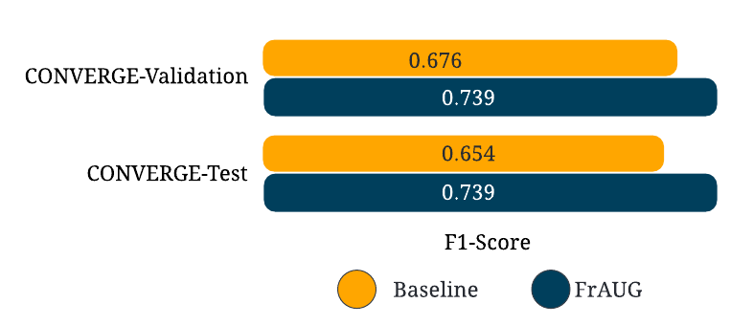
Results - III
Results, in-terms of F1-Score for depression detection on the CONVERGE dataset using x-vector embeddings with a CNN classifier as the backend, with and without FrAUG
Notes:
Lastly, we shown that frame-rate-based augmentation generalizes well to another dataset with a different model and different input acoustic feature. In this case, performs improves by 9.32% from 0.676 to 0.739 on the converge validation split and by 12.9% from 0.654 to 0.739 on the test split. These results are rather significant because improvements were observed even though the downstream model was trained on x-vector embeddings and not features themselves. The improvements obtained in this experiment shows that our method can generalize well to other data sets and model architectures.

Slide 21
Summary
Frame-rate-based data augmentation can be useful for depression detection from speech signals.
Does not alter depression-related acoustic parameters.
The proposed method is shown to be independent of the model, the dataset and input acoustic features.
Performance gains are reported even on the downstream classification network when FrAUG is applied.
This framework will be extended to other acoustic features such as voice quality features.
Notes:
To conclude, we propose a frame-rate-based data-augmentation method in this paper and demonstrate it’s usefulness in detection of depression from speech signals. We show that this method is better than some commonly used data augmentation methods and is independent of the dataset, input features, model or model-training style. In the future, we will extend this to other acoustic features such as the voice quality features Vqual.

Slide 22
Acknowledgements
Funding in part by the NIH (R01MH122569).
Author email: vijaysumravi@ucla.edu
Notes:
This work was funded in part by the NIH. Please feel free to contact us if have any questions.

Slide 23
References
[1] GBD 2017 Disease and Injury Incidence and Prevalence Collaborators. (2018). Global, regional, and national incidence, prevalence, and years lived with disability for 354 diseases and injuries for 195 countries and territories, 1990–2017: a systematic analysis for the Global Burden of Disease Study 2017. The Lancet. DOI.
[2] Mathers CD, Loncar D. Projections of global mortality and burden of disease from 2002 to 2030. PLoS Med. 2006 Nov;3(11):e442. doi: 10.1371/journal.pmed.0030442. PMID: 17132052; PMCID: PMC1664601.
[3] K. B. Wells, R. D. Hays, M. A. Burnham, W. H. Rogers, S. Green- field, and J. E. Ware, “Detection of depressive disorder for patients receiving prepaid or fee-for-service care. Results from the Medi- cal Outcomes Study.” Jama, vol. 262, pp. 3298–3302, 1989.
[4] U.S. Department of Health and Human Services. (n.d.). Major depression. National Institute of Mental Health. https://www.nimh.nih.gov/health/statistics/major-depression#part_155721.
[5] 2021 Alzheimer's disease facts and figures. (2021). Alzheimer's & Dementia, 17(3), 327-406. doi: 10.1002/alz.12328
[6] Rajan, K., Weuve, J., Barnes, L., McAninch, E., Wilson, R., & Evans, D. (2021). Population estimate of people with clinical Alzheimer's disease and mild cognitive impairment in the United States (2020–2060). Alzheimer's & Dementia. doi: 10.1002/alz.12362
[7] Lang, L., Clifford, A., Wei, L., Zhang, D., Leung, D., Augustine, G., Danat, I. M., Zhou, W., Copeland, J. R., Anstey, K. J., & Chen, R. (2017). Prevalence and determinants of undetected dementia in the community: a systematic literature review and a meta-analysis. BMJ open, 7(2), e011146. https://doi.org/10.1136/bmjopen-2016-011146
[8] N.Cummins,S.Scherer,J.Krajewski,S.Schneider, J.Epps,and T. F. Quatieri, “A review of depression and suicide risk assessment using speech analysis,” Speech Communication, vol. 71, pp. 10– 49, 2015.
[9] B. Stasak, J. Epps, and R. Goecke, “Elicitation design for acous- tic depression classification: An investigation of articulation ef- fort, linguistic complexity, and word affect,” INTERSPEECH, vol. 2017-Augus, pp. 834–838, 2017.
[10] F. Ho ̈nig, A. Batliner, E. No ̈th, S. Schnieder, and J. Krajewski, “Automatic modelling of depressed speech: Relevant features and relevance of gender,” INTERSPEECH, no. 444, pp. 1248–1252, 2014.
[11] J. C. Mundt, P. J. Snyder, M. S. Cannizzaro, K. Chappie, and D. S. Geralts, “Voice acoustic measures of depression severity and treatment response collected via interactive voice response (IVR) technology,” Journal of Neurolinguistics, vol. 20, no. 1, pp. 50– 64, 2007.
[12] S.Scherer,G.Stratou,J.Gratch,andL.P.Morency,“Investigating voice quality as a speaker-independent indicator of depression and PTSD,” INTERSPEECH, pp. 847–851, 2013.
[13] N. Cummins, J. Joshi, and R. Goecke, “Diagnosis of Depression by Behavioural Signals : A Multimodal Approach Categories and Subject Descriptors,” Proceedings of the 3rd ACM international workshop on Audio/visual emotion challenge, pp. 11–20, 2013.
[14] N. Cummins, J. Epps, V. Sethu, M. Breakspear, and R. Goecke, “Modeling spectral variability for the classification of depressed speech,” INTERSPEECH, pp. 857–861, 2013.
[15] J.R.Williamson,E.Godoy,M.Cha,A.Schwarzentruber,P.Khor- rami, Y. Gwon, H.-T. Kung, C. Dagli, and T. F. Quatieri, “De- tecting Depression using Vocal, Facial and Semantic Communi- cation Cues,” Proceedings of the 6th International Workshop on Audio/Visual Emotion Challenge - AVEC ’16, pp. 11–18, 2016.
[16] J. C. Mundt, A. P. Vogel, D. E. Feltner, and W. R. Lenderking, “Vocal acoustic biomarkers of depression severity and treatment response,” Biological Psychiatry, vol. 72, no. 7, pp. 580–587, 2012.
[17] S.Alghowinem,R.Goecke,M.Wagner,J.Epps,M.Breakspear, and G. Parker, “Detecting depression: A comparison between spontaneous and read speech,” ICASSP, no. May, pp. 7547–7551, 2013.
[18] E. Moore, M. Clements, J. Peifer, and L. Weisser, “Comparing objective feature statistics of speech for classifying clinical de- pression,” The 26th Annual International Conference of the IEEE Engineering in Medicine and Biology Society, vol. 3, pp. 17–20, 2004.
[19] Meilán, Juan José G., et al. "Speech in Alzheimer's disease: can temporal and acoustic parameters discriminate dementia?." Dementia and Geriatric Cognitive Disorders 37.5-6 (2014): 327-334

Slide 24
References
[20] Syed, Muhammad Shehram Shah, et al. "Automated Screening for Alzheimer's Dementia Through Spontaneous Speech." INTERSPEECH. 2020.
[21] Martinc, Matej, and Senja Pollak. "Tackling the ADReSS Challenge: A Multimodal Approach to the Automated Recognition of Alzheimer's Dementia." INTERSPEECH. 2020.
[22] Yuan, Jiahong, et al. "Disfluencies and Fine-Tuning Pre-Trained Language Models for Detection of Alzheimer's Disease." INTERSPEECH. 2020.
[23] M. Fro ̈hlich, D. Michaelis, and H. W. Strube, “SIMsimultaneous inverse filtering and matching of a glottal flow model for acoustic speech signals,” The Journal of the Acoustical Society of America, vol. 110, no. 1, pp. 479–488, 2001.
[24] S. J. Park, C. Sigouin, J. Kreiman, P. Keating, J. Guo, G. Yeung, F.-y. Kuo, and A. Alwan, “Speaker Identity and Voice Quality : Modeling Human Responses and Automatic Speaker Recogni- tion,” Interspeech, pp. 1044–1048, 2016.
[25] N. Dehak, P. J. Kenny, R. Dehak, P. Dumouchel, and P. Ouellet, “Front-end factor analysis for speaker verification,” IEEE Trans- actions on Audio, Speech and Language Processing, vol. 19, no. 4, pp. 788–798, 2011.
[26] B. Schuller, S. Steidl, A. Batliner, J. Hirschberg, J. K. Burgoon, A. Baird, A. Elkins, Y. Zhang, E. Coutinho, and K. Evanini, “The INTERSPEECH 2016 computational paralinguistics chal- lenge: Deception, sincerity & native language,” INTERSPEECH, vol. 08-12-Sept, pp. 2001–2005, 2016.
[27] Y.-L. Shue, P. Keating, and C. Vicenik, “VOICESAUCE: A pro- gram for voice analysis.” The Journal of the Acoustical Society of America, vol. 126, no. August, p. 2221, 2009.
[28] Y. Li, S. Shi, F. Yang, J. Gao, Y. Li, M. Tao, G. Wang, K. Zhang, C. Gao, L. Liu, K. Li, K. Li, Y. Liu, X. Wang, J. Zhang, L. Lv, X. Wang, Q. Chen, J. Hu, L. Sun, J. Shi, Y. Chen, D. Xie, J. Flint, K. S. Kendler, and Z. Zhang, “Patterns of co-morbidity with anxi- ety disorders in Chinese women with recurrent major depression,” Psychological Medicine, vol. 42, no. 6, pp. 1239–1248, 2012.
[29] David Snyder, Guoguo Chen, and Daniel Povey, “Musan: A music, speech, and noise corpus,” arXiv preprint arXiv:1510.08484, 2015.
[30] Navdeep Jaitly and Geoffrey E Hinton, “Vocal tract length perturbation (vtlp) improves speech recognition,” in Proc. ICML Workshop on Deep Learning for Audio, Speech and Language, 2013, vol. 117, p. 21.
[31] Ko, Tom, et al. "Audio augmentation for speech recognition." Sixteenth annual conference of the international speech communication association. 2015.
[32] Rabiner, Lawrence R., and Ronald W. Schafer. Introduction to digital speech processing. Vol. 1. Now Publishers Inc, 2007.
[33] Daniel Povey, Arnab Ghoshal, et al., “The kaldi speech recognition toolkit,” in ASRU. 2011, IEEE Signal Processing Society.
[34] Michel Valstar, Jonathan Gratch, et al., “Avec 2016: Depression, mood, and emotion recognition workshop and challenge,” in Proceedings of the 6th international workshop on audio/visual emotion challenge, 2016, pp. 3–10.
[35] Xingchen Ma, Hongyu Yang, et al., “Depaudionet: An efficient deep model for audio-based depression classification,” in Proceedings of the 6th international workshop on audio/visual emotion challenge, 2016, pp. 35–42.
[36] David Snyder, Daniel Garcia-Romero, et al., “X-vectors: Robust dnn embeddings for speaker recognition,” in ICASSP. IEEE, 2018, pp. 5329–5333.
[37] Manoj Kumar, Tae Jin-Park, et al., “Designing neural speaker embeddings with meta learning,” 2020.
[38] Yue Fan, JW Kang, et al., “Cn-celeb: a challenging Chinese speaker recognition dataset,” in ICASSP. IEEE, 2020, pp. 7604–7608.
[39] Ravi, Vijay, et al. "Voice quality and between-frame entropy for sleepiness estimation." Interspeech 2019 (2019).

Slide 25
Thank you!
Notes:
Thank you watching this presentation.

