Slide 1
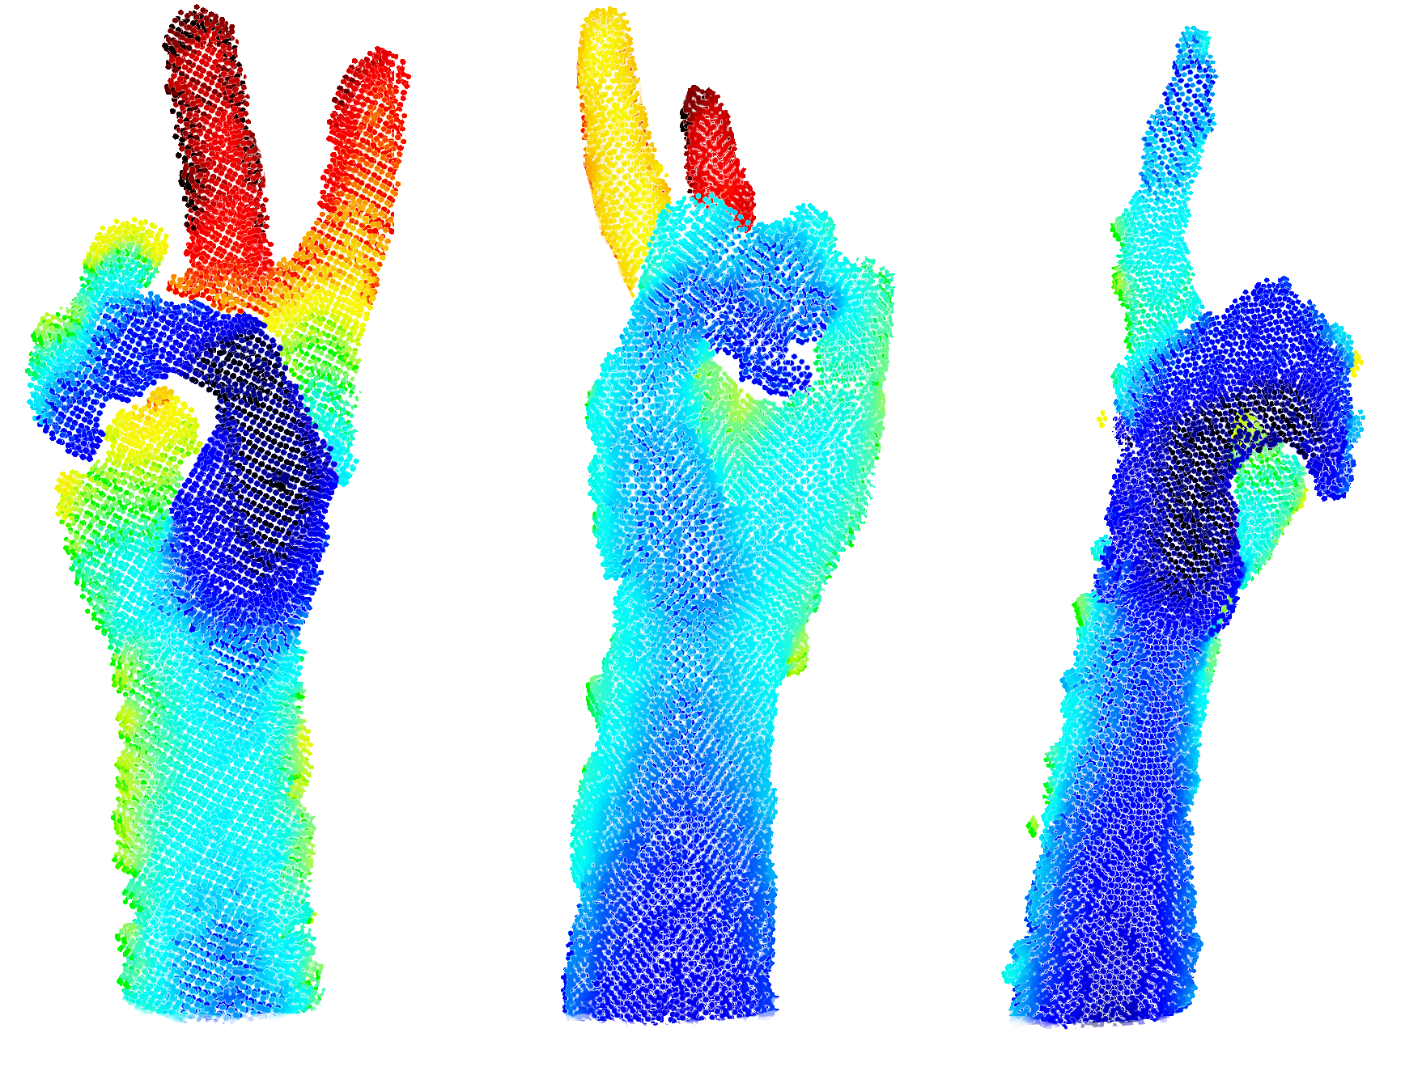
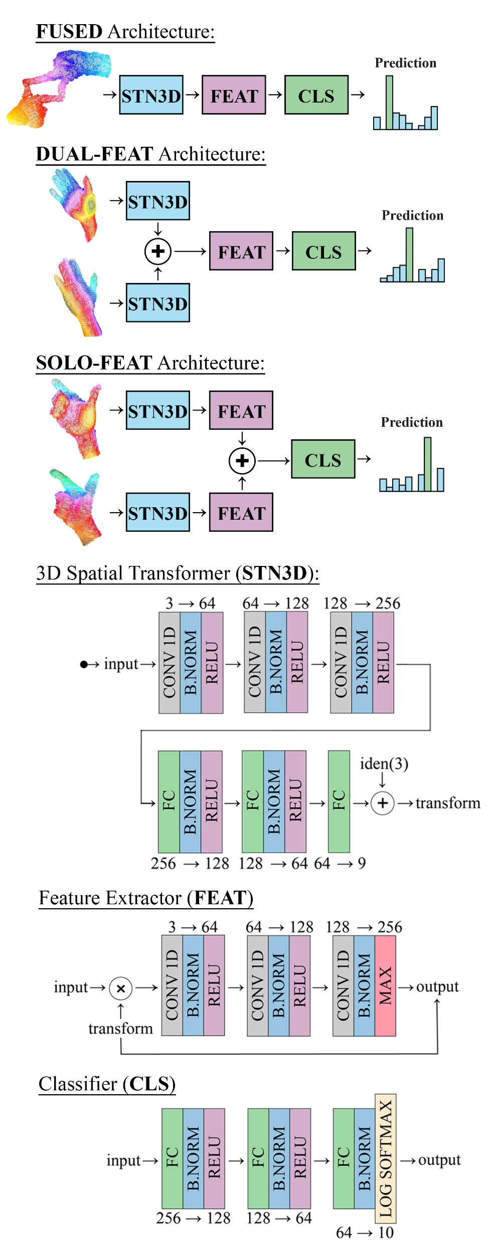
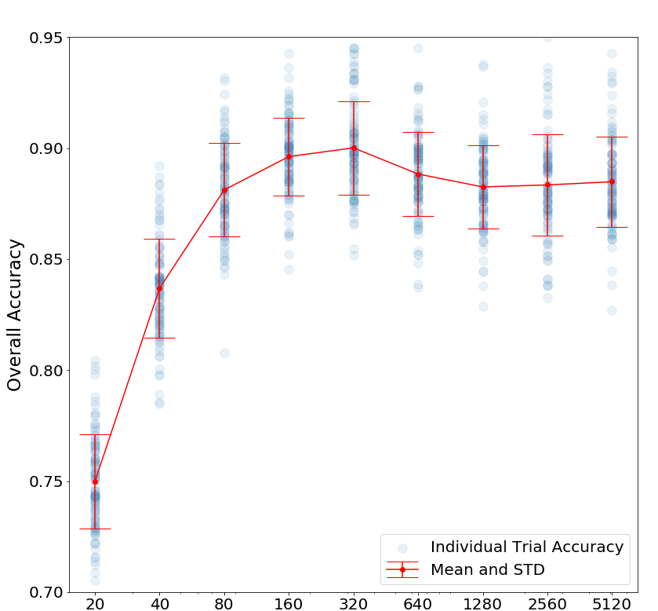
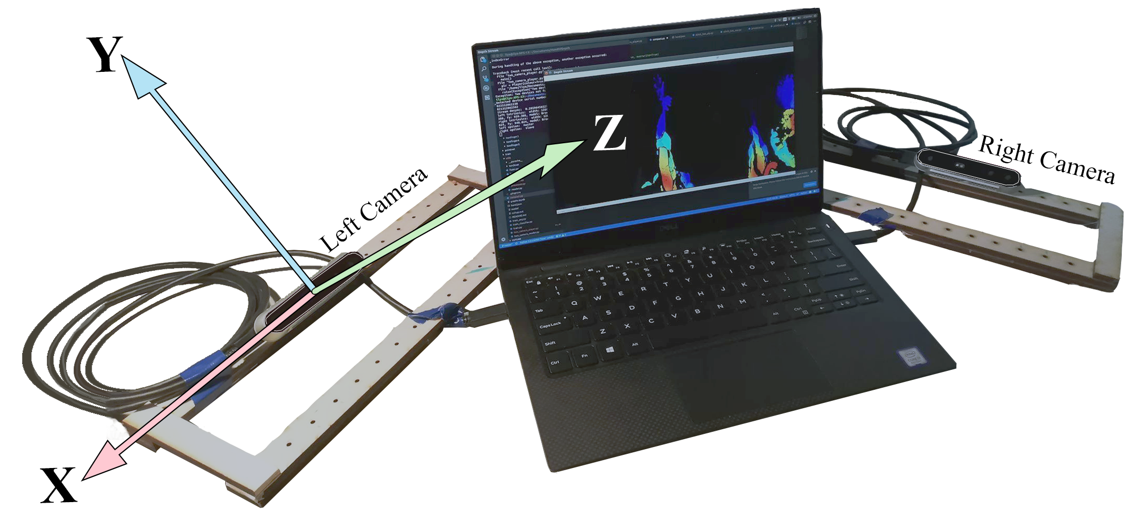
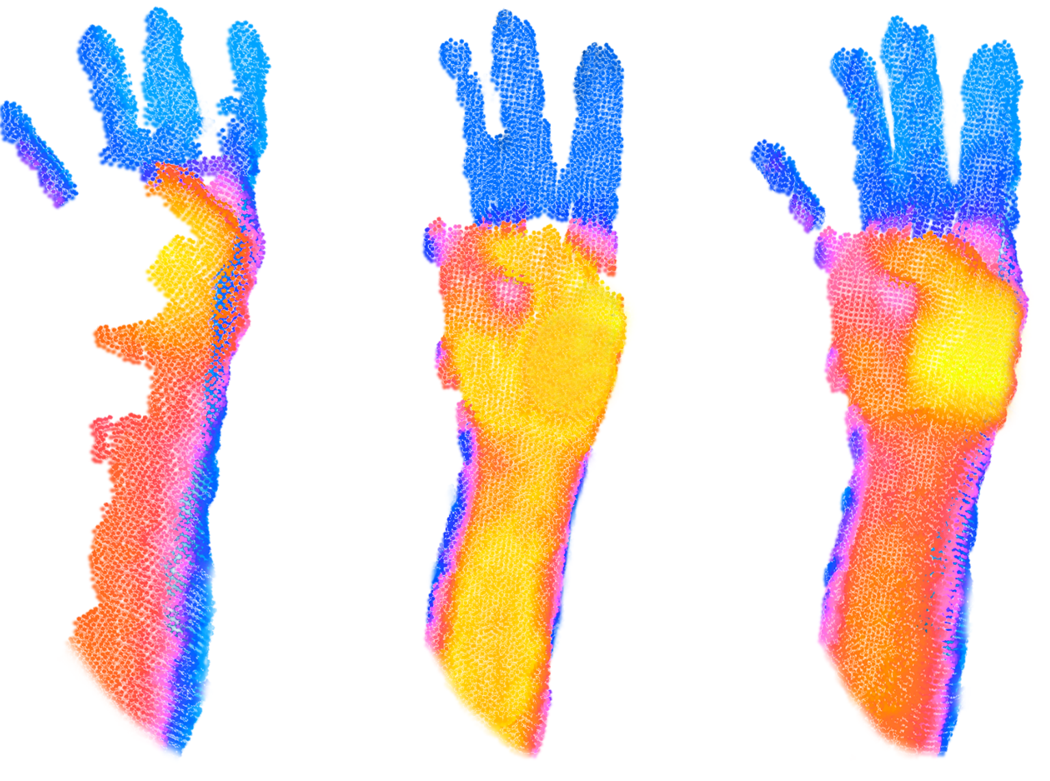
DUODEPTH: STATIC GESTURE RECOGNITION WITH DUAL DEPTH SENSORS
Ilya Chugunov and Avideh Zakhor
University of California, Berkeley
Problem Statement
Model Architecture
Results
Gesture recognition is powerful non-verbal communication tool
Pose of a user’s hands can lead to self-occlusion
Many modern recognition methods sensitive to occlusion
DuoDepth: compares network architectures for dual sensors
Architectures constructed from three base compon-ents: STN3D, FEAT, CLS
FUSED architecture classifies registered and fused point clouds
Identical structure as original PointNet [12]
DUAL-FEAT takes two un-registered point clouds, calculates 3D spatial transforms for each, and concatenates points before feature extraction.
SOLO-FEAT calculates transforms and features independently for two input point clouds, and concatenates features before classification.
STN3D allows spatial transformation of feature maps, produces models invariant to translation, scale, rotation, warping
Compared multi-sensor methods to single camera performance (left/right)
DUAL-FEAT performs best among four architectures
DUAL-FEAT had similar error rate as [31] but on more difficult dataset
Point cloud size: 320 for DUAL-FEAT, 2048 for [31] → larger network to train / slower inference
Fast inference: < 1.2ms on GTX 1080Ti.
SOLO-FEAT had lower accuracy but was resilient to random rotational pert- urbations on data
Possible robotics applications
Data Collection and Processing
1. 2. 3. 4. 5. 6. 7. 8. 9. 10.
Recorded ten static gestures from two RGBD cameras.
Used density of points on Z-axis for segmentation.
Fused point clouds with ICP for FUSED architecture
Augmented data with random translations and point jitter
Left
Right
Fused
Point Cloud Size
[7] Joshua Owoyemi and Koichi Hashimoto, “Spatiotemporal learning of dynamic gestures from 3d point cloud data,” CoRR, vol. abs/1804.08859, 2018.
[10] G. Marin, F. Dominio, and P. Zanuttigh, “Hand gesture recognition with leap motion and kinect devices,” in 2014 IEEE International Conference on Image Processing (ICIP), Oct 2014, pp. 1565–1569.
[12] Charles Ruizhongtai Qi, Hao Su, Kaichun Mo, and Leonidas J.Guibas, “Pointnet: Deep learning on point sets for 3d classifi-cation and segmentation,”CoRR, vol. abs/1612.00593, 2016
[28] Chaoyu Liang, Yonghong Song, and Yuanlin Zhang, “Hand gesture recognition using view projection from point cloud,” 09 2016, pp. 4413–4417.
[31] Cherdsak Kingkan, Joshua Owoyemi, and Koichi Hashimoto, “Point attention network for gesture recognition using point cloud data,” in BMVC, 2018.

