Slide 1
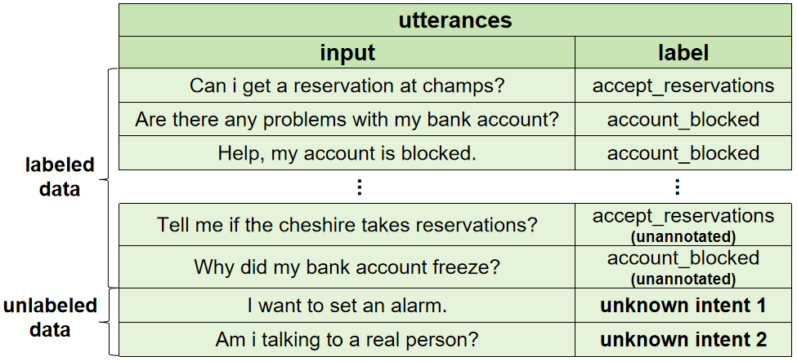
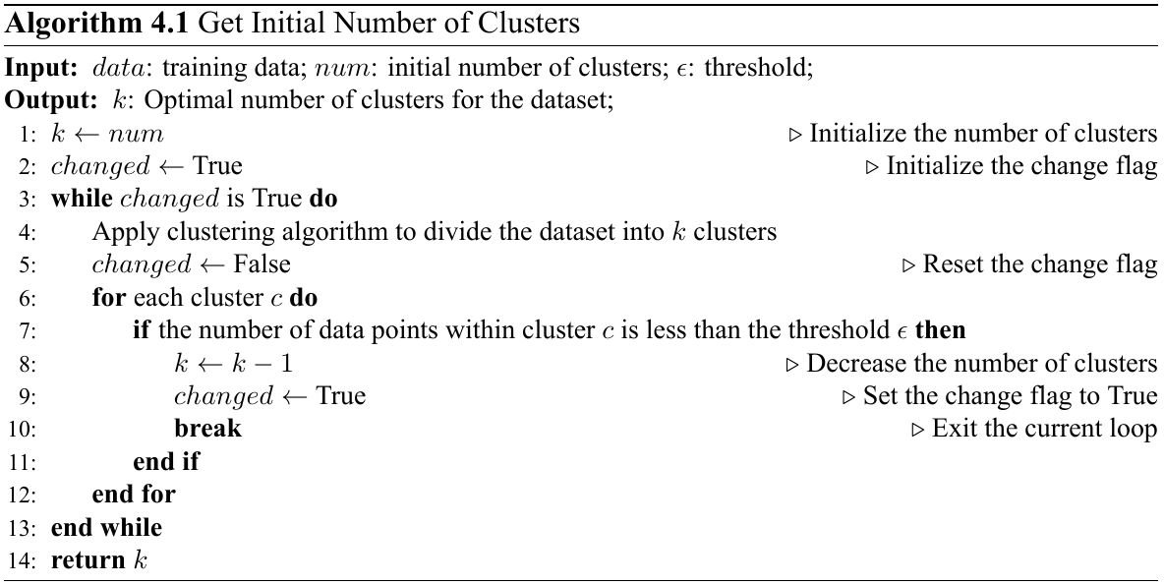
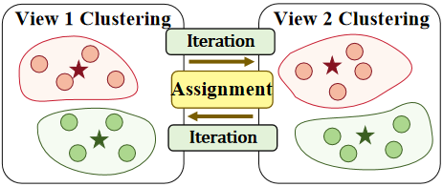
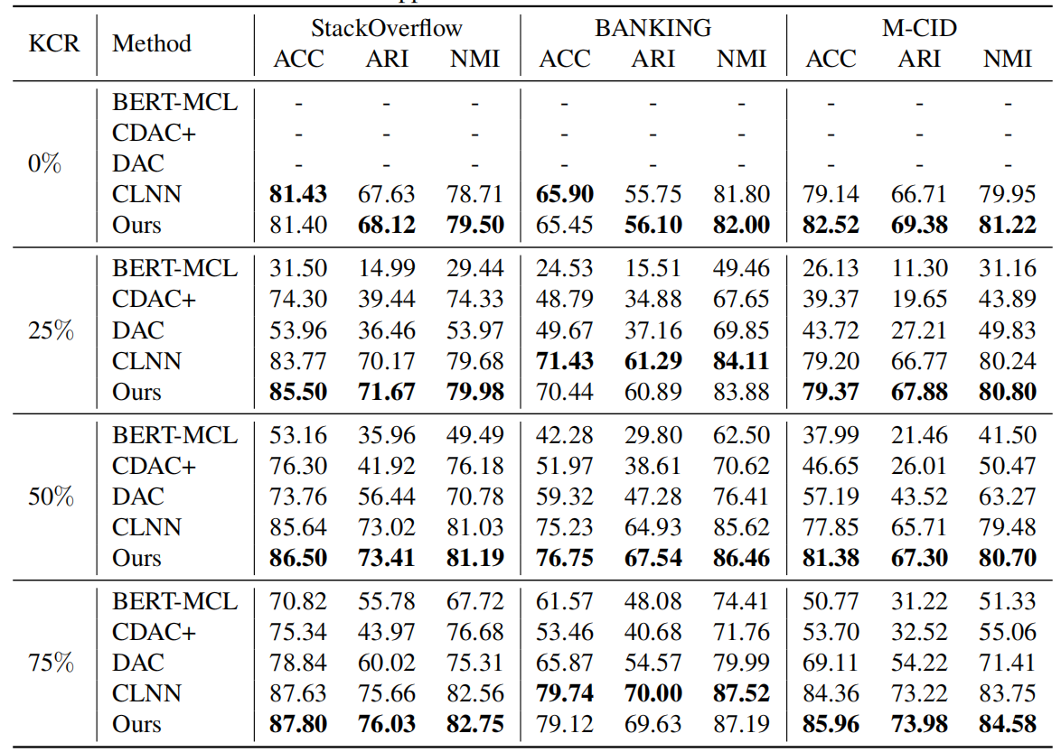
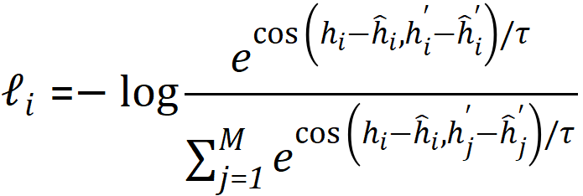
New Intent Discovery With Multi-View Clustering
Han Liu¹, Junjie Sun¹, Xiaotong Zhang¹, Hongyang Chen²
¹ Dalian University of Technology ² Zhejiang Lab
1. Proposed Method
2. Background
5. Multi-View Clustering
Step1: Obtain the initial number of clusters
New intent discovery is proposed to identify new unknown intents in $𝒟_{unlabeled}$ and incorporate the discovered intents into the set of known intent $𝒟_{labeled}$, where $𝒟_{labeled}=\{(x_{i},y_{i})| y_{i} ε 𝒴^{k}\}$ , $𝒟_{unlabeled}=\{x_{i}| y_{i} ε 𝒴^{k}∪𝒴^{u}\}$ .
3. IntentBERT-Based Representation Learning
Step2: Obtain cluster assignment
Obtain text feature representations through multi-task learning (supervised classification task and unsupervised masked language model task)
Through the iterative process, clustering assignment can be gradually optimized to more accurately reflect the semantics and category in the dataset.
Unsupervised setting:
Semi-supervised setting:
6. Experiments
4. PromptBERT-Based Representation Learning
Step1: Integrate domain information
(1) Generate dataset information
(2) Generate label description information
(3) Get domain information
Step2: Obtain text representation
(1) Use prompt templates to construct text representations
(2) Optimize through contrastive learning loss function
Experiment performance of new intent discovery with different known class ratios. For each dataset, the best results are marked in bold. “-” means the method is not applicable in the scenarios.
$KCR=C_{k}/C_{k}+C_{u},$when $KCR=0,$ it is unsupervised setting.

