Slide 1
Pose Guided Person Image Generation Based on Pose Skeleton Sequence and 3D Convolution
Wenbin Zhao, Qing Xie, Yanchun Ma, Yongjian Liu, and Shengwu Xiong
School of Computer Science and Technology, Wuhan University of Technology

Slide 2
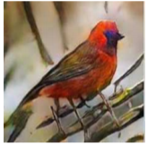
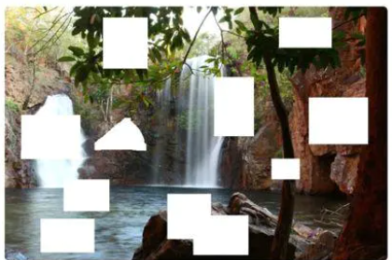
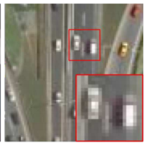
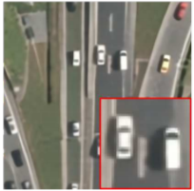
01 Background
Image synthesis
It has a wide range of applications: image generation from a piece of text, image restoration, super-resolution, etc.
This bird is red and brown in color, with a stubby beak.

Slide 3
02 Problem Statement
Pose Guided Person Image Generation
Target Pose
Condition Image
Output Image

Slide 4
03 Challenges
Non-rigid and large deformation, complex clothing details, lack of some keypoints…

Slide 5
04 Intuition
Capturing the geometric constraints between the condition pose and target pose nicely is crucially important to generate a corresponding pose structure

Slide 6
05 Our approach
Pose Transfer Block
$$F_{c}$$
Conv
BN
ReLU
Conv
BN
conv2d
Residual Blocks
con$v_{c}$
$$F_{1}^{p}$$
$$F_{t−1}^{p}$$
$$F_{T}^{p}$$
Condition pose $S_{c}$ (Left)
Target pose $S_{t}$ (Right)
Condition image $P_{c}$
·
$$F_{t}^{p}$$
+
deconv
Conv
BN
ReLU
Conv
Generated image $P_{g}$
Linear Pose Interpolation
$$F_{s}$$
σ
conv3d
$$M$$
con$v_{s}$
$$F_{t−1}^{p}$$
Conv
BN
ReLU
Conv
BN
$$F_{t}^{p}$$
Pose skeleton sequence S
+
con$v_{F}$
Structure of block_t

Slide 7
06 Our approach
Linear pose interpolation and 3D convolutional module
Linear pose interpolation aims to generate the pose skeleton sequence
3D convolutional module was introduced to learn spatiotemporal features from the pose sequence
Condition pose
Target pose

Slide 8
07 Loss function
Adversarial loss
L1 loss
Perceptual loss
Full loss

Slide 9
08 Experiment setting
Dataset
We trained our model on the challenging person re-identification dataset Market-1501. As this dataset contains some images in which no human body is detected by HPE, we remove those images and collect 263632 training pairs
Implementation details
We train our model by Adam optimizer with learning rate of 0.0002, $β_{1}=0.5$, $β_{2}=0.999$.
For the hyperparameters, we set $α, λ_{1},λ_{2}$as 10, 10, 5 for all experiments.
The batch size is set to 32.

Slide 10
08 Qualitative comparisons

Slide 11
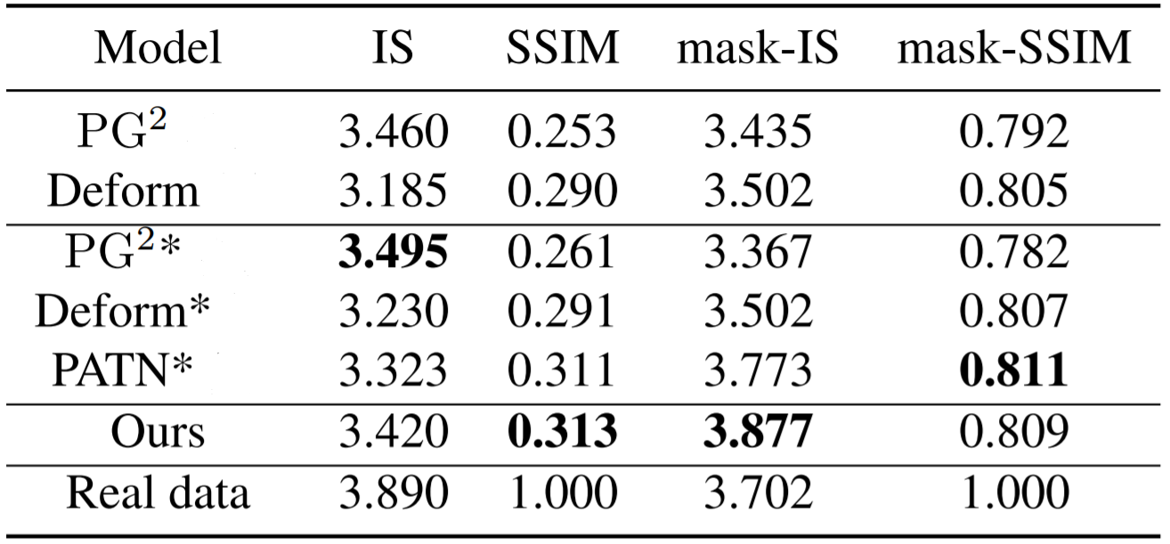
09 Quantitative comparisons
Quantitative results on Market-1501 datasets. * denotes the results tested on our test set

Slide 12
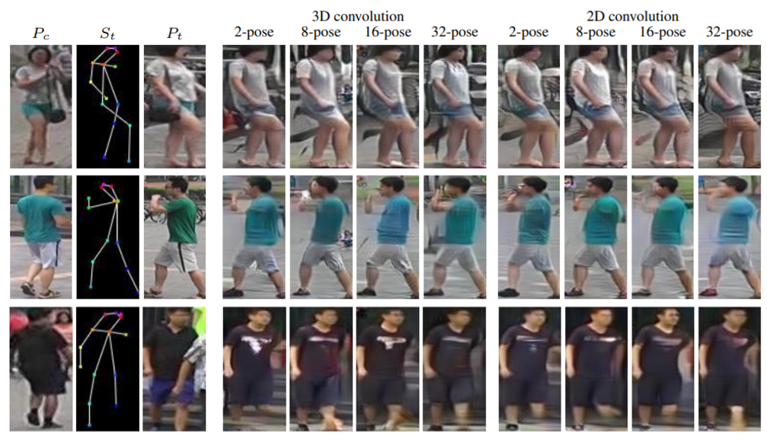
10 Ablation study

Slide 13
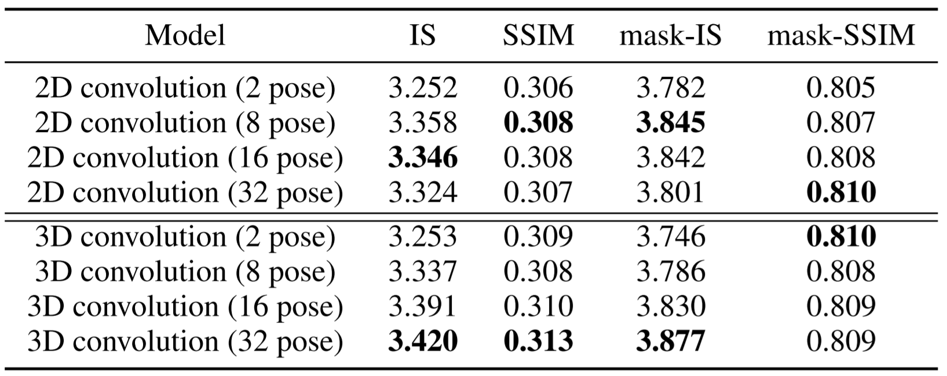
11 Ablation study
Quantitative comparison of the ablation study on Market-1501 dataset

Slide 14
12 Summary
We propose a linear pose interpolation module to generate pose skeleton sequence
3D Convolution is employed in the generator of our model to learn spatiotemporal features

Slide 15
Thanks for your watching!

