Slide 1
AUDIO FEATURE GENERATION FOR MISSING MODALITY PROBLEM IN VIDEO ACTION RECOGNITION
Hu-Cheng Lee, Chih-Yu Lin, Pin-Chun Hsu, Winston H. Hsu
National Taiwan University
Communications & Multimedia Laboratory
Notes:
Hi Everyone. My name is Hu-Cheng Lee
Today I’m really excited to be sharing our work
Audio feature generation for missing modality problem in video action recognition.
This is a joint work with my collaborators at National Taiwan University as well as my advisors.

Slide 2
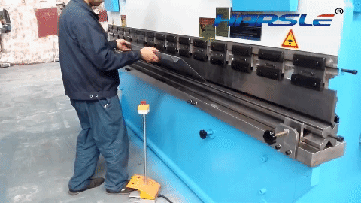
Action Recognition
“bending metal”
Notes:
So
Before we start
We need to know what is action recognition
Given a video, we need to classify what this video is.
For example, there is a man bending the metal in the video.
So we would say this action is “bending metal”
This is action recognition in video.

Slide 3
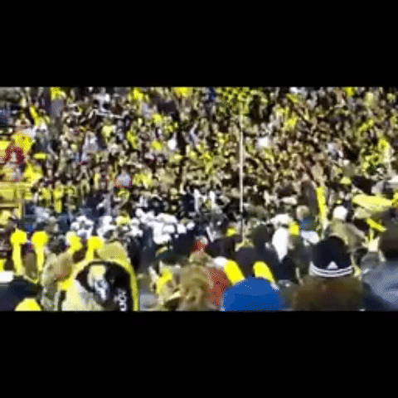
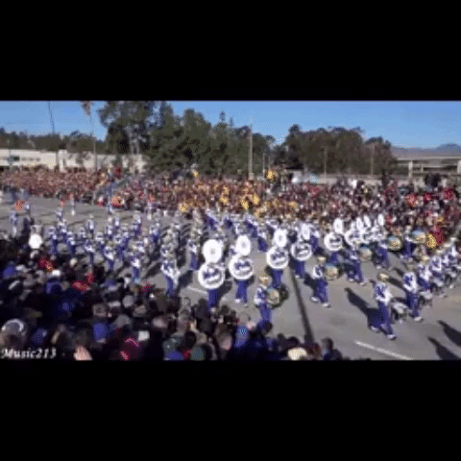
Crowded People
Notes:
So let’s consider one situation.
let’s take a look at these two videos. The left video. There are many audiences watching the baseball. And the right video. There are a lot of marchers parading on the avenue. And we can see that they all share the similar vision, that is crowed people. It is difficult to recognize them only by the vision.
However, let’s listen to the sound track of the video.
First, the left one. Second, it’s the right one.
As you can hear. They sound totally different from each other.

Slide 4
Crowded People
Cheering
Parading
Notes:
So we can recognize them clearly with the help of sound. The left one is cheering. And the right one is parading.

Slide 5
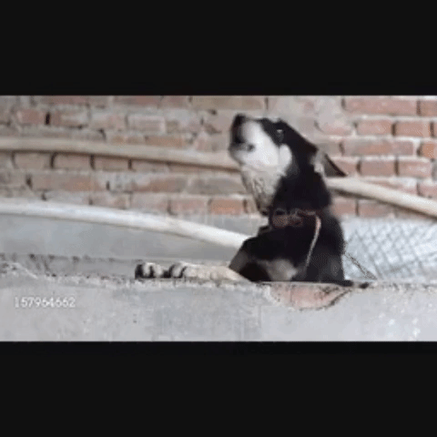
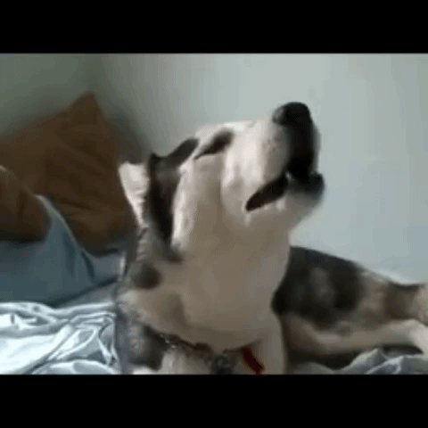
Dog
Notes:
So let’s take a look at another example. We can see that they all look like a dog is barking. However, let’s listen to the sound track of the video again.
First, the left one. Second, it’s the right one.
As you can hear. They sound totally different from each other.

Slide 6
Dog
Barking
Howling
Notes:
The left one , the dog is barking. The right one, the dog is howling. They might have slightly different appearance. But they have huge difference in sound.

Slide 7
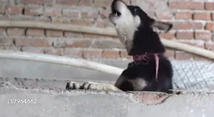
Observation
Action recognition
barking? howling?
confused
t=0,..,T
Only visual appearance
Action recognition
barking howling
t=0,..,T
Visual appearance with sound track
Sound matters in some situation
Notes:
So. Just summarize the example I just mentioned.
If we only
The model may get confused when the input is similar.
However, with the heal of the sound, we can easily tell the difference between two actions.

Slide 8
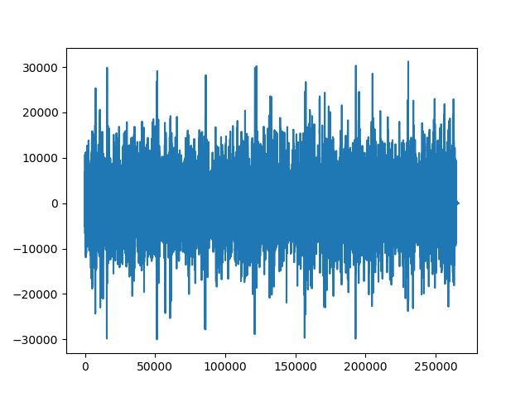
Property of Video
Multi-modal data
Sound matters in some situation
Context information –
RGB
Dynamic information –
optical flow
Acoustic information –
sound
Notes:
And let’s introduce the property of the video. Video is multi-modal data. Usually we will leverage three information from video to help us recognize the action.
And we just mention that sound matters in some situation.

Slide 9
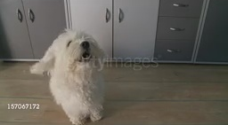
What if
Action recognition
barking? howling?
confused
t=0,..,T
Only visual appearance
Action recognition
barking howling
t=0,..,T
Visual appearance with sound track
t=0,..,T
Visual appearance missing sound track
Notes:
But there’s one problem.
What if there’s no sound track in the video. How do we solve this problem?

Slide 10
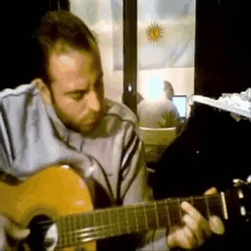
Challenge
In reality, some modalities are not accessible beforehand.
e.g. broken files, limitation of devices, GIF format
Missing Modality Problem
Roughly 44 % videos in Moments in Time (MIT) dataset are soundless
Notes:
But there’s a challenge.
Although we can beneﬁt the action recognition from multi-modal data, in reality, we usually confront the situation that some modalities of data are not accessible beforehand.
For example, we may confront the situation such as broken files, limitation of devices, GIF format
We deﬁne such situation as Missing Modality Problem.

Slide 11
Intuition
Existing
Existing
Missing
RGB
optical flow
sound
Generate the missing modality from existing modalities
Notes:
With the help of sound, we can easily discriminate some kinds of action classes.
How do we solve this problem?
Our intuition is.
Since most of the time, we have context information, dynamic information which is RGB, optical flow, but don’t have sound.

Slide 12
Our Goal
We want to tackle the Missing Modality Problem
We formulate our solution into cross-modality generation
Audio Feature Generation
enhancing the performance of action recognition
Audio Feature Generation
Action recognition
barking
t=0,..,T
Visual appearance missing sound track
Notes:
So
Our Goal is that we want to solve the missing modality problem
And based on our observation and intuition, we formulate our solution into cross-modality generation
In this case, that is audio feature generation
Given a video without the sound, we want to generate the audio feature by our model, and thus enhance the performance of action recognition

Slide 13
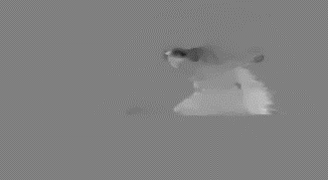
Our proposed architecture
Sound feature reconstruction
Feature extractor
RGB
$$v_{r,t}$$
Sound feature generator
$$I_{r,t}$$
$$v_{c,t}$$
Action classifier
$$I_{f,t}$$
$$v_{f,t}$$
Optical Flow
Notes:
Alright, let’s delve into technical details
We can think of this as … where …
Let’s take a look at the …. In A liitle bit more details
For dataset, we leverage
Since this is
So let’s take a look at our results
Overview of our proposed architecture:
Since we possess spatial and temporal modality rather than auditory modality, we intuitively formulate our problem into cross-modality generation problem.
We have two main architecture: (a) LSTM-based sound generator and (b) autoencoder-based sound generator.

Slide 14
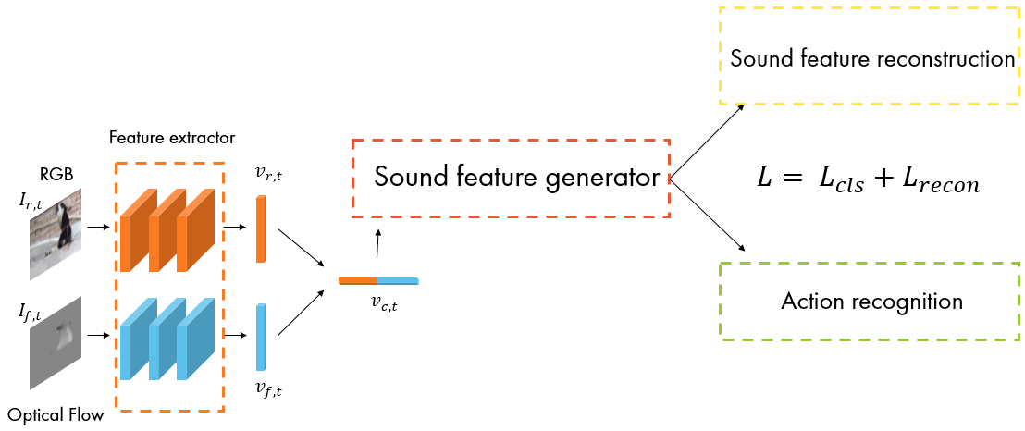
Sound Feature Generator
We exploit two architectures for our sound feature generator
LSTM
autoencoder
LSTM
autoencoder
LSTM
LSTM
…
LSTM
$$v_{c,t}$$
$$v_{c,t}$$
Notes:
Since video has the property of continuity, we want to exploit the context information among a sequence of frames.
Therefore, we use two architecture as our generation structure, LSTM and autoencoder
要分開work

Slide 15
Sound Feature Reconstruction
We need to extract the sound feature from raw signal first
AENet [1]
VGGish [2]
We utilize two kinds of loss for reconstruction ($L_{recon}$)
$L_{2}$
$KL−divergence$
Ground truth
sound feature extractor
$$r(y)$$
$$r(\hat{y})$$
Sound feature generator
$$L_{recon}$$
Sound feature reconstruction
[1] Takahashi, Naoya, Michael Gygli, and Luc Van Gool. "Aenet: Learning deep audio features for video analysis." IEEE Transactions on Multimedia 20.3 (2018): 513-524.
[2] Gemmeke, Jort F., et al. "Audio set: An ontology and human-labeled dataset for audio events." Acoustics, Speech and Signal Processing (ICASSP), 2017 IEEE International Conference on. IEEE, 2017.
Notes:
So before we reconstruct the sound feature, we need to extract the sound feature from raw signal first.
Here we try two sound feature extractor, AENet and VGGish.
AENet and VGGish Pretrained
They will extract the ground truth sound feature.
Then our sound feature generator will generate the sound feature from RGB and optical flow.
We want to reconstruct the sound feature.
Here we utilize two kinds of loss for reconstruction
L2 and KL divergence

Slide 16
Action Classifier Loss
Classification loss ($L_{cls}$) is identical to those defined in action recognition
Cross-entropy loss
$$p(y)$$
$$p(\hat{y})$$
Sound feature generator
$$L_{cls}$$
Action classifier
Notes:
Our sound feature will not only be constrained by reconstruction, it will also be constrained by action recognition. The classification loss is identical…. Here we use cross-entropy loss.

Slide 17
Multi-task loss
${L= L}_{cls}{+ L}_{recon}$
Sound feature reconstruction
Feature extractor
RGB
$$v_{r,t}$$
Sound feature generator
$${L= L}_{cls}{+ L}_{recon}$$
$$I_{r,t}$$
$$v_{c,t}$$
Action classifier
$$I_{f,t}$$
$$v_{f,t}$$
Optical Flow
Notes:
So our whole framework is trained by multi-task loss
Which is classification loss and reconstruction loss
Alright, let’s delve into technical details
We can think of this as … where …
Let’s take a look at the …. In A liitle bit more details
For dataset, we leverage
Since this is
So let’s take a look at our results
Overview of our proposed architecture:
Since we possess spatial and temporal modality rather than auditory modality, we intuitively formulate our problem into cross-modality generation problem.
We have two main architecture: (a) LSTM-based sound generator and (b) autoencoder-based sound generator.

Slide 18
Training and Testing Stage
Training Stage
Audio Feature Generator
Simulated audio feature
t=0,..,T
Visual appearance with sound track
Testing Stage
Audio Feature Generator
Action recognition
barking
t=0,..,T
Late fusion
Visual appearance missing sound track
Notes:
To summarize our whole process.
I just mention that 44% videos in our dataset are soundless.
So At training stage,
we use the 56% videos with sound to train the audio feature generator, since they have the sound of ground truth.
Then
At testing stage,
We will generator the sound feature for those soundless video.
And then use the sound feature to enhance the performance of the action recognition.

Slide 19
Dataset
Moments in Time Dataset (MIT Dataset)
a large-scale human-annotated collection of 3-second videos.
We use mini-track of the dataset.
200 different classes.
# of videos | Training | Validation
With sound | 55196 | 6286
Without sound | 44804 | 3714
total | 100000 | 10000
Notes:
For dataset
We choose moments in time dataset
It’s a large-scale human-an…
There’re hundred thousand videos in training
Then thousand videos in validation
Alright, let’s delve into technical details
We can think of this as … where …
Let’s take a look at the …. In A liitle bit more details
For dataset, we leverage
Since this is
So let’s take a look at our results
Overview of our proposed architecture:
Since we possess spatial and temporal modality rather than auditory modality, we intuitively formulate our problem into cross-modality generation problem.
We have two main architecture: (a) LSTM-based sound generator and (b) autoencoder-based sound generator.

Slide 20
Results
We aim to explore the best combination of our audio feature simulated framework
For AENet sound feature
LSTM-based sound generator with L2 loss, w/o classifier, is the best generation architecture
AENET |  | Top-1 (%) | Top-5 (%)
w/o generation (baseline) |  | 4.41 | 11.78
LSTM
L2 Loss | w/ classifier | 4.53 | 11.69
 | w/o classifier | 5.19 | 13.44
KL Div. | w/ classifier | 4.47 | 11.50
 | w/o classifier | 4.45 | 11.40
Autoencoder
L2 Loss | w/ classifier | 4.70 | 11.70
 | w/o classifier | 4.70 | 11.70
KL Div. | w/ classifier | 4.52 | 11.48
 | w/o classifier | 4.55 | 11.60
Notes:
So let’s take a look at our results
For our sound feature generator.
We try so a lot of sound feature extractor, loss function, and with or without classifier.
We aim to explore the
So we use directly use sound feature to classify the video.
For aenet sound feature.
Without the generation, action recognition top-1 accuracy is about 4.41%
And after generation, we can see that performance of all combination are enhanced

Slide 21
Results
We aim to explore the best combination of our audio feature simulated framework
For VGGish sound feature
Autoencoder-based sound generator with L2 loss, with classifier, is the best generation architecture
VGGish |  | Top-1 (%) | Top-5 (%)
w/o generation (baseline) |  | 1.57 | 7.29
LSTM
L2 Loss | w/ classifier | 1.54 | 6.91
 | w/o classifier | 1.95 | 7.59
KL Div. | w/ classifier | 1.59 | 6.85
 | w/o classifier | 1.59 | 6.83
Autoencoder
L2 Loss | w/ classifier | 2.19 | 7.86
 | w/o classifier | 2.11 | 7.84
KL Div. | w/ classifier | 1.71 | 7.23
 | w/o classifier | 1.72 | 6.90
Notes:
For VGGish

Slide 22
Results
Experiments shows that after generation, the results all surpass those without generation
AENET |  | Top-1 (%) | Top-5 (%)
w/o generation (baseline) |  | 4.41 | 11.78
LSTM
L2 Loss | w/ classifier | 4.53 | 11.69
 | w/o classifier | 5.19 | 13.44
KL Div. | w/ classifier | 4.47 | 11.50
 | w/o classifier | 4.45 | 11.40
Autoencoder
L2 Loss | w/ classifier | 4.70 | 11.70
 | w/o classifier | 4.70 | 11.70
KL Div. | w/ classifier | 4.52 | 11.48
 | w/o classifier | 4.55 | 11.60
VGGish |  | Top-1 (%) | Top-5 (%)
w/o generation (baseline) |  | 1.57 | 7.29
LSTM
L2 Loss | w/ classifier | 1.54 | 6.91
 | w/o classifier | 1.95 | 7.59
KL Div. | w/ classifier | 1.59 | 6.85
 | w/o classifier | 1.59 | 6.83
Autoencoder
L2 Loss | w/ classifier | 2.19 | 7.86
 | w/o classifier | 2.11 | 7.84
KL Div. | w/ classifier | 1.71 | 7.23
 | w/o classifier | 1.72 | 6.90

Slide 23
Results
Our proposed method outperforms other methods.
We can see significant improvements over each modality input modality as well as over the late-fused results.
Method | Top-1 (%) | Top-5 (%)
RGB (spatial) | 24.23 | 50.86
Flow (temporal) | 12.28 | 29.90
RGB + Flow (fusion) | 27.02 | 52.50
RGB + AENet | 26.69 | 52.62
RGB + VGGish | 23.54 | 49.56
RGB + AENet (Gen-LSTM) | 26.91 | 52.93
RGB + AENet (Gen-AE) | 26.78 | 52.58
RGB + VGGish (Gen-LSTM) | 25.96 | 51.77
RGB + VGGish (Gen-AE) | 26.02 | 51.75
Fusion + AENet (Gen-LSTM) | 28.19 | 53.73
Fusion + VGGish (Gen-AE) | 27.58 | 53.29
Notes:
Finally, after choosing our best audio feature generation framework, we demonstrate the whole action recognition results with our simulated features.
With our sound feature generation, we can see the improvements of the accuracy.

Slide 24
Improvement ranking
We list the top-3 improved action class.
For those sound-related actions such as whistling
nearly every video has sound track in dataset
they will not be improved so much after audio feature generation.
However, we can still improve the performance by those soundless yet sound-related videos such as boiling and swimming.
(RGB + Sound) vs. RGB | (RGB + Sound(gen)) vs. RGB | (RGB + Sound) vs. (RGB + Sound(gen))
whistling | whistling | boiling
howling | howling | wrapping
chewing | mowing | swimming
Notes:
We compare the performance of each action class after the adding of sound feature
and list the top-3 improved classes
the most-improved classes of original sound feature ((R+S) vs.R) are nearly identical to those of simulated sound feature ((R+S(gen)) vs.R)
However, Table. 2, 3 demonstrate that the accuracy of simulated features perform better than that of original features
We know that after the generation, the performance are improved. So we want to know what classes are improved the most after the generation
That is we compare rgb+sound, rgb+sound(gen)
For those…
They all have sound of water

Slide 25
Conclusion
To cope with the missing modality problem, we propose an approach to simulating deep audio feature from merely spatial-temporal data.
We demonstrate that simulating sound feature significantly assists our action recognition model.
Our proposed method performs favorably against two-stream method on MIT Dataset.
Notes:
So here’s the conclusion.

Slide 26
Thank you for your listening
Notes:
So here’s the conclusion.

Slide 27
Method | Top-1 (%) | Top-5 (%)
RGB (spatial) | 24.23 | 50.86
Flow (temporal) | 12.28 | 29.90
RGB + Flow (fusion) | 27.02 | 52.50
RGB + AENet | 26.69 | 52.62
RGB + VGGish | 23.54 | 49.56
RGB + AENet (Gen-LSTM) | 26.91 | 52.93
RGB + AENet (Gen-AE) | 26.78 | 52.58
RGB + VGGish (Gen-LSTM) | 25.96 | 51.77
RGB + VGGish (Gen-AE) | 26.02 | 51.75
Fusion + AENet (Gen-LSTM) | 28.19 | 53.73
Fusion + VGGish (Gen-AE) | 27.58 | 53.29
(R+S) vs. R | (R+S(gen)) vs. R | (R+S) vs. (R+S(gen))
whistling | whistling | boiling
howling | howling | wrapping
chewing | mowing | swimming

Slide 28
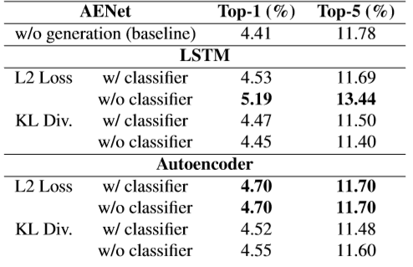
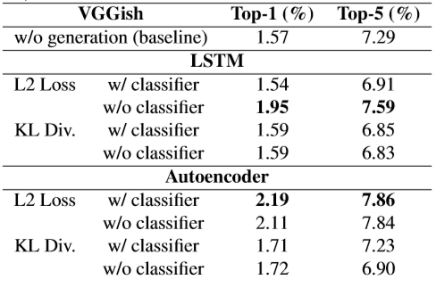
Results
We aim to explore the best combination of our audio feature simulated framework
For AENet sound feature
LSTM-based sound generator with L2 loss, w/o classifier, is the best generation architecture
For VGGish sound feature
Autoencoder-based sound generator with L2 loss, with classifier, is the best generation architecture
Experiments shows that after generation, the results all surpass those without generation, which shows that after adding simulating sound feature, it will definitely improve the accuracy of action recognition.
Notes:
First, we try to discuss the effectiveness of the sound feature(AENet and VGGish) for action recognition.
We compare the different combination of sound generation strategies in Table
Afterwards, we aim to explore the best combination of our audio-simulated framework.
LSTM-based sound generator with L2 loss, w/o classifier, is the best architecture for AENet sound feature.
Autoencoder-based sound generator with L2 loss, with classifier, is the best architecture for VGGish sound feature.

Slide 29
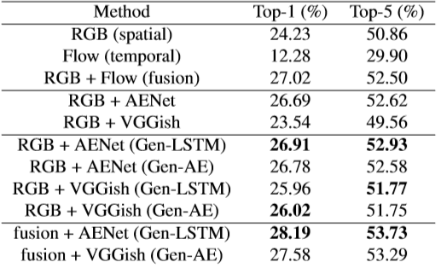
Results
Finally, after choosing our best audio feature generation framework, we demonstrate the whole action recognition results with our simulated features.
Our proposed method outperforms other methods.
We can see significant improvements over each modality input modality as well as over the late-fused results.
Notes:
We can see significant improvements over each modality input modality as well as over the late-fused results.
Bullet points

Slide 30
Our proposed architecture
$$r(y)$$
$$r(\hat{y})$$
Sound feature generation
LSTM
Sound feature reconstruction
Feature extractor
RGB
$$v_{r,t}$$
LSTM
LSTM
…
LSTM
$$I_{r,t}$$
$$x$$
$$I_{f,t}$$
$$v_{c,t}$$
Action recognition
$$p(y)$$
$$p(\hat{y})$$
$$v_{f,t}$$
Optical Flow
(a) Sound generator - LSTM
Notes:
Alright, let’s delve into technical details
We can think of this as … where …
Let’s take a look at the …. In A liitle bit more details
For dataset, we leverage
Since this is
So let’s take a look at our results
Overview of our proposed architecture:
Since we possess spatial and temporal modality rather than auditory modality, we intuitively formulate our problem into cross-modality generation problem.
We have two main architecture: (a) LSTM-based sound generator and (b) autoencoder-based sound generator.

Slide 31
Our proposed architecture
Sound feature generation
autoencoder
Feature extractor
$$l$$
RGB
$$v_{r,t}$$
$$I_{r,t}$$
$$x$$
$$v_{c,t}$$
$$p(y)$$
$$I_{f,t}$$
$$r(y)$$
$$p(\hat{y})$$
$$v_{f,t}$$
Action recognition
Optical Flow
$$r(\hat{y})$$
Sound feature reconstruction
(b) Sound generator - autoencoder

Slide 32
Related work (sound feature extraction)
Takahashi [1] proposed a new deep network for audio event recognition, called AENet. They perform transfer learning and show that their model learned generic audio features, similar to the way CNNs learn generic features on vision
Gemmeke [2] used various CNN architectures to classify the soundtracks of a dataset of 70M training videos (5.24 million hours) with 30,871 video-level labels. They examine fully connected Deep Neural Networks (DNNs), AlexNet, VGG, Inception, and ResNet.
[1] Takahashi, Naoya, Michael Gygli, and Luc Van Gool. "Aenet: Learning deep audio features for video analysis." IEEE Transactions on Multimedia 20.3 (2018): 513-524.
[2] Gemmeke, Jort F., et al. "Audio set: An ontology and human-labeled dataset for audio events." Acoustics, Speech and Signal Processing (ICASSP), 2017 IEEE International Conference on. IEEE, 2017.

Slide 33
Proposal
our model
generate
Sound feature
RGB
Late fusion
Video input
Action recognition
Optical flow
Notes:
Sound generation

