Slide 1
INDOOR DENSE DEPTH MAP AT DRONE HOVERING
Arindam Saha, Soumyadip Maity, Brojeshwar Bhowmick
8th October 2018

Slide 2
Content
Motivation & Problem Statement
Structure from Small Motion (SfSM)
Literature survey
Proposed Methodology
Novelty
Detail description (Segmentation & Depth Propagation)
Experimental Result

Slide 3
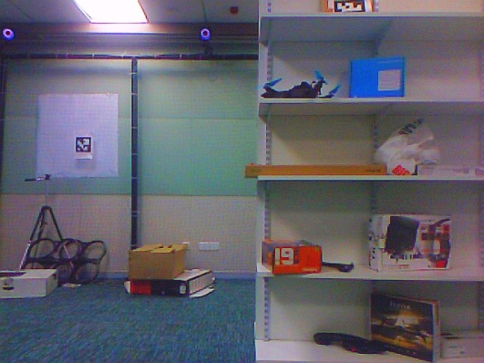
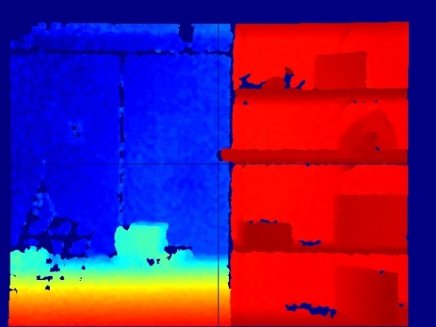
Motivation & Problem Statement
Drone Capture
vSLAM produces sparse point cloud
Near Obstacle
Open space
Far
Real-time dense reconstruction or dense visual SLAM is computationally very heavy.
So there exist a requirement of a computationally light weight real-time solution for dense depth estimation.
Near
But this is actually require

Slide 4
Structure from Small Motion (SfSM)
Dense depth map estimation on SfSM configuration is computationally less complex.
So dense depth estimation at drone hovering using SfSM configuration (small baseline images) is a feasible approach.

Slide 5
Limitations in State of the Art (SoA)
Traditional visual SLAMs [ORB, cvpr 14; PL, ICRA 17; Edge, ICCV 2017] produce erroneous metric depth when the baseline is less than ∼8 mm and viewing angle of a 3D point is less than 0.2◦ [Yu F., cvpr 14].
There exists depth estimation inaccuracy in SfSM system on planer surfaces, object boundary etc.
Execution time more than several minutes.

Slide 6
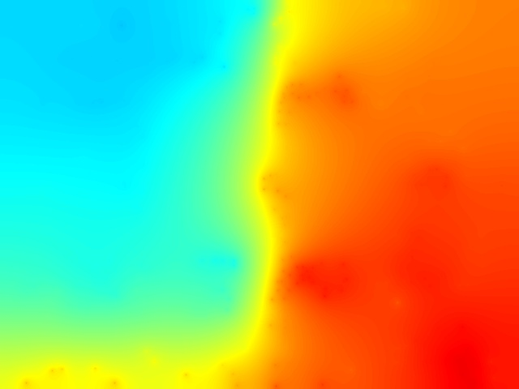
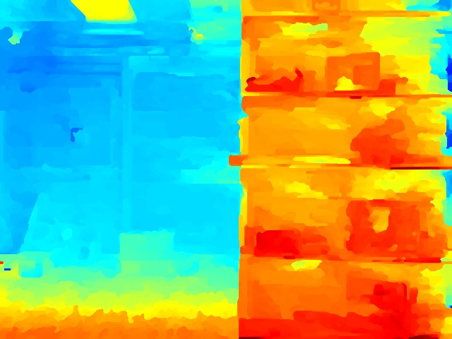
Limitation in SoA (Cont.)
Far
Near
Reference Image (Lab-room dataset)
Kinect Depth Map
Depth Map using S. Im et al. ICCV 15
Depth Map using H. Ha et al. CVPR 16

Slide 7
Proposed Methodology
Sparse reconstruction using Edge SLAM while drone is on move. Outputs are sparse point cloud and key frame poses.
Estimate the poses (without BA) of small motion images (at drone hovering) using Edge SLAM.
Segment the visible space with sudden depth changes.
Dense depth propagation for every segment independently.

Slide 8
Novelty
The visible space is segmented based on sparse reconstruction and depth propagation runs independently on every segment.
Patch based plane fitting approach is proposed through minimizing a cost function consisting of sparse 3D points, intensity and gradients of pixels and co-planarity with neighbouring patches.
We attach a weight with cost of every patch based on its depth initialization. Further add that cost for minimization when the weight is below to certain threshold.

Slide 9
Segmentation
Segment the visible 3D space based on sparse point cloud using a combination of nearest neighbour clustering and colour similarity between 3D points.
Segment the reference image using a colour based region growing segmentation.
Reference Image

Slide 10
Depth Propagation
Cost Function =
Geometric Consistency
Gradient Matching
Pairwise Regularization
Photo Consistency
ω represents the set patches in a segment. Nω is the set neighbouring patches of patch p.
φp represents the set of sparse 3D points whose projection lies within the patch p boundary and η = |φp | and area(φp) represents the 2D projected area of points in φp and ∆ is a given threshold.

Slide 11
Depth Propagation (Cont.)
Geometric consistency =
∂ denotes the average reprojection error for the point i ∈ φp. It provides lower weight to the sparse 3D points having high reprojection error.
Photo-consistency =
θ is the set of pixels in patch p.

Slide 12
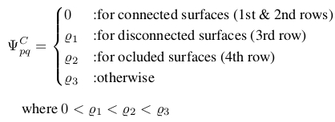
Depth Propagation (Cont.)
(a)
(b)
(c)
(d)
Regularization =

Slide 13
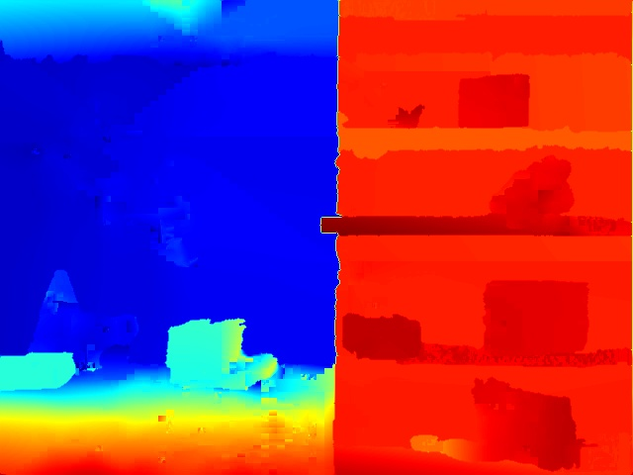
Results
We perform all our experiments on 640x480 VGA resolution.
Our method takes ∼14 sec using 20 images.
Far
Near
Our depth estimation in Lab-room dataset

Slide 14
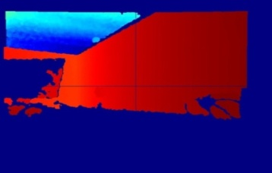
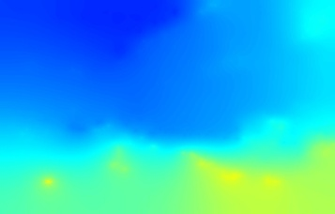
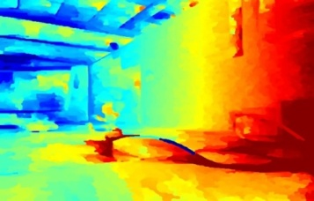
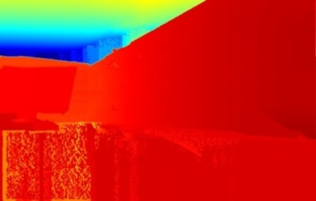
Results (Cont.)
Office-Space dataset
Kinect
S. Im et al. ICCV 15
H. Ha et al. CVPR 16
Ours
The mean error in depth estimation using our method against Kinect point cloud is 0.2352 meter whereas method by H. Ha et al. CVPR 16 producing 2.11575 meters errors.

Slide 15
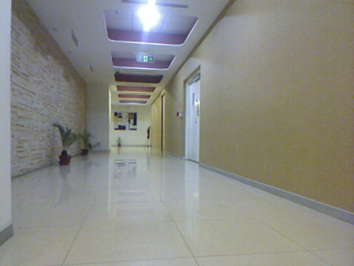
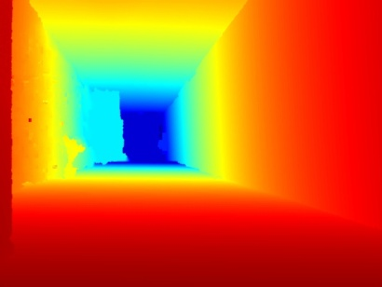
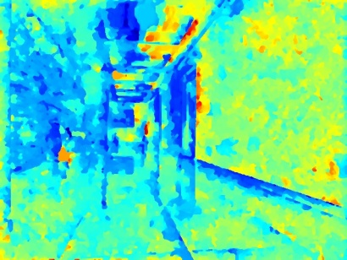
Results (Cont.)
Depth map using our method
Objects are identified successfully
S. Im et al. ICCV 15
H. Ha et al. CVPR 16

Slide 16
Thank You

