Slide 1
Retrieval-Augmented Natural Language Reasoning for Explanable Visual Question Answering
Su Hyeon Lim, Minkuk Kim, Hyeon Bae Kim, Seong Tae Kim*
IEEE International Conference on Image Processing (ICIP) LVLM Workshop, 2024
Oct. 29, 2024
Presenter: Hyeon-bae Kim
Augmented Intelligence Lab
Kyung Hee University, Republic of Korea

Slide 2
Contents
01.
Introduction
02.
Method
03.
Experiments
04.
Conclusion

Slide 3
1. Introduction

Slide 4
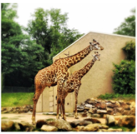
1. Introduction
Task
Visual Question Answering with Natural Language Explanation (VQA-NLE)
Query Image
Answer
Giraffe
Explanation
because it has long neck and covered with yellow skin
Question
What is this animal?
Input
Model
Output
Answer = VQA
Answer + Explanation = VQA-NLE
When given an image and a question as inputs, the model generates both the correct answer and an explanation for that answer.

Slide 5
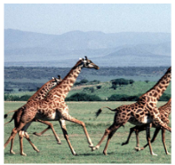
1. Introduction
Motivation
Human cognitive process
Recall relative information
What is this animal?
Giraffe because their skin is covered with black spot and has tall neck
Query Image
Answer
Giraffe
Explanation
because it has long neck and covered with yellow skin
Question
What is this animal?
Input
Human
Output
Humans recall relevant information to understand the provided information. Based on recalled information, human can provide answer with reason.

Slide 6
1. Introduction
Model Design
Retrieval Augmented Generation (RAG)
Memory Database
Question
Question
What is this animal?
·  
What is this animal?
Explanation
Explanation
Giraffe because their skin is covered with black spot and has tall neck
·  
Selected
Giraffe because their skin is covered with black spot and has tall neck
Query Image
Query
Retrieval
Answer
Giraffe
Explanation
because it has long neck and covered with yellow skin
Question
What is this animal?
Input
Model
Output
We adopted Retrieval Augmented Generation, designing our approach to retrieve relevant information from Memory Database and utilize it as additional context.

Slide 7
1. Introduction
Contributions
Our motivation
Our work was inspired by the human cognitive process, specifically the way people search for relevant information from their memory.
Contributions
We propose Retrieval-augmented Natural Language Reasoning (ReRe), a method specifically designed to enhance the NLE task with retrieval, particularly for the VQA-NLE task.
ReRe shows improvement in explanations compared to other state-of-the-art methods.

Slide 8
2. Method

Slide 9
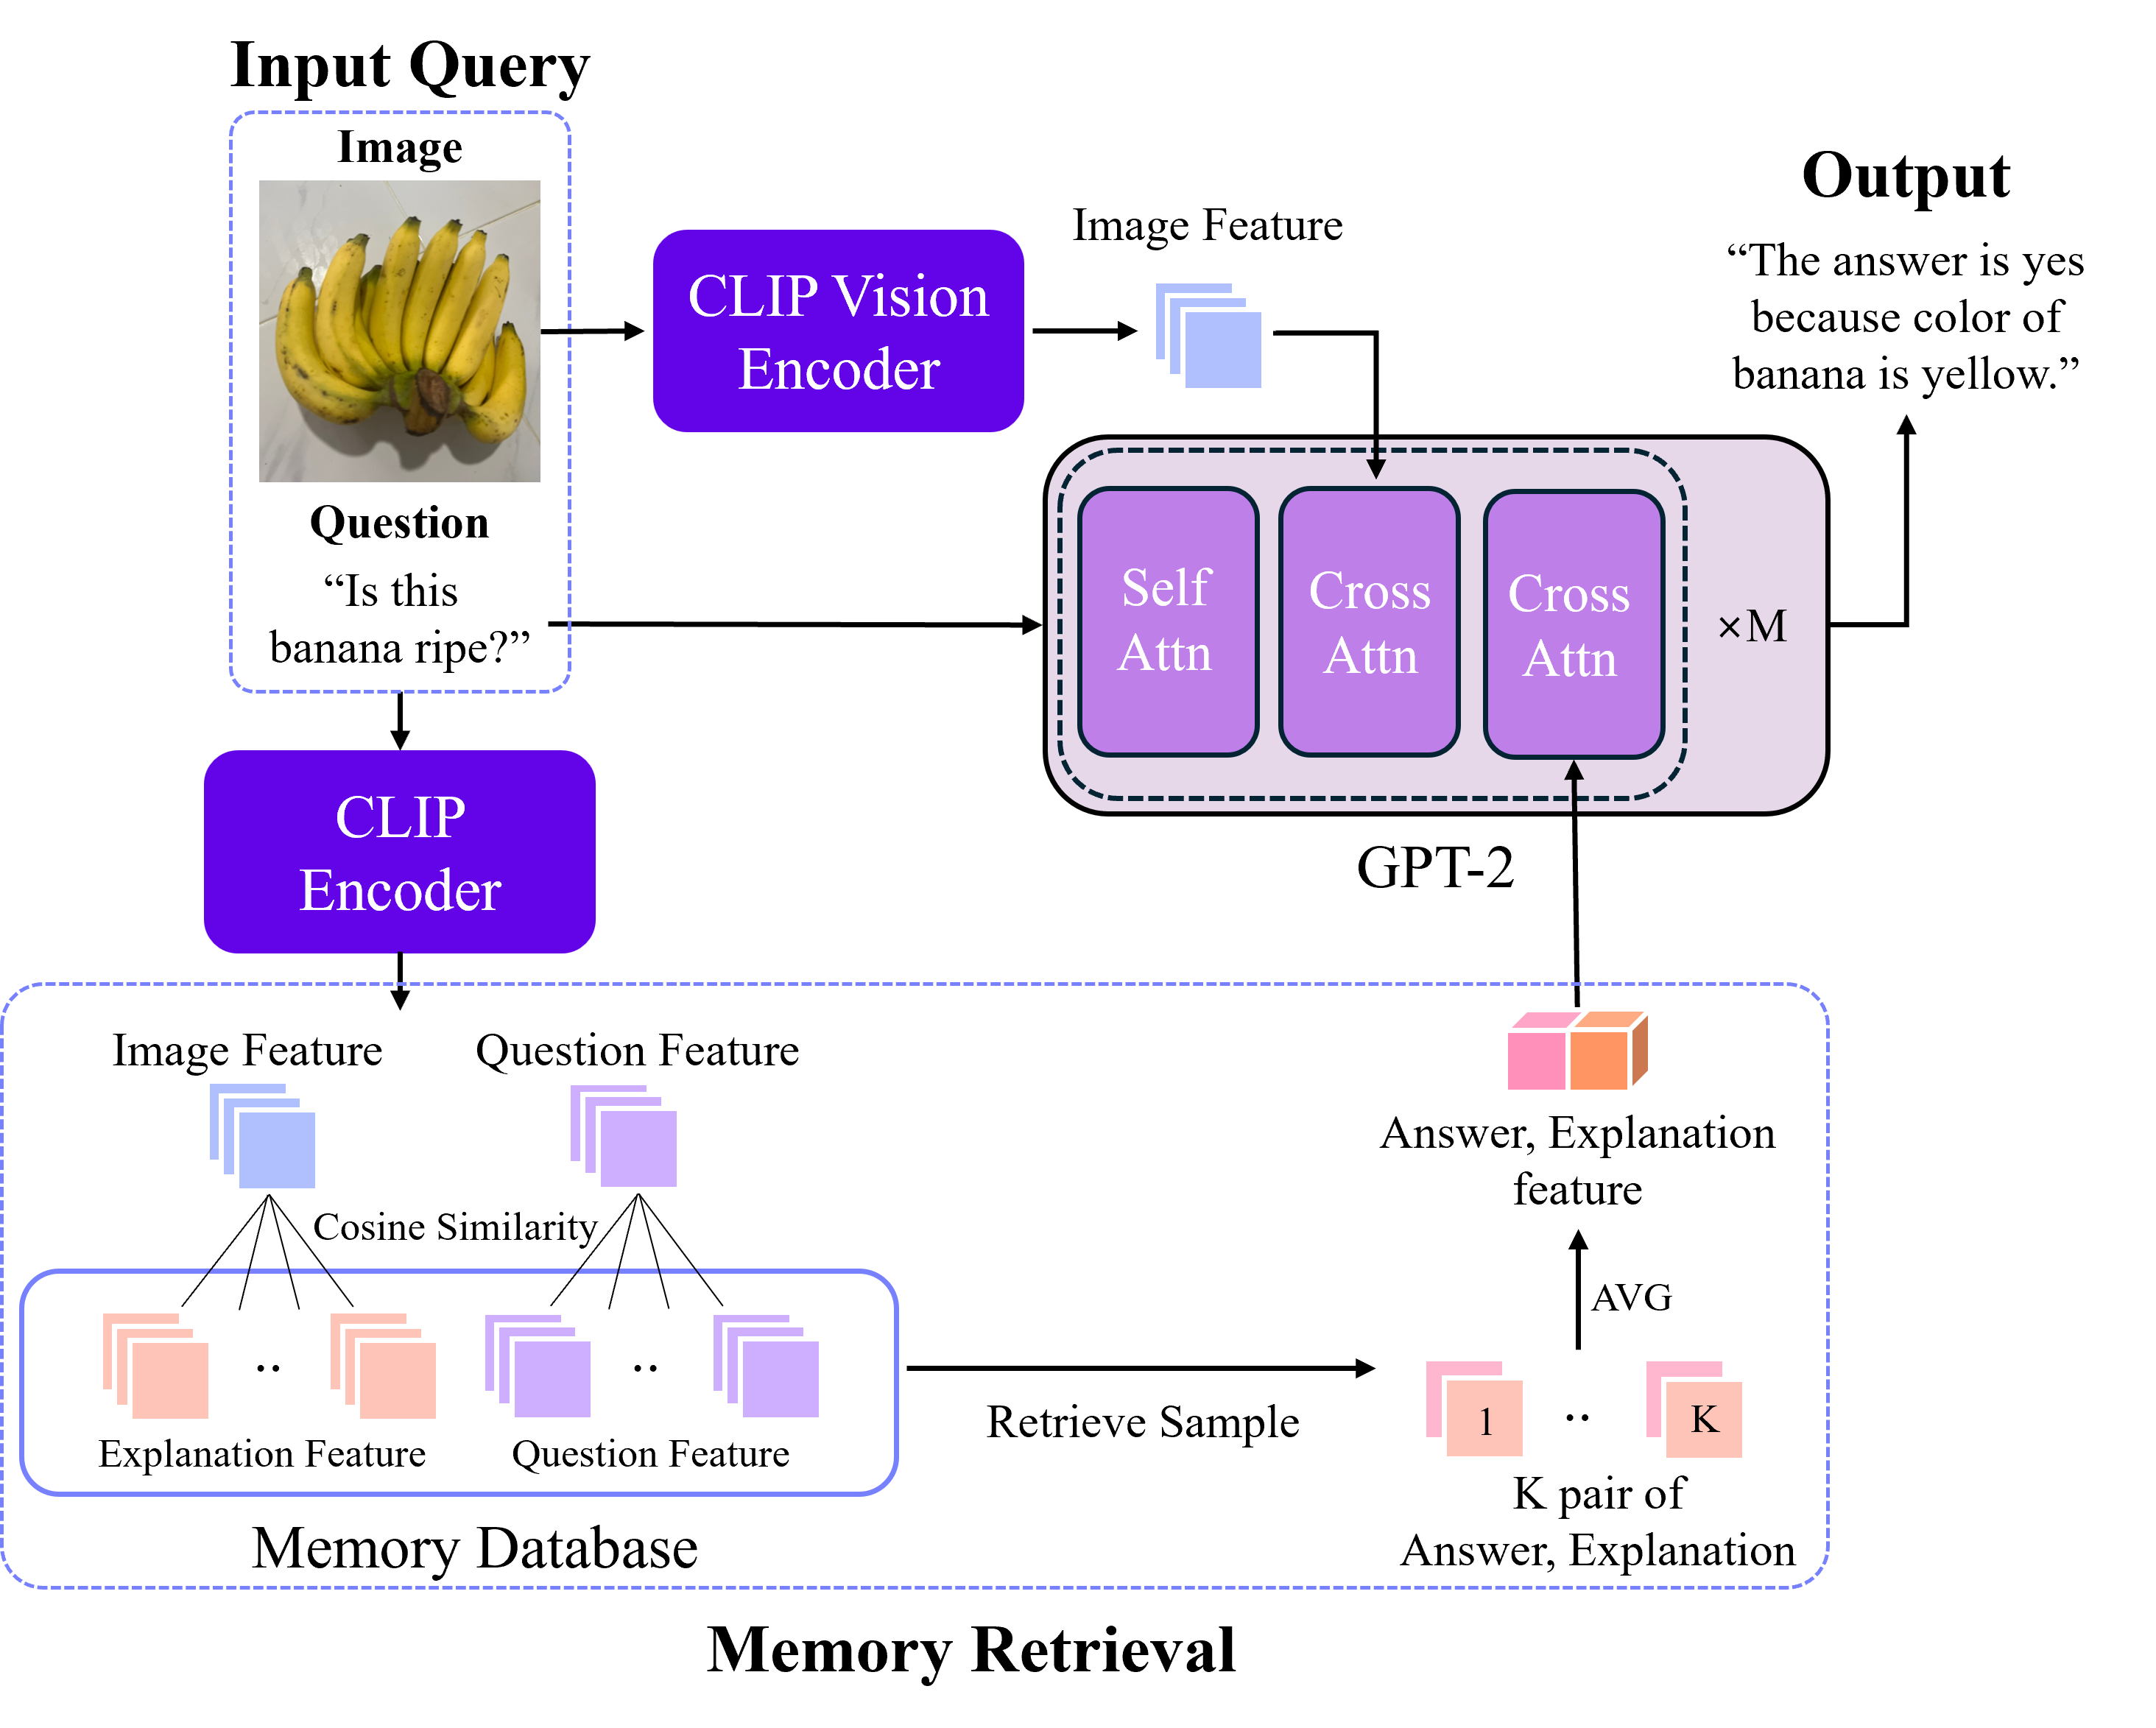
2. Method
Overview
Retrieval-augmented natural language Reasoning (ReRe)
Model Architecture
Visual Encoder : Pre-trained CLIP-L
Language Model : Pre-trained Distilled GPT-2
(Frozen during training)
RAG
Memory Database : constructed using CLIP feature
$${Score}_{Retrieval}=\cos\left(Q_{q},Q_{s}\right)+cos⁡(I_{q},E_{s})$$
Feature Extractor : CLIP-L
Averaged retrieved feature → New cross-attention layer
Vision-Language
$$Q_{q}=Query Question$$
$$Q_{s}=Sample Question$$
$$I_{q}=Query Image$$
$$E_{s}=Sample Explanation$$

Slide 10
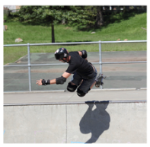
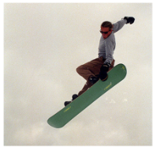
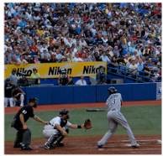
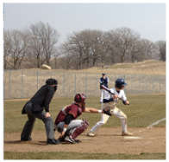
2. Method
Score_{Retrieval}
Examples of retrieval in our method.
What is the man doing?
What is the man doing?
Are they professional players?
Sunny or overcast?
What is this animal?
What is this animal?
Skateboarding because he is riding a skateboard with helmet on
Snowboarding because he is practicing snowboarding skills
Yes because they are at the stadium
Overcast because the sky is covered with cloud
Giraffe because it has long neck and covered with yellow skin
Giraffe because their skin is covered with black spot and has tall neck
(A)
Similar question
Different semantic information of image
(B)
Similar semantic information of image
Different question
(C)
“Ideal Case”
Similar question and semantic information of image
Type (C) is ideal case between the input and the retrieved samples.
We aim to avoid type (A) and (B)
The reason of “${Score}_{Retrieval}=\cos\left(Q_{q},Q_{s}\right)+cos⁡(I_{q},E_{s})$”

Slide 11
2. Method
Utilize Retrieved features
Additional Cross-attention layer for Retrieved features
Purpose
Process retrieved features
Preserving original language model’s capabilities
This structure incorporates retrieval information while maintaining the original language model’s capabilities.

Slide 12
2. Method
Answer Explanation Generation
Answer Explanation Generation
Output Template
“The answer is [answer] because [explanation]”
Our model generates the answer and explanation simultaneously, enhancing the logical coherence between them.

Slide 13
3. Experiments

Slide 14
3. Experiments
Quantitative result
Filtered scores comparison with the state-of-the-art model on VQA-X datasets.
* Filtered score: Considers only samples with correct answers.
 | B4 | M | R | C | S | BS | ACC
PJ-X | 22.7 | 19.7 | 46.0 | 82.7 | 17.1 | 84.6 | 76.4
FME | 23.1 | 20.4 | 47.1 | 87.0 | 18.4 | 85.2 | 75.5
RVT | 17.4 | 19.2 | 42.1 | 52.5 | 15.8 | 85.7 | 68.6
e-UG | 23.2 | 22.1 | 45.7 | 49.9 | 20.1 | 87.0 | 80.5
NLX-GPT | 28.5 | 23.1 | 51.5 | 110.6 | 22.1 | 86.9 | 83.1
ReVisE | 28.2 | 23.2 | 51.8 | 108.9 | 22.6 | 88.1 | -
ReRe_{I} | 28.7 | 23.4 | 52.0 | 111.7 | 22.7 | 90.1 | 83.0
ReRe | 29.2 | 23.4 | 52.1 | 113.4 | 22.7 | 90.2 | 83.7
* B4 = BLEU4
* M = METEOR
* R = ROUGE-L
* C = CIDEr
* S = SPICE
* BS = BERT SCORE
* ACC = Answer accuracy
ReRe_{I} : Measuring retrieval score using cosine similarity between images ($cos⁡(I_{q},I_{s})$), instead of the proposed method $cos⁡(I_{q},E_{s})$
ReRe demonstrates improvements across all metrics.

Slide 15
3. Experiments
Quantitative result
To measure the upper bound of our approach (Oracle Test)
* Filtered score: Considers only samples with correct answers.
 | B4 | M | R | C | S | BS | ACC
ReRe | 29.2 | 23.4 | 52.1 | 113.4 | 22.7 | 90.2 | 83.7
Oracle_{e} | 36.4 | 27.9 | 58.2 | 142.1 | 27.1 | 90.85 | 83.84
Oracle_{ae} | 30.8 | 24.3 | 52.6 | 118.9 | 24.0 | 90.43 | 94.10
Oracle_{e} : Using only explanation retrieved based on the ground-truth explanation
Oracle_{ae} : Using both the answer and explanation retrieved based on the ground-truth answer and explanation
Retrieval-Augmented Generation could achieve even better performance.
If we can establish more effective criteria for retrieval.

Slide 16
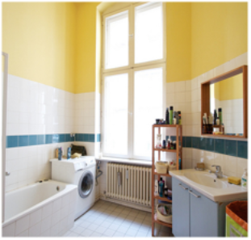
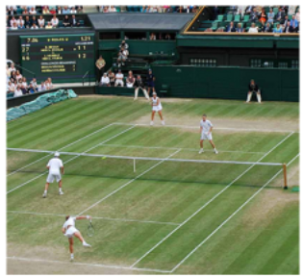
3. Experiments
Qualitative result
Question: What room is this?
Retrieval:
Q: What room is this?
A: Bathroom
E: there is a tub in the room
Pred: Bathroom because there is a sink, a mirror, and a tub.
GT: Bathroom because there is a bathtub in it.
Question: What sport is being played?
Retrieval:
Q: What sport are they playing?
A: tennis
E: they are on a tennis court, holding tennis rackets
Pred: Tennis because there are people on a court with rackets.
GT: Tennis because they are on a tennis court holding tennis rackets.
“ReRe generates answers and explanations using the retrieved information.”

Slide 17
4. Conclusion

Slide 18
4. Conclusion
Summary
We propose applying the retrieval augmentation method to the VQA-NLE task, defining appropriate retrieval based on question type and semantic consistency while utilizing cosine similarity on feature combinations.
ReRe shows improvement in accuracy and explanation score on VQA-X.
Our future work will involve expanding the size of the memory database and enhancing the criteria for selecting relevant information.

Slide 19
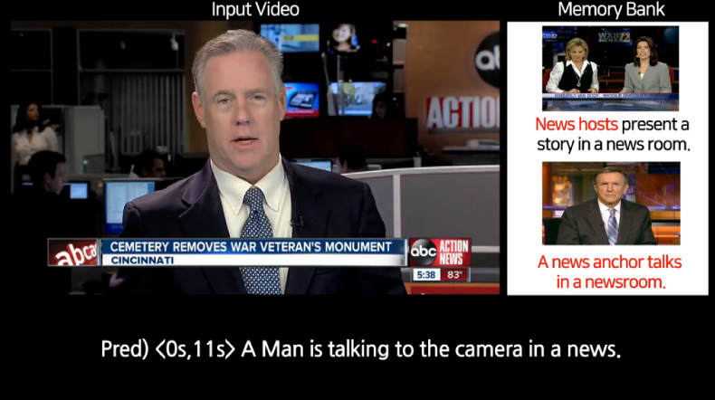
Demo 16:30 – 17:00
Official code
Contact
ReRe Github
Linked-in
E-mail: hyeonbae.kim@khu.ac.kr
Cross-Modal Memory Retrieval for Natural Language Generation

Slide 20
Thank you

