Slide 1
Leveraging ordinal regression with soft labels for 3D head pose estimation from point sets
Xupeng Wang
School of Information and Software Engineering
University of Electronic Science and Technology of China
xupeng.wang@uestc.edu.cn

Slide 2
Contents
1
Background
2
Motivation
3
Our work
4
Conclusion

Slide 3
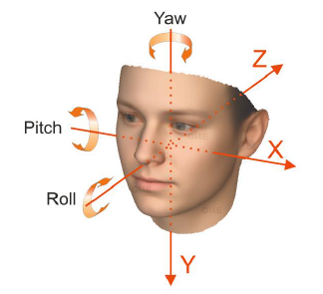
Background
What is head pose estimation？
Head pose estimation refers to the analysis of an input image or video, so as to predict the pose information of a head in 3D space.
Representation
Euler Rotation Angles.
Quaternion.
...

Slide 4
Background
Robust head pose estimation is a fundamental task for many problems of computer vision and computer graphics, with wide applications in human-machine interaction,
VR/AR, driver behavior analysis, and so on.

Slide 5
Contents
1
Background
2
Motivation
3
Our work
4
Conclusion

Slide 6
Motivation
Deep learning of point cloud becames more and more popular.
Popular models: PointNet, PointNet++, PointCNN, PU-Net, etc.
What is the advantage of point cloud data?
Three dimensional geometry information of target can be obtained.
There is no projection transformation from 3D space to 2D imaging plane.
Less affected by the change of external light and imaging distance.
What is the challenge of point cloud for deep learning？
A point cloud is an unordered set of vectors.
Geometric transformations, such as rigid transformation.
Non-uniformity density in different areas.

Slide 7
Motivation
Our solutions
First, we present a convolutional neural network for 3D head pose estimation in an end-to-end manner.
Second, to the best of our knowledge, this is the first work to estimate head pose angles from point sets.
Third, ordinal regression with soft labels is applied to 3D head pose estimation for the first time.

Slide 8
Contents
1
Background
2
Motivation
3
Our work
4
Conclusion

Slide 9
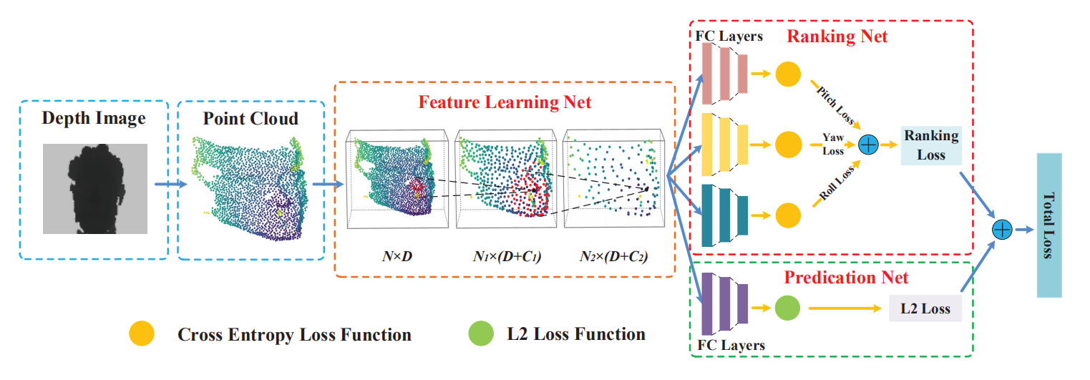
Our Work

Slide 10
Our Work
The network is composed of three modules:
Feature Learning Net
Ranking Net
Prediction Net
Feature Learning Net
The feature learning net exploits the PointNet++ architecture to extract features from a point cloud.
Input data：point cloud data (only 3D coordinate information)
Output data：feature vector

Slide 11
Our Work
Ranking Net
Hard label
In the case of training samples with independent classes, labels can be represented as one-hot vectors.It set the probability of an instance belonging to a class to zero except for the ground truth.

Slide 12
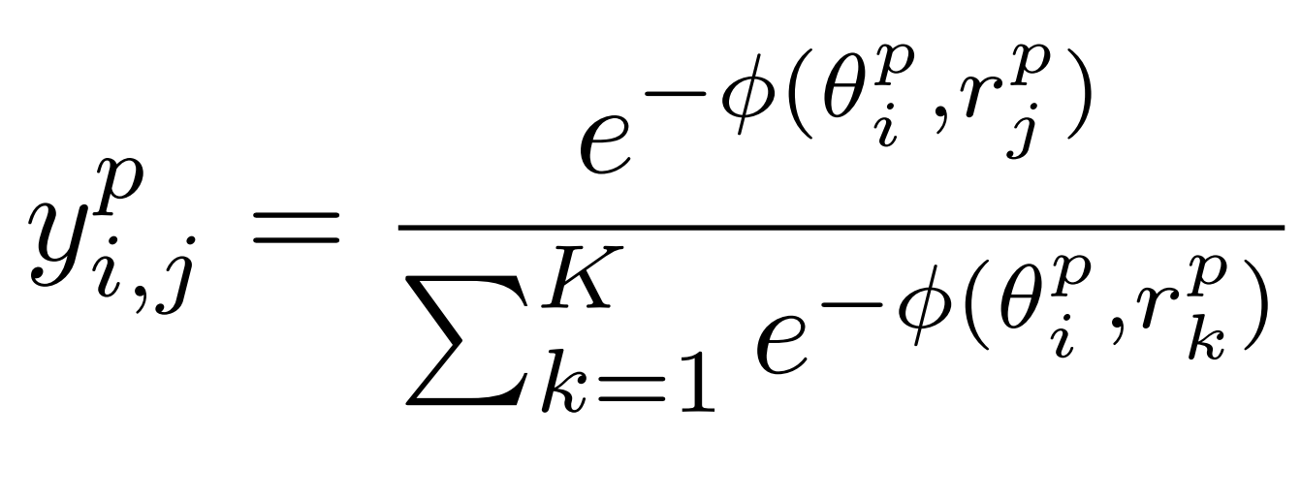
Our Work
Soft label
In the case of classes with natural orders, the class labels can be cast as probability distributions on the domain. This likelihood can be for mulated by its inter-class distance, that a class closer to the ground truth has a higher probability.

Slide 13
Our Work
We use soft label to further improve the performance.
Loss of Ranking Net
The loss function of the ranking net is defined using cross entropy as follows:

Slide 14
Our Work
Prediction Net
The prediction net maps the learned feature to the head pose angles by three consecutive fully connected layers.
Loss of Prediction Net
The L2 loss is utilized by our prediction net and defined as follows：

Slide 15
Our Work
Total Loss
The network is trained in combination with the ordinal regression loss and L2 regression loss. Thus, the overall loss function L is defined as follows:
λ controls the contributions made by the ranking net during the training of the network.

Slide 16
Our Work
Experiment
Datasets： Biwi Head Pose Dataset and Pandora dataset
Sample frames from the Pandora dataset. As depicted, extreme poses and challenging camouflage can be present.

Slide 17
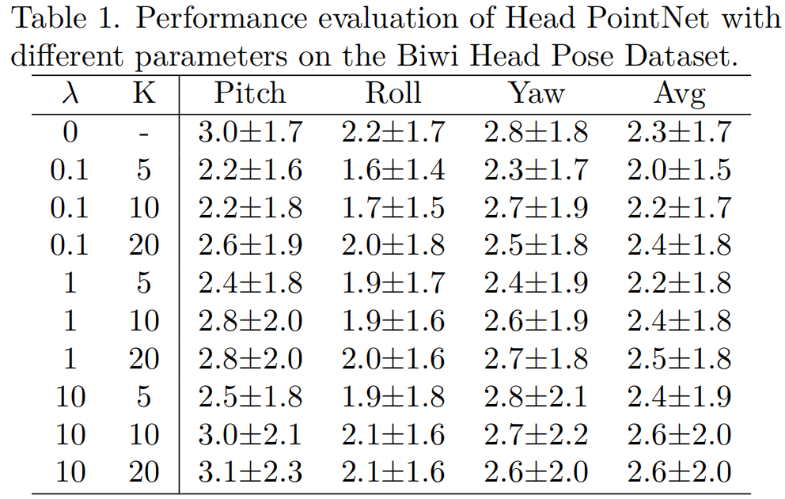
Our Work
Ablation Study
Based on the ablation study, λ is set to 0.1, and K is set to 5 in the rest of the experiments.

Slide 18
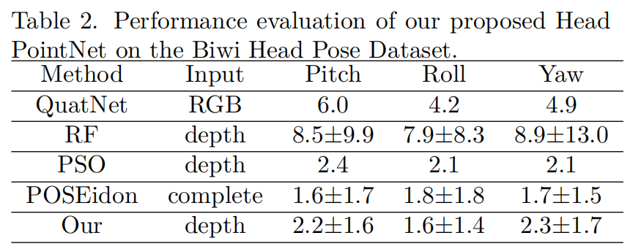
Our Work
Quantitative Results
The best performance is achieved by the methods based on depth image. The RGB image is a projection from 3D space to 2D image, which loses information important for 3D head pose estimation.

Slide 19
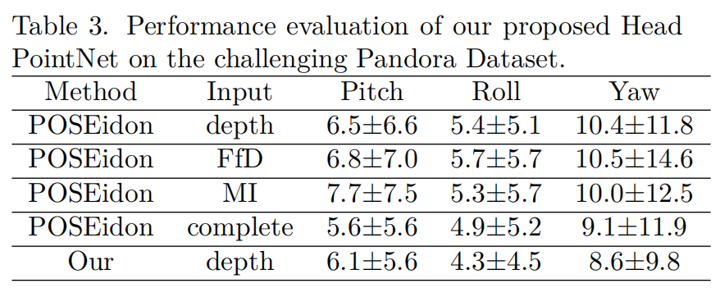
Our Work
Quantitative Results
As shown in Tab.3, Head PointNet outperforms POSEidon with single inputs on the Pandora Dataset. Furthermore, there is an obvious performance improvement on accuracy exception for the pitch angle, in contrast to POSEidon with complete inputes.

Slide 20
Contents
1
Background
2
Motivation
3
Our Work
4
Conclusion

Slide 21
Conclusion
A novel deep learning framework is presented for 3D head pose estimation, which extracts features from the point cloud data.
A ranking net is deployed to boost the performance, which formulates head pose estimation as the problem of ordinal regression with soft labels.
In the further, motion information will be introduced to facilitate the network.

