Slide 1
Learned Convolutional Sparse Coding
Hillel Sreter & Raja Giryes
ICASSP 2018

Slide 2
Outline
Motivation and applications
Brief sparse coding background
(ASC) Approximate sparse coding
(CSC) Convolution sparse coding
(ACSC) Approximate Convolution sparse coding

Slide 3
ACSC - real-time image processing
Sparse coding is a strong image processing tool
Sparse coding algorithms tend to be quite slow
Train an approximate efficient sparse coding model
Keep the quality. Drop the runtime

Slide 4
ACSC - advantages
Sparse coding has been shown to work well for Image processing task.
Yet, it tends to be slow Requires multiple minutes on CPU.
Approximate convolutional sparse coding cuts the runtime to a fraction while maintaining the sparse coding performance.
Requires less than a second on a CPU.

Slide 5
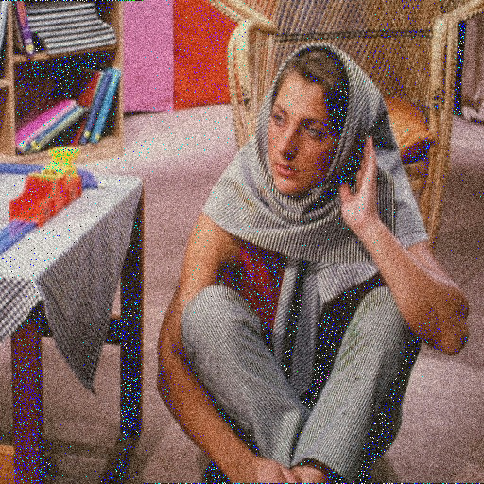
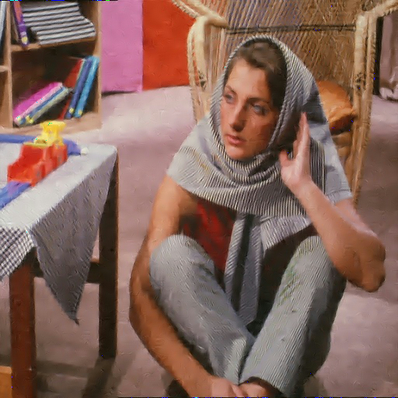
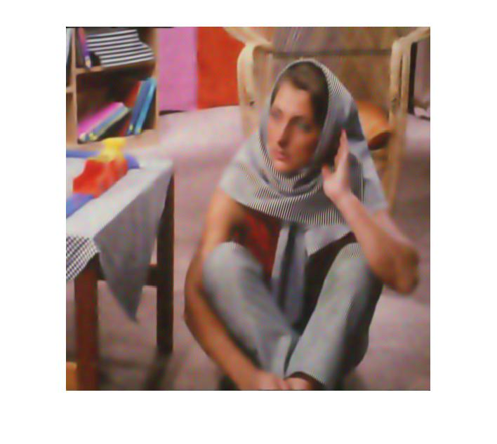
ACSC - Image denoising example
ACSC (0.7 sec) PSNR 29.88 dB
KSVD (70 sec) PSNR 28.67 dB
x100 speedup compared to OMP sparse coding in KSVD

Slide 6
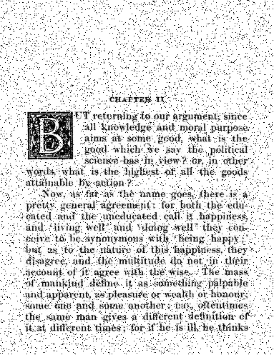
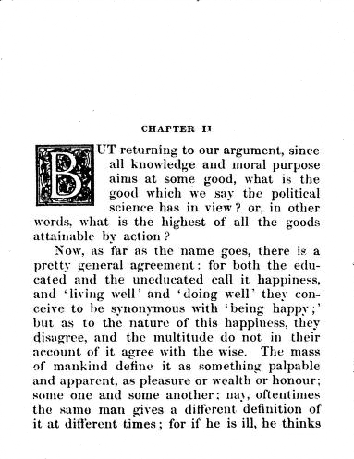
ACSC - Document S&P denoising
ACSC (0.43 sec) PSNR 30.2 dB

Slide 7
ACSC - Document inpainting
ACSC (0.43 sec) PSNR 30.13 dB

Slide 8
Sparse Code problem setup
Given An input X and an over complete matrix D Find such that:

Slide 9
Sparse Code problem setup
Given An input X and an over complete matrix D Find such that:
Solving the above is intractable due to the norm. Can be approximated by relaxation Leads to the LASSO minimization problem

Slide 10
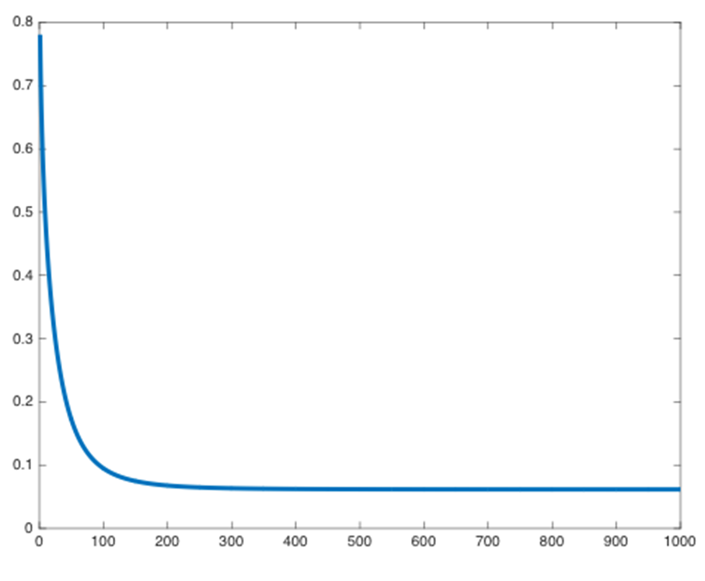
Sparse Code setup - solving LASSO
Use the proximal gradient technique -
This is an iterative method
ISTA
Many iterations may be required for convergence!

Slide 11
Sparse Code setup - solving LASSO
Long convergence time of ISTA can be an issue for time sensitive applications
An acceleration strategy that approximates the solution is required
Learned ISTA (LISTA): Replaces linear operations and threshold in ISTA with learned ones
LISTA

Slide 12
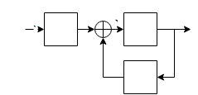
Using Learned-ISTA as a SC approximation
Given a fixed number of iterations learn the matrices S and W and the thresholds
Learning Fast Approximations of Sparse Coding - Karol Gregor and Yann LeCun
S
S
S
recurrent structure
trained by unfolding

Slide 13
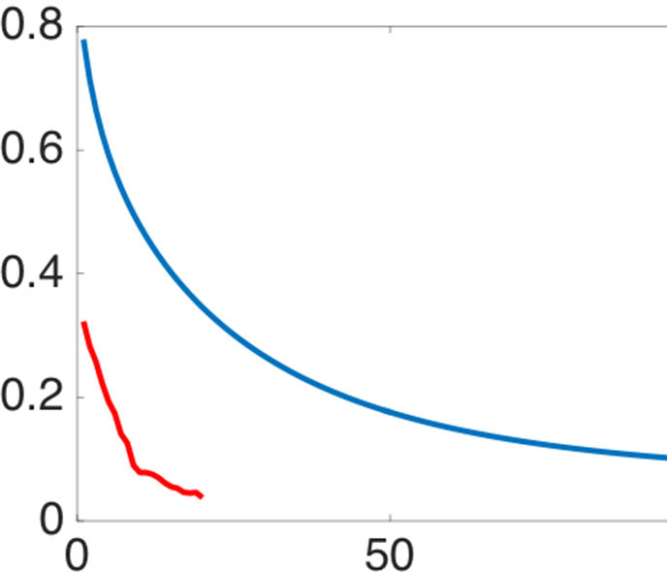
LISTA training
LISTA iteration:
Train using loss function:
Where is the sparse code of
Learning Fast Approximations of Sparse Coding - Karol Gregor and Yann LeCun
S
S
S
trained by unfolding

Slide 14
LISTA disadvantages
LISTA is a patch based method.
Therefore, we have
Loss of spatial information.
Inefficient for large patches
Image properties not incorporated (i.e. translation invariance).
Solution: Use convolutional structure.

Slide 15
Approximate Convolutional Sparse Coding (ACSC)
Learn a convolutional sparse coding of the whole image instead of patches A global algorithm:
Image is processed as whole.
Efficient.
Convolution based inherently incorporates image properties.
This overcomes the disadvantages of LISTA being a patch based method:
Loss of spatial information.
Not Inefficient for large patches
Image properties not incorporated (i.e. translation invariance)

Slide 16
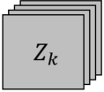
Standard Convolutional Sparse Coding (CSC)
In convolutional sparse coding we replace the regular dictionary with a convolutional one:
Given input X, solve:
In other word --
Find a set of kernels d that reconstruct X with sparse feature maps Z

Slide 17
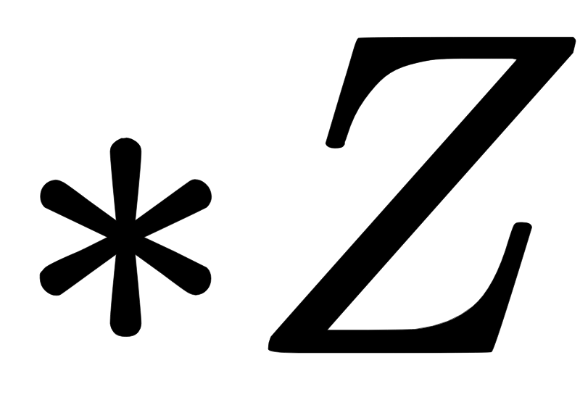
Convolutional Sparse Coding as Regular Sparse Coding
Convolutional Sparse Coding (CSC) Regular Sparse Coding (SC)
A convolutional dictionary is a concatenation of toeplitz matrices
Equivalent to

Slide 18
Convolutional Sparse Coding (CSC) setup
CSC works on the global image
Finding the global CSC dictionary with vanilla SC methods is impractical because of its large size (Z is the sparse code of the full image and not the patches)
(Assuming “SAME” convolution)

Slide 19
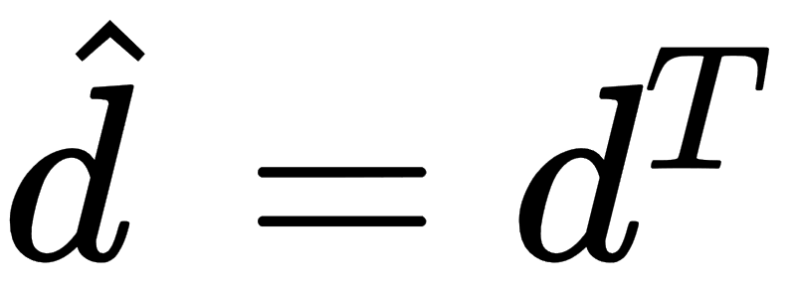
From SC to CSC
Rewrite ISTA as a solution to CSC problem
Assuming D is a concatenation of toeplitz matrices we can replace matrix multiplication with convolution
D is a toeplitz matrix
Convolutional ISTA

Slide 20
From CSC to Approximate CSC
Approximate Convolutional sparse coding (ACSC): Replaces convolutional operations and threshold in Convolutional ISTA solution with learned ones
ACSC

Slide 21
Approximate CSC architecture
Proposed recurrent architecture for CSC with unfold of T steps
ACSC step
ACSC step
ASCS step

Slide 22
Approximate CSC with dictionary learning
Train end to end as a sparse autoencoder
Encoder
Decoder
Convolutional sparse encoder
Convolutional sparse dictionary
We learn in our framework both the sparse coding and the dictionary In LISTA, only the sparse coding is being learned

Slide 23
Training ACSC autoencoder
Initialization is important
We found kernel of size 7x7 to give best results.
We found Unfolding 3 time step to be sufficient
Use loss function
H. Zhao, O. Gallo, I. Frosio, and J. Kautz, “Loss functions for image restoration with neural networks,”

Slide 24
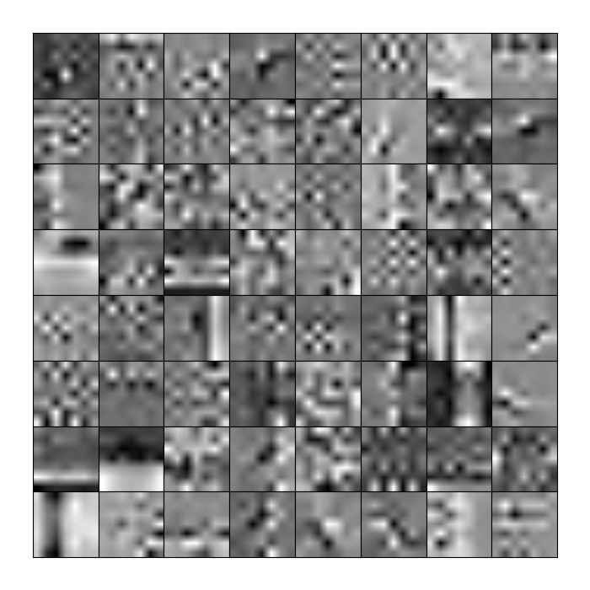
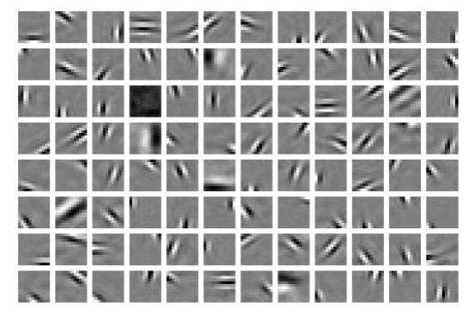
Approximate CSC and dictionary learning
Learned convolution dictionary Classical sparse dictionary
Classical approach tends to learn the same atom with a translation.
Convolution dictionary a single atom covers all translation.

Slide 25
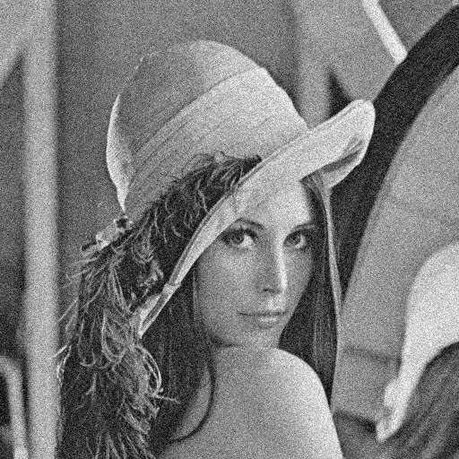
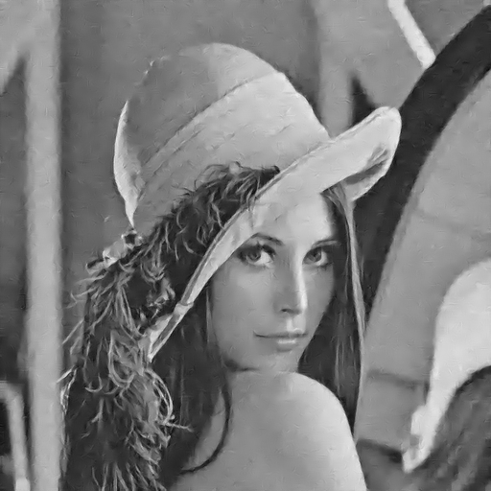
Approximate CSC Tasks
Example result on denoising task
ACSC (0.56 sec) PSNR 32.11 dB
KSVD (57 sec) PSNR 32.09 dB
x100 speedup compared to OMP sparse coding in KSVD

Slide 26
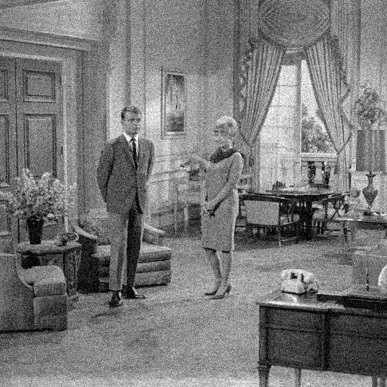
Approximate CSC Tasks
Example result on denoising task
ACSC (0.6 sec) PSNR 30.14 dB
KSVD (64 sec) PSNR 30.05 dB
x100 speedup compared to OMP sparse coding in KSVD

Slide 27
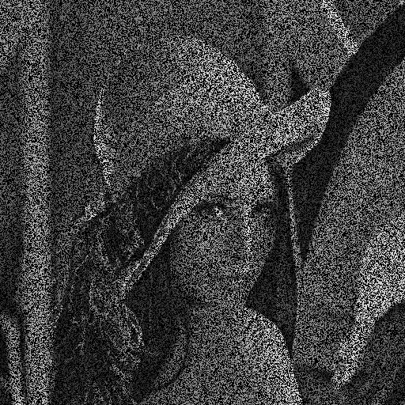
Approximate CSC Tasks
Example result on inpainting task
ACSC (0.57 sec) PSNR 32.3 dB

Slide 28
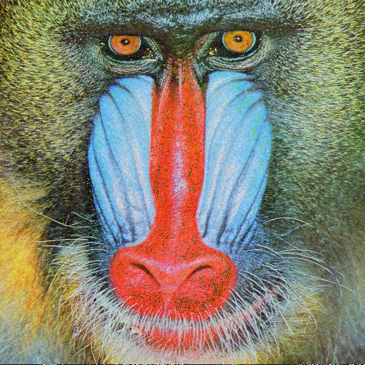
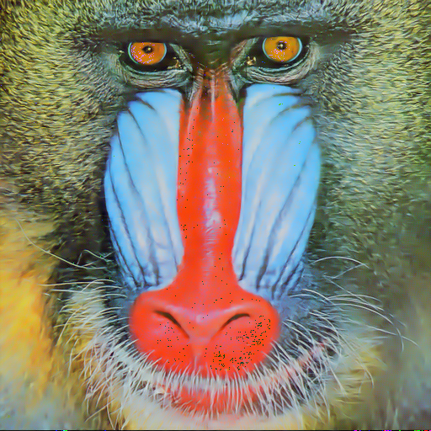
Approximate CSC Tasks
Example result on denoising task
ACSC (0.83 sec) PSNR 30.32 dB
KSVD (78 sec) PSNR 30.21 dB
x100 speedup compared to OMP sparse coding in KSVD

Slide 29
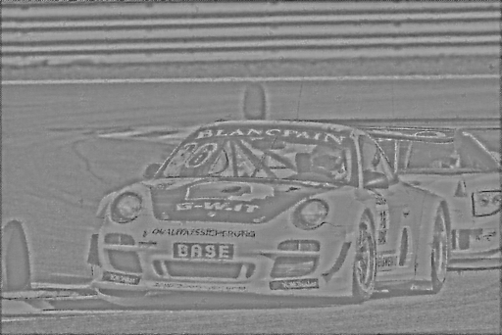
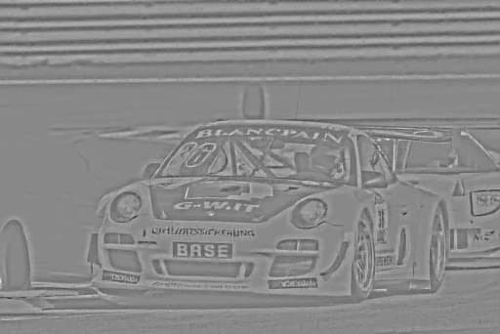
Approximate CSC Tasks
Example result on inpainting task
ACSC (0.48 sec) PSNR 30.32 dB
Heide et al.(320 sec) PSNR 30.21 dB
x650 speedup compared to Heide et al. (Fast and Flexible Convolutional sparse coding)

Slide 30
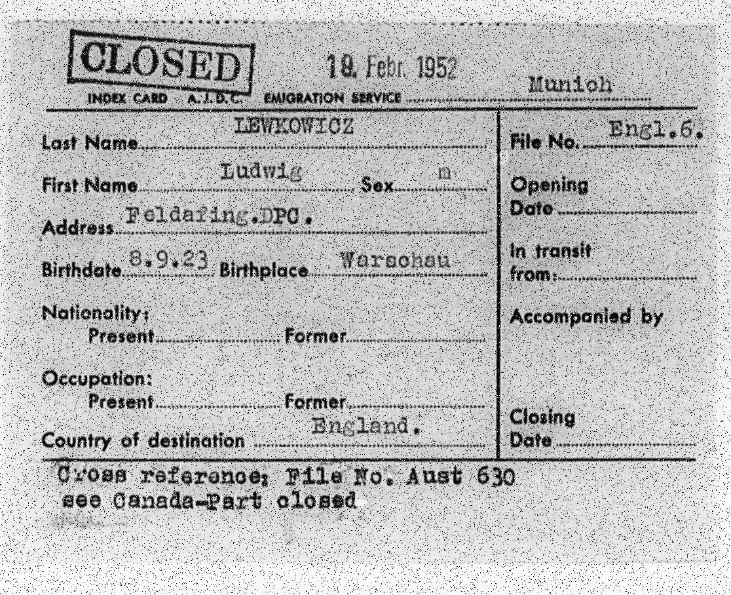
Approximate CSC Tasks
Example result on document denoising task
ACSC (0.44 sec) PSNR 29.8dB

Slide 31
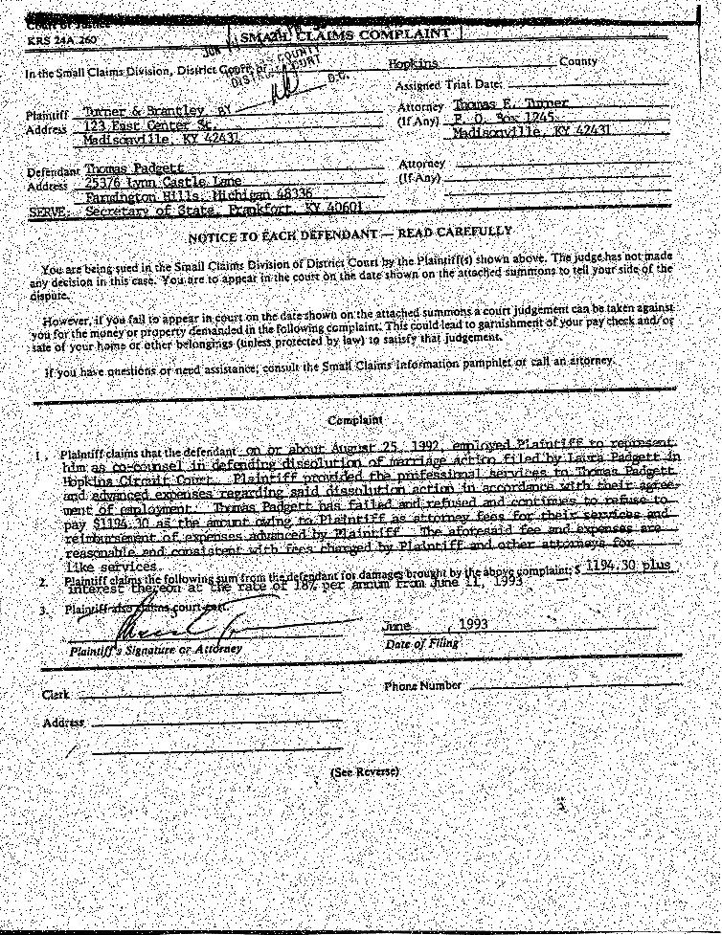
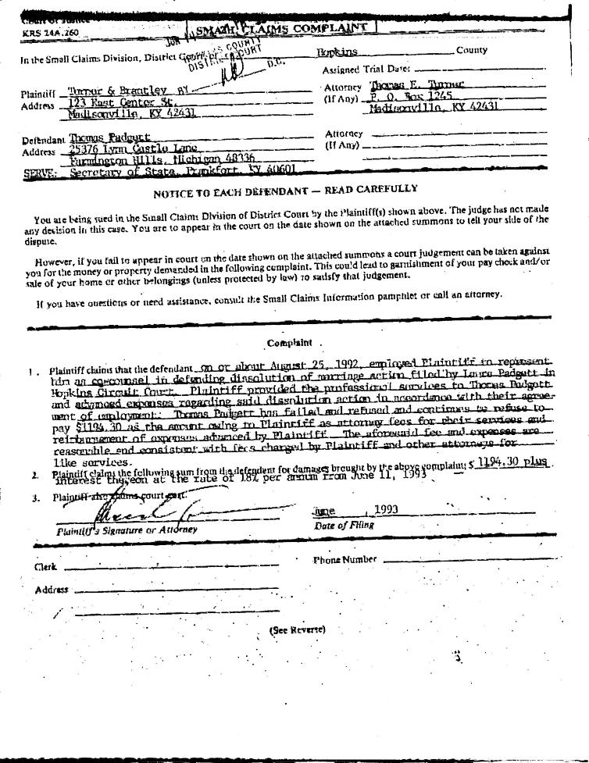
Approximate CSC Tasks
Example result on document denoising task
ACSC (0.38 sec) PSNR 29.4dB

Slide 32
Conclusion
LISTA is good for accelerating sparse coding for patches
Yet, it is slow when working on images as a whole
Our proposed learned CSC is good for processing the whole image
Provide comparable performance to other sparse coding based techniques on images with up to x100 speedup

Slide 33
Thank You!
Encoder
Decoder
Convolutional sparse encoder
Convolutional sparse dictionary

