Slide 1
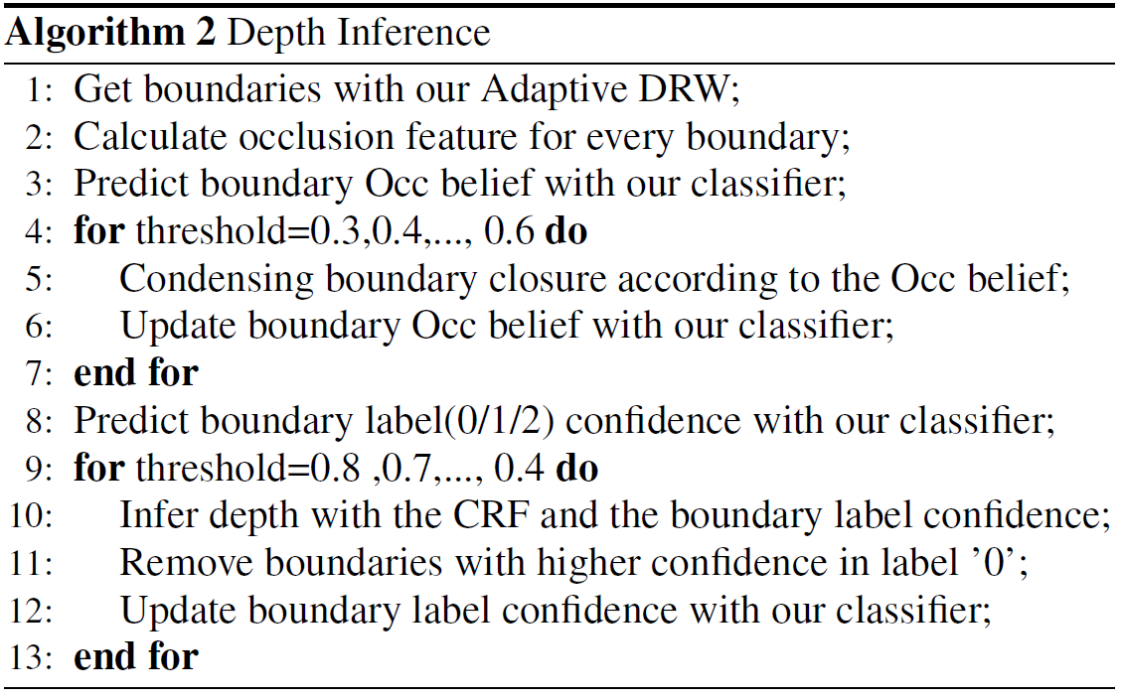
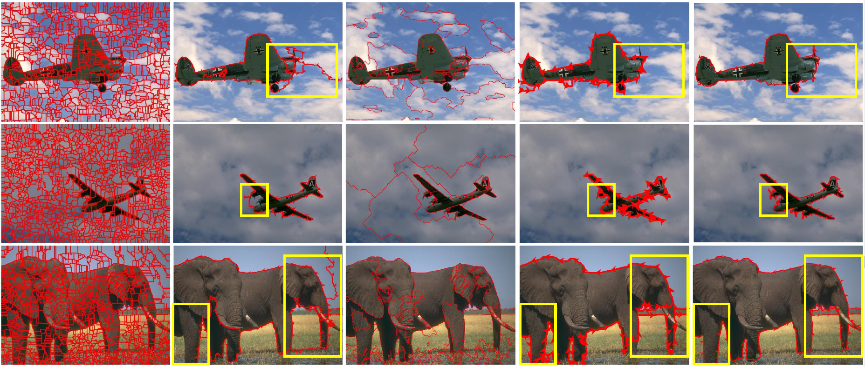
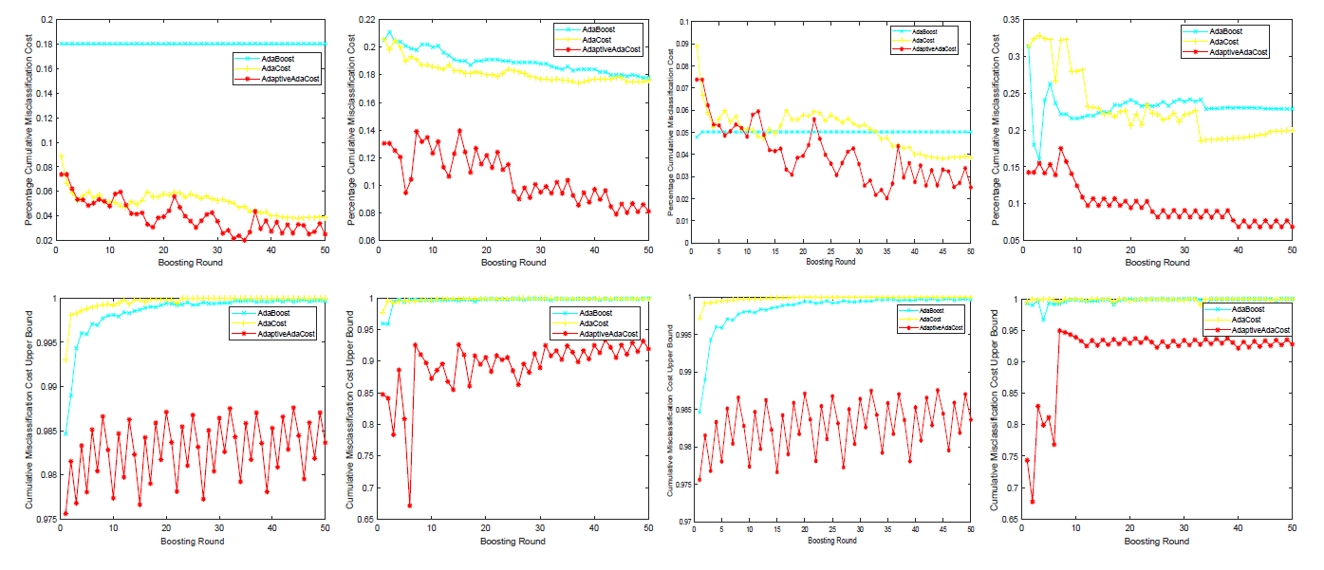
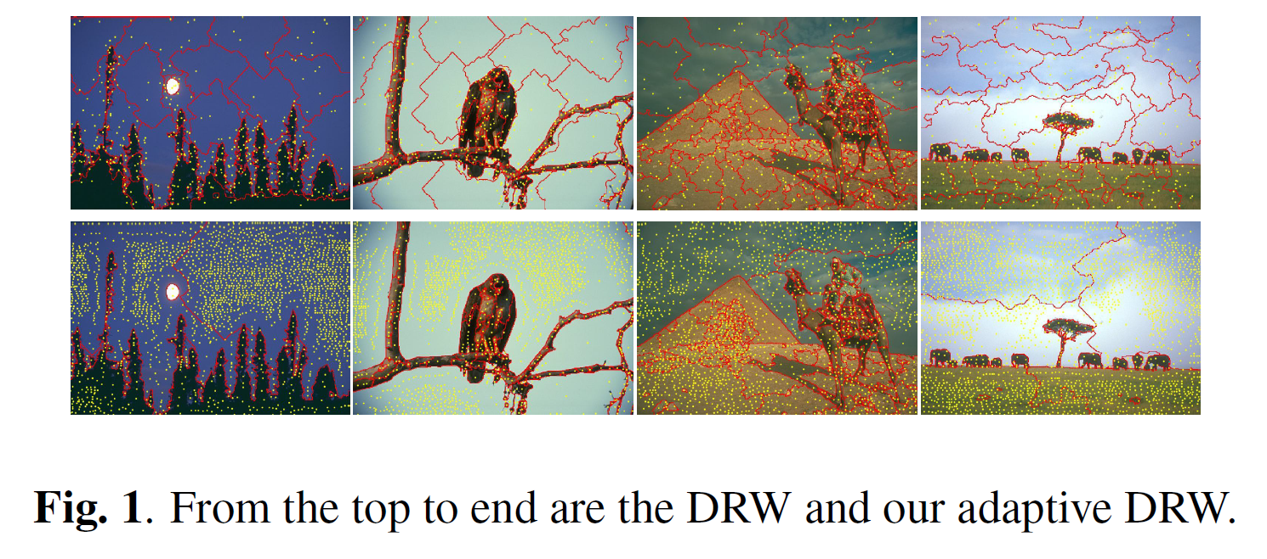
Adaptive Occlusion Boundary Extraction for Depth Inference
Lizhu Ye, Lei Zhu, Xuejing Kang*, Anlong Ming
School of Computer Science, Beijing University of Posts and Telecommunications, Beijing, 100876
ABSTRACT
The Adaptive AdaBoost
a) the adjustable misclassification cost:
b) cost adjustment term
c) weight updating
the upper bound of the training cumulative misclassification cost holds:
For our practical use, we give the estimated $α_{t}$ and $β_{t}$ to replace the analytical $α_{t}$ and $β_{t}$ for minimizing the upper bound.
where the $u_{t}=\sum_{i}{D_{t}\left(i\right)y_{i}h_{t}(x_{i})}, v_{t}=\sum_{i}{\frac{1}{m}y_{i}h_{t}(x_{i})}$. The quantitive results are in the Fig.3.
In this paper, we propose an adaptive occlusion boundary extraction method for depth inference:
an Adaptive DRW segmentation with more accurate seeds and adaptive weight constraint, which can better balance boundary adherence, superpixel adaptability and regular shape;
an Adaptive AdaCost boosting method, which adopts an adaptive cost adjustment strategy to improve the imbalance classification and further lower the cumulative misclassification cost and its upper bound;
a more reliable for depth inference with the tight cooperation between our Adaptive DRW and Adaptive Ada-Cost.
3. Depth Inference
With more reliable boundaries extracted, we use the conditional random field (CRF) and follow the Algorithm 2 to get a consistent depth result.
METHODS
Ours segmentation and depth inference results.
Groundtruth
The Adaptive DRW
a) seed initialization: PB map and WaterShed
b) weight constraint:
$$g\left(i\right)={e^{\left.−β\right.}χ\left(i\right) f_{i}}/{B_{i}}$$
, where $f_{i}=\sum{p_{ij}f_{j}}$ and $χ\left(i\right)ε(0,1)$ represents the four-neighbor labeled or not. The segment result are shown in Fig.1.
Fig. 4. The segmentation and depth result.
CONCLUSION
In this paper, we propose an adaptive occlusion boundary extraction method based on our Adaptive DRW and Adaptive AdaCost for more reliable depth inference. Further work will concentrate on more reliable occlusion features and the depth inference model with better self-correcting capability.
Ours
Fig. 3. The CMC cost and upper bound of our and other algorithm tested on four datasets.
Fig. 1. From the top to end are the DRW and our Adaptive DRW

