Slide 1
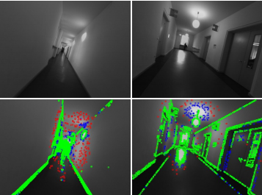
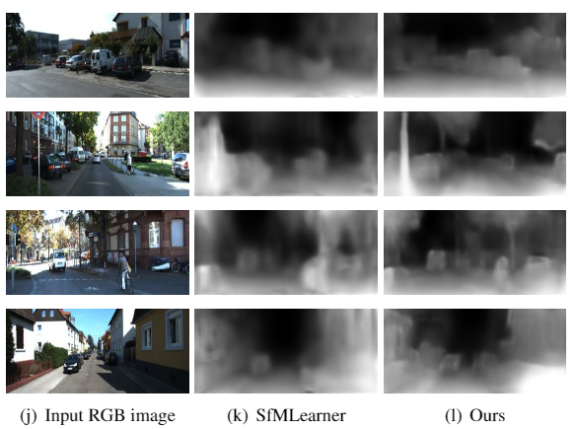
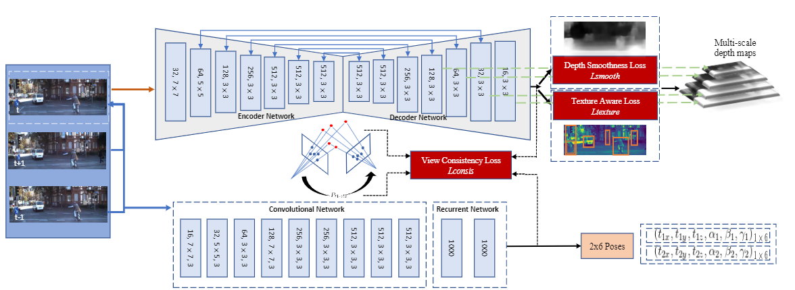
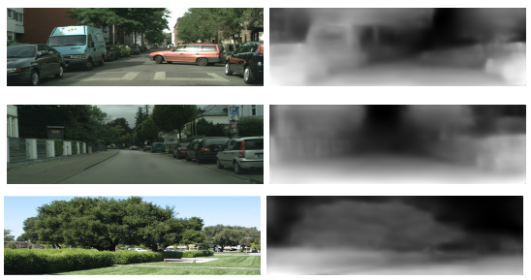
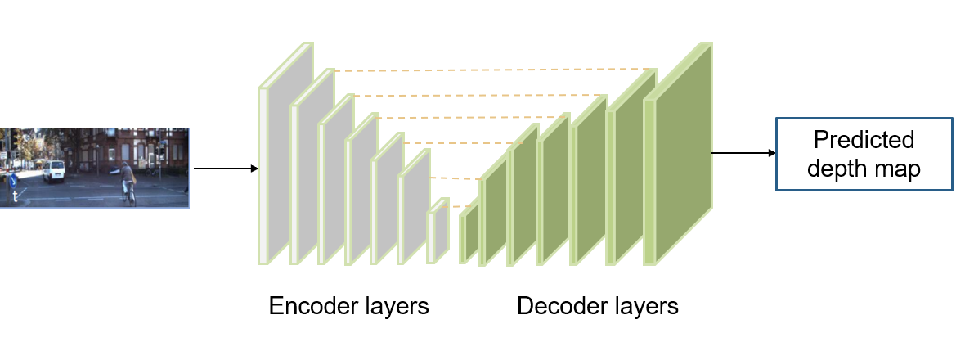
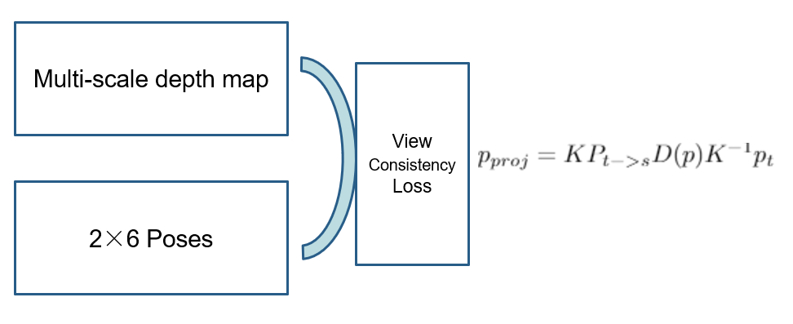
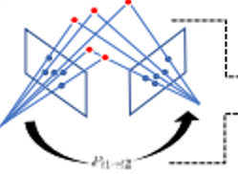
DEEP UNSUPERVISED LEARNING FOR SIMULTANEOUS VISUAL ODOMETRY AND DEPTH ESTIMATION Yawen Lu, Guoyu Lu Rochester Institute of Technology, USA
Contribution:
We train a deep neural network to jointly learn scene depth and camera poses in an unsupervised manner;
We employed recurrent convolutional neural networks (RCNN) to extract the relationships between continuous adjacent frames;
A texture smoothness term is designed to minimize the Laplacian values of the depth map to prevent small divergent depth; An improved view consistency loss is applied to better synthesize target scene from a nearby viewpoint.
Experiments on diverse environments show the superior robustness and accuracy of our method.
Problem for previous camera pose estimation methods:
Monocular depth prediction:
Our unsupervised depth estimation result on KITTI dataset.
Comparison of monocular depth estimation with other state-of-the-art methods.
Require enough accurate point correspondences in computing camera poses.
Problem for previous monocular depth prediction methods:
Require extensive amount of labeled 3D data from lidar or depth sensor, and the predicted results contains blur and wrong regions.
Overview:
Depth smoothness term is applied here to prevent significant discontinuity in the predicted depth map by minimizing the spatial gradients of the inverse depth weighted by image gradient.
Texture-aware term is to further prevent smaller divergent depth in occluded and low-textured regions based on smoothness term. It minimizes depth related Laplacian values. As a consequence, the depth discontinuity would be penalized if the image is continuous in the same region.
Robustness of our method:
Cross-dataset validation on Cityscapes and Make3D.
Absolute Trajectory Error compared with other methods on the KITTI odometry test split.
We employ an encoder-decoder structures with skip connections to realize the depth prediction.
Joint learning basis:
The basis to combine them together is to minimize the photometric error between the target image and the warped source image based on the camera transformation, thus enforcing them to be consistent.
A separate recurrent convolutional neural network (RCNN)-based pose network is designed to estimate the camera pose for visual odometry to obtain more accurate poses.
[7] Zhou et al., Unsupervised learning of depth and ego-motion from video, in CVPR, 2017
[14] Liu et al., Learning depth from single monocular images using deep convolutional neural fields, in TPAMI, 2016.
[18] Eigen et al., Depth map prediction from a single image using a multi-scale deep network, in NIPS, 2014.
[19] Mahjourian et al., Unsupervised learning of depth and ego-motion from monocular video using 3d geometric constraints, in CVPR, 2018.
P1->P2
[27] Raul et al., Orb-slam: a versatile and accurate monocular slam system, in TR, 2015.

