Slide 1
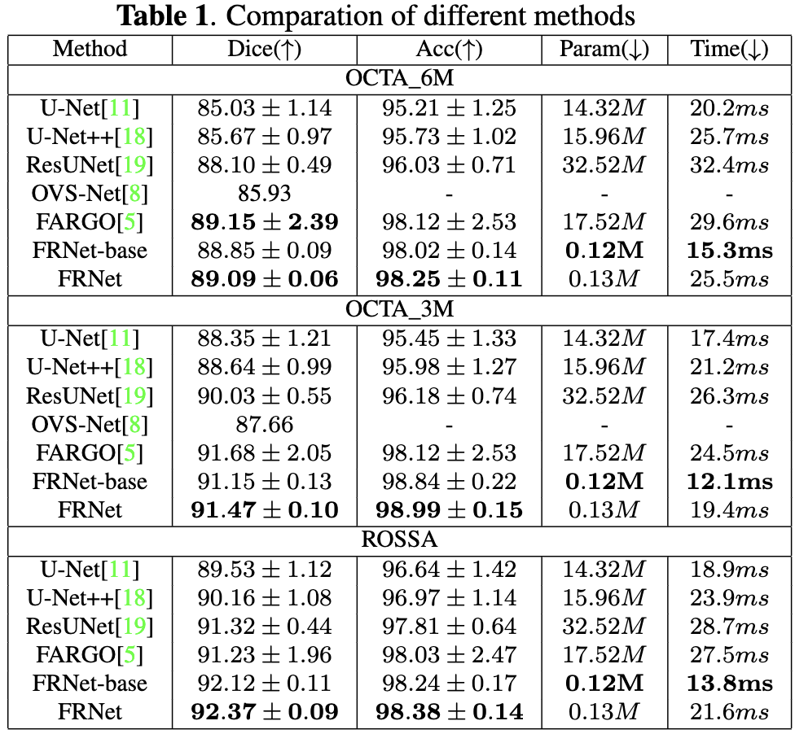
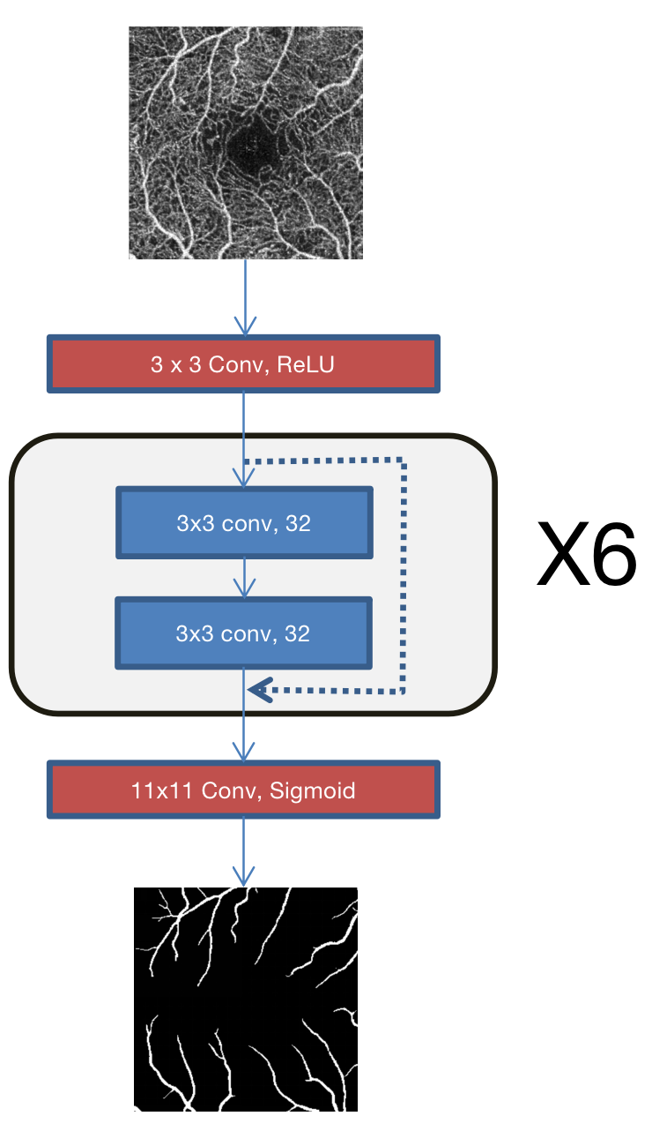
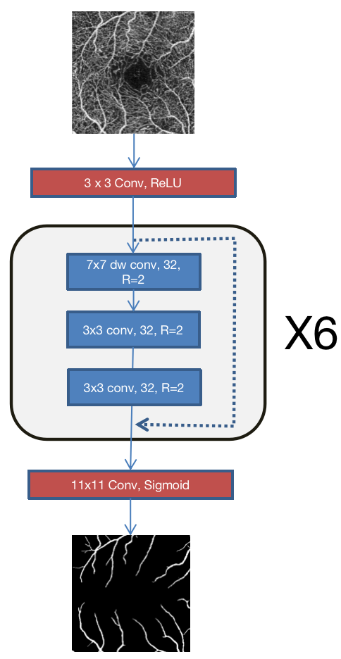
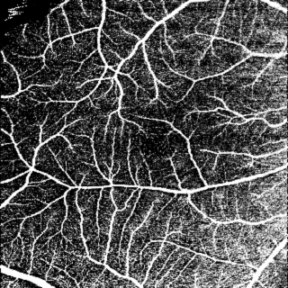
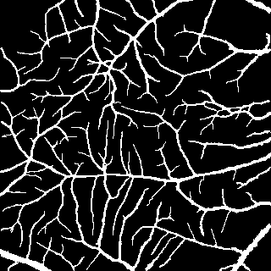
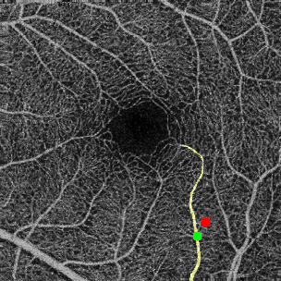
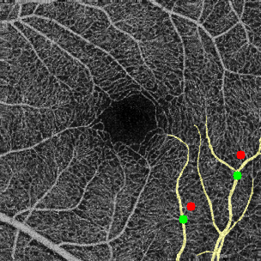
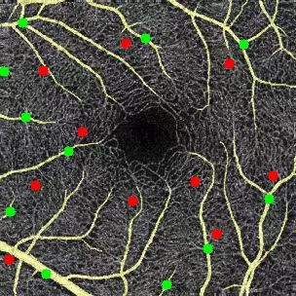
AN ACCURATE AND EFFICIENT NEURAL NETWORK FOR OCTA VESSEL SEGMENTATION AND A NEW DATASET
Haojian Ning⋆ Chengliang Wang⋆ Xinrun Chen⋆ Shiying Li† ⋆ School of Computer Science, Chongqing University, Chongqing, China † Eye Institute of Xiamen University, Xiamen, China
Introduction
Methods
Experiments
Optical coherence tomography angiography (OCTA) is a rapid and non-invasive imaging technology for retinal micro-vasculature. It can help diagnose various retinal diseases such as age-related macular degeneration (AMD), diabetic retinopathy (DR), glaucoma, etc. Automatic OCTA vessel segmentation based on neural networks has been a research hotspot because it helps to improve the efficiency of diagnosis.
On-device inference is important for industrial applications of neural networks. Since the computing power and storage space of end-side devices are often very limited, it is necessary for the model to have a small number of parameters and high computing efficiency. Previous work mainly adopted the encoder-decoder architecture and achieved very high accuracy in OCTA vessel segmentation. However, these networks usually have a large number of parameters and slow inference speed, which is unfriendly to on-device applications. There is stil a lack of models that are friendly to industrial applications in OCTA images.
In this paper, we make the following contributions:
• We propose a full-resolution convolutional network(FRNet), which consists of several modiﬁed Recurrent ConvNeXt Blocks. The network has comparable accuracy to other SOTA methods while having signiﬁcantly fewer parameters and faster inference speed, making it
very friendly for industrial applications.
• We create a new dataset containing 918 OCTA images and their corresponding vessel annotations. The data set is semi-automatically annotated with the help of Segment Anything Model (SAM), which greatly improves the annotation speed. To the best of our knowledge, our dataset is the largest (with 918 images) OCTA vessel segmentation dataset, and we believe it can help the community alleviate the problem of insufﬁcient datasets.
• We conducte various experiments to demonstrate the
effectiveness of the proposed model. And we make the code and dataset of this work publicly available, which helps improve the reproducibility of the work.
Since OCTA images contain many tiny vessels, which may only consist of a few pixels. For the widely used encoder-decoder architecture, the image is down-sampled and then up-sampled, making it difficult to fully restore the pixels of these small vessels, which affects the segmentation accuracy. Furthermore, each downsampling typically results in doubling the number of channels in the convolutional layer, which results in a model with a large number of parameters. This is why we believe that the encoder-decoder model is not the most suitable for OCTA vessel segmentation.
To address these problems, we start with a simple full-resolution network(FRNet-base). As shown in the first of the above figures, FRNet-base consists of convolutional blocks without any downsampling or upsampling modules. The structure of these convolutional blocks is the same as the BasicBlock in ResNet, that is, a residual link is added after two convolutions. FRNet-base contains 6 such convolution blocks, and their number of channels is 32.
The benefits of this design are: First, the total number of convolution channels is greatly reduced, which leads to a significant decrease in the number of parameters. Second, it avoids the loss of information of small vessels during downsampling, so that high accuracy can be achieved.
We take inspiration from ConvNeXt to further improve FRNet. Based on ConvNeXt Block, we set convolutional channels to 32. In order to increase the receptive field, we replace the 1x1 pixelwise convolution with a 3x3 convolution. Furthermore, we apply the idea of recurrent convolution in this module. Recurrent convolution means that the input will be looped through the convolutional layer R times. In our model we set R=2. According to our experiments, FRNet improves the Dice score by 0.24%-0.32% compared to FRNet-base.
Experiments are conducted on OCTA-500 and ROSSA datasets. OCTA-500 has two subsets: OCTA_6M and OCTA_3M, which contain 300 and 200 images respectively. We use the training set to train network parameters, use the validation set to select the best model and use the test set for evaluation.
Our methods are implemented with Pytorch using an NVIDIA A100 Tensor Core GPU. We use the Adam optimizer with a learning
rate of 0.0001 and train the network for a total of 300 epochs. The batch size is set to 2. The loss function is the Dice loss. The results are tabulated in the following table.
Conclusion
In this work, we propose an accurate and efficient neural network(FRNet) for retinal vessel segmentation in OCTA images. By applying the modified Recurrent ConvNeXt Block to a full resolution convolutional network, the proposed model, with very tiny model size, can run faster and more accurate than opponents. Besides, we create a new dataset(ROSSA) containing 918 OCTA images and their corresponding vessel annotations. We use Segment Anything Model (SAM) to semi-automatically annotate images, which greatly speeds up the annotation work. The datasets and new annotation pipelines we provide can help solve the problem of lack of data in the medical field.
Related Work
In recent years, convolutional neural networks have been widely applied in medical image processing, including OCTA images. Previous work on OCTA vessel segmentation usually adopts the encoder-decoder architecture, more specifically, the U-Net architecture. For example, Peng et al applied an iterative encoder-decoder network to correct wrong output. Hu et al proposed a joint encoding and seperate decoding network to handle multiple tasks. Ma et al designed a two-stage split attention residual UNet to refine the segmentation results.
Ziping et al added a contrastive learning module after an encoder-decoder network to improve the performance.
The above method achieves quite high accuracy, but they are heavyweight, having a large number of parameters and slow inference speed, which brings inconvenience to industrial applications.
There is a trend in the 2020s for transformers to replace convolutional networks in various fields of computer vision. However, the work of Liu et al. on ConvNeXt demonstrated that properly designed convolutional networks can achieve better results than transformers. So in this work we adopt convolutional networks on the basis of ConvNeXt. Details will be discussed in the next section.
Acknowledgements
Dataset
This work is supported by the Chongqing Technology Innovation and Application Development Key Project (cstc2020jscx; dxwtBX0055; cstb2022tiad-kpx0148).
We use Segment Anything Model (SAM), to accelarate the annotation pipeline. The original weights of SAM cannot be directly applied to OCTA vessel annotation because it was not trained on similar datasets. In order to apply SAM to OCTA vessel annotation, we first manually annotated 300 OCTA vessel images (NO.1-NO.300), and then used these data to fine-tune SAM. Finally, using fine-tuned SAM, we were able to annotate a vessel with just a simple click of prompt. Although sometimes images annotated by SAM require a small amount of manual correction, overall the time to annotate an image has dropped to about 2 minutes. In this study, we used SAM to annotate 618 images (NO.301-NO.918).
The flowing figures illustrate how we use prompts to get vessel annotations.
Contact Information
Chengliang Wang
Address Chongqing University, Chongqing, China | Tel: +86 189 8305 5830 Email: wangcl@cqu.edu.cn

