Slide 1
Compressive Image Recovery using Recurrent Generative Model
Akshat Dave, Anil Kumar Vadathya, Kaushik Mitra
Computational Imaging lab, IIT Madras, India

Slide 2
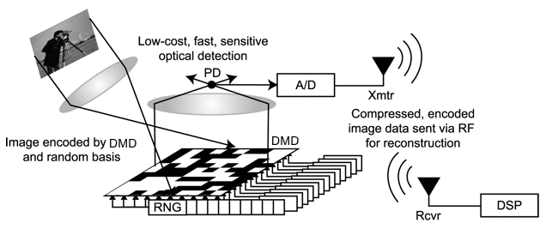
Single Pixel Camera
Single photon detector
Series of random projections
SPC, RICE DSP lab
$$y=ϕx$$
$$√N×√N$$
$$y ε ℝ^{M}$$
$$x ϵ ℝ^{N}, ϕ ϵ ℝ^{M×N}$$
$$y ϵ ℝ^{M}$$
Solving for x is ill posed
$$M≪N$$
priors
$$\underset{x}{argmin}{ψ(x)}$$
$$y=ϕx$$

Slide 3
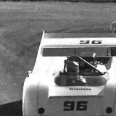
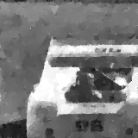
Analytic Priors for SPC reconstruction
$${\underset{x}{argmin}\left\|ψ\left(x\right)\right\|}_{1}$$
$$s.t y=φx$$
Traditional solutions; TVAL and sparsity based priors
Challenge - reconstruction from low measurements
40%
10%
Notes:
Get PSNR for 40% reconstruction

Slide 4
Deep learning for Compressive Imaging
ReconNet by Kulkarni et al., DR²-Net by Yao et al.,
ReconNet by Kulkarni et al. CVPR 16
Discriminative learning - task specific networks
Does not account global multiplexing
M.R. 10%
Notes:
Add Rich’s recent papers

Slide 5
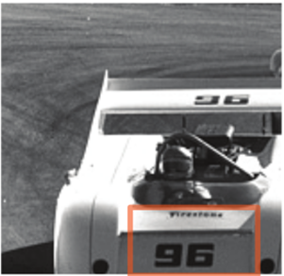
Solution…
Analytic priors
Suffer at low measurement rates
Deep discriminative models
Task specific
Do not account global multiplexing
Solution?
Use data driven priors based on deep learning
Specifically,
We use recurrent generative model, RIDE by Theis et al. NIPS’ 15
$$y=Ax+n$$
Original
Analytic
Data driven
$$\underset{x}{argmax}{p(x|y)}$$
$$p\left(x | y\right)∝p\left(y | x\right)p(x)$$
likelihood
prior
24.70 dB
29.68 dB

Slide 6
Deep generative models
Autoregressive models
$$p(x1)$$
$$p(x2|x1)$$
$$p(x3|x_{1:2})$$
$$p(x3|x_{1:2})$$
$$p\left(x\right)=\prod_{i}{p(x_{i}|x_{<i})}$$
<START>
It
was
raining
$$x1$$
$$x2$$
$$x3$$
VAEs
GANs
generated distribution
true data distribution
code
Enccoder
Decoder
$$\hat{I}$$
$$\hat{p}(x)$$
$$p(x)$$
$$I$$
unit gaussian
generative model
(neural net)
$$q(z|x)$$
$$z$$
$$KL(p,q)$$
$$θ$$
loss
$$p(z)$$

Slide 7
Autoregressive models
$$p\left(x\right)=\prod_{ij}{p(x_{ij}|x_{<ij})}$$
Factorize the distribution
Each factor,
$$p(x_{ij}|x_{<ij})$$
sequence prediction
Figure courtesy: Oord et al.
$$NLL:−\log{p\left(x\right)}=−\sum_{ij}{log⁡p(x_{ij}|x_{<ij},θ_{ij}) }$$
$$=−\sum_{ij}{log⁡p(x_{ij}|x_{<ij},θ) }$$
Training:
Recent works:
RIDE by Theis et al., PixelRNN/CNN by Oord et al., PixelCNN++ by Salimans et al.,
$$\underset{θ}{argmin}{−\sum_{n}{log}{p\left(x_{n},θ\right)}}$$

Slide 8
Autoregressive models
$$p\left(x\right)=\prod_{ij}{p(x_{ij}|x_{<ij})}$$
Factorize the distribution
Each factor,
$$p(x_{ij}|x_{<ij})$$
sequence prediction
Figure courtesy: Oord et al.
$$NLL:−\log{p\left(x\right)}=−\sum_{ij}{log⁡p(x_{ij}|x_{<ij},θ_{ij}) }$$
$$=−\sum_{ij}{log⁡p(x_{ij}|x_{<ij},θ) }$$
why RIDE?
Models continuous distribution
Simple and easy to train
Recent works:
RIDE by Theis et al., PixelRNN/CNN by Oord et al., PixelCNN++ by Salimans et al.,

Slide 9
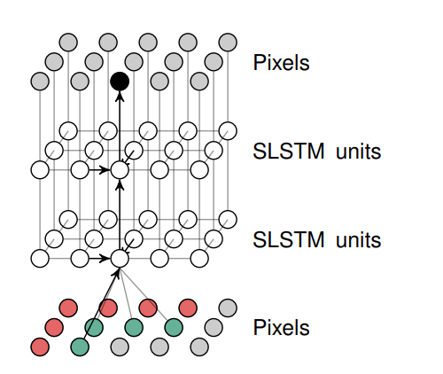
Deep autoregressive models
Recurrent Image Density Estimator (RIDE) by Theis et al. 2015
$$p\left(x\right)=\prod_{ij}{p(x_{ij}|x_{<ij})}$$
Markovian case
$$p\left(x_{ij} | x_{<ij},θ\right)=\sum_{c}{p\left(c | x_{<ij}\right)}p(x_{ij}|{c,x}_{<ij},θ)$$
*picture courtesy, Theis et al.
$$h_{ij}=f(x_{<ij},h_{i−1,j},h_{i,j−1})$$
Recurrent neural network
*picture courtesy, Theis et al.

Slide 10
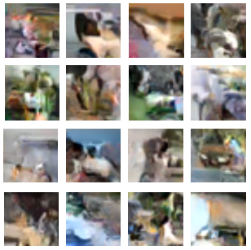
Deep autoregressive models
Recurrent Image Density Estimator (RIDE) by Theis et al. 2015
$$p\left(x\right)=\prod_{ij}{p(x_{ij}|x_{<ij})}$$
Markovian case
$$p\left(x_{ij} | x_{<ij},θ\right)=\sum_{c}{p\left(c | x_{<ij}\right)}p(x_{ij}|{c,x}_{<ij},θ)$$
*picture courtesy, Theis et al.
$$h_{ij}=f(x_{<ij},h_{i−1,j},h_{i,j−1})$$
Recurrent neural network
Samples from RIDE on CIFAR data by Theis et al., 2015
*picture courtesy, Theis et al.

Slide 11
RIDE for SPC reconstruction
$${\underset{x}{argmin}\left\|ψ\left(x\right)\right\|}_{1}$$
$$s.t y=φx$$
RIDE as an image prior,
Data driven
Recurrent, can handle global multiplexing
Flexible unlike discriminative models
Now, with RIDE as prior,
$$\underset{x}{argmax}{p(x)}$$
$$s.t. y=φx$$
In each iteration, t :
- gradient ascent
- projection
30%
$$\hat{x}t=x_{t−1}+η∇_{x_{t−1}}p(x)$$
$$xt={\hat{x}}_{t}−φT{\left(φφT\right)}^{−1}(φ{\hat{x}}_{t}−y)$$

Slide 12
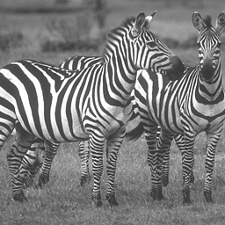
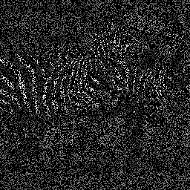
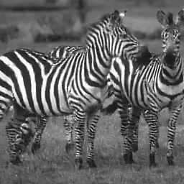
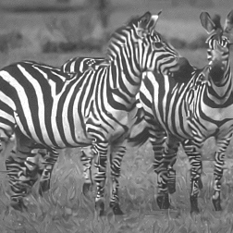
RIDE for Image In-painting
Original
Missing pixels
80%
Multiscale KSVD by Mairal et al.
21.21 dB
With RIDE
22.07 dB

Slide 13
RIDE for SPC reconstruction
Comparisons
D-AMP
TVAL
Ours
$$128 x 128$$
26.76 dB
24.70 dB
29.68 dB
15% measurements

Slide 14
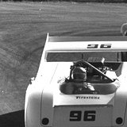
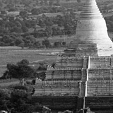
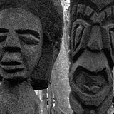
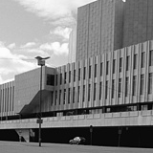
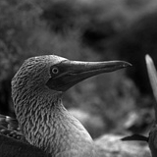
RIDE for SPC reconstruction
Quantitative results; five 128x128 images from BSDS test set
Method | M.R. = 40% |  | M.R. = 30% |  | M.R. = 25% |  | M.R. = 15%
 | PSNR | SSIM | PSNR | SSIM | PSNR | SSIM | PSNR | SSIM
TVAL3 | 29.70 | 0.833 | 28.68 | 0.793 | 27.73 | 0.759 | 25.58 | 0.670
D-AMP | 32.54 | 0.848 | 29.95 | 0.800 | 28.26 | 0.760 | 24.02 | 0.615
Ours | 33.71 | 0.903 | 31.91 | 0.862 | 30.71 | 0.830 | 27.11 | 0.704

Slide 15
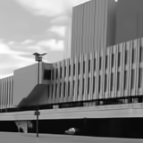
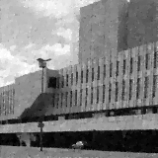
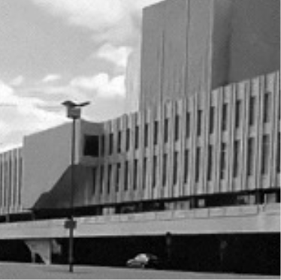
RIDE for SPC reconstruction
Reconstruction using RIDE at 30% M.R.
Original
D-AMP
TVAL
Ours
32.21 dB, 0.929
26.16 dB, 0.784
33.82 dB, 0.935

Slide 16
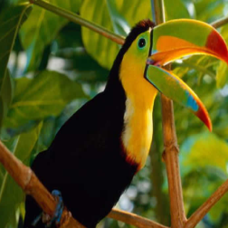
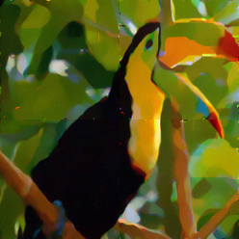
RIDE for SPC reconstruction
Original (256x256)
30% M.R.
10% M.R.
7% M.R.

Slide 17
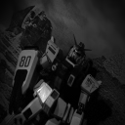
Real SPC reconstructions @ 30% M.R.
Full reconstruction
D-AMP
TVAL
Ours
32.31 dB, 0.876
32.95 dB, 0.883
35.87 dB, 0.908

Slide 18
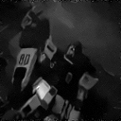
Real SPC reconstructions @ 15% M.R.
Full reconstruction
D-AMP
TVAL
Ours
28.34 dB, 0.760
24.68 dB, 0.687
31.12 dB, 0.813

Slide 19
Summary
Analytic priors
Suffer at low measurement rates
Deep discriminative models
Task specific, do not handle global multiplexing
RIDE as an image prior for SPC
Data driven
Recurrent
Flexible
SPC reconstruction
On the downside
Sequential nature increases computational cost
Check arxiv for more details: https://arxiv.org/abs/1612.04229
Code is available on github: https://adaveiitm.github.io/research.html

Slide 20
END

