Slide 1
Enhancing GAN Performance through Neural Architecture Search and Tensor Decomposition
Prasanna Reddy Pulakurthi^{1*}, Mahsa Mozaffari¹, Sohail A. Dianat¹, Majid Rabbani¹, Jamison Heard¹, and Raghuveer Rao²
¹Rochester Institute of Technology, USA
²DEVCOM Army Research Laboratory, USA

Slide 2
Generative Adversarial Network (GAN)
X
Input data
Discriminator: D
Real/Fake
Z
Random noise
Generator: G
Y
Generated data
Generative Adversarial Networks are a class of machine learning techniques that learn to generate adversarial samples from a desired distribution.
The learning is accomplished via a two-player minimax optimization game between the generator and the discriminator.
The generator network G aims to generate adversarial samples that fool the discriminator into thinking they are real, and the discriminator network D tries to distinguish between the real and fake samples.
[1] Goodfellow, Ian, et al. "Generative adversarial networks." Communications of the ACM 63.11 (2020): 139-144.

Slide 3
Factors Influencing the GAN Performance
Our research focuses on the three main factors that influence the performance of GANs:
Training Objectives
Network Architecture
Training Procedures

Slide 4
1. GAN Training Objectives (Loss Functions)
Minimax loss [1]: The drawback is the issue of vanishing gradients.
Non-saturating loss [1]: Solves the vanishing gradient problem, however, has the potential for mode collapse or instability.
Hinge loss [2], also used in SVM, encourages better separation between real and generated samples. However, it can suffer from mode collapse.
Wasserstein loss [3]: offers more meaningful gradient information, as it directly minimizes the distance between the real and generated distributions. Training can be slower due to the need for multiple discriminator updates per generator update.
MMD-GAN repulsive loss [4]: Superior for its ability to separate real samples from each other, in addition to distinguishing between real and generated samples

Slide 5
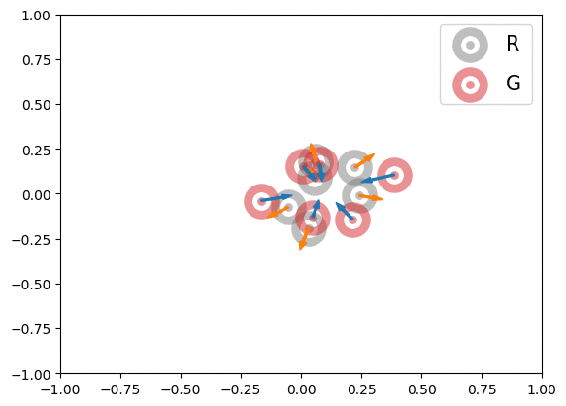
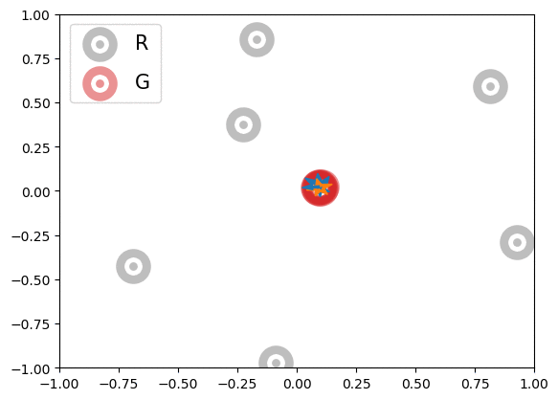
MMD-GAN Repulsive Loss
The MMD-GAN repulsive loss between real $P_{x}$ and generated $P_{y}$:
Discriminator: $\min_{D}{E_{P_{X}}\left[k_{D}\left(x,x^{′}\right)\right]−E_{P_{z}}\left[k_{D}\left(y,y^{′}\right)\right]}$, where the discriminator is subjected to Lipschitz constraint.
Generator : $\min_{G}{E_{P_{X}}\left[k_{D}\left(x,x^{′}\right)\right]+E_{P_{z}}\left[k_{D}\left(y,y^{′}\right)\right]}−2E_{P_{X},P_{Z}}\left[k_{D}\left(x,y\right)\right]$
[4] Wang, Wei, Yuan Sun, and Saman Halgamuge, "Improving MMD-GAN training with repulsive loss function." arXiv preprint arXiv:1812.09916 (2018).

Slide 6
2. Network Architecture: Neural Architecture Search
[5] Gao, Chen, et al. "Adversarialnas: Adversarial neural architecture search for GANs," Proceedings of the IEEE/CVF Conference on Computer Vision and Pattern Recognition. 2020.

Slide 7
Network Architecture: Adversarial Neural Architecture Search for GANs (AdversarialNAS)
[5] Gao, Chen, et al. "Adversarialnas: Adversarial neural architecture search for GANs," Proceedings of the IEEE/CVF Conference on Computer Vision and Pattern Recognition. 2020.

Slide 8
Our Contributions
Integrated the MMD-GAN repulsive loss function within the Neural Architecture Search (NAS) framework to enhance the GAN performance.
Proposed a new training procedure to improve the GAN Performance.
Applied tensor decomposition to compress the GAN architecture, leading to a more compact architecture with similar performance.

Slide 9
1. Integrating the MMD-GAN Repulsive Loss Function within the NAS Framework
Integrated the MMD-GAN repulsive loss function within the Neural Architecture Search (NAS) framework to find the optimal architecture.
The optimal architecture generated on the Cifar-10 dataset is shown above.
The optimal architecture consists of 13 layers with a size of 20.18 MB.

Slide 10
2. Novel Training Procedure
The basic idea is to start the training with a small $b_{u}$ and increase the value of $b_{u}$ until the performance is saturated.
We start at $b_{u}=4$, and double $b_{u}$ if no further improvement in the FID score is observed within a fixed number of epochs.
Epochs | $$b_{u}$$ | FID
85 | 4 | 9.46
120 | 8 | 8.56
150 | 16 | 7.86

Slide 11
Results of the Novel Training Procedure
Epochs | $$b_{u}$$ | FID
85 | 4 | 9.46
120 | 8 | 8.56
150 | 16 | 7.86
9.46
8.56
7.86

Slide 12
Pseudo Code

Slide 13
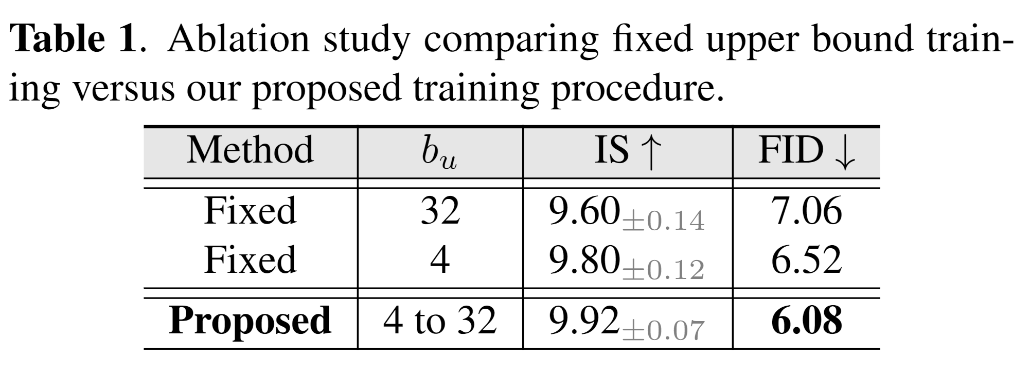
Ablation Study
The following two methods are compared:
Fixed $b_{u}$: Keep the value of $b_{u}$ fixed at 4 or 32 throughout the experiment.
Varying $b_{u}$: Start with $b_{u}$ = 4 and increase according to the training procedure.

Slide 14
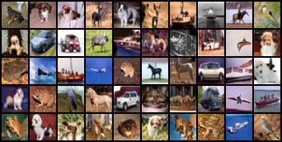
Visual Results
CIFAR-10 generated images (32$×$32)
STL-10 generated images (48$×$48)

Slide 15
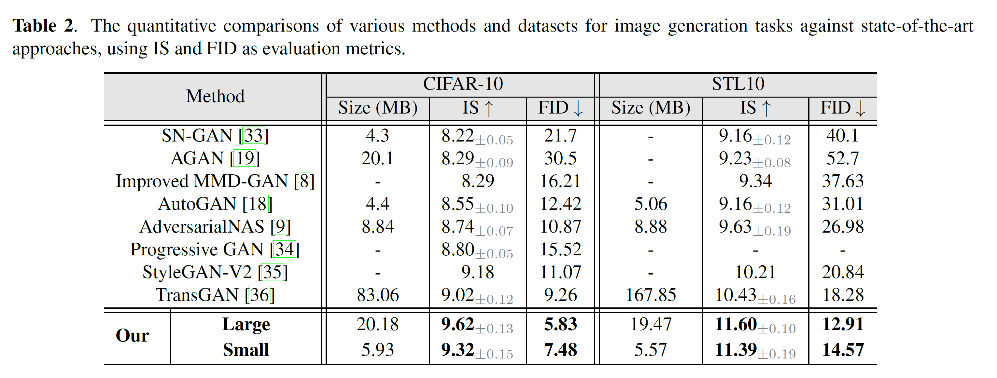
Quantitative Results

Slide 16
3. Motivation for Compressing The GAN Generator Architecture
The MMD-GAN resulting from integrating the repulsive loss into the AdversarialNAS framework outperforms the state-of-the-art methods. However, its size is inherently larger than architectures generated using other losses.
For example, on the Cifar-10 dataset the NAS-derived architecture using MMD-GAN repulsive loss resulted in a size of 20.1MB compared to the size of 8.8MB from the hinge loss.

Slide 17
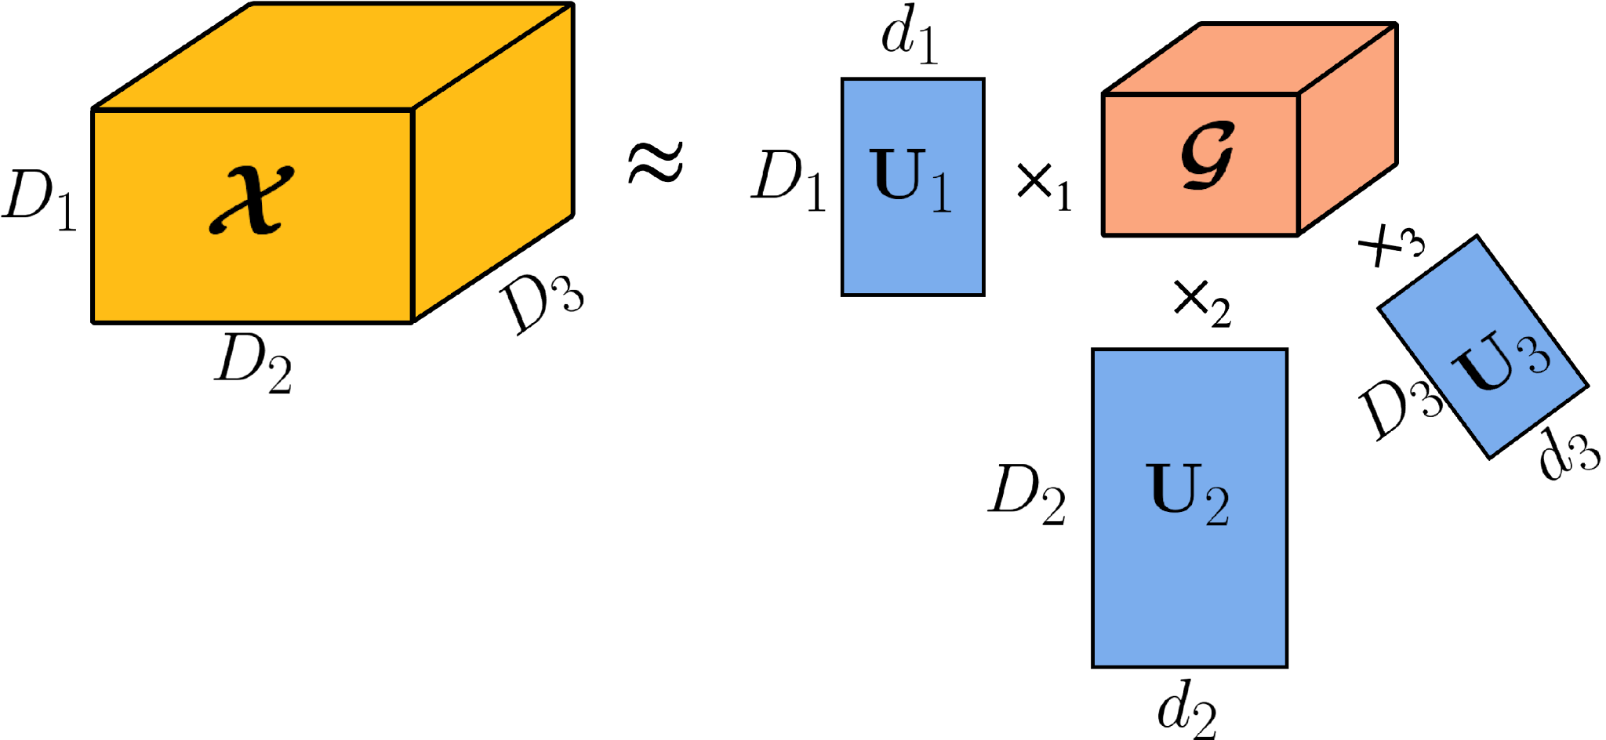
Tensor Decomposition
A mathematical tool that can be considered as a high-order generalization of matrix factorization, such as Singular Value Decomposition (SVD) and Principal Component Analysis (PCA).
Decomposes high order tensors into combination of lower-dimensional matrices/tensors.
3-way tensor
1. Tucker Decomposition:
2. Canonical Polyadic Decomposition (CPD):
$D_{1}D_{2}D_{3} →d_{1}D_{1}+d_{2}D_{2}$+ $d_{3}D_{3}$+ $d_{1}d_{2}d_{3}$
$$D_{1}D_{2}D_{3} →R\left(D_{1}+D_{2}+D_{3}\right)$$

Slide 18
Compression of Convolution Layers
$$𝒲∈ℝ^{T×C×H×W}$$
$$A∈ℝ^{T×R}$$
$$B∈ℝ^{C×R}$$
$$C∈ℝ^{H×R}$$
$$D∈ℝ^{W×R}$$
$𝒲≈\hat{𝒲}=⟦A,B,C,D⟧$
${\hat{𝒲}}_{t,c,h,w}=\sum_{r=1}^{R}{A_{t,r}B_{c,r}C_{h,r}D_{w,r}}$
$Z_{t,i,j}=\sum_{w,h,c}{𝒲_{t,c,h,w} Y_{c,h^{′},w^{′}}}$ $≈\sum_{w,h,c,r}{A_{t,r}{ B}_{c,r}{ C}_{h,r}{ D}_{w,r}{ Y}_{c,h^{′},w^{′}}}$
$=\sum_{r}{A_{t,r}\left(\sum_{r}{{ C}_{h,r}} \left(\sum_{r}{{ D}_{w,r}} \left(\sum_{c}{{ B}_{c,r}{ Y}_{c,h^{′},w^{′}}}\right)\right)\right)}$

Slide 19
Generator Layers’ Weight Dimensions
Count | Weight Size | Layer Type | Ratio to Total Size
9 | $$256×256×1×1$$ | Convolution | $$0.32\%$$
5 | $$256×256×3×3$$ | Convolution | 2.92%
8 | $$256×256×5×5$$ | Convolution | 8.12%
1 | $$3×256×3×3$$ | Convolution | 0.03%
Large Network: 20.18 M
Small Network: 5.93 M
Goal is to compress the 13 convolution layers that collectively constitute ~$80\%$ of the network’s parameters.
Notes:
Large – 256
Small -128

Slide 20
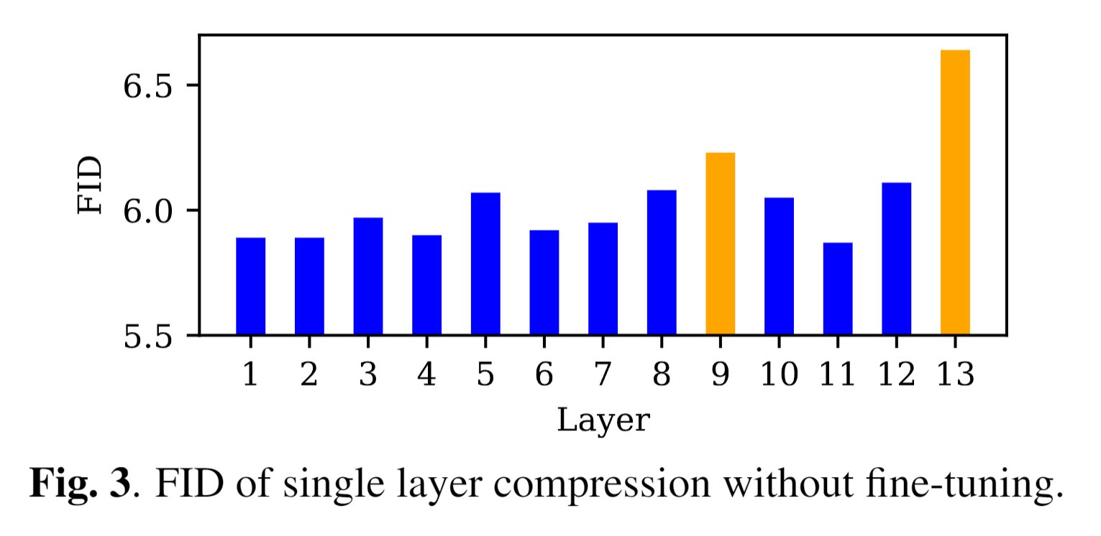
Single Layer Compression
CPD is applied to the generator layers.
Each layer is compressed in isolation and only the layers with minimal performance degradation are compressed.
Because layers 9 and 13 undergo a significant performance degradation, they are not compressed.
After compression, the network is fine-tuned to improve performance.
Notes:
Very Low-rank

Slide 21
Compression of Fully Connected Layers
After compression of convolution layers followed by fine-tuning, the fully connected (FC) layers of the generator are compressed.
Fine-tuning after the compression of fully connected layers resulted in instability and, therefore, bypassed.
The decomposition rank was chosen such that performance was either unaffected or minimally affected.
New Layers
$$W≈UV$$
…
…
$$W$$
$$U$$
$$V$$

Slide 22
Quantitative Results
[6] Code: https://github.com/PrasannaPulakurthi/MMD-AdversarialNAS

Slide 23
Summary of Our Research
Integrates the MMD-GAN repulsive loss into the AdversarialNAS framework to find optimal architecture.
Implements a novel training procedure aimed at improving generative performance.
Applies tensor decomposition to reduce the network footprint while maintaining performance (as measured by the FID score), thus facilitating deployment on edge devices.
The proposed technique achieves a 34% improvement in FID score compared to the state-of-the-art [7] on the CIFAR-10 dataset with a 14× reduction in network size.

Slide 24
Thank You

Slide 25
References
[1] Goodfellow, Ian, et al. "Generative adversarial networks." Communications of the ACM 63.11 (2020): 139-144.
[2] Tran, Dustin, Rajesh Ranganath, and David Blei. "Hierarchical implicit models and likelihood-free variational inference." Advances in Neural Information Processing Systems 30 (2017).
[3] Arjovsky, Martin, Soumith Chintala, and Léon Bottou. "Wasserstein generative adversarial networks." International conference on machine learning. PMLR, 2017.
[4] Wang, Wei, Yuan Sun, and Saman Halgamuge, "Improving MMD-GAN training with repulsive loss function." arXiv preprint arXiv:1812.09916 (2018).
[5] Gao, Chen, et al. "Adversarialnas: Adversarial neural architecture search for GANs," Proceedings of the IEEE/CVF Conference on Computer Vision and Pattern Recognition. 2020.
[6] Code: https://github.com/PrasannaPulakurthi/MMD-AdversarialNAS
[7] Yifan Jiang, Shiyu Chang, and Zhangyang Wang, “Transgan: Two pure transformers can make one strong gan, and that can scale up,” Advances in Neural Information Processing Systems, vol. 34, 2021.

