Slide 1
GLAUCOMA DETECTION FROM RAW CIRCUMPAPILLARY OCT IMAGES USING FULLY CONVOLUTIONAL NEURAL NETWORKS
GABRIEL GARCÍA, ROCÍO DEL AMOR, ADRIÁN COLOMER, VALERY NARANJO
SESSION: ARS-02-BIOMEDICAL AND BIOLOGICAL IMAGE ANALYSIS
CVBLAB - Computer Vision and Behaviour Analysis Lab
i3B - Instituto de Investigación e Innovación en Bioingeniería
UPV - Universitat Politècnica de València

Slide 2
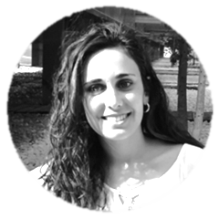
GLAUCOMA DETECTION FROM RAW CIRCUMPAPILLARY OCT IMAGES USING FULLY CONVOLUTIONAL NEURAL NETWORKS
GABRIEL GARCÍA, ROCÍO DEL AMOR, ADRIÁN COLOMER, VALERY NARANJO
Biomedical Engineer
Biomedical Engineer
Telecomunication Engineer
Telecomunication Engineer

Slide 3
Index
1. INTRODUCTION
2. MATERIAL
3. METHODS
3.1. DATA PARTITIONING
3.2. LEARNING FROM SCRATCH
3.3. LEARNING BY FINE TUNING
4. RESULTS AND DISCUSSION
4.1. VALIDATION RESULTS
4.2. TEST RESULTS
5. CONCLUSIONS

Slide 4
Index
1. INTRODUCTION
2. MATERIAL
3. METHODS
3.1. DATA PARTITIONING
3.2. LEARNING FROM SCRATCH
3.3. LEARNING BY FINE TUNING
4. RESULTS AND DISCUSSION
4.1. VALIDATION RESULTS
4.2. TEST RESULTS
5. CONCLUSIONS

Slide 5
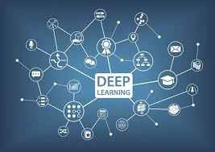
Index
1. INTRODUCTION
2. MATERIAL
3. METHODS
3.1. DATA PARTITIONING
3.2. LEARNING FROM SCRATCH
3.3. LEARNING BY FINE TUNING
4. RESULTS AND DISCUSSION
4.1. VALIDATION RESULTS
4.2. TEST RESULTS
5. CONCLUSIONS

Slide 6
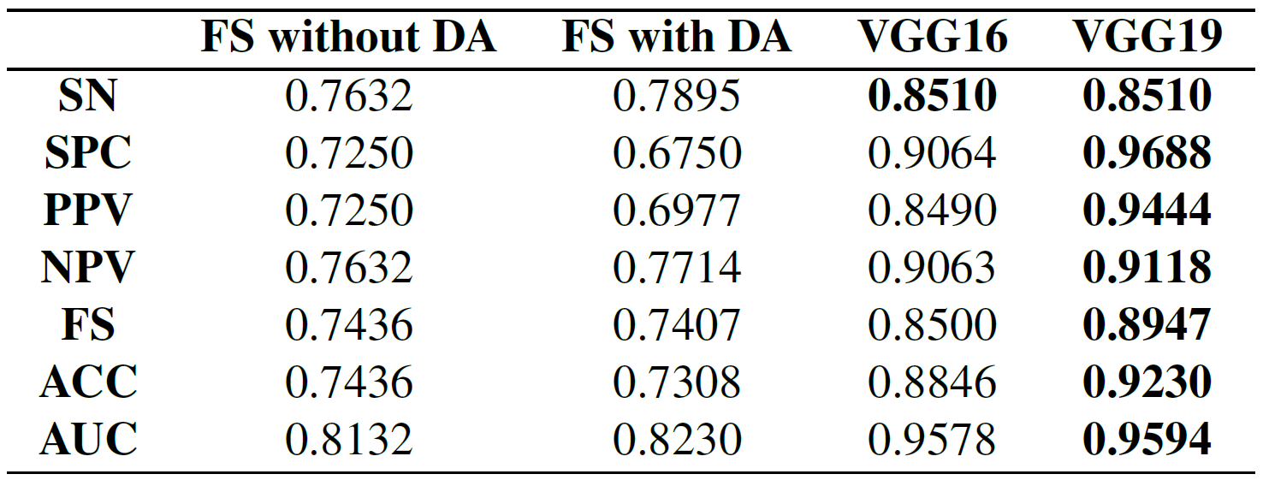
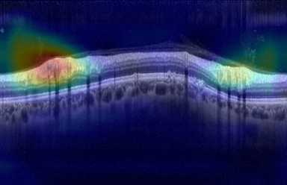
Index
1. INTRODUCTION
2. MATERIAL
3. METHODS
3.1. DATA PARTITIONING
3.2. LEARNING FROM SCRATCH
3.3. LEARNING BY FINE TUNING
4. RESULTS AND DISCUSSION
4.1. VALIDATION RESULTS
4.2. TEST RESULTS
5. CONCLUSIONS

Slide 7
Index
1. INTRODUCTION
2. MATERIAL
3. METHODS
3.1. DATA PARTITIONING
3.2. LEARNING FROM SCRATCH
3.3. LEARNING BY FINE TUNING
4. RESULTS AND DISCUSSION
4.1. VALIDATION RESULTS
4.2. TEST RESULTS
5. CONCLUSIONS

Slide 8
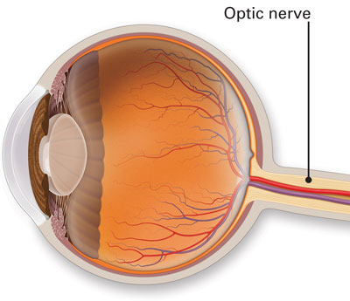
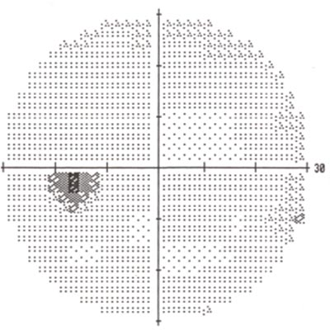
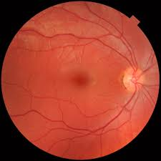
INTRODUCTION
Material
Methods
Results
Conclusions
GLAUCOMA is a group of progressive optic neuropathies that affects the optic nerve head (ONH) causing several visual field defects and structural changes.
Definition
This chronic disease has become the leading cause of blindness worldwide, whose impact is expected to grow, affecting around 111.8 million people in 2040.
Motivation
There is no single accurate test to certify the glaucoma diagnosis, so the procedure includes a lot of hardworking tests such as pachymetry, tonometry, visual field tests and a subjective examination from different experts, who often disagree.
Diagnostic Procedure
State-of-the art studies
Many state-of-the-art studies have addressed the glaucoma detection using machine-learning techniques based on image analysis such as fundus image and optical coherence tomography (OCT).
Vs.
3

Slide 9
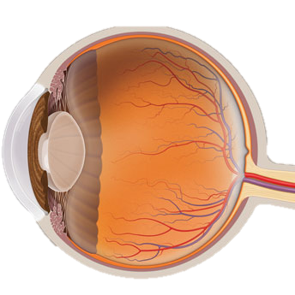
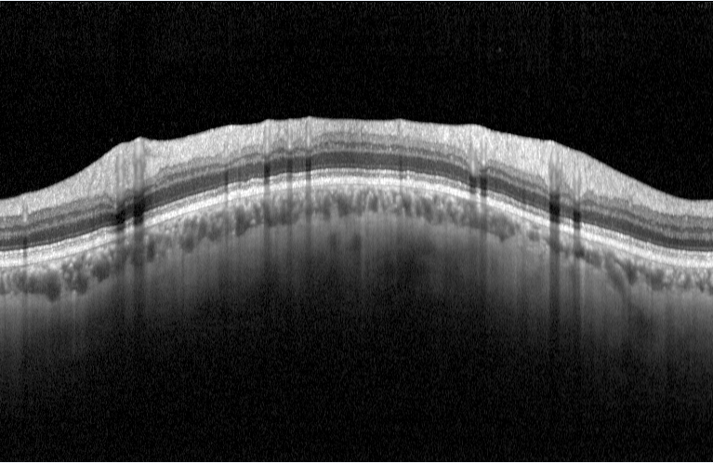
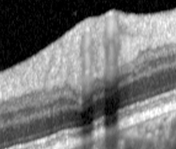
INTRODUCTION
Material
Methods
Results
Conclusions
Contribution of this work
Fundus image analysis is a great cost-effectiveness technique which has reported promising results in the detection of several eye-focused diseases, but OCT imaging modality is the quintessential technique for glaucoma damage evaluation.
We propose an end-to-end system for glaucoma detection from raw circumpapillary OCT images, without using another kind of images or external expensive tests related to the VF and IOP parameters.
RNFL
1. To demonstrate that a single circumpapillary OCT image may be of great interest when carrying out an accurate glaucoma detection
Objectives
2. To design and compare two different approaches based on deep-learning algorithms intended to glaucoma detection.
4
Notes:
However, fundus image is colour-dpendent on the training data set and its interpretation remains subjective. In addition, glaucoma is evident in the deterioration of the cell layer of the optic disc, which can not be appreciated in the 2D projection corresponding to the fundus photography.
Otherwise, OCT imaging modality is a non-contact and non-invasive technique that allows focusing on the depth axis to quantify structural retinal
Changes.
For that reason, although fundus image-based studies are cheaper than OCT, this modality is the quintessential imaging technique for
glaucomatous damage evaluation. Additionally, several studies claimed that circumpapillary retinal nerve fiber
layer (RNFL) is essential to carry out an early detection of glaucoma.
So, in order to accomplish this study, we focus on the optic nerve head of the retina to extract the B-scan corresponding to the circumpapillary OCT image. This B-scan allows us to show the different layers of fibers of the retina, where the RNFL structure appears highlighted.
With all of this, the main objectives of this work are:

Slide 10
Introduction
MATERIAL
Methods
Results
Conclusions
249
Circumpapillary
OCT images
496 pixels
89
Healthy patients
59
Glaucomatous patients
768 pixels
Private database from Oftalvist Ophthalmic Clinic
156
Normal
OCT images
93
Glaucomatous
OCT images
Annotated by expert ophthalmologists
Images acquired with Heidelberg Spectralis OCT system
5

Slide 11
Introduction
Material
METHODS
Results
Conclusions
Data partitioning
Random data partitioning
into 5 different subsets
Construction of training,
validation and test sets
k=5-fold cross-validation
Train
Test
TRAINING
TEST
k=5
k=2
k=1
SubTrain
Val
4/5
Subtrain
1/5
Validation
6

Slide 12
Introduction
Material
METHODS
Results
Conclusions
Models development
Learning from scratch
Model hyperparameters
Architecture parameters
Parameters
Possible
values
Selected
values
Parameters
Possible
values
Selected
values
Learning rate
$[5e^{−1}$, 1 $e^{−5}]$
$$5e^{−2}$$
Convolutional blocks
$[1$, 5$]$
$$4$$
Optimizer
$$SGD$$
Adadelta
Adadelta
Convolutional layers per block
$[1$, 4$]$
$$1$$
$$MSE$$
BCE
Hinge
W-BCE
$$Max pooling$$
Batch normalization
Dropout
$$True$$
$$False$$
$$False$$
Loss function
Additional
layers
Batch size
8, 16, 32, 64
16
$$Flatten$$
GMP
GAP
Top model
input
$$GMP$$
Number of epochs
$[50$, 5$00]$
$$150$$
7

Slide 13
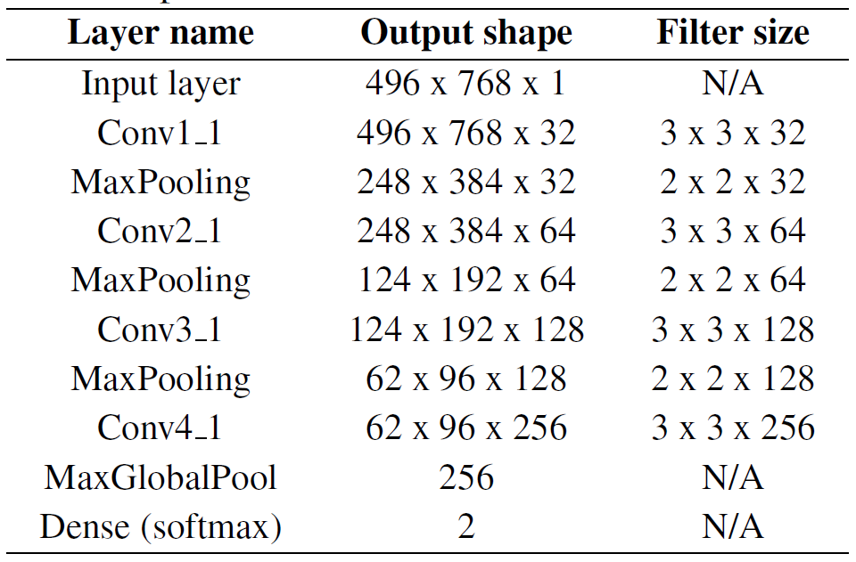
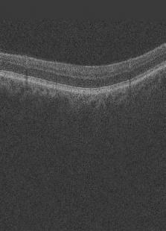
Introduction
Material
METHODS
Results
Conclusions
Models development
Learning from scratch
Kernel size
Number of filters
Proposed architecture
Convolutional layer
Max pooling layer
Global max pooling layer
Random geometric and dense elastic transformations from de original images
DATA AUGMENTATION
Softmax-activated dense layer
Factor ratio = 0.2
8

Slide 14
Introduction
Material
METHODS
Results
Conclusions
Models development
Learning by fine tuning
State-of-the-art- architectures
(base model)
Top model
Model hyperparameters
Dropout layer (0.4)
+
GMP layer
+
Softmax layer
Possible
values
Selected
values
InceptionV3
Parameters
Learning rate
$[5e^{−1}$, 1 $e^{−5}]$
$$1e^{−3}$$
Xception
Optimizer
$$SGD$$
Adadelta
Adadelta
Considerations
ResNet
$$MSE$$
BCE
Hinge
Down-sampling x0.5 to alleviate the GPU memory constraints
Loss function
W-BCE
VGG16
Batch size
8, 16, 32, 64
16
Replicating x3 the channels of the gray-scale to adapt the input images
Number of epochs
$[50$, 5$00]$
$$125$$
VGG19
9

Slide 15
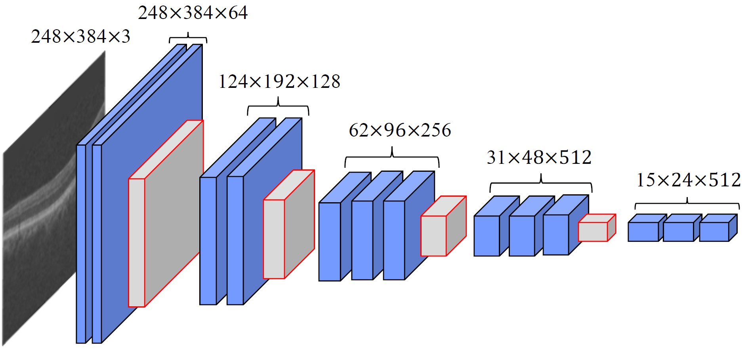
Introduction
Material
METHODS
Results
Conclusions
Models development
Learning by fine tuning
Deep-fine tuning strategy to retrain only the two last convolutonal blocks
Unfrozen coefficients to retrain
512
Proposed top model
VGG16 base model
10

Slide 16
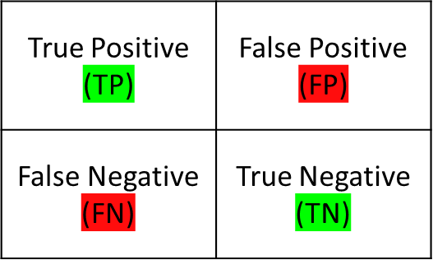
Introduction
Material
RESULTS
Methods
Conclusions
Metrics
$$Sensitivity \left(SN\right)=\frac{TP}{TP+FN}$$
Confusion Matrix
$$Specificity \left(SPC\right)=\frac{TN}{TN+FP}$$
$$Positive Predictive Value (PPV)=\frac{TP}{TP+FP}$$
Prediction
$$Negative Predictive Value (NPV)=\frac{TN}{TN+FN}$$
$$F1 Score \left(FS\right)=2·\frac{SN·PPV}{SN+PPV}$$
Truth
$$Accuracy (ACC)=\frac{TP+TN}{TP+FP+TN+FN}$$
11

Slide 17
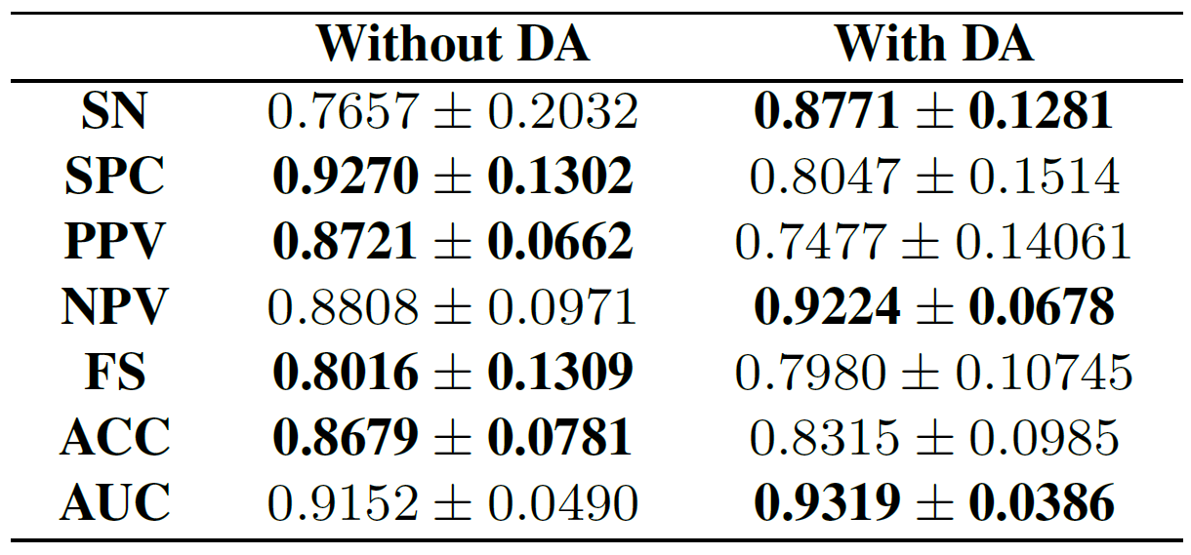
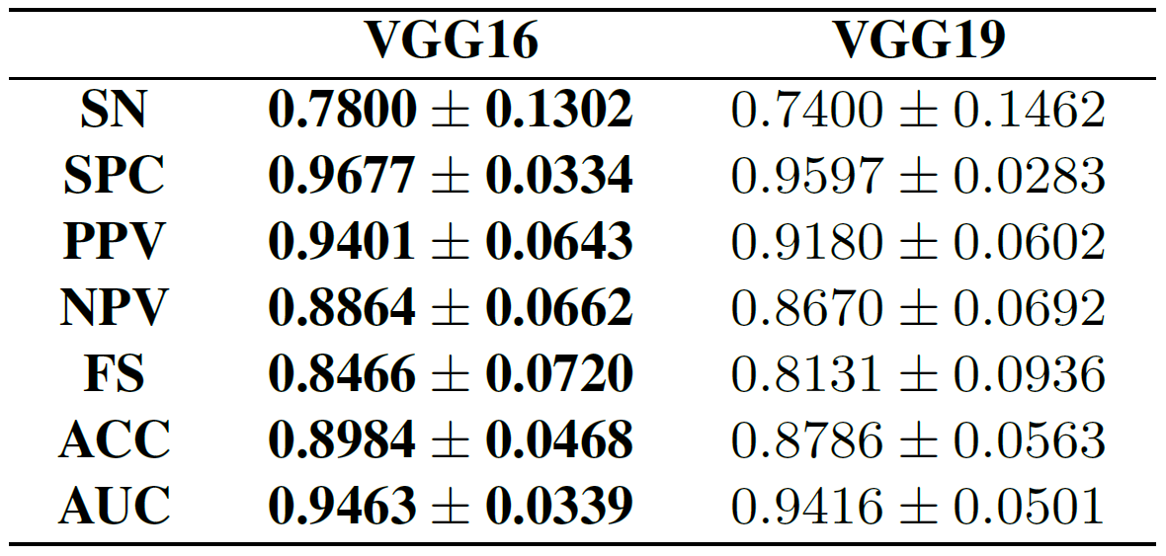
Introduction
Material
RESULTS
Methods
Conclusions
Validation results
5-fold-cross-validation stage
Learning from scratch
Learning by fine tuning
12

Slide 18
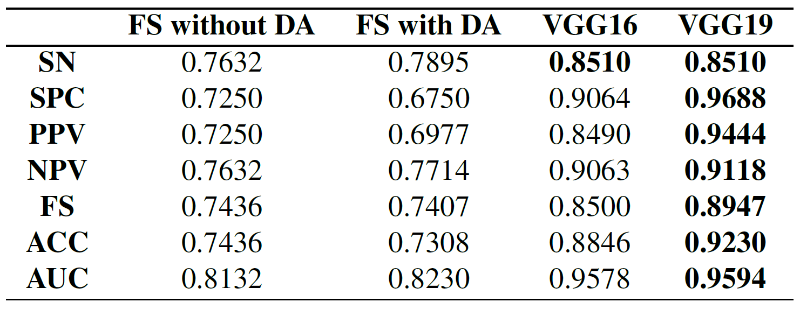
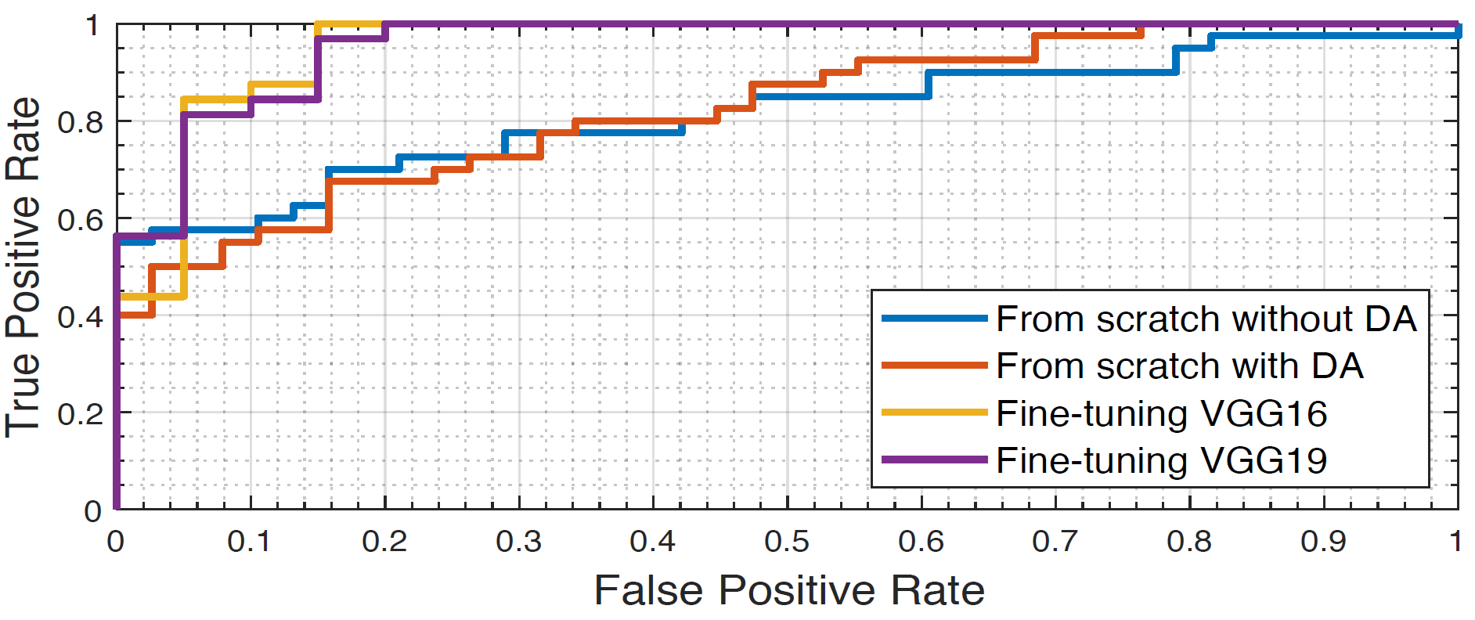
Introduction
Material
RESULTS
Methods
Conclusions
Test results
Prediction stage
Learning from scratch
Learning by fine tuning
13

Slide 19
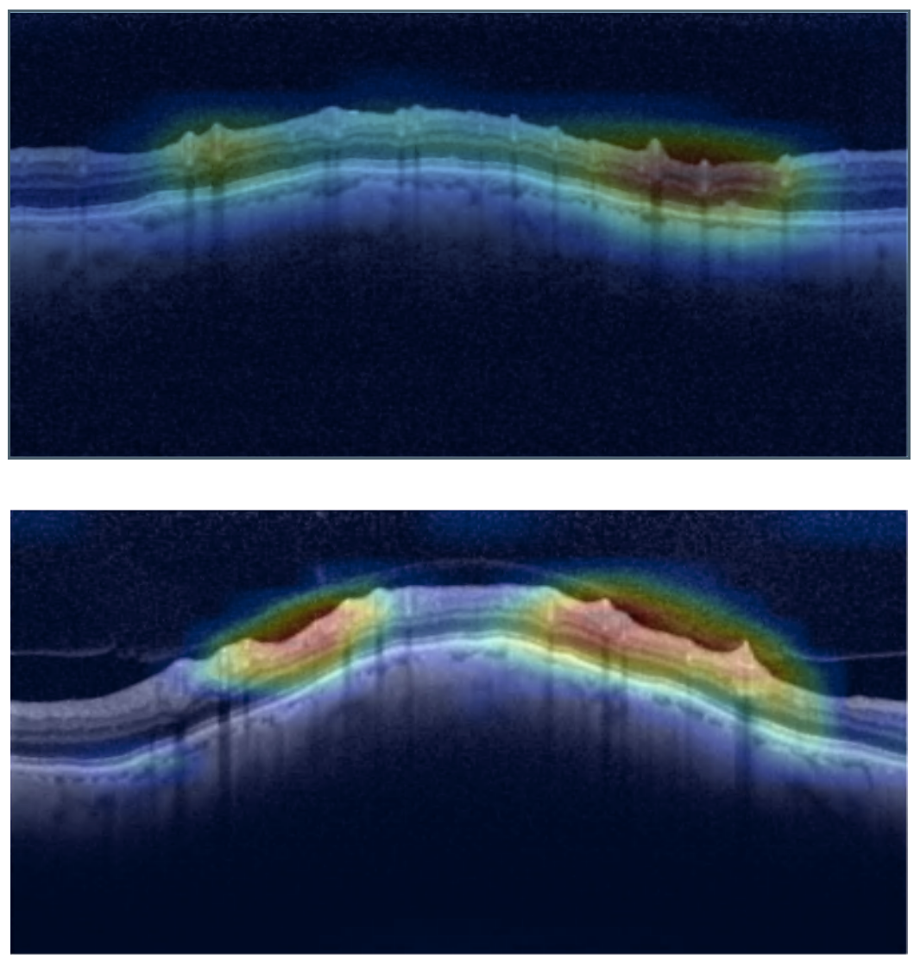
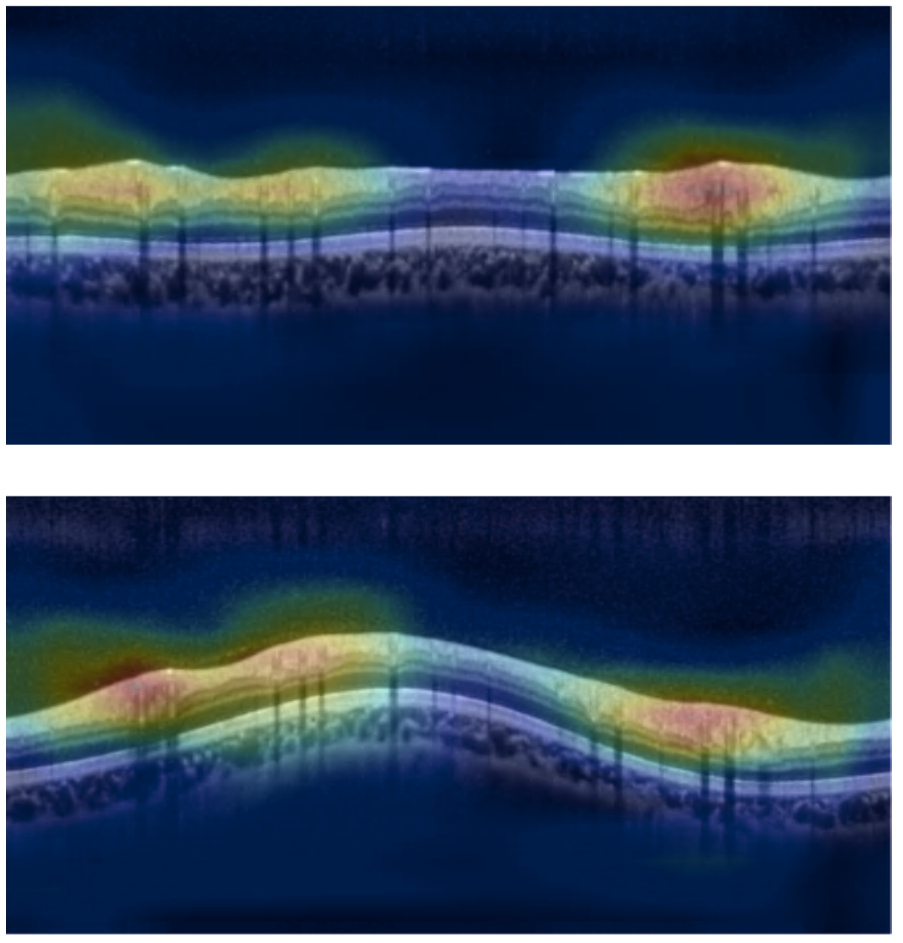
Introduction
Material
RESULTS
Methods
Conclusions
Qualitative results
Class Activation Maps
Heatmaps allows identifying where the neural network is paying attention to predict the class of the sample
Examples of circumpapillary OCT images corresponding to glaucomatous patients
The findings from the CAMs are directly in line with the reported by expert clinicians, who claim that a thickening of the RNFL is intimately linked with healthy patients, whereas a thinning of the RNFL evidences a glaucomatous case.
Examples of circumpapillary OCT images corresponding to healthy patients
14

Slide 20
Introduction
Material
CONCLUSIONS
Methods
Results
Conclusions
Two different deep-learning approaches have been developed to elucidate the added value enclosed in the circumpapillary OCT images for glaucoma detection.
The use of data augmentation techniques improves the models’ performance when addressing small databases as in this case.
Fine-tuning algorithms allows outperforming the models trained from scratch, especially the VGG family of neural networks.
The findings from the Class Activation Maps (CAMs) are in line with the clinical interpretation since the same well-known areas of interest appear highlighted in the heatmaps.
Future research lines
An external evaluation employing larger databases of circumpapillary OCT images will be considered.
15

Slide 21
GLAUCOMA DETECTION FROM RAW CIRCUMPAPILLARY OCT IMAGES USING FULLY CONVOLUTIONAL NEURAL NETWORKS
GABRIEL GARCÍA, ROCÍO DEL AMOR, ADRIÁN COLOMER, VALERY NARANJO
THANK YOU FOR YOUR ATTENTION

