Slide 1
Transforming Tabular Data For Multi-modality: Enhancing Breast Cancer Metastasis Prediction Through Data Conversion
${\text{Faseela} \text{Abdullakutty}}^{1}$, ${\text{Younes} \text{Akbari}}^{1}$ , ${\text{Somaya} \text{Al}\text{−}\text{Maadeed}}^{1}$, ${\text{Ahmed} \text{Bouridane}}^{2}$, ${\text{Rifat} \text{Hamoudi} }^{2}$
$$1_{\text{Qatar} \text{University}\text{, }\text{Qatar}\text{,}}$$
$$2_{\text{University} \text{of} \text{Sharjah}\text{, }\text{United} \text{Arab} \text{Emirates}}$$

Slide 2
Outline
Background
Dataset
Method
Results
Summary

Slide 3
Breast Cancer: An Overview
Breast cancer is one of the most common cancers affecting women worldwide, leading to significant morbidity and mortality.
The spread of cancer from the breast to distant organs (metastasis) complicates treatment, significantly reducing survival rates.
Accurate diagnosis of metastasis is crucial for effective treatment and prognosis.

Slide 4
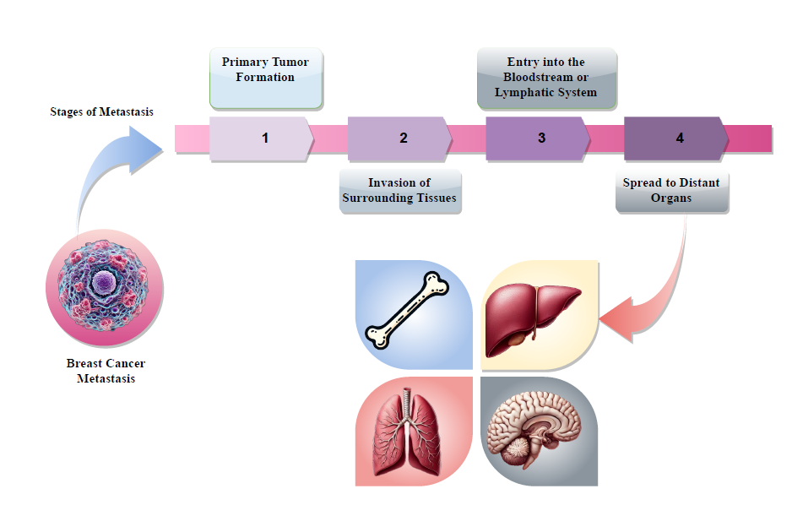
Metastasis

Slide 5
AI in Breast Cancer Metastasis Prediction
ML techniques have revolutionized the diagnosis and prediction of breast cancer metastases.
ML models can detect subtle and complex patterns and relationships in large, complex datasets.
Mainly rely on structured clinical data, which may lack the depth needed for comprehensive understanding.
These could lead to missed or incomplete insights, reducing metastasis prediction accuracy.
Bridging the diagnostic gap with unstructured and nuanced data (e.g., imaging, reports).
provide a more comprehensive tool for metastasis prediction, improving diagnostic outcomes.

Slide 6
Dataset
Dataset size
Clinical dataset for metastasis prediction [1]
Total size: 413
Progresses :83
Not Progressed: 330
[1] An explainable ai approach for breast cancer metastasis prediction based on clinicopathological data,” IEEE Transactions on Biomedical Engineering, 2023

Slide 7
Dataset Overview
Includes demographic factors: age, nulliparity, oral contraception, menopause.
Covers familial history, pregnancy details, obesity, and biomarkers (estrogen, progesterone receptors).
Detailed tumor characteristics: size, histology, vascular invasion, grade.
Treatment specifics: surgery, chemotherapy, radiotherapy, trastuzumab, hormone therapy

Slide 8
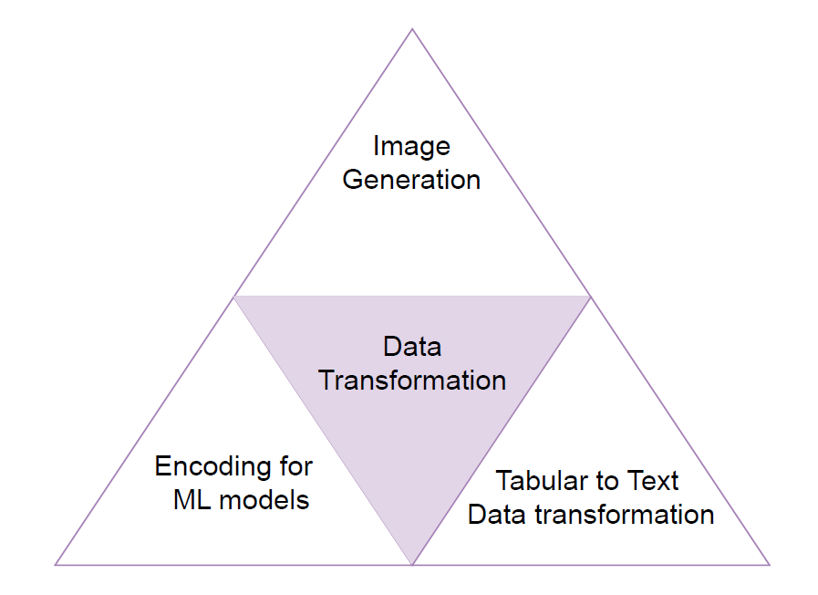
Data Transformation

Slide 9
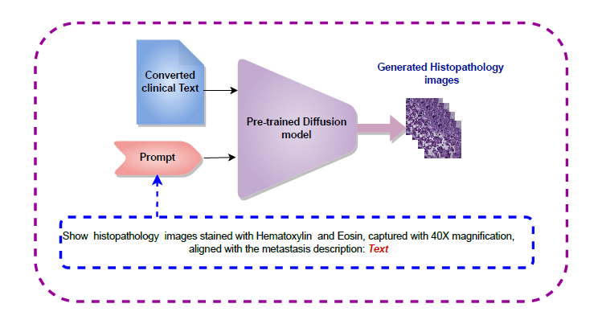
Image Generation
Prompt2MedImage Pre-trained Model [2]
Generates detailed medical images from text descriptions.
Utilizes a prompt containing tumor details and image type.
[2] Radiology objects in context (roco): a multimodal image dataset,” in Intravascular Imaging and Computer Assisted Stenting and Large-Scale Annotation of Biomedical Data and Expert Label Synthesis: 7th Joint International Workshop, MICCAI -2018

Slide 10
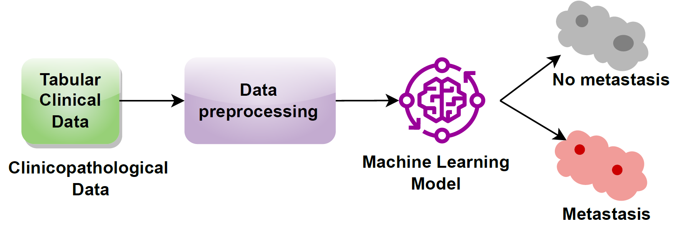
Metastasis prediction using tabular Clinical Data

Slide 11
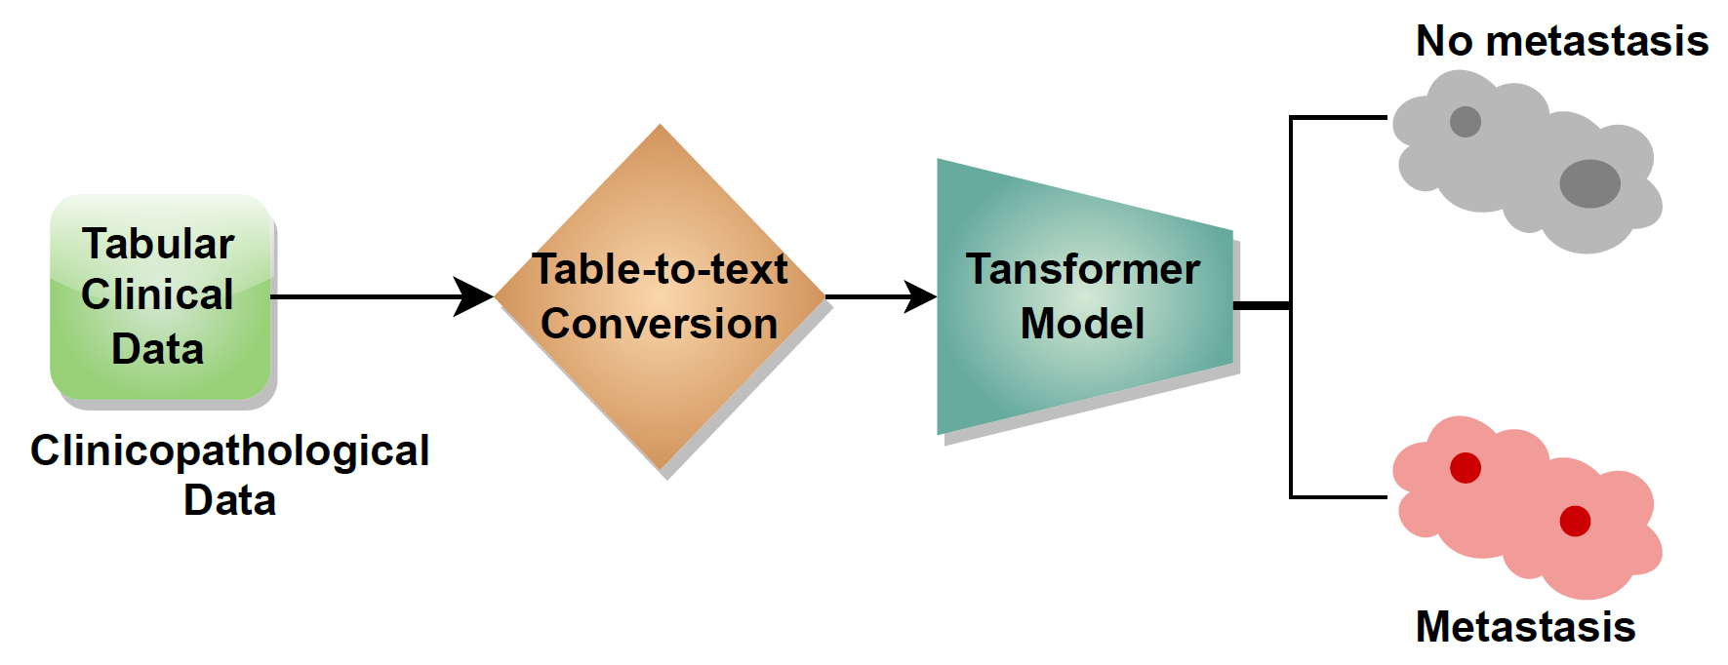
Metastasis prediction using text data

Slide 12
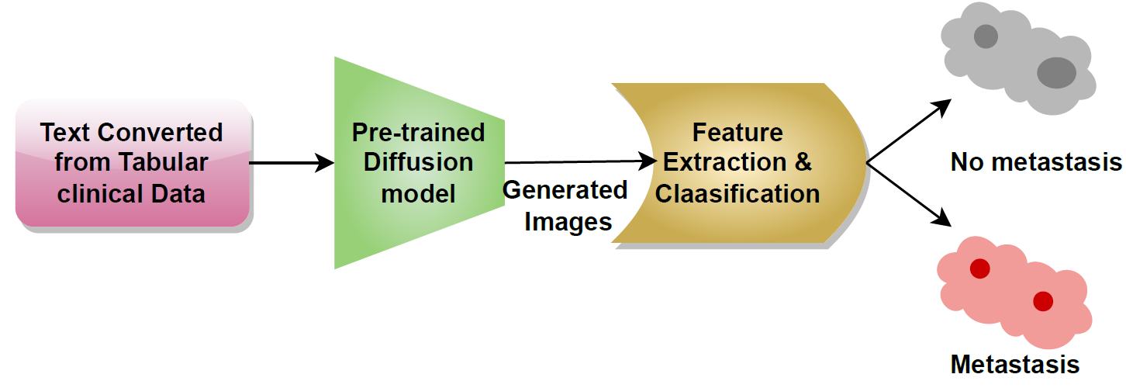
Metastasis prediction using histopathology images

Slide 13
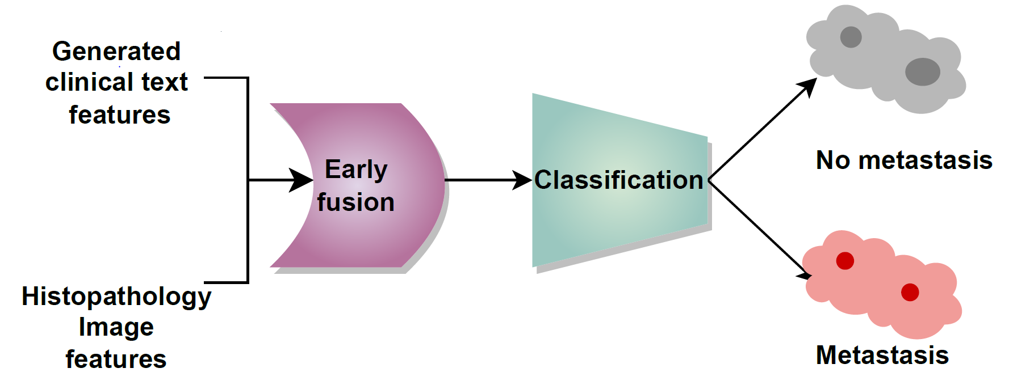
Early fusion for metastasis prediction
Used a multi-modal early fusion strategy integrating vision-derived features with text-based features from BERT.
Aimed to provide a comprehensive solution for predicting breast cancer metastasis.

Slide 14
Results

Slide 15
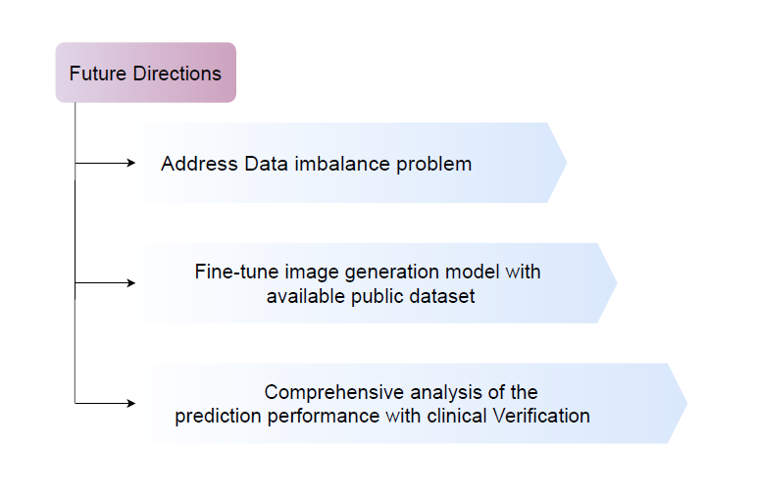

Slide 16
Summary
Converting clinical tables to text significantly enhanced diagnostic accuracy in the study
Training BERT on converted text data demonstrated superior performance underscoring the value of task-specific fine-tuning.
Initial use of a pre-trained model in image generation; fine-tuning with histopathology images could potentially improve outcomes.
Combining features extracted from BERT and Vision Transformer models led to higher accuracy, emphasizing the importance of compatible feature extraction models.

Slide 18
Thank you

