Slide 1
Guided Blocks WOM Codes
Gilad Baruch
Bar Ilan University
Shmuel T. Klein
Bar Ilan University
Dana Shapira
Ariel University
DCC 2021

Slide 2
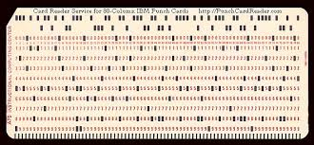
WOM- write once memory
Main constraint of flash: changing a bit-value
0 to 1 easy
1 to 0 only in blocks
Rewriting Code
Rivest-Shamir: 3 bits encode, twice, 4 values of 2 bits
Notes:
2

Slide 3
Rivest Shamir rewriting code
First: 5 - 00110101
Input | First round | Second round
00 | 000 | 111
01 | 100 | 011
10 | 010 | 101
11 | 001 | 110
00
11
01
01
000
001
100
100
011
011
100
101
01
01
01
10
Second: V - 01010110
Ratio = # info bits / # storage bits = 1.333
Notes:
3
3

Slide 4
Guided Blocks
0 1 2 3 4 5 6 7 8 9 10 11 12 13
F
0 1 0 0 0 1 0 0 1 0 1 0 0
1
0 0 1 0 1
2
0 0 1 0 1
S
3
0 0 1 0 1
4
0 0 1 0 1
0 . . . .
F
1 1 1 0 0 1 0 1 1 0 1 0 0

Slide 5
Results
For sparse data: prob(1-bit) < 0.5
Better than state of the art

Slide 6
Thank you !

