Slide 1
END-TO-END ASR-ENHANCED NEURAL NETWORK FOR ALZHEIMER’S DISEASE DIAGNOSIS
Jiancheng Gui, Yikai Li, Kai Chen, Joanna Siebert, Qingcai Chen
Harbin Institute of Technology (Shenzhen)
ICASSP 2022

Slide 2
Introduction
Background
Alzheimer’s disease (AD) is an irreversible chronic neurodegenerative disorder
Alzheimer’s disease(AD), mild cognitive impairment(MCI), and healthy controls(HC)
Biomarkers
Fluid and imaging examinations, such as CSF, PET, MRI, EEG, and MEG
Cues of speech in Alzheimer’s
acoustic-based features: pitch, articulation rate, duration of breaks, and syllable duration, etc
text-based features: lexical and grammar deficits, lexical complexity, etc

Slide 3
Related Works
Linguistic methods
Based on pretrained language model
GPT, BERT, ERNIE, etc
Extract hand-crafted features
Sentence structure, repetitiveness, and lexical complexity features, etc
Phonetic methods
End-to-end
DNN, CNN-LSTM, ResNet18, etc
Extract hand-crafted features
LLD(Low Level Descriptors), eGeMAPS, BoAW, etc

Slide 4
Motivation
Defects of linguistic methods
Manual transcripts are rarely available
Trustless transcribed text leads to poor performance
No specific ASR system for Alzheimer’s speech
Propose
Using ASR to learn the semantic cues of Alzheimer’s speech
End-to-end structure to automatically learn discriminative acoustic representations

Slide 5
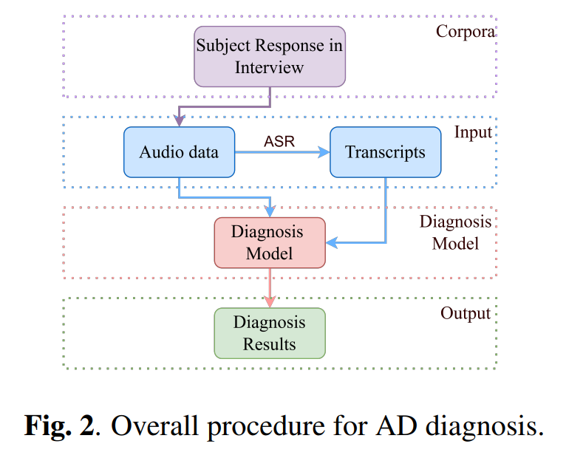
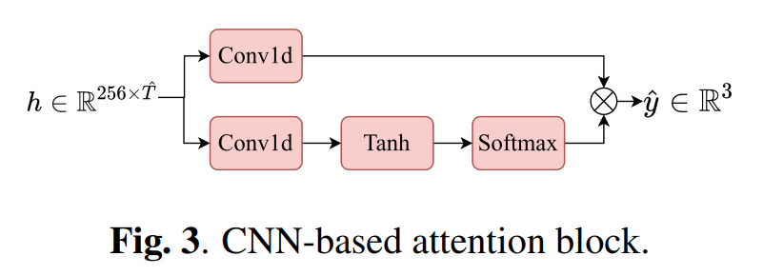
Method

Slide 6
Experiments
Dataset
Train set: 280 Chinese speech samples collected from picture descriptions, fluency tests, and free conversation tasks. Their lengths ranged from 30 to 60 s.
Test set: 119 long (60-s) and 1153 short (6-s) utterances.
Details
Pretrained ASR model: Wenet/multi_cn examples
Transcripts: iFLYTEK ASR API
Training and testing on 6-s utterances

Slide 7
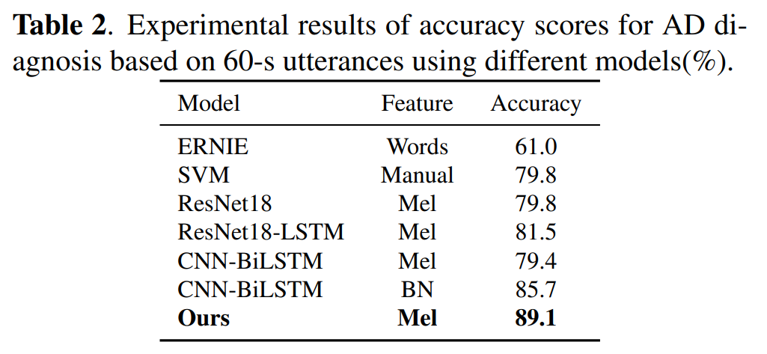
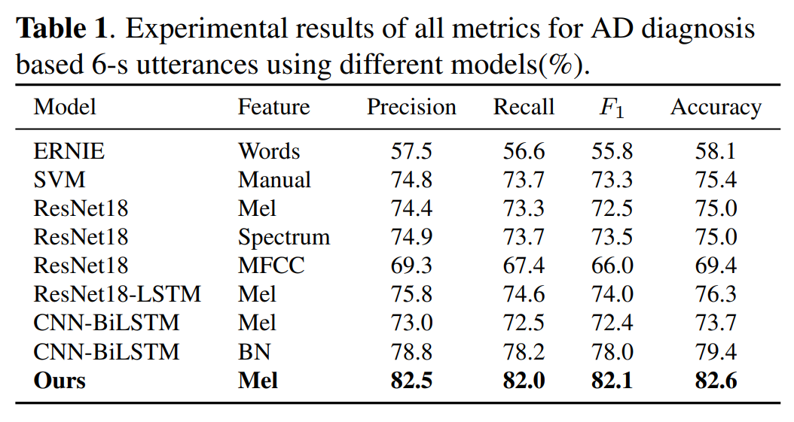
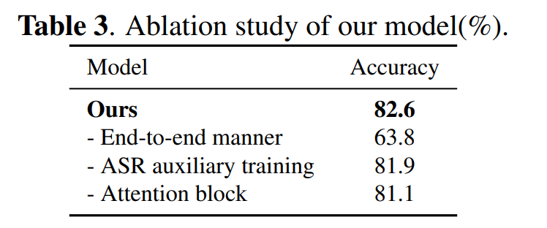
Results
BN: bottleneck features from ASR encoder
Manual: 1582 dim acoustic features using openSMILE

Slide 8
Conclusion
Contribution
Incorporating ASR into AD classification task
Dose not rely on reliable transcripts
Limitations
Small data size
No other datasets were attempted
Future work
Try a dataset in another language
Investigate the reasons for which the ASR-enhanced model can tolerate articulatory errors
Elaborately devise a classification network

