Slide 1



ADC Bit Allocation under a Power Constraint For MmWave Massive MIMO Communication Receivers
Jinseok Choi, Brian L. Evans and *Alan Gatherer
Embedded Signal Processing Laboratory
Wireless Networking & Communications Group
The University of Texas at Austin, Austin, Texas USA
*Huawei Technologies, Plano, Texas, USA
http://www.wncg.org

Slide 2
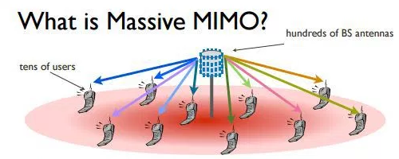
Millimeter Wave Communications [1]
Massive MIMO
Carrier frequency 3-300 GHz
Small antenna sizes
Bandwidths on order of 1 GHz
Multi-Gigabit data rates possible
Large pathloss
Large antenna arrays
Large beamforming gain
Challenges in mmWave Massive MIMO
Large number of RF processing chains with ADCs
High-resolution ADCs primary power consumer [2]
Goal: Reduce ADC resolution to reduce power consumption
[1] Z. Pi and F. Khan. "An introduction to millimeter-wave mobile broadband systems," IEEE Comm. Mag. vol. 49. no. 6, 2011, pp. 101-107.
[2] F. Boccardi, R. Heath and A. Lozano . "Five disruptive technology directions for 5G," IEEE Comm. Mag., vol. 52, no. .2, 2014, pp. 74-80.
2
Notes:
Put a dotted circle to 28GHz band /
Take the mmWave graph -> backup slide(Hyperlink)

Slide 3
Reduction of ADC Power Consumption
Intuition
Channels are sparse in beamspace (on next two slides)
Exploit sparsity for efficient bit allocation
Approach
Apply analog beamforming for beamspace projection
Minimize quantization error subject to power constraint
Contributions
Low-complexity and near-optimal ADC bit allocation technique
Numerical validation using error vector magnitude
3

Slide 4
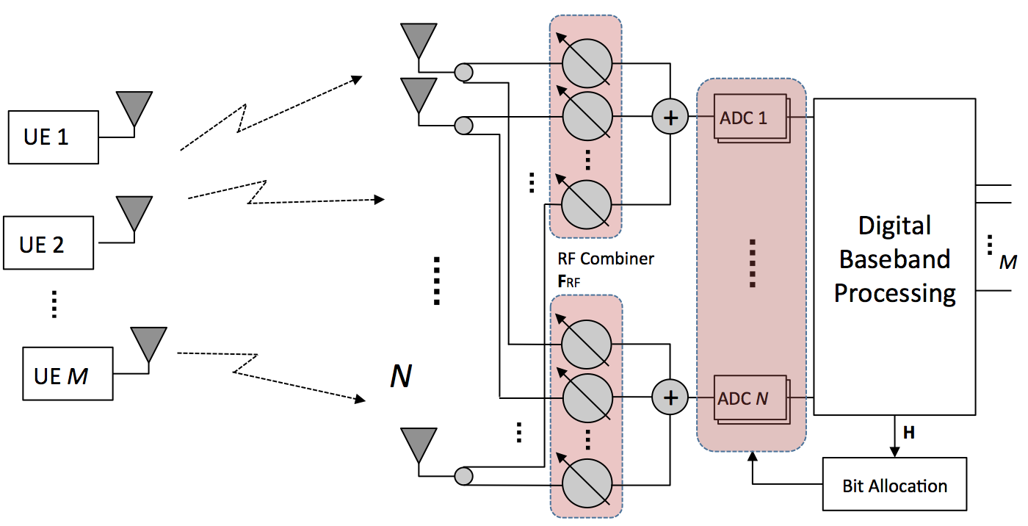
System Model:
Multiuser Massive MIMO Uplink
M users, each with a single Tx antenna
Base station with N Rx antennas (N >> M)
Narrowband channel
Known channel state information
Received signals in vector form
and
4
Notes:
WHY SINGLE TX ANTENNA AT THE MOBILE PLATFORM – A VALID ASSUMPTION?

Slide 5
Channel Model:
Millimeter Wave Channel
p major scattering paths (limited scattering)
Virtual channel representation under ULA* assumption
p major
elements
N-p minor
elements
DFT matrix
Beamspace channel matrix for M users
where
: array response vector with
: beamspace channel vector of i-th user
(p major elements + N-p minor elements)
*Uniform linear array
5
Notes:
In our network model,
In our signal model,

Slide 6
ADC Quantization Model:
Linear Gain Plus Noise
Assumes optimal scalar minimum mean square error quantizer
Best fit linear gain for input y_{i} and output y_{qi}
Apply linear gain plus noise model for ADC quantization
where
where
: quantization noise
6
Notes:
In our network model,
In our signal model,

Slide 7
RF Preprocessing: Analog Beamforming
Reveals channel sparsity
Analog beamforming output
ADC output (quantization) model
: DFT matrix (Recall )
p major
elements
N-p minor
elements
7

Slide 8
Bit Allocation: Problem Formulation
Mean square quantization error (MSQE)
Model beamforming output as complex Gaussian distribution*
where
Under Gaussian model for , MSQE becomes
Quantization bits for i-th ADC
8
* Due to the Central Limit Theorem

Slide 9
Bit Allocation: Problem Formulation
Relax MSQE minimization problem
i) Relax non-negative integer problem to a real number problem
ii) Relax power consumption model to be
where
c = energy consumption per conversion step (e.g. 494 fJ)
W = sampling rate
Relaxation (ii) removes
9

Slide 10
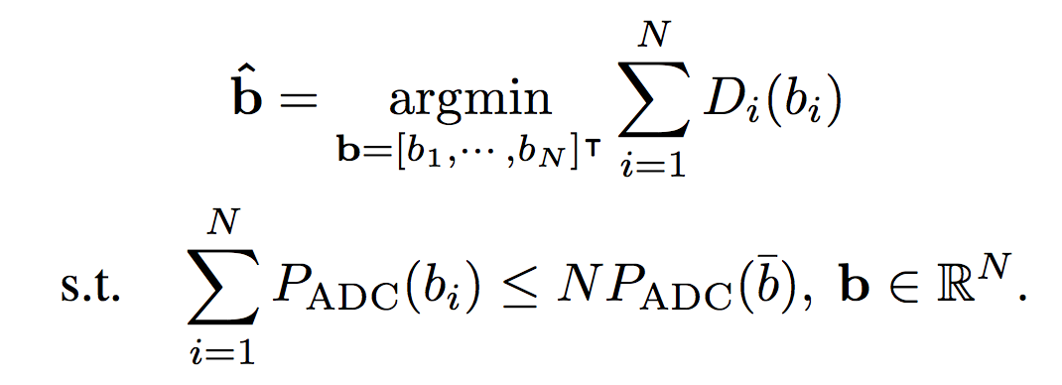
Bit Allocation: Relaxed Minimization and Solution
Relaxed MSQE minimization problem
Subject to power constraint (total power of N -bit ADCs)
Convex optimization
Closed-form solution by using Karush-Kuhn-Tucker conditions
Global optimal solution
where
10
Notes:
Log term can be minus

Slide 11
Bit Allocation: Mapping Relaxed Solution
Map real-valued bit allocations to non-negative integers
Map to 0 because
Map using and
If power constraint is not met then,
compute MSQE vs. ADC power consumption tradeoff
For the set of ,
i) iteratively pick bit allocation with smallest tradeoff function value
ii) perform until power constraint met
increase of quantization error per unit power saving
11

Slide 12
Validation: Link-Level Simulation
Settings
Performance measures
QPSK modulation
N = 256 Rx antennas elements
M = {8, 16} users
Channel: 1 cluster with 4 subpaths [3]
Carrier frequency: 73 GHz
Antenna spacing:
Error vector magnitude (EVM)
Signal-to-noise ratio (SNR)
SNR
12
[3] T. A. Thomas, H. C. Nguyen, G. R. MacCartney, and T. S. Rappaport, “3D mmWave channel model proposal,” Proc. IEEE Veh. Tech. Conf. , Sep. 2014,.
Notes:
We performed link-level simulation for the validation of our algorithm for 10MHz case
the simulation is set as 64QAM Modulation with 8, 16, 32 and 64 antenna cases. And the number of users is fixed as 4.
Assigned Resource blocks per user is 12 block, total 48 block out of 50 blocks (which is 96% of full usage).
Compression Block Length is 1096 and Pedestrian A channel model is used.

Slide 13
Error Vector Magnitude
Bit allocation vs. Uniform bit ADC
13

Slide 14
Error Vector Magnitude
Bit allocation vs. Uniform bit ADC
14

Slide 15
Error Vector Magnitude
Bit allocation vs. Uniform bit ADC
15

Slide 16
ADC Configuration
256 Rx Antennas
0-bit ADCs represent deactivated ADCs
16

Slide 17
Conclusion
Near Optimal Bit Allocation Technique
Reduces EVM for all cases of and
Consumes lower or equal amount of power
Has low complexity
Develop Future Bit Allocation Algorithms
Wideband channels & imperfect channel state information
Multiple Tx antennas & basestation planar array
Impact of interference & hybrid beamforming
17

Slide 18
Thank you

Slide 19
References
[1] Z. Pi and F. Khan. "An introduction to millimeter-wave mobile broadband systems.” IEEE Communications Magazine, vol. 49, no. 6, 2011, pp. 101-107.
[2] F. Boccardi, R. Heath and A. Lozano, "Five disruptive technology directions for 5G," IEEE Communications Magazine, vol. 52, no. 2, 2014, pp. 74-80.
[3] T. A. Thomas, H. C. Nguyen, G. R. MacCartney, and T. S. Rappaport, “3D mmWave channel model proposal,”
in Proc. IEEE Vehicular Technology Conference , Sep. 2014.
19

Slide 20
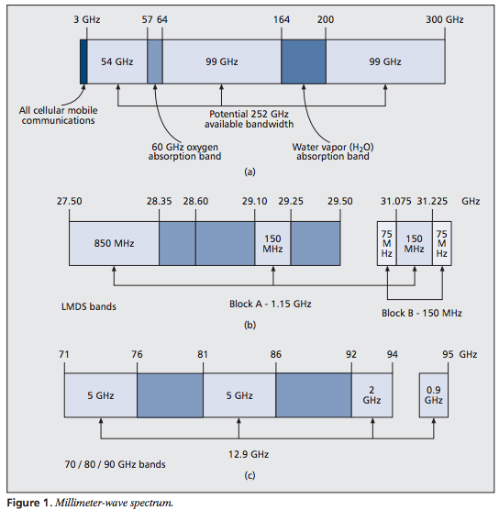
Millimeter Wave Communications
Carrier frequency 3-300 GHz
Small antenna sizes
Bandwidths on order of 1 GHz
Multi-Gigabit data rates possible
Large pathloss
[1] Z. Pi and F. Khan. "An introduction to millimeter-wave mobile broadband systems." IEEE Comm. Mag. ,vol. 49. no. 6, 2011, pp. 101-107.
Millimeter Wave Spectrum [Pi11]
20
Notes:
Put a dotted circle to 28GHz band /
Take the mmWave graph -> backup slide(Hyperlink)

Slide 21
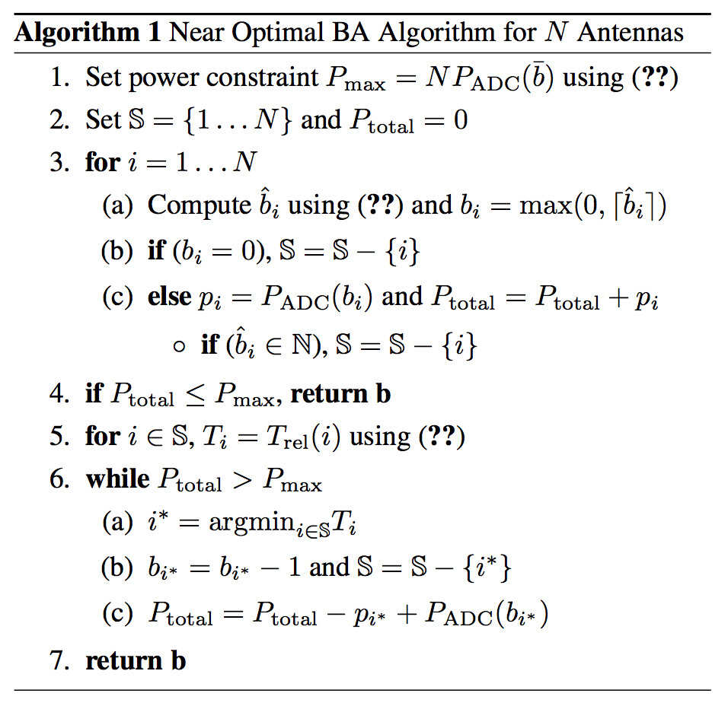
Proposed Near Optimal Bit Allocation
Algorithm
Step 1) Maps to
Step 2) Maps to
Step 3-1) If violates the constraint, compute
Step 3-2) bi with the smallest Trel(i):
Minimum error increase/unit power saving
Step 3-3) Repeat until satisfies the constraint

Slide 22
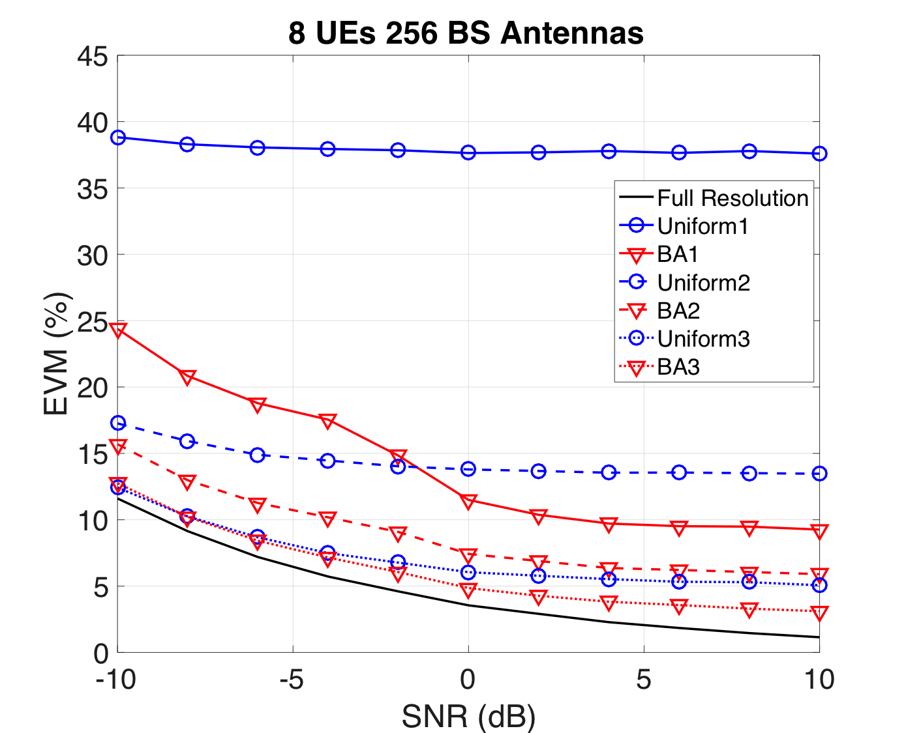
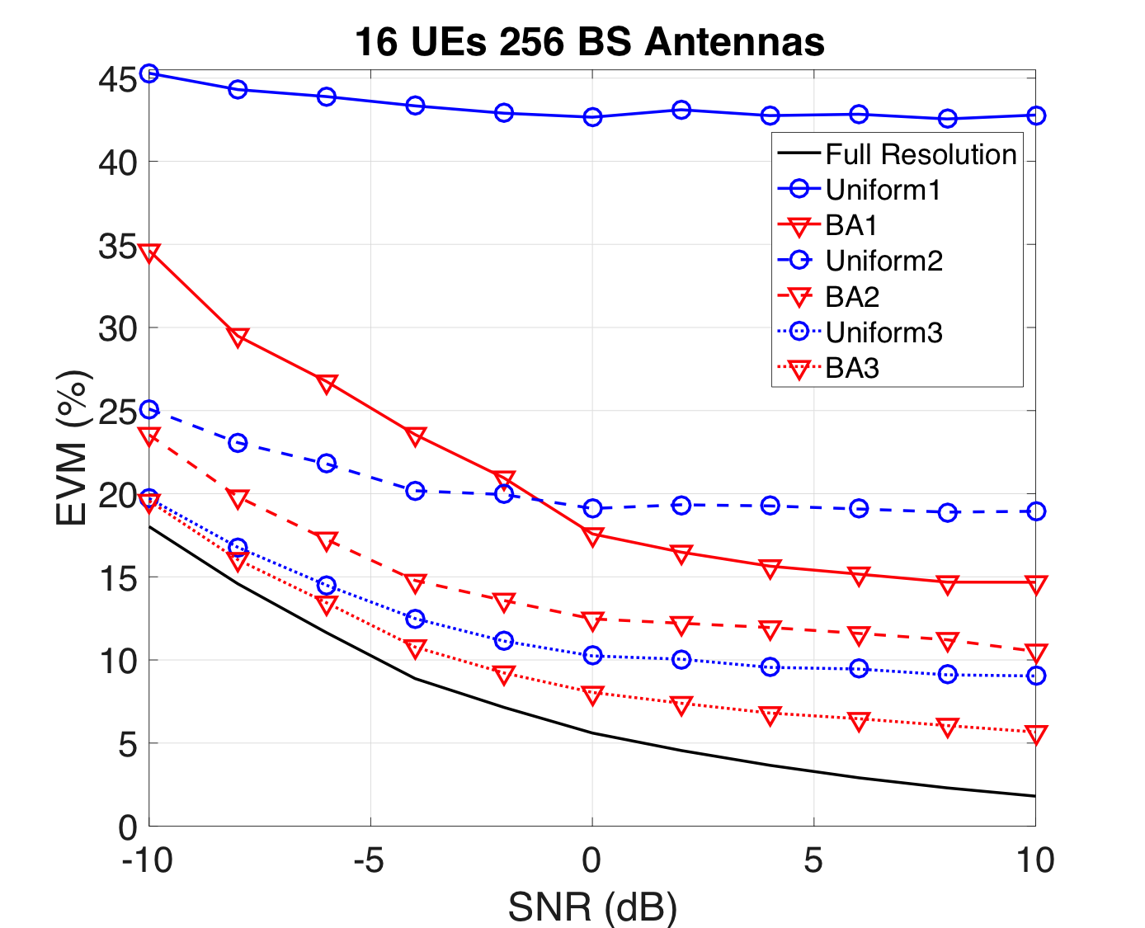
Error Vector Magnitude
Bit allocation vs. Uniform bit ADC
22

