Slide 1
Semantic Neural Rendering-based Video Coding: Towards Ultra-Low Bitrate Video Conferencing
Yujie Hu†,‡, Youmin Xu†, Jianhui Chang†, Jian Zhang†,‡
†Peking University Shenzhen Graduate School, China
‡Peng Cheng Laboratory, China
Peng Cheng Laboratory

Slide 2
Introduction
$$F_{k}$$
Transform
Quantization
Advanced Video Coding (AVC)
High Efficiency Video Coding (HEVC)
Versatile Video Coding (VVC)
Audio Video Standard (AVS),
Inverse
Transform
Motion Compensation
Entropy
Coding
Block based Motion Estimation
$${\hat{F}}_{k−1}$$
$${\hat{F}}_{k}$$
(a) Block-based framework

Slide 3
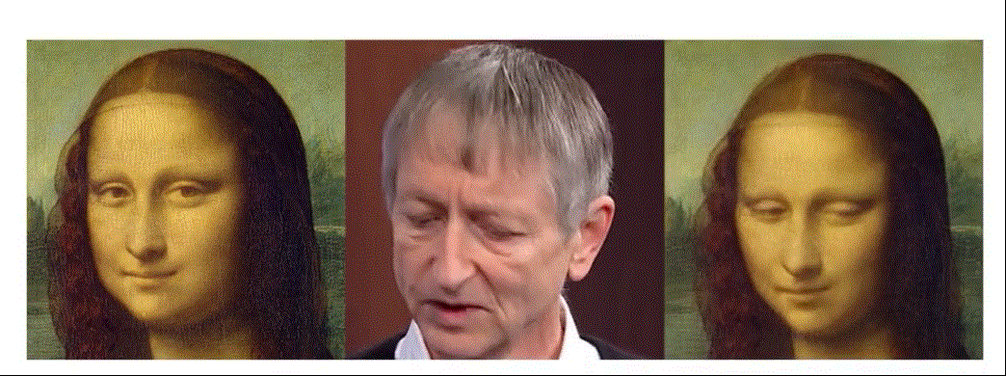
Introduction
$$F_{1}$$
Frame Encoder
Quantization
$$F_{2}$$
Frame Decoder
…
Motion Descriptor
Encoder
$$F_{k−1}$$
Entropy
Coding
$${\hat{F}}_{1}$$
Quantization
$$F_{k}$$
$${\hat{F}}_{2}$$
…
Source Image
Driving Video
Target Video
Motion Descriptor
Decoder
Motion Imitator
$${\hat{F}}_{k−1}$$
$${\hat{F}}_{k}$$
(b) Model-based framework

Slide 4
Proposed SNRVC Framework
Encoder
Bitstream
Decoder
Frame Coding
010
001
…
101
110
111
…
000
011
…
Frame Decoding
Encoded Frame 1
$β$ - expression
Decoded Frame 1
$R$ – head rotation
Truncation
Entropy
Coding
Entropy
Decoding
$t$ – translation
$φ$ – size
Encoded Frame 2
Decoded Frame 2
Motion Parameters Extractor
Truncation
Motion Imitator
-
+
Encoded Frame 3
…
…
…
…
Decoded Frame 3
Truncation
-
+
…
…
100…
…
…
Encoded Frame k
Decoded Frame k
Truncation
-
Entropy
Coding
001011
…
Entropy
Decoding
+
*Deng Y, Yang J, Xu S, et al. Accurate 3d face reconstruction with weakly-supervised learning: From single image to image set[C]//Proceedings of the IEEE/CVF Conference on Computer Vision and Pattern Recognition Workshops. 2019: 0-0.
*Ren Y, Li G, Chen Y, et al. PIRenderer: Controllable Portrait Image Generation via Semantic Neural Rendering[C]//Proceedings of the IEEE/CVF International Conference on Computer Vision. 2021: 13759-13768.

Slide 5
Truncation
GT
Decoded
GT
Decoded
GT
Decoded

Slide 6
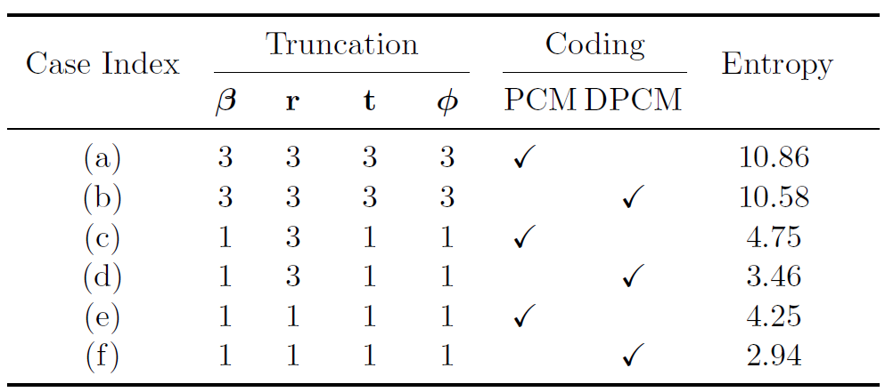
Differential Coding

Slide 7
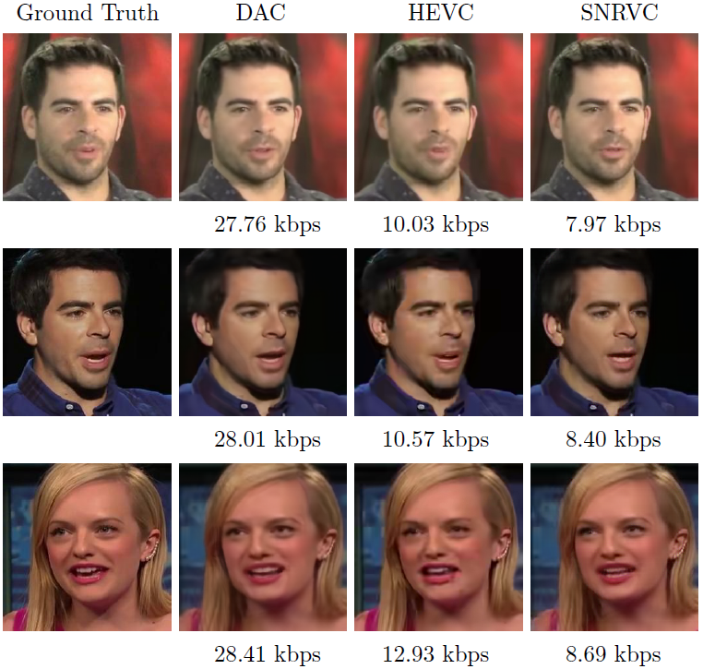
Visual Comparison
DAC
GT
HEVC
SNRVC (Ours)
*Konuko G, Valenzise G, Lathuilière S. Ultra-low bitrate video conferencing using deep image animation[C]//ICASSP 2021-2021 IEEE International Conference on Acoustics, Speech and Signal Processing (ICASSP). IEEE, 2021: 4210-4214.

Slide 8
Visual Comparison
DAC
SNRVC (Ours)
DAC orignal
30.85 kbps
DAC after truncation
10.63 kbps
8.53 kbps
HEVC
6.15 kbps
6.86 kbps
9.42 kbps
14.46 kbps
19.59 kbps

Slide 9
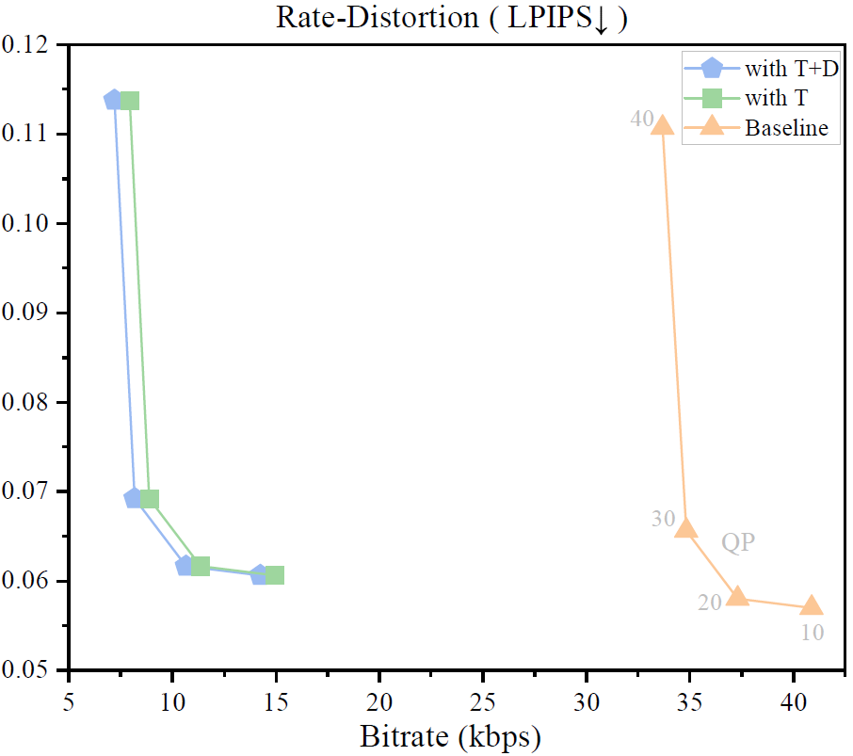
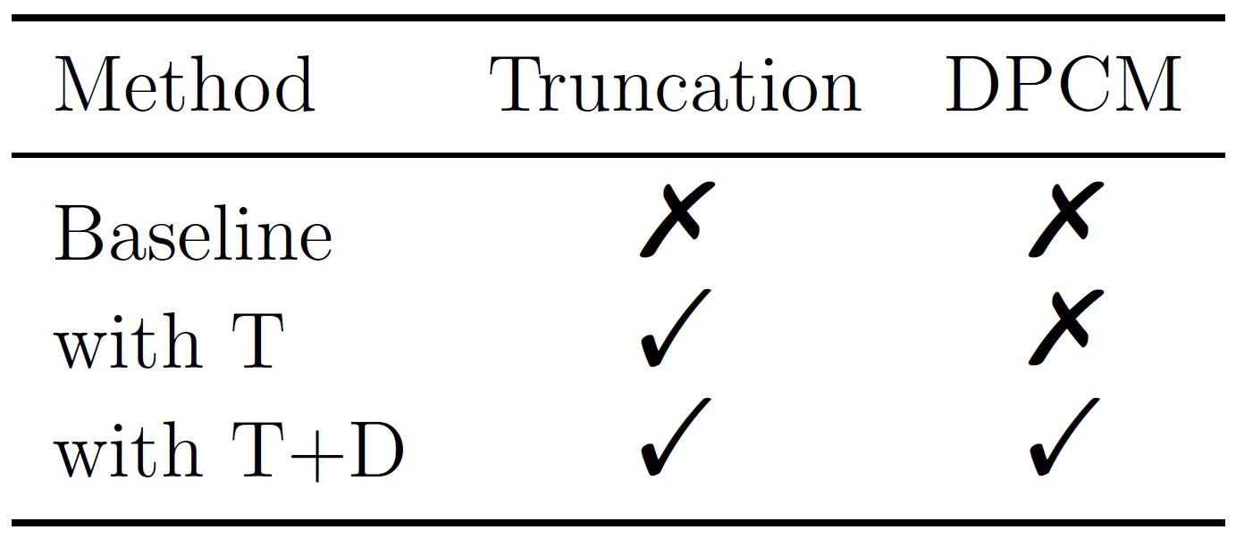
Rate-Distortion (RD) Curves

Slide 10
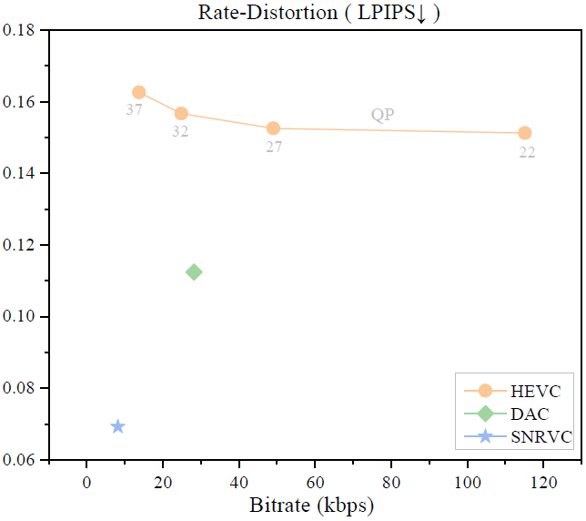
Rate-Distortion (RD) Curves

Slide 11
Conclusion
We take advantage of the current mature 3D parameter-driven motion imitation model to propose a semantic neural rendering-based video coding framework.
Through experiments and statistical analysis, we perform truncation and DPCM on these parameters, which greatly reduces the bitrate without affecting the subjective quality of the video.
In fact, with the development of deep learning, motion imitation models and 3D face reconstruction models are always advancing. With the help of these models, our method can also keep up with the times to achieve better performance.
At the same time, our method also provides more practical scenarios and wider applications for these models, which stimulates their potential to a greater extent.

Slide 12
Thank you for listening!
Semantic Neural Rendering-based Video Coding: Towards Ultra-Low Bitrate Video Conferencing
Yujie Hu†,‡, Youmin Xu†, Jianhui Chang†, Jian Zhang†,‡
†Peking University Shenzhen Graduate School, China
‡Peng Cheng Laboratory, China
Peng Cheng Laboratory

