Slide 1
Ultra-lightweight Neural Differential DSP Vocoder for High Quality Speech Synthesis
ICASSP 2024
Presenters: Thilo Koehler, Prabhav Agrawal Joint work with: Zhiping Xiu, Prashant Serai, Qing He
Notes:
Title + Speaker Intro

Slide 2
Outline
Motivation
On-device TTS System Overview
DSP Vocoder
DDSP Vocoder Training and Architecture
Results
Conclusion

Slide 3
Motivation
Waveform learning is expensive, but waveform ≠ perception
Important for perception: magnitude spectrogram and phase change, modelled by traditional DSP vocoder using source filter model
Traditional DSP vocoder suffers from “vocoded” sound (muffled, muddy, buzzy)
Idea: Make magnitude spectrogram and periodicity end-to-end learnable using differentiable vocoder (loss addresses vocoder imperfections)

Slide 4
Differential DSP Vocoder for On-device TTS
Frontend: SSML, Text Normalization, Grammatical/Semantic Analysis, Phonetic Annotation
Acoustic Backend: Render linguistic information into an audio waveform
Prosody model: Models phone level log F0 and log Dur from linguistic features
Acoustic model: Models frame level acoustic features: logF0, spectral envelope & periodicity
Vocoder (focus of this talk): Provides audio waveform from the acoustic features

Slide 5
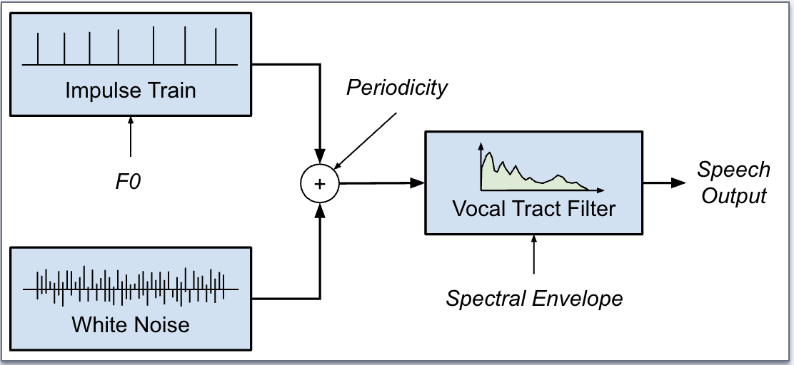
DSP Vocoder: Source-Filter Model

Slide 6
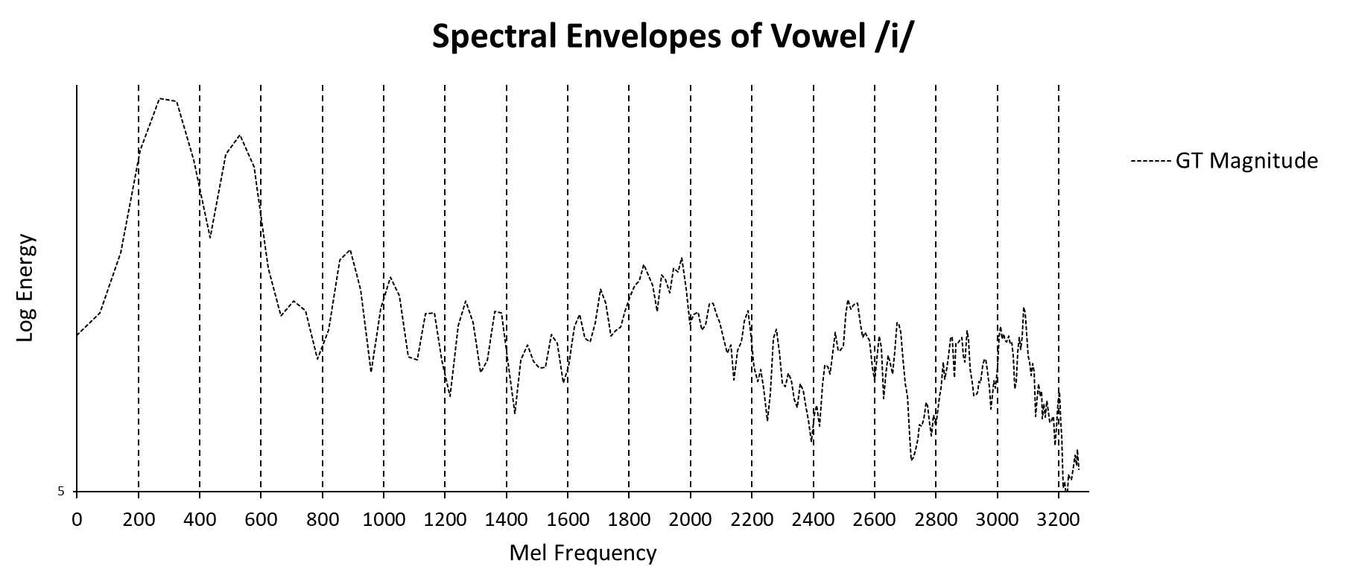
What is the real spectral envelope?

Slide 7
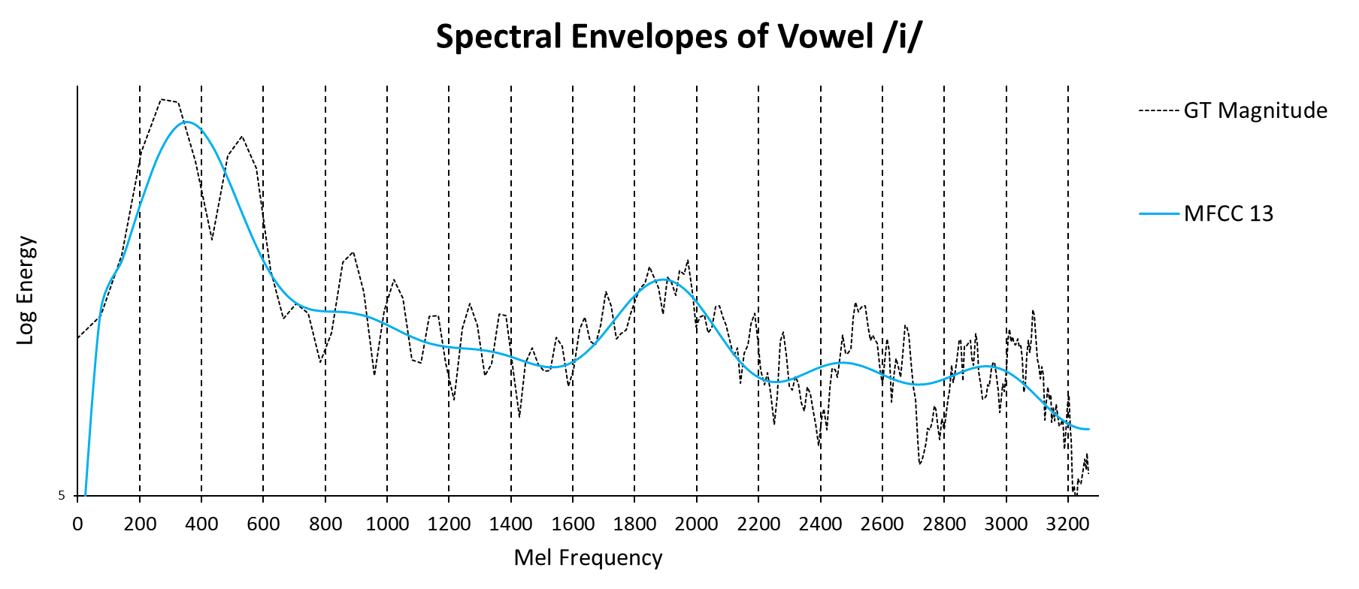
What is the real spectral envelope?

Slide 8
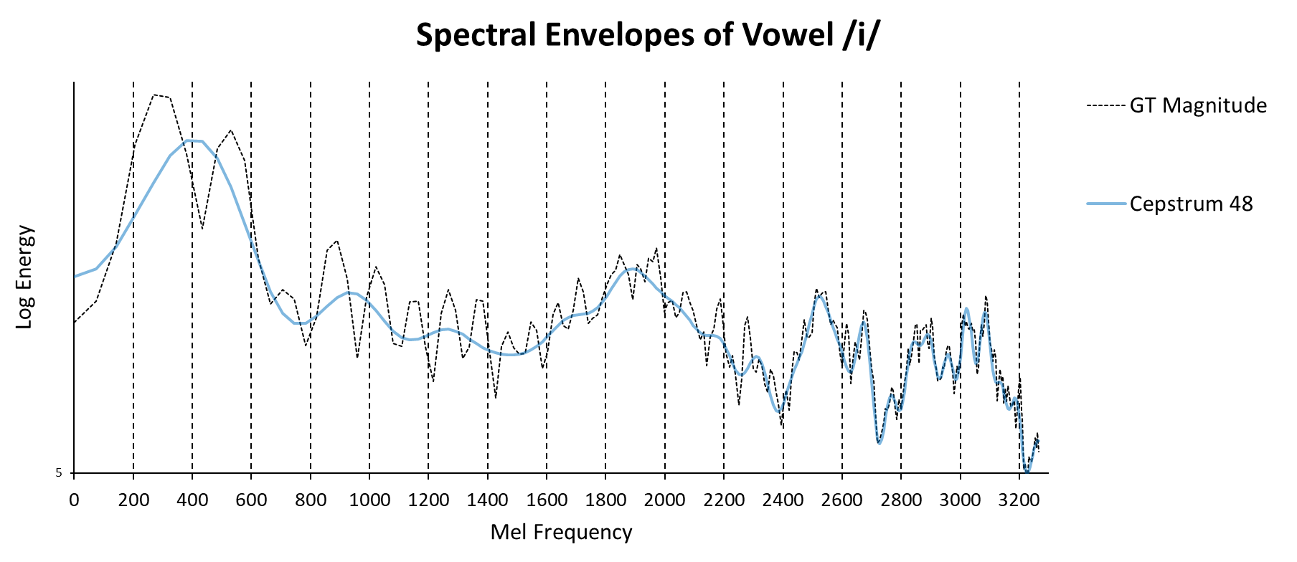
What is the real spectral envelope?

Slide 9
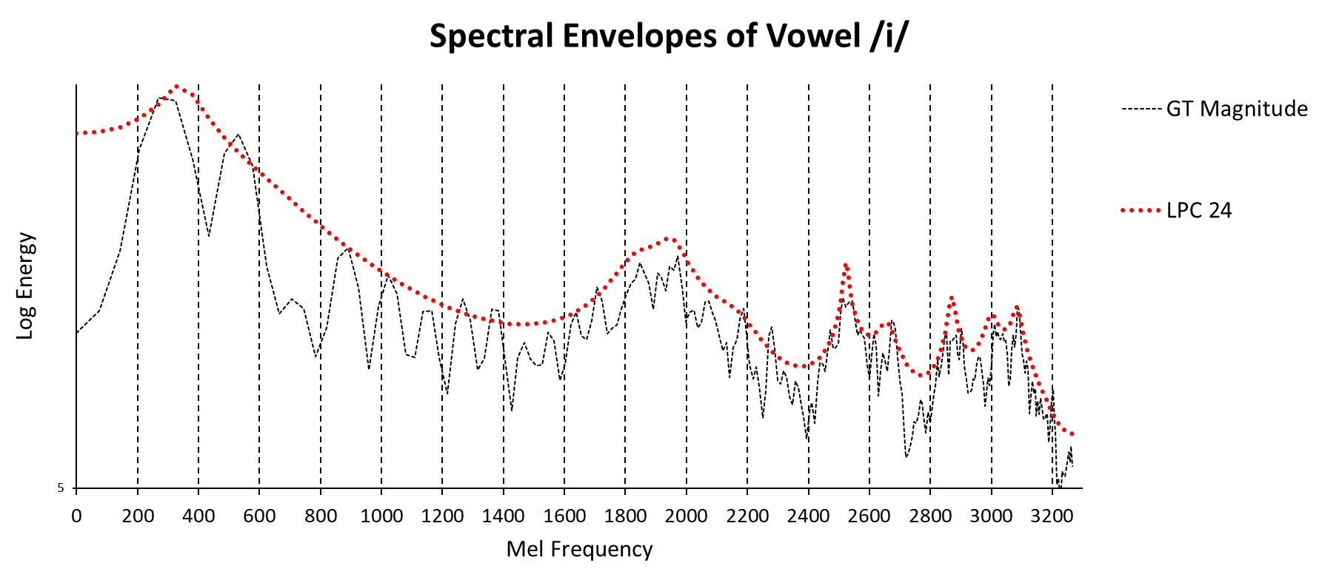
What is the real spectral envelope?

Slide 10
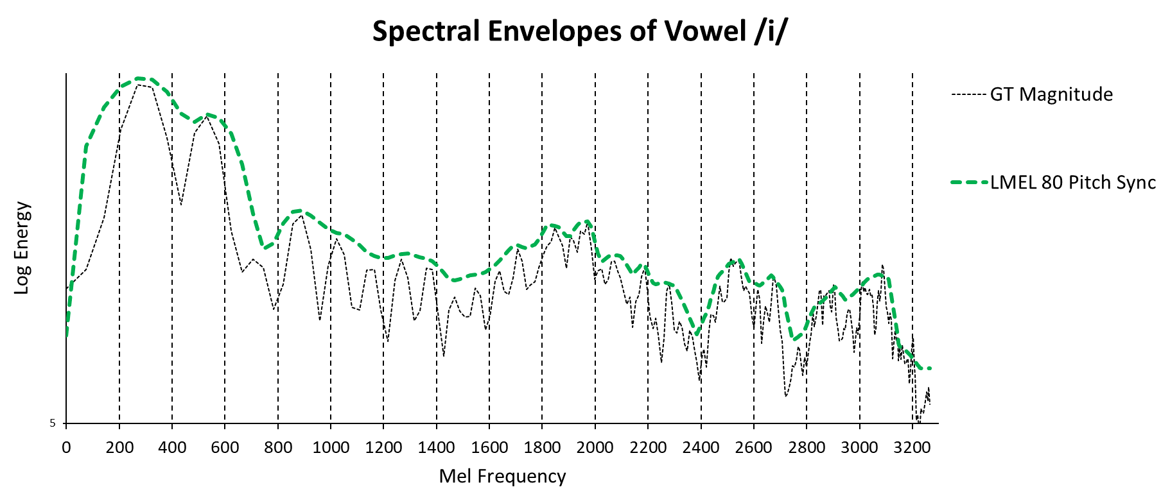
What is the real spectral envelope?

Slide 11
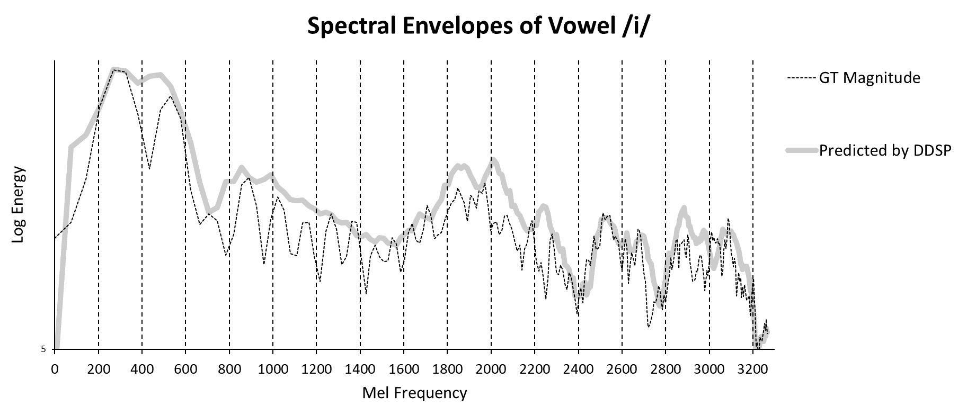
What is the real spectral envelope?

Slide 12
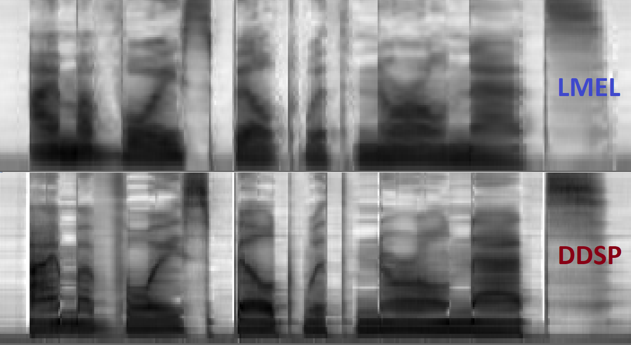
Comparison: LMEL80 vs DDSP Output

Slide 13
Comparison: LMEL80 vs DDSP Model Outputs
plosive burst
formants

Slide 14
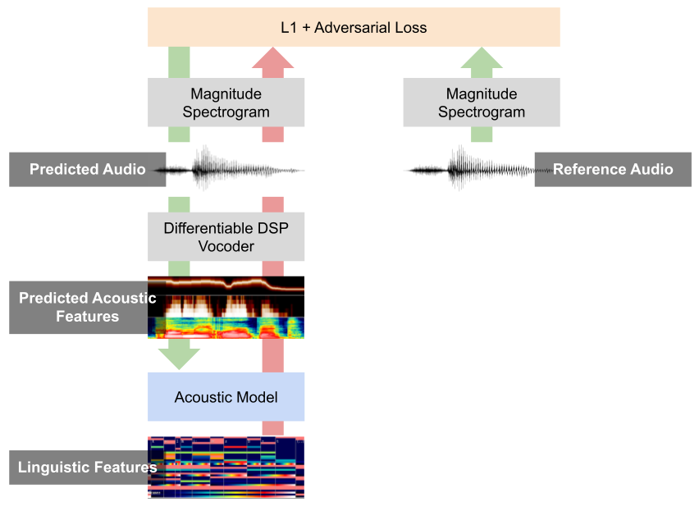
DDSP Vocoder Training and Architecture Details

Slide 15
Training Losses
Reference MSE Loss (for F0 and periodicity)
Hard to learn F0 directly with E2E spectrogram losses. Impulse train for vocoder generated using ref F0 for training to ensure spectral alignment wrt pitch
Periodicity learning works e2e, but becomes better with a reference L2 loss
Notes:
where periodicity dimension dP = 12 . We set λF 0 = 50 and λP =30.

Slide 16
Training Losses
Multi-window STFT loss with 3 window sizes of 512, 1024, 2048 with GT audio
Window size selected equal or greater than vocoder FFT window of 512
Best setup worked with L1 loss on log magnitude spectrograms
Notes:
Xi = amp log(|STFTi(x)|), X ̃i = amp log(|STFTi(x ̃)|) , and Ni is number of elements in the magnitude for the ith FFT size. λstfts denote the loss weights for each of the C = 3 FFT sizes of 512, 1024 and 2048, and are set at 25.7, 51.3 and 102.5 respectively. STFT extraction is done at a frame shift of 128 samples. The amp log operator amplifies the signal by 72dB, takes log for the signal above e, and makes it linear below e. . This approach ensures that digital zero input maps to zero output, and we never get excessively large negative numbers after taking log.

Slide 17
Training Losses
Adversarial loss on magnitude spectrograms (since vocoder does not learn phase)
K= 8 discriminators seeing a 48-point frequency band of 257-dim spectrogram, with overlap 8 (terminal ones 40-point band)
Notes:
Adversarial loss helps to reduce the overs-smoothing in L2 loss and improved perceptual quality.
Having multiple discriminators exploits the fact that the spectrogram has different characteristics in different frequency bands, discriminator takes patches treating spectrogram as an image, and tries to classify as real/fake

Slide 18
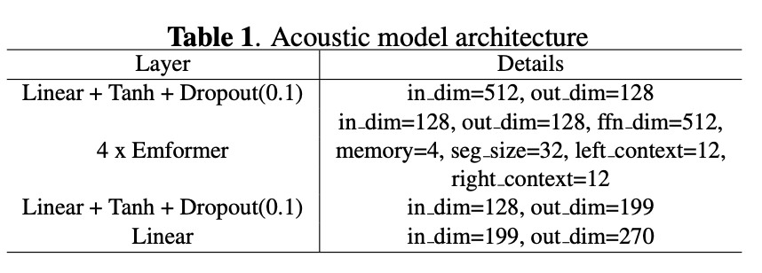
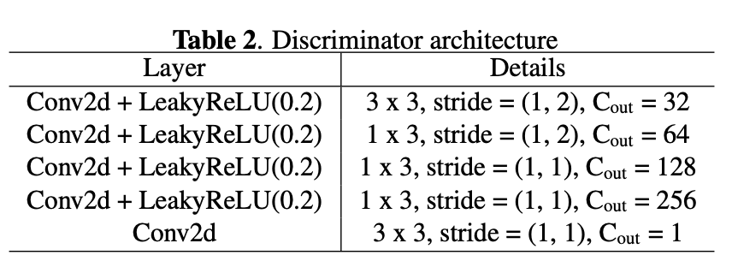
Model Architectures
Notes:
Emformer = streaming transformer encoder with FC layers at input and output
Discriminator looks at patches of size 5 X 31, running discriminator on patches treating spectrogram as an image was the most effective (similar to image sharpening)

Slide 19
Experimentation Setup
Single-speaker models using two corpora: 1) Female speaker with 37 h audio 2) Male speaker with 12 h audio, resampled to 24Khz with 42 unseen utterances for MOS evaluations
DDSP System Compared Against
Neural Vocoders (MB-MelGAN, HiFi-GAN, WaveRNN)
Consume 1-dim F0, 13-dim MFCC, 5-dim Periodicity as Input features
DSP Vocoders (DSP, DSP Adv)
Consume 1-dim F0, 80-dim Pitch Synchronous log mels, 12-dim Periodicity as Input features, apply L2 loss on acoustic model outputs
DSP Adv applies adversarial loss to 80-dim log mel predictions in addition to L2 loss
Used reference prosody (duration, f0) with no audio post-processing, acoustic model architecture kept the same with only last FC layer dimension modified

Slide 20
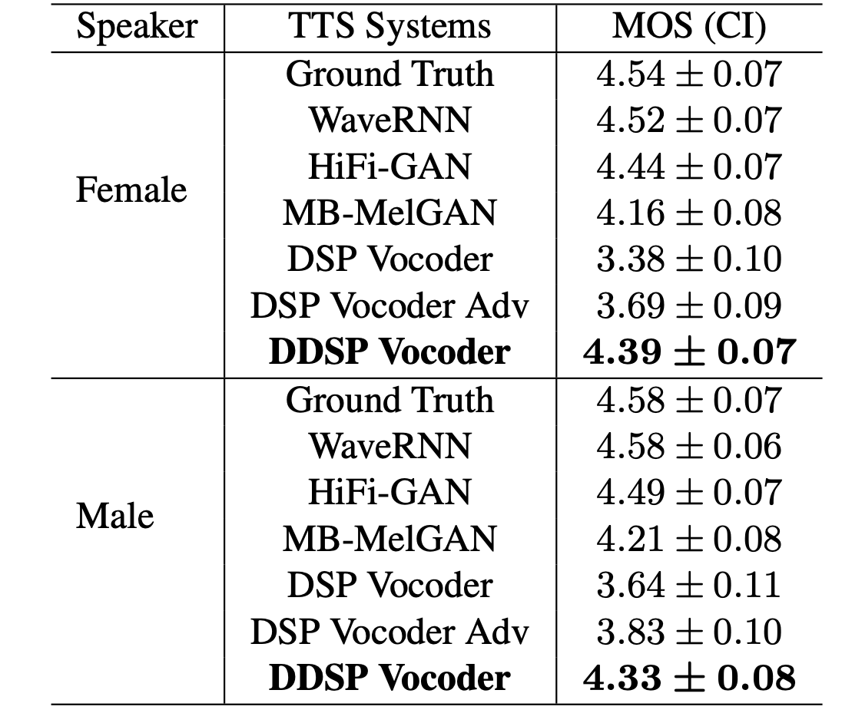
Results: Quality
Subjective MOS evaluation scores on a 5-point scale
Notes:
DSP Adv version
All 42 utterances across all the 7 models are evaluated, and rater gave a score on a scale of 1-5 with focussing on the audio quality, none of the systems have post-filtering/postprocessing It can be done to make DSP systems better, but not clean esp when doing on neural models across different speakers

Slide 21
Results: Quality
TTS System
Ground Truth Recording
WaveRNN
HifiGAN
MB-MelGAN
DSP
DSP Adv
DDSP (This Paper)

Slide 22
Results: Performance
GigaFlops = number of floating point operations per sec
RTF = Time taken to generate the audio / Duration of the audio
Notes:
Ptflops used to count flops for MB-MelGAN, 2 flops per MAC
Intel CPU

Slide 23
Conclusion and Future Work
Proposed DDSP vocoder; a novel way of training of jointly optimizing an acoustic model and a DSP vocoder without using an engineered spectral feature, which leads to an audio quality close to high quality neural vocoders with much lower computation.
Extend the system with an e2e estimation of f0 and periodicity to avoid their explicit feature extraction

Slide 24
Thank you for listening! Q & A

Slide 25
Results

