Slide 1




Concept and Evaluation of Mobile Cell Connectivity over a Satellite Backhaul for Future 5G Networks
Florian Völk*, Robert T. Schwarz*, Mario Lorenz⁺, Andreas Knopp*, and Markus Landmann⁺
www.unibw.de/satcom

Slide 2





5G Usecases
Where can Satellite Communications Play a Role?
Sensor Networks
Animal Tracking
Building Automation
Massive Machine Type
Communications
3D Videos
UHD Videos
In-Flight Entertainment
Deliver Content to the Network Edge
Enhanced Mobile
Broadband
Industry Automation
Self Driving Cars
Ultra-Reliable and
Low Latency Communications

Slide 3
Presentation Outline
1. Problem Analysis
2. Testbed Architecture
  System Architecture
  SATCOM Carrier Management
  Testbed Setup
3. Results
4. Conclusion

Slide 4
Initial Analysis
Satellite Advantages Related to 5G Features
Network mobility
Security of the network
Provision of global connectivity to mobile cells such as airplane, ships and trains.
Satellite networks provide a solution for a resilient communication.
Broadcast content to the edge
Coverage
Efficient delivery of content across multiple sites with similar transmission delay
Capacity across the globe to establish the ideal solution for highly distributed networks.

Slide 5
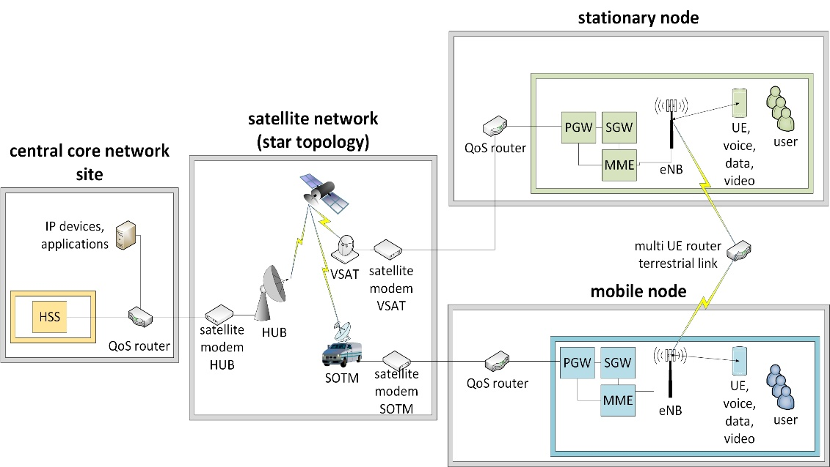
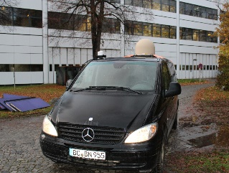
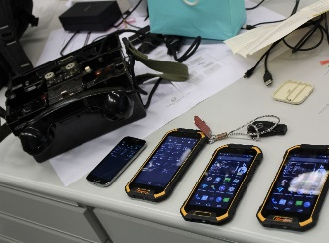
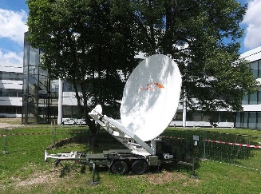
Our Research
Concept and Evaluation of Mobile Cell Connectivity over a Satellite Backhaul for Future 5G Networks
COTS UE Equipment
Satellite Backhaul
Mobile Cell Connectivity
Testbed Architecture
What kind of testbed architecture do we need?

Slide 6
2.Testbed
Architecture

Slide 7
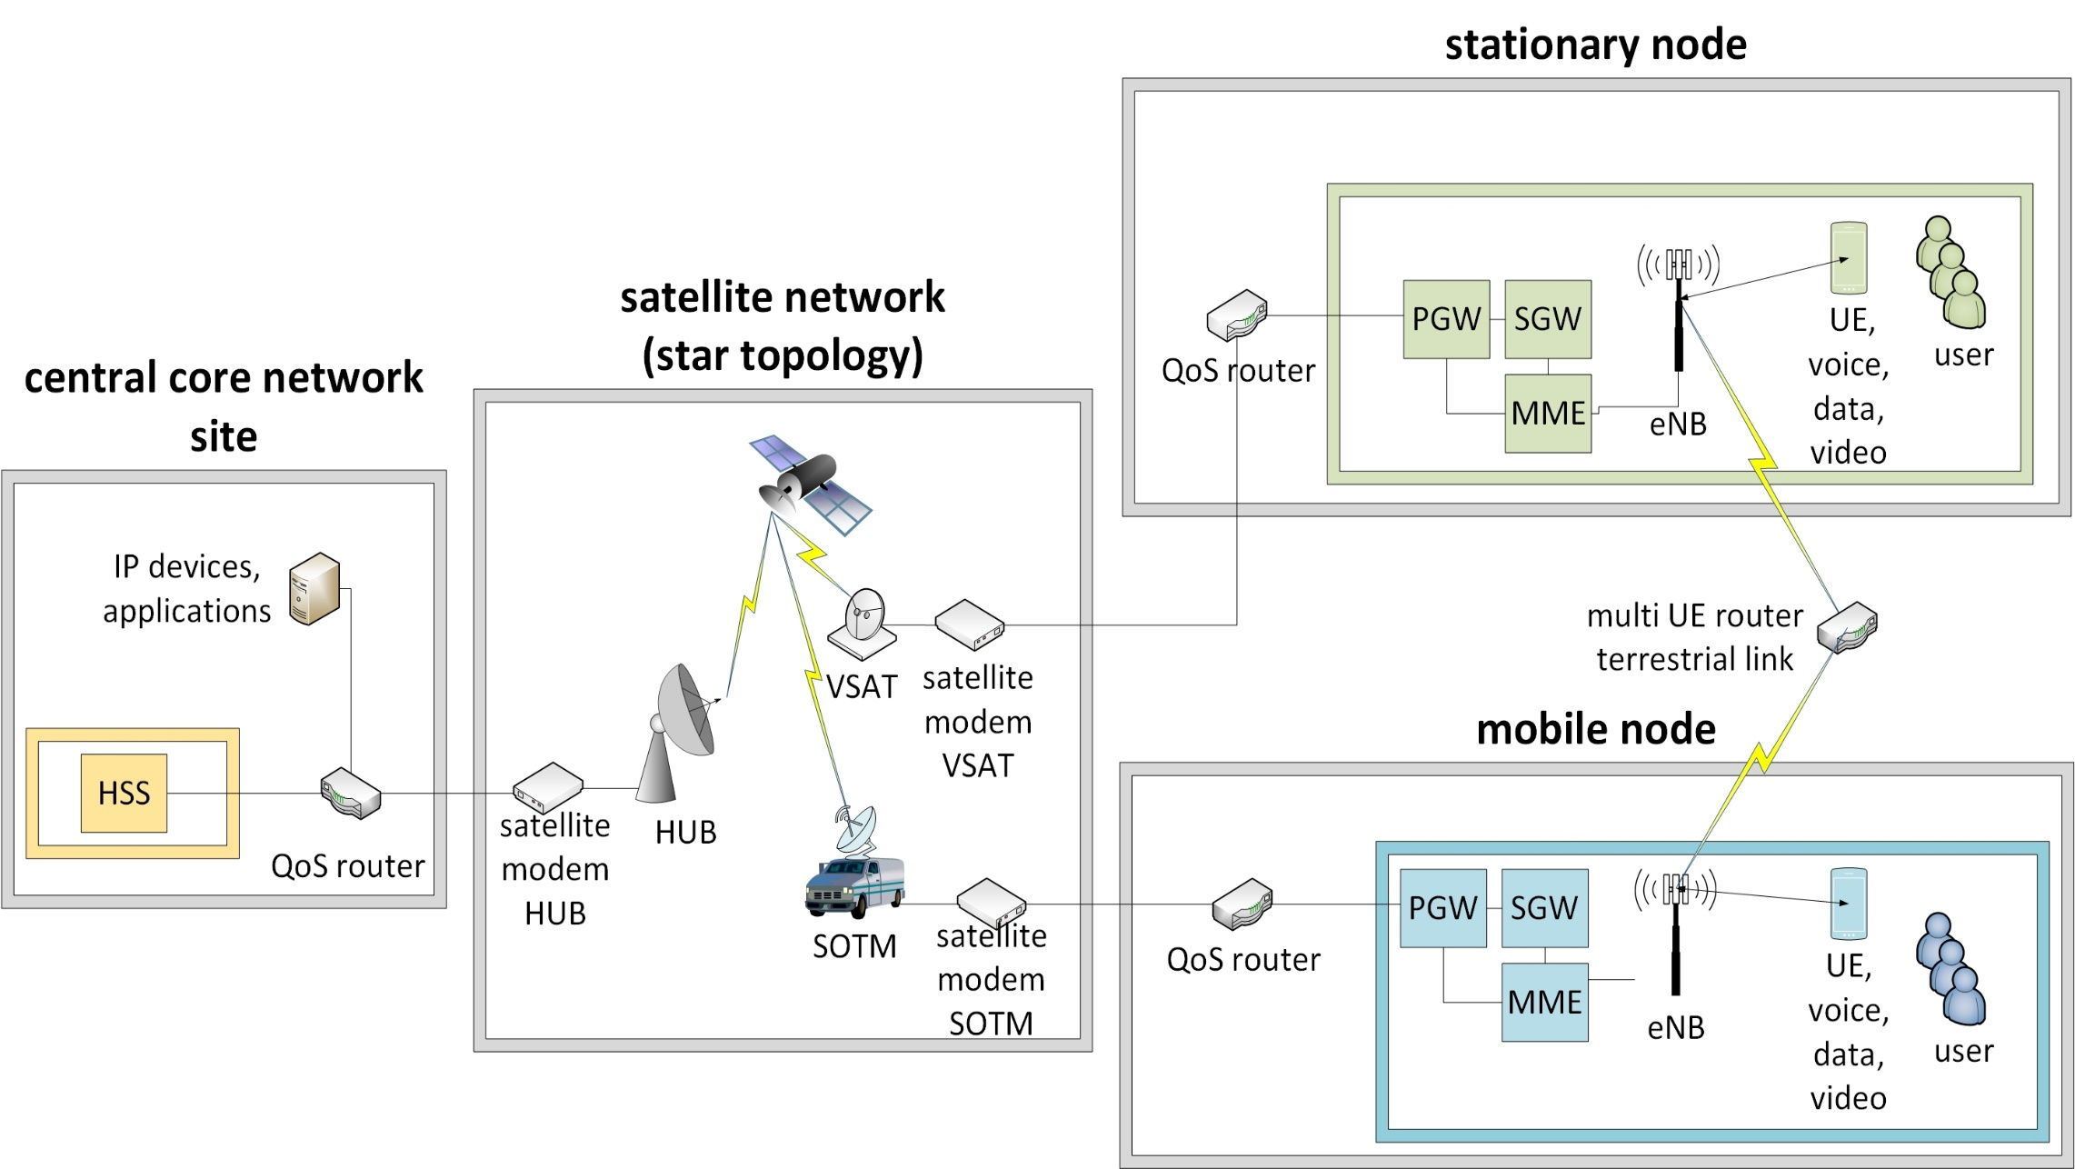
System Architecture

Slide 8
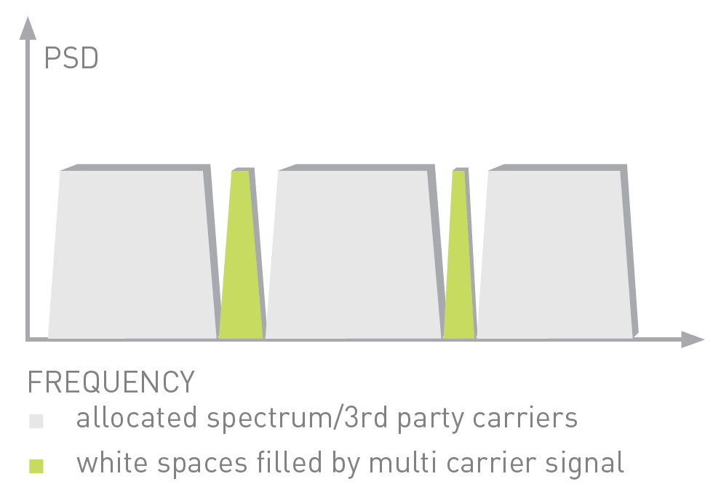
Multi-Carrier Spectrum Filling Technology
Spectrum fragmentation is a common problem in SATCOM transponders
Modem based on standard DVB-S2
Splits the incoming data stream in to multiple carriers
Aggregates even narrow band spectrum gaps

Slide 9
SATCOM Carrier Management
central core network site
stationary node
Parameter | central core network site -> stationary node (forward link) | central core network site -> mobile node (forward link) | stationary node -> central core network site (return link | mobile node -> central core network site (return link)
Carrier No. | 1 and 2 | 3 and 4 | 5 and 6 | 7 and 8
C/N | 16.5 dB | 7.5 – 8.5 dB | 10 – 11 dB | 4 – 6 dB
MODCOD | 32APSK 5/6 | 8PSK 3/5 | 16APSK 2/3 | QPSK 1/2 - 3/4
Data rate per carrier | 7000 kBit/s | 3000 kBit/s | 1300 kBit/s | 490 – 660 kBit/s
mobile node
Power Spectral Density
Frequency

Slide 10
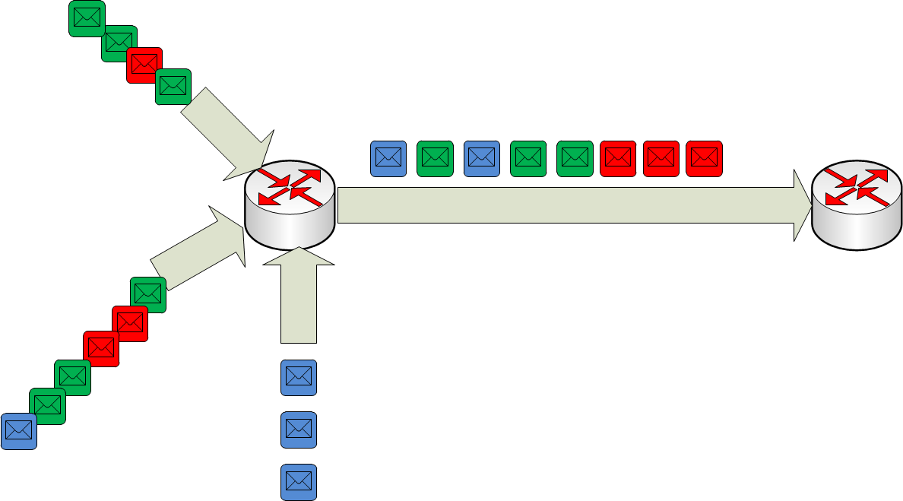
Testbed setup
Modem
Spectrum-
Manager
QoS-
Router
remote
Spectrum-
Manager
remote
Spectrum-
Manager
QoS based on STANAG 4711
QoS with DiffServ (Prio in IP-Header)
Parameter for service classes
  Priority
  Delay handling
  Drop likelihood
  Bit rates

Slide 11
3. Results

Slide 12
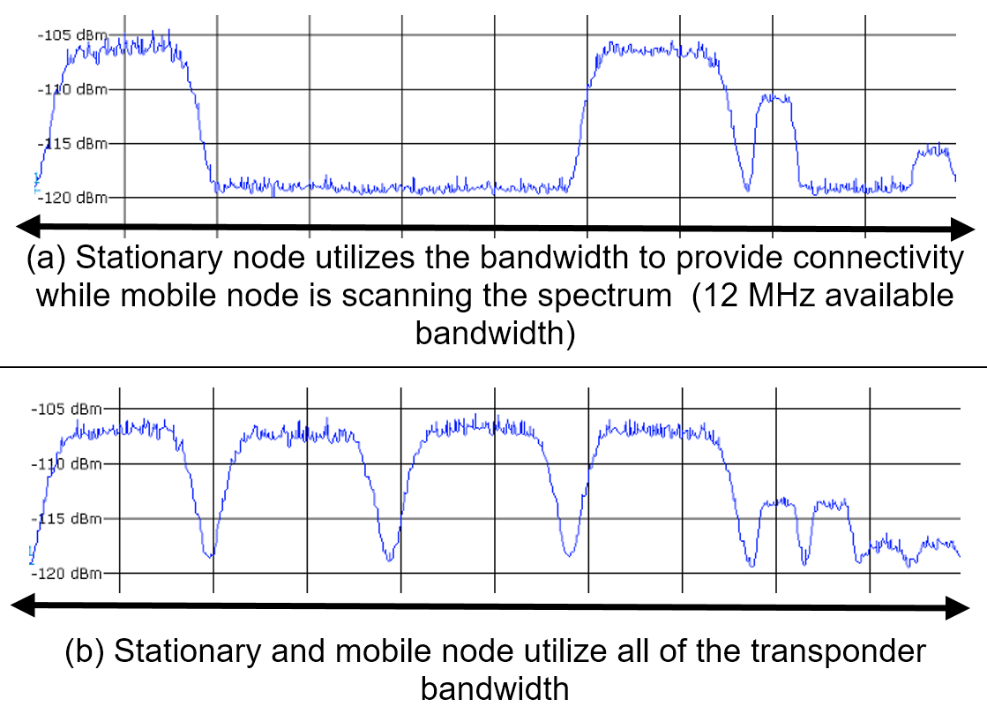
Results
Concept and Evaluation of Mobile Cell Connectivity over a Satellite Backhaul for Future 5G Networks
central core network site
stationary node
mobile node
Power Spectral Density
Frequency

Slide 13
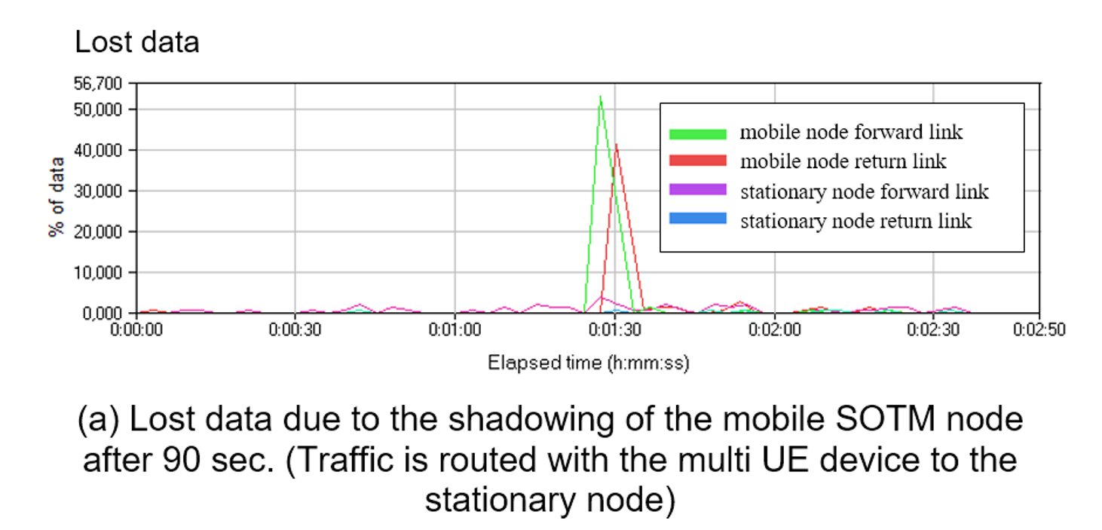
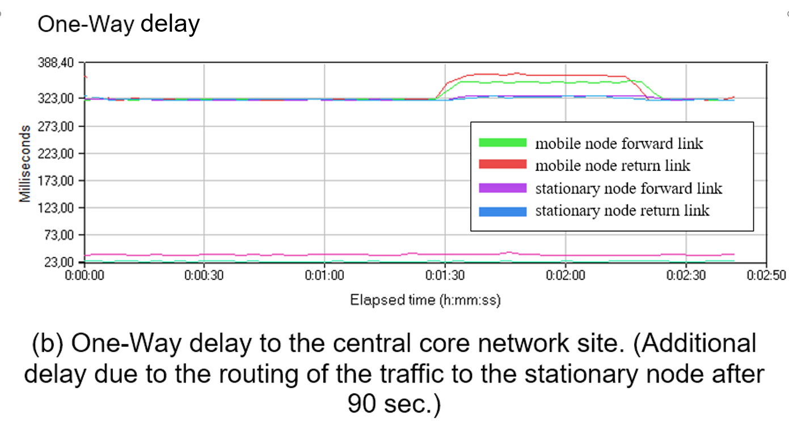
Results
Concept and Evaluation of Mobile Cell Connectivity over a Satellite Backhaul for Future 5G Networks
Shadowing of the mobile node after 90s
Traffic is routed over stationary node
central core network site
stationary node
multi UE dev.
mobile node

Slide 14
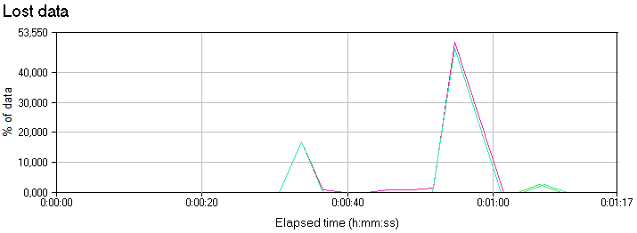
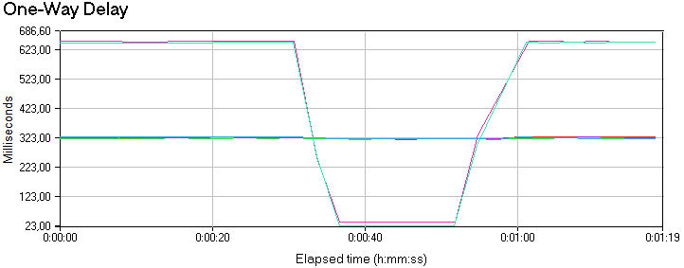
Results
Concept and Evaluation of Mobile Cell Connectivity over a Satellite Backhaul for Future 5G Networks
Device A in stationary cell
Device B in mobile cell
After 30s mobile node within coverage of stationary node
central core network site
stationary node
multi UE dev.
mobile node

Slide 15
4. Conclusion

Slide 16
Conclusion
Concept and Evaluation of Mobile Cell Connectivity over a Satellite Backhaul for Future 5G Networks
Proof of concept: Mobile Cell Connectivity can be implemented
Edge Node concept to reduce control plane traffic over satellite
Cognitive multi-carrier satellite modem demonstrator with QoS
Many of the drawbacks of legacy satellite networks are avoided

Slide 17
Thank you
www.unibw.de/satcom

