Slide 1



When Visible-to-Thermal Facial GAN Beats Conditional Diffusion
Catherine Ordun¹², Edward Raff¹², Sanjay Purushotham¹
¹University of Maryland Baltimore County, MD, USA
²Booz Allen Hamilton, McLean, VA, USA

Slide 2
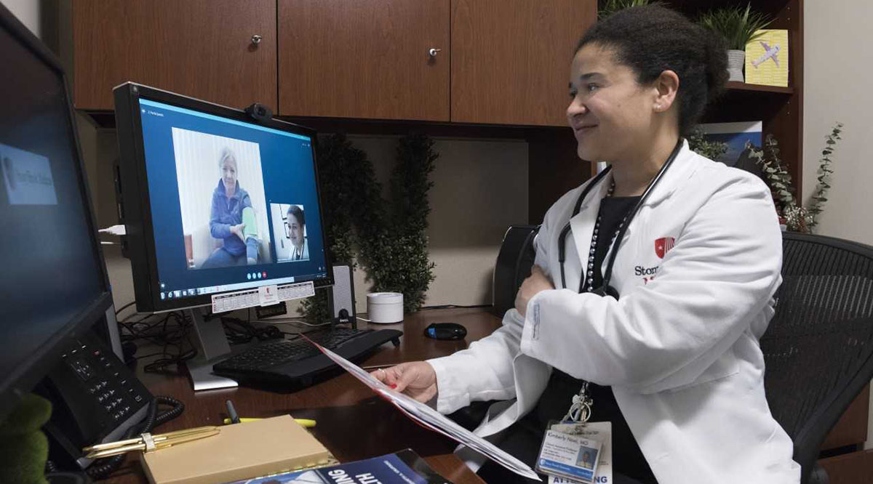
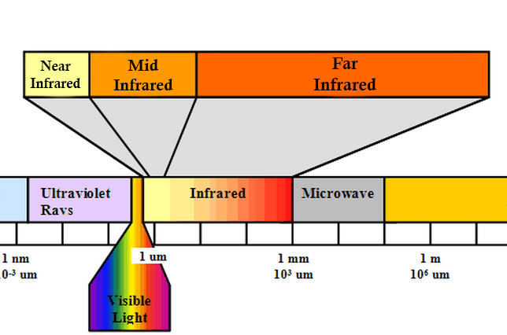
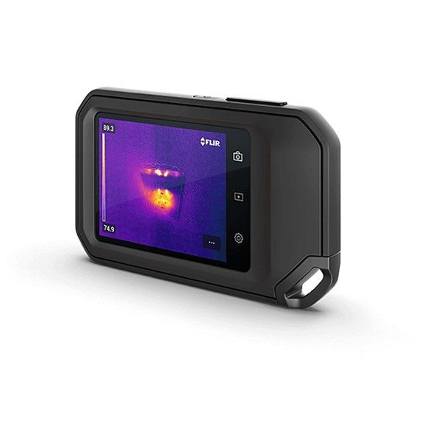
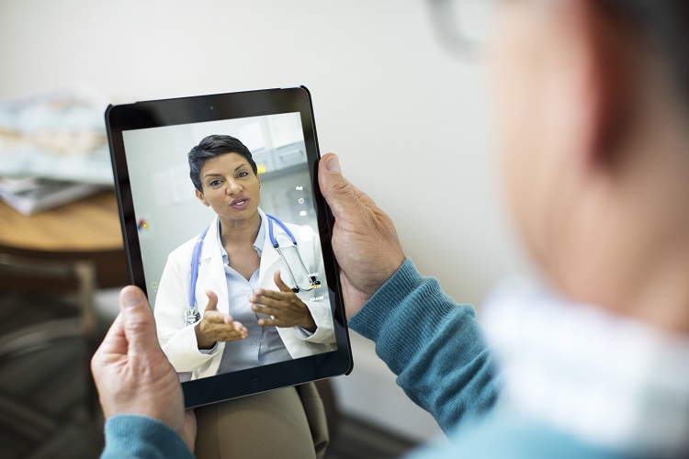
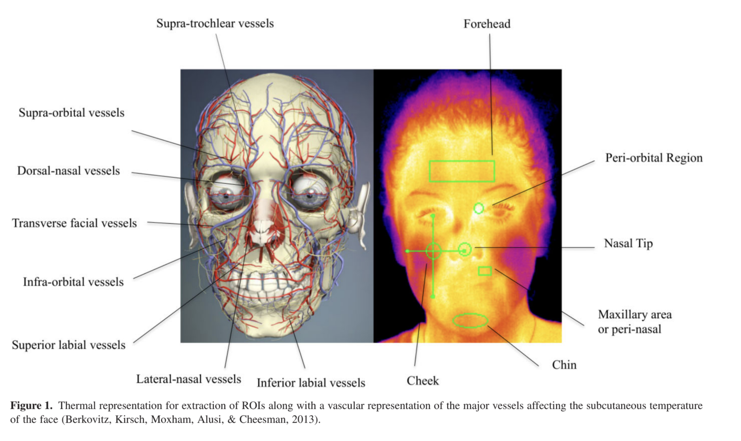
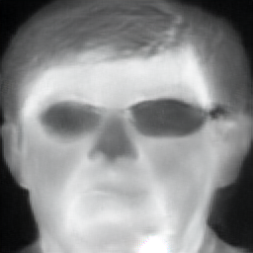
What if we could emulate a thermal sensor with AI?
$ & Tech
GAN
✅
Visible-to-Thermal Image Translation

Slide 3
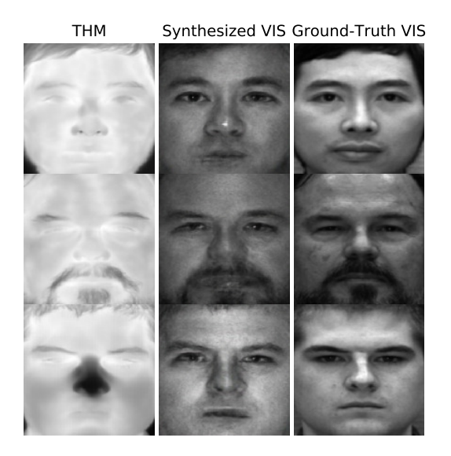
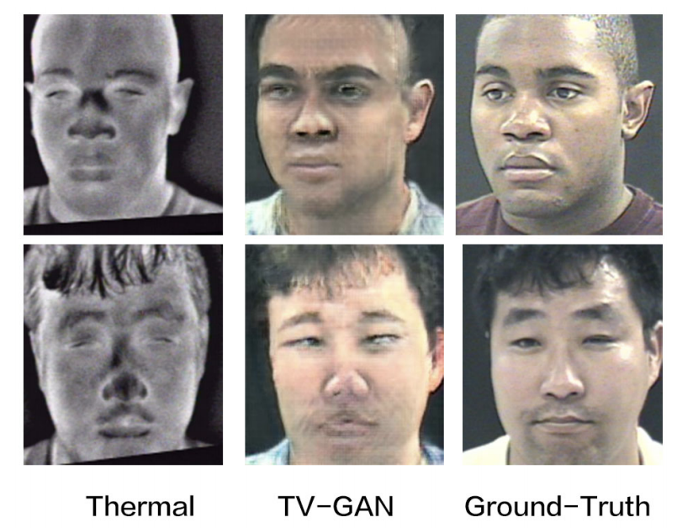
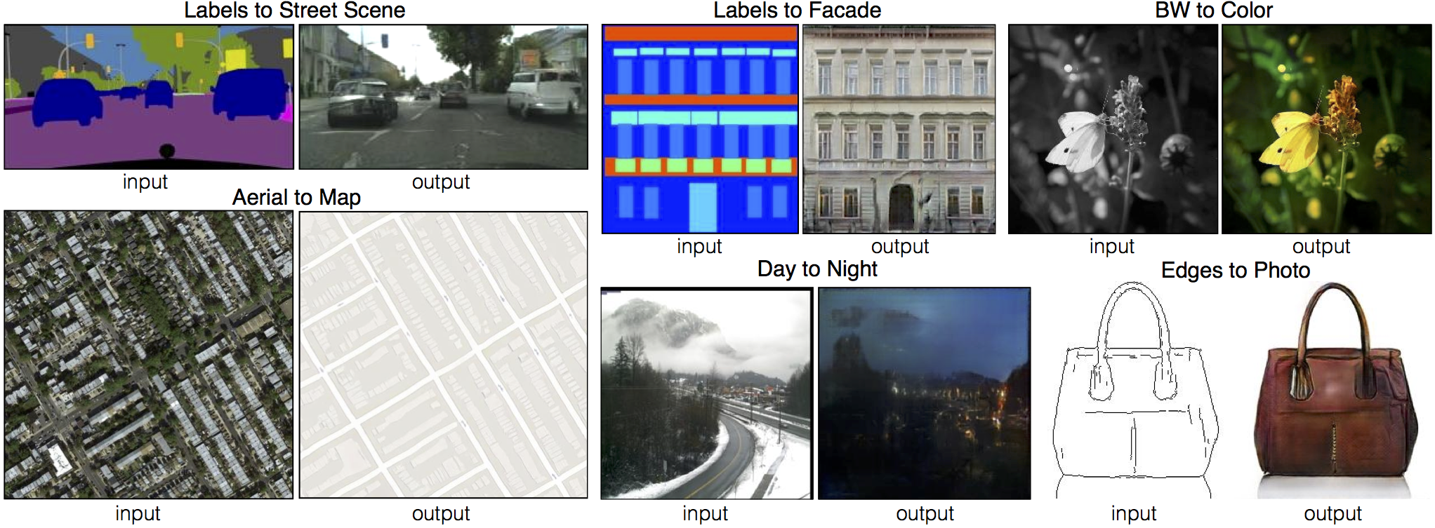
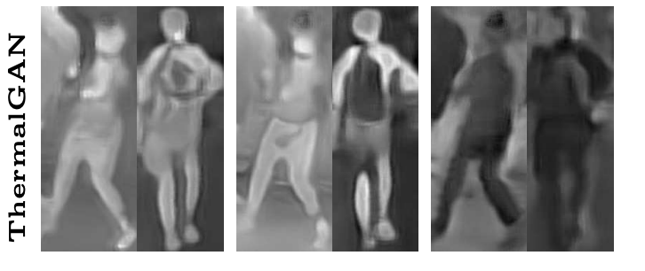
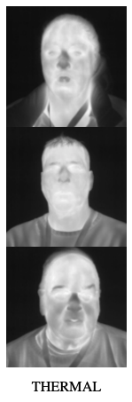
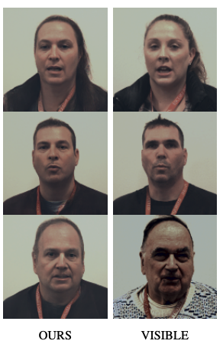

Our work is based in cross-spectral image-to-image translation
TV-GAN (Zhang)
Semantic-Guided GAN (Chen)
Classic pix2pix and CycleGAN image translation tasks
ThermalGAN (Kniaz)
T2V-DDPM (Nair)
$T →V$ translation is well studied!

Slide 4
contributions
The Visible-to-Thermal Facial GAN (VTF-GAN) that learns thermal patch structure and temperature estimation.
Two VTF-GAN variants designed to learn the frequency domain through a Fourier Transform Loss.
Comparison against four GAN baselines and diffusion, through the first application of VT face translation using a conditional diffusion model (VTF-Diff).

Slide 5
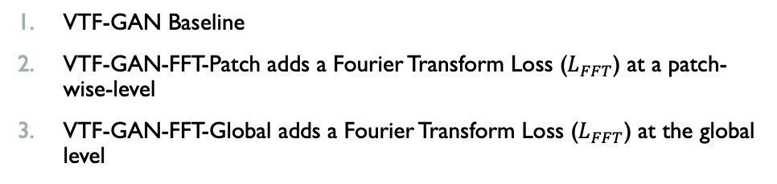
Visible-Thermal Facial GAN (VTF-GAN)
VTF-GAN Losses
$L_{temp }$- Controls distribution of thermal patterns
$L_{patch}$ - Controls for structural similarity
VTF-GAN Baseline
VTF-GAN-FFT-Patch adds a Fourier Transform Loss ($L_{FFT}$) at a patch-wise-level
VTF-GAN-FFT-Global adds a Fourier Transform Loss ($L_{FFT}$) at the global level
$L_{perc }$- Controls for perceptual similarity
$L_{FFT }$- Controls for texture and frequency
$L_{GAN }$- Relativistic Adversarial Loss

Slide 6

$L_{FFT }$is a key component
Patch-based
Global
Magnitude spectra between ground-truth visible and thermal images demonstrate differences between low and high frequency components.

Slide 7

Visible-Thermal Facial Diffusion (VTF-Diff)
Condition input on visible image
U-NET as noise estimator
Squared cosine noise scheduler
$L_{MSE}$ - Controls noise prediction
q: forward process (+ noise)
p: reverse (generative process) (- noise)

Slide 8
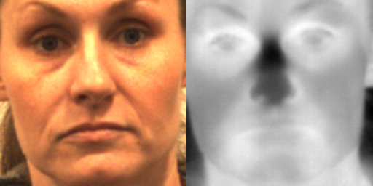
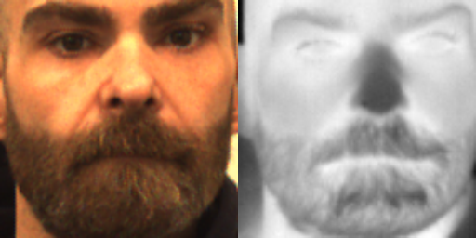
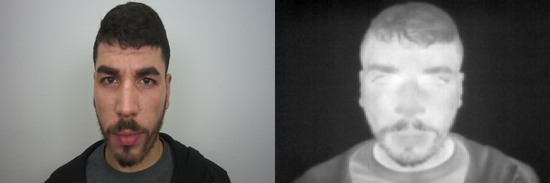
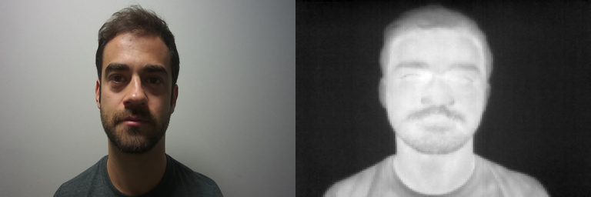
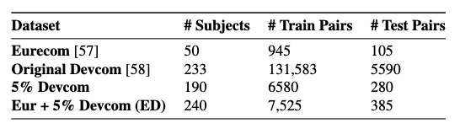
experimental setup
4 Baselines
pix2pix, 2) CycleGAN, 3) ThermalGAN, and 4) favtGAN
We compare the baselines against VTF-GAN and its variants VTF-GAN-FFT-P and VTF-GAN-FFT-G
Additional baselines that failed: pix2pixHD, FastCUT, GansNRoses, StarGAN, and MUNIT.
Army Research Lab (ARL) Devcom Dataset (Poster, et al.)
Evaluation Metrics
Frechet Inception Distance (FID) – realism and diversity in GAN generated images.
Deep Bilinear CNN (DBCNN) - measures distortion in GAN generated images.
MSE between the generated and real thermal image magnitude spectra (frequencies and texture).
Eurecom Dataset (Mallat, et al.)
Implementation
Multi-parallel Training - 3x NVIDIA Quadro RTX 8000s and 2x NVIDIA RTX A6000s
PyTorch, batch_size=32, epochs=200, Average Mixed Precision (AMP), lr=0.0002, Adam Optimizer

Slide 9
quantitative results
VTF-GAN outperforms FID scores for Eurecom.
VTF-Diff outperforms DBCNN scores for Eurecom.
VTF-GAN outperforms FID, DBCNN, and MSE SPEC scores for the Devcom dataset
% changes, compared to the top performing model for the metric. For example, FID for VTF-Diff (80.212) suffers by 12.5% compared to VTF-GAN (baseline) of 70.221

Slide 10
Real Visible
Real Thermal
CycleGAN
pix2pix
VTF-GAN-FFT-G
VTF-GAN (Baseline)
VTF-Diff

Slide 11
magnitude spectra are more similar between real thermal (rt) and vtf-gaN

Slide 12
we tried 5 additional baselines that ended up failing

Slide 13
ablation study

Slide 14
vtf-diff pros and cons
Top: Real Thermal
Bottom: VTF-Diff Results
Cons
Sampling takes approximately 11.05 sec/image on a single RTX 8000.
Training is slow, despite multi-GPU, parallel training, AMP, grayscale, small resolution.
Results are inconsistent – distortion and uneven temperature distribution (cold when hot, hot when cold)
Pros
Conditional diffusion requires one loss function, compared to five for VTF-GAN!
Despite inconsistent results, when it works out, results are quite good, especially geometric translation.

Slide 15
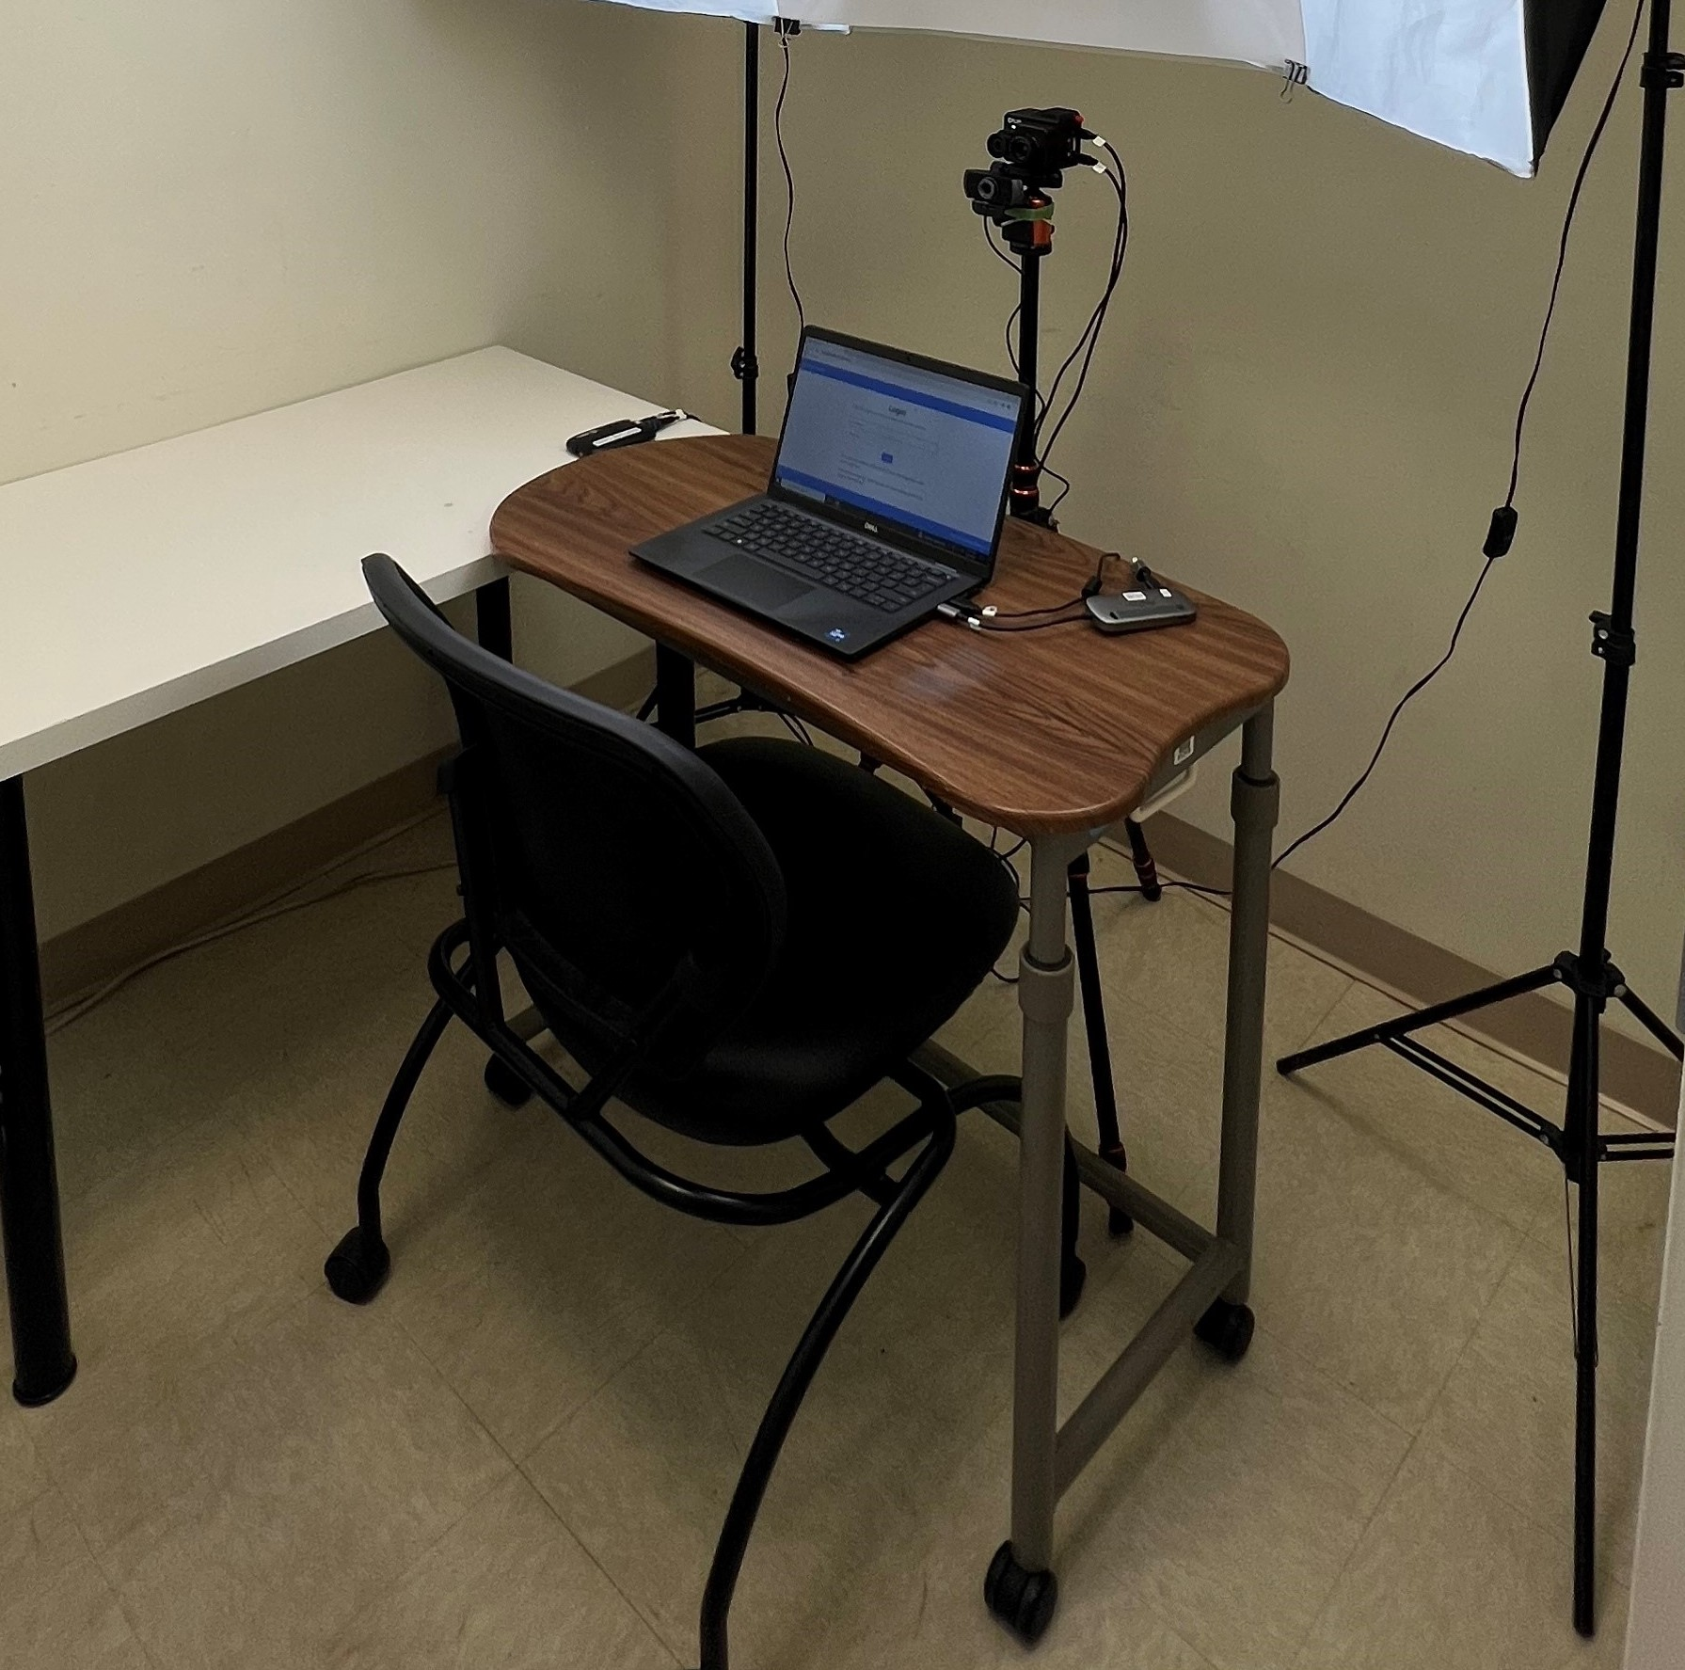
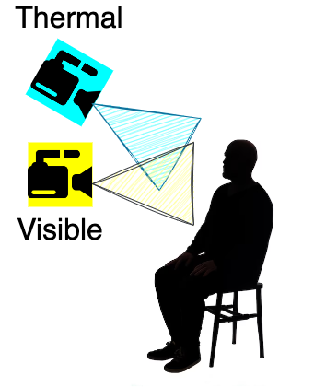
VTF-GAN Key Component in generating consistent biometric identity
Ordun, Catherine, Edward Raff, and Sanjay Purushotham. "Vista-Morph: Unsupervised Image Registration of Visible-Thermal Facial Pairs." IEEE IJCB 2023.

Slide 16
thank you
Catherine Ordun, Ph.D
University of Maryland Baltimore County cordun1@umbc.edu
Booz Allen Hamilton ordun_catherine@bah.com

